Slide 1




Data Validation & Insights 3 Week 3
Shipping Dataset Analysis

Slide 2


Executive Summary
Analysis Overview
Thiscomprehensive datavalidation assessment examined our
shipping dataset to identify critical data quality issues that could impact business operations and decision-making processes. Our systematic approach uncovered multiple areas requiring immediate
attention to ensure data reliability and accuracy.
Through rigorous validation checks and statistical analysis, we
identified five distinct categories of data quality issues, each with
specific implications for our shipping operations and customer service
delivery. The findings reveal both systemic weaknesses in our data
collection processes and opportunities for significant operational
improvements.
This report provides actionable insights and strategic
recommendations to transform our data infrastructure, enabling
more accurate analytics, improved operational efficiency, and
enhanced decision-making capabilities across all shipping-related
business processes.

Slide 3

Objective
Verify consistency & completeness
Detect duplicates & anomalies
Advanced pattern recognition toidentifyduplicate entries and statistical outliers that could skew analysis results
Systematic examinationofdataintegrity acrossall shipping
records to ensure field completeness and internal consistency
Check business rule compliance
Validation againstestablishedbusinesslogicand operational constraints to ensure data meets organizational standards
Recommend data quality improvements
Strategicrecommendationsfor processenhancements and system
modifications to prevent future data quality issues

Slide 4

Detailed Validation Results
ValidationCheck
Duplicate shipping_id Invalid status values Missing customer IDs Missing status Negative customer IDs
Issue Detected
Same ID appears >1 Status = 5 (only 0,1,2 valid) NULL customer column NULL status column Invalid negative values
Count
1 1 1 1 1
Our comprehensive validation process identified five critical data quality issues within the shipping dataset. Each issue represents a specific failure
point in our data collection and validation processes. While the absolute count of issues is relatively low, the impact on data reliability and business
operations is significant. These findings highlight the need for enhanced data governance protocols and automated validation systems to prevent
similar issues in future data processing cycles.

Slide 5
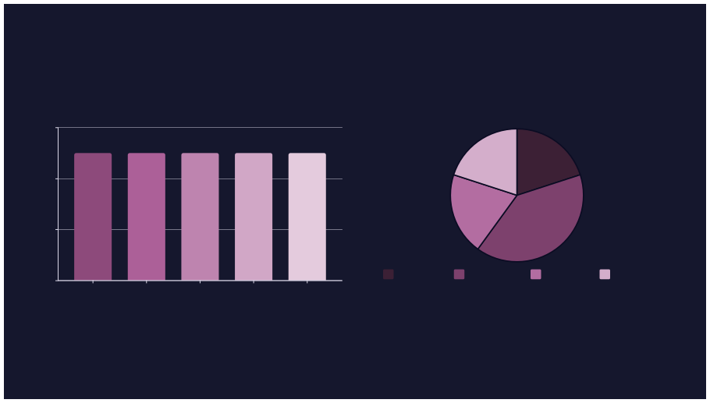
Validation Results 3 Visual Analysis
Issue Distribution Analysis
StatusDistribution Overview
1.2
0.8
0.4
0
Status 0
Status 1
Status 2
Invalid
Status 5
Duplicate
Invalid Status
Missing Customer
Missing Status
Negative ID
The visual analysis reveals an even distribution of data quality issues across different validation categories, suggesting systemic rather than
isolated problems. The status distribution chart shows that while most records follow valid status codes (0, 1, 2), the presence of invalid status code
5 indicates a breakdown in input validation processes.

Slide 6


Key Insights
Duplicates cause overcounting
Duplicate shipping IDs createinflatedmetrics and inaccurate reporting, potentially leading to incorrect inventory management and financial discrepancies that impact customer satisfaction and operational efficiency.
Invalid status = process errors
Status code 5outside thevalidrange (0,1,2) indicates upstream system
failures or manual data entry errors that compromise tracking accuracy and automated workflow processes.
Missing values reduce analysis completeness
NULLvalues in criticalfields likecustomerIDandstatussignificantly limit
our analytical capabilities, preventing comprehensive customer journey mapping and performance optimization.
Negative IDs = weak validation rules
Negative customer IDs reveal insufficientinputvalidation controls,
suggesting broader data integrity vulnerabilities that could affect system reliability and customer data accuracy.

Slide 7

Strategic Recommendations
Remove or merge duplicates
Implementautomateddeduplication processes and establish unique constraint enforcement at the database level. Create merge protocols for legitimate duplicate scenarios while
maintaining data lineage and audit trails for compliance purposes.
Standardize status (0,1,2 only)
Deploy data validation rulesat point ofentry and establish lookup
tables with referential integrity constraints. Implement status code mapping for legacy systems and create automated alerts for
invalid status code attempts.
Fix missing values (impute/remove)
Enforce constraints to block negatives
Develop intelligentimputation strategies based on historical
Implement comprehensiveinput validation withpositive integer
patterns and business logic. Establish mandatory field validation with appropriate default values and implement progressive data collection to capture missing information over time.
constraints for ID fields. Create automated testing frameworks to prevent regression and establish monitoring dashboards for real- time data quality oversight.

Slide 8



Implementation Roadmap
Phase 1: Immediate Fixes
1
Address current data qualityissuesthroughmanual cleanup processes and implement emergency validation rules to
prevent further degradation.
2
Phase 2: System Enhancement
Deployautomated validation systems,establish data quality monitoring, and implement comprehensive constraint enforcement across all data entry points.
Phase 3: Process Integration
3
Integrate dataquality checks into existingworkflows, establish governance protocols, and create ongoing
4
monitoring and reporting mechanisms.
Expected Outcomes
95%reductionindata qualityissues within 6 months
Enhanced accuracy in reporting and analytics Improved operational efficiency through reliable data
Better decision-making capabilities across teams

Slide 9

Conclusion
Clean Data ³ Accurate
Insights ³ Better Decisions
Our comprehensive validation analysis has revealed critical opportunities to enhance data quality and operational efficiency. By implementing the
recommended solutions, we can transform our shipping data infrastructure into a reliable foundation for strategic decision-making and improved customer experiences.
Thank You

