Slide 1

Employee Attrition Prediction using HR Analytics
Predicting Employee Attrition with HR Analytics
Acomprehensive data-driven approachtounderstandingandpredictingemployee
turnoverpatterns inmodern organizations.

Slide 2

Understanding Employee Attrition
What is Attrition?
Why It Matters
The rate atwhichemployees leave an organization over a specific period, either voluntarily or involuntarily.
High attritiondisrupts business
continuity, increases recruitment costs, and impacts team morale and productivity.
Strategic Importance
Understanding attritionpatternsenables proactive retention strategies and
better workforce planning decisions.
Employee attrition is a critical business challenge that affects organizational
performance, culture, and bottom-line results. By leveraging data analytics,
companies can transform reactive HR practices into strategic, predictive
approaches.

Slide 3

The Business Impact Problem
Financial Consequences
Operational Challenges
Recruitmentand training costs average 20-50% of annual salary
Lost productivity during transition
periods
Knowledge loss and skill gaps
Overtime costs for remaining staff
Disrupted project timelines and deliverables
Decreased team morale and
engagement
Customer service interruptions
Increased workload on existing
employees
High employee turnover creates a cascade of negative effects throughout the
organization. Without predictive insights, companies remain reactive, addressing
attrition only after valuable talent has already left.

Slide 4
Project Objectives
01
Develop Predictive Models
02
Identify Key Risk Factors
Buildaccuratemachinelearning modelsto identify employees at risk of leaving before they make the decision.
Discover themostinfluentialvariables that contribute to employee
attrition across different departments and roles.
03
Enable Strategic Interventions
04
Measure Business Impact
Quantify potential costsavingsandROI from reduced turnover and improved retention rates.
Provide actionable insightsthat allowHRteams to implement targeted retention strategies for high-risk employees.
This project aims to transform HR decision-making from reactive to proactive, enabling organizations to retain top talent through data-driven
insights and strategic interventions.

Slide 5

Dataset Overview
Demographics
Job Characteristics
Age,gender,marital status, education level, and years of experience providing comprehensive employee profiles.
Department, jobrole,performance ratings, work-life balance
scores, and career advancement opportunities.
Compensation
Satisfaction Metrics
Job satisfaction, environmentsatisfaction, relationship
Monthlyincome,salary hikes, stock options, and total compensation packages across different levels.
satisfaction, and overall engagement scores.
Our comprehensive dataset includes over 35 variables capturing multiple dimensions of the employee experience, enabling robust predictive
modeling and deep insights into attrition patterns.

Slide 6

Data Preprocessing Pipeline
Data Quality Assessment
Identifiedandhandled missingvalues,outliers, and data
inconsistencies across all variables.
Feature Engineering
Applied categorical encoding,normalization, and created derived
features to enhance model performance.
Train-Test Split
Implemented stratifiedsampling to ensure balanced representation
across training and testing datasets.
Rigorous data preprocessing ensures model reliability and accuracy. Our
systematic approach addresses data quality issues while preserving the integrity of
employee patterns and relationships within the dataset.

Slide 7
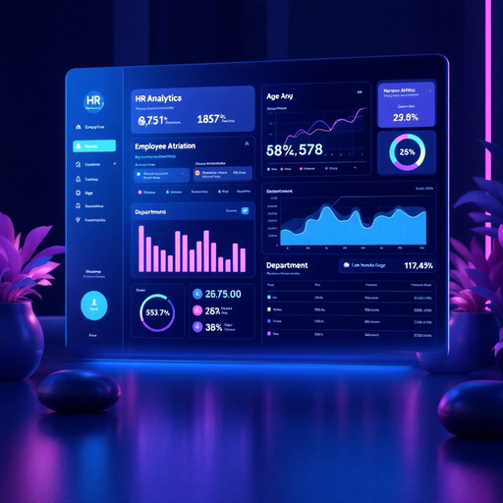
Exploratory Data Analysis Insights
Key Attrition Patterns
Age Demographics
Highest attrition rates observed in 25-35 age group seeking career advancement opportunities.
Department Variations
Sales and R&D departments show significantly higher turnover compared to HR and IT.
Job Role Impact
Laboratory technicians and sales executives demonstrate the highest attrition rates.
Visual analysis reveals distinct attrition patterns across demographic groups and organizational structures. These insights inform targeted retention strategies and help prioritize intervention efforts for maximum impact.

Slide 8

Model Building Approach
Logistic Regression
Baselinemodel providinginterpretable coefficients and probability estimates
for attrition risk assessment.
Random Forest
Ensemble methodcapturing complex feature interactions and providing robust
predictions with feature importance rankings.
Gradient Boosting
Advancedboosting algorithm optimizing prediction accuracy through iterative
learning and error correction.
Support Vector Machine
High-dimensionalclassificationapproach identifying optimal decision
boundaries for attrition prediction.
Multiple algorithms were implemented and compared to identify the optimal
approach for employee attrition prediction, ensuring both accuracy and business
applicability.

Slide 9

Results & Business Impact
87% $2.4M 45%
Model Accuracy
Projected
Savings
Annual cost reduction through improved retention strategies
Early Detection
Random Forest achieved
Improvementin
highestaccuracyin predicting employee
identifying at-risk employees before
attrition
turnover
Key Success Factors
Strategic Recommendations
Job satisfaction scores emerged as the strongest predictor Work-life balance significantly impacts retention decisions
Career development
opportunities crucial for long-term
retention
Implement proactive engagement surveys Develop targeted retention
programs
Create clear career progression
pathways
The predictive model enables HR teams to identify at-risk employees with high
accuracy, allowing for strategic interventions that significantly reduce turnover costs
and improve organizational stability. This data-driven approach transforms reactive
HR practices into proactive talent management strategies.

