Slide 1
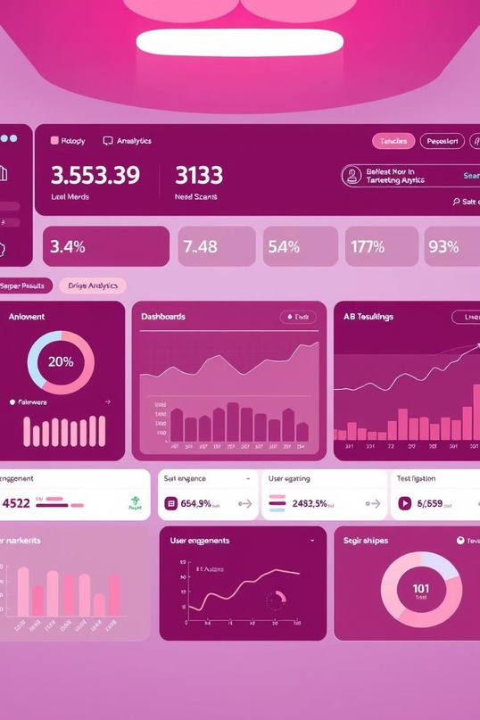
Email A/B/n Testing Dashboard
Anall-in-oneGradiodashboardforcomprehensiveemail experiment
analysis.

Slide 2
Agenda
ProjectSetup&Data Generation
StatisticalTesting Methods Data Visualization Gradio Dashboard Overview
Key Insights & Next Steps

Slide 3


Project Setup & Libraries
WebeginbymountingGoogleDriveandinstallingessentialPython libraries for data analysis and visualization.
Drive Mounting
Library Installation
from google.colab import drive drive.mount('/content/drive')
!pip install gradio plotly pandas numpy scipy scikit-learn statsmodels

Slide 4



Data Generation
SyntheticdataisgeneratedtosimulateanA/B/n email testing campaign, including various user behaviors and email metrics.
1
2
3
User & Variant Assignment
Email Attributes
Engagement Metrics
Assigns unique user IDs and random variants (A, B, C, D).
Includes subject line, send time, device, and region.
Simulates opened, clicked, converted, spam, and unsubscribed rates.

Slide 5


Statistical Tests
Thedashboardincorporatesbothfrequentist and Bayesian statistical methods to analyze experiment results.
Frequentist Test
Bayesian Probability
Compares variants using t-tests to determine statistical significance.
Calculates the probability that one variant performs better than another.
ttest_ind(df[df.variant == a][metric], df[df.variant == b] [metric])
np.mean(samples_b > samples_a)

Slide 6


Power Calculation & Segmentation
Determine required sample sizes and identify key user segments impacting conversion.
Power Calculation
Segmentation Report
Estimates the number of users needed per variant to detect a 3% lift in conversion.
Uses a Decision Tree Classifier to analyze conversion by variant, device, and region.
analysis.solve_power(effect_size, alpha=0.05, power=0.8)
DecisionTreeClassifier(max_depth=4).fit(X, y)

Slide 7
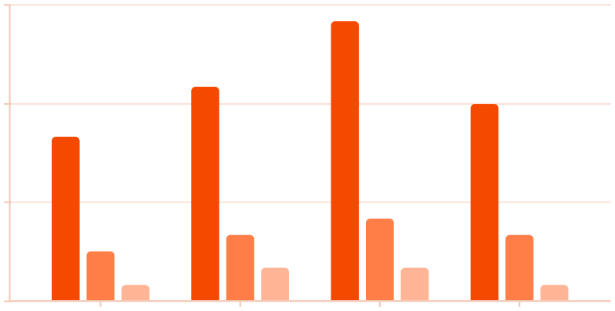
Engagement Metrics Visualization
Abarchartvisualizestheaverageopened,clicked,andconvertedratesacrossdifferentemail variants.
0.18
0.12
0.06
0
A
B
C
D
Opened
Clicked
Converted

Slide 8
Gradio Dashboard Overview
TheGradiointerfaceprovidesaninteractivedashboardforreal-timeA/B/ntest analysis.
Metrics Chart
Results & Insights
Data Download
Visualizes engagement rates across variants.
Displays statistical test results and segmentation reports.
Allows users to download the dataset as a CSV.

Slide 9
Key Takeaways & Next Steps
ComprehensiveAnalysis: Integrated frequentist and Bayesian testsforrobust insights.
ActionableSegmentation: Identifyhigh-performing segments for targeted campaigns. Future Enhancements: Explore more advanced machine learning models for predictive analytics.

