Slide 1
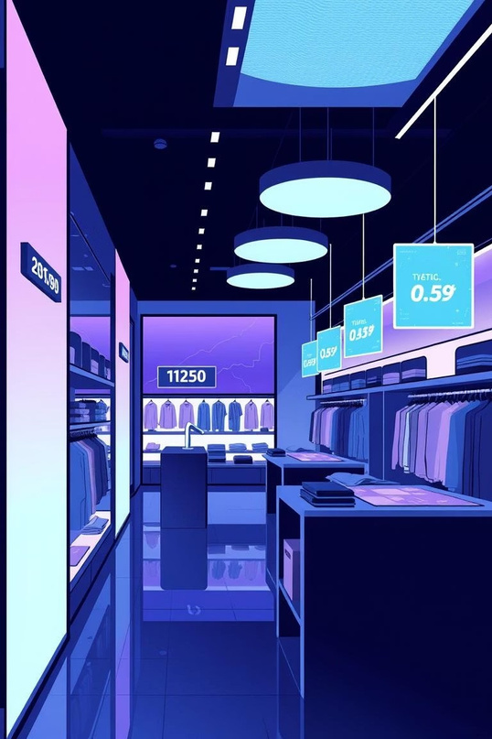
DealSense: Intelligent Price Tracking
Unlock smarter shopping with predictive pricing and personalized alerts.

Slide 2





Agenda
1
2
3
Introduction to DealSense
Core Functionality
Technical Implementation
Overview of our intelligent price tracker.
Keyfeatures for tracking, forecasting, and alerting.
A look at the libraries and steps
involved.
4
5
Reporting & Alerts
Key Takeaways
Howwedeliverinsightsand notifications.
Summaryofbenefits and future outlook.

Slide 3

What is DealSense?
DealSenseisan intelligent pricetracker designed to help users
make informed purchasing decisions.It monitors product prices, predicts future trends, and provides timely alerts for the best deals.
Track price changes over time.
Forecast future price movements.
Receive alerts for significant price drops.
Generate comprehensive price summary reports.

Slide 4
Core Functionality
Price Trend Analysis
Discount Tracking
Visualizehistoricalpricedata for any product.
Monitordiscountpercentages over time.
Future Price Prediction
Deal Alerts
Forecast prices using linear regression.
Getnotifiedofmajor price drops.

Slide 5
Technical Implementation: Libraries
DealSense leverages powerful Python libraries for data processing, analysis, and reporting.
Data Handling
Visualization
Machine Learning
Reporting
Pandas: For data manipulation and analysis.
datetime: For
timestamp processing.
Matplotlib: For creating static, interactive, and animated visualizations.
Seaborn: For statistical
data visualization.
Scikit-learn (Linear Regression): For price forecasting.
ReportLab: For generating PDF summaries.

Slide 6
Technical Implementation: Workflow
1. Data Ingestion
Readspricelogdatafrom a CSV file.
2. Data Preprocessing
Convertstimestampsandcalculates discount percentages.
3. Price Prediction
AppliesLinearRegression to forecast future prices.
4. Report Generation
CreatesadetailedPDFsummary for each product.
5. Alert System
Notifiesusersofsignificant price drops.

Slide 7
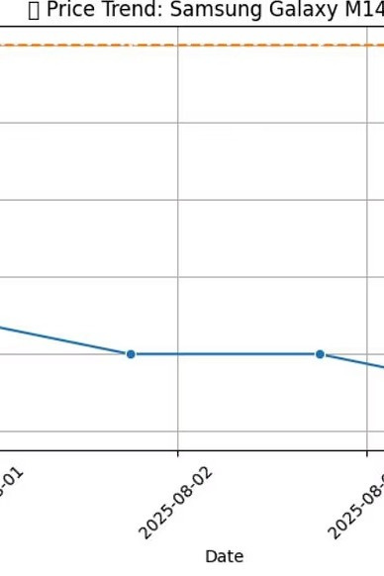
Price Trend Visualization
The system generatesclearline plotsshowingcurrentvs.original
pricesover time foreach product.
This helps users quickly identify pricing patterns and historical
highs/lows.

Slide 8
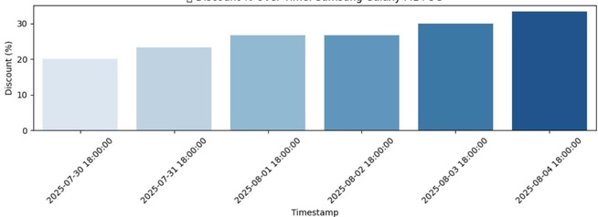
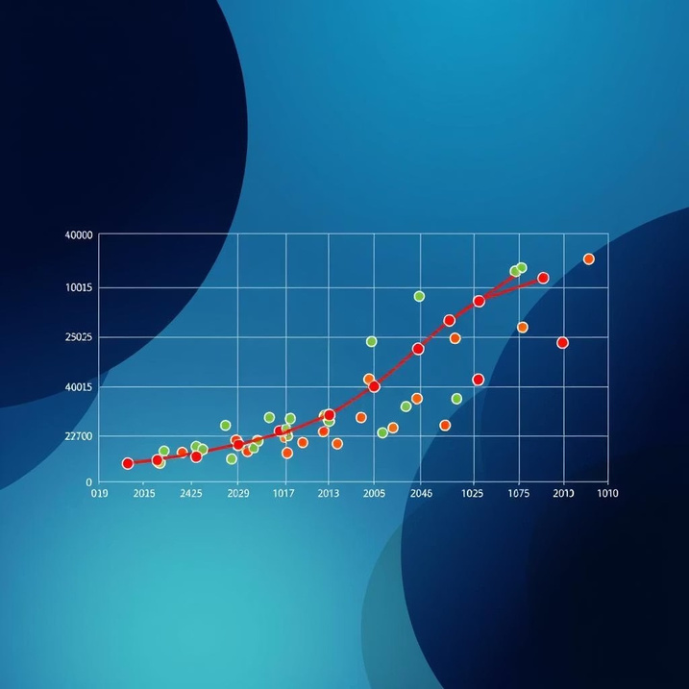
Discount & Availability Insights
Bar plots illustrate discount percentages over time, highlighting periods of significant savings.
Availabilitycharts provide a quick visual of when a productwasinor out of stock.

Slide 9
Automated Reporting & Alerts
PDF SummaryReport
Real-time Alerts
AcomprehensivePDFreport is generated, detailing:
Thesystemtriggersalerts for significant price drops (e.g.,
Predicted future prices.
Best historical discount days.
Monthly average discounts.
>= 20% discount), ensuring users never miss a deal.
Example: "
Discount: 25.00%"
ALERT: Big drop for Product X!

Slide 10
Key Takeaways & Next Steps
SmarterShopping
Ef ficiency
Future Enhancements
Empoweruserswith data-driven insights for optimal purchasing.
Automatedtracking and reporting save time and effort.
Expandto moree-commerce
platforms and add custom alert thresholds.

