Slide 1



Personalized Learning Recommendation System
Revolutionizing education through AI-poweredpersonalizedlearningexperiences
Developed by: Advanced EdTech Research Team Transforming how students learn with intelligent recommendation algorithms

Slide 2


The Problem with One-Size-Fits-All Learning
Current Challenge
Traditional educational systems deliveridentical content to diverse
learners, ignoring individual learning styles, pace preferences, and knowledge gaps. This approach leads to:
Poor engagement rates (average 60% dropout in online courses)
Ineffective knowledge retention
Frustrated learners and educators
Wasted educational resources
The Reality: Every student has unique learning needs, yet most systems treat them identically.

Slide 3

Project Objectives
Personalized Learning Paths
Enhanced Engagement
Increase student motivation and participation through relevant, appropriately challenging content that adapts to their skill level and interests.
Improved Learning Outcomes
Boost knowledge retention,course completion
Create individualized contentrecommendations based on learning patterns, preferences, and performance history to optimize each student's educational journey.
rates, and academic performance through data- driven, adaptive learning recommendations.

Slide 4


Dataset Overview
Key Dataset Features
Feature
Student Profiles Course Content Interaction Data Performance Metrics Learning Patterns
Description
Demographics, learning preferences, goals Subjects, difficulty levels, formats Time spent, completion rates, clicks Grades, assessments, feedback scores Study habits, peak activity times
50K
Student Records
Comprehensive learner profiles
2.5K
Course Modules
Diverse educational content
1.2M
Interactions
Rich behavioral data

Slide 5
System Methodology
Data Preprocessing
ML Model Training
Deploy collaborative filtering anddeep
Recommendation Generation
Clean and normalize studentinteraction data, handle missing values, and extract meaningful features from learning behaviors.
learning algorithms to identify patterns and predict student preferences for course recommendations.
Generatepersonalized contentsuggestions
using hybrid algorithms that combine collaborative, content-based, and
knowledge-based filtering approaches.
Our approach leverages advanced machine learning techniques including matrix factorization, neural collaborative filtering, and ensemble methods to
deliver highly accurate personalized recommendations.

Slide 6
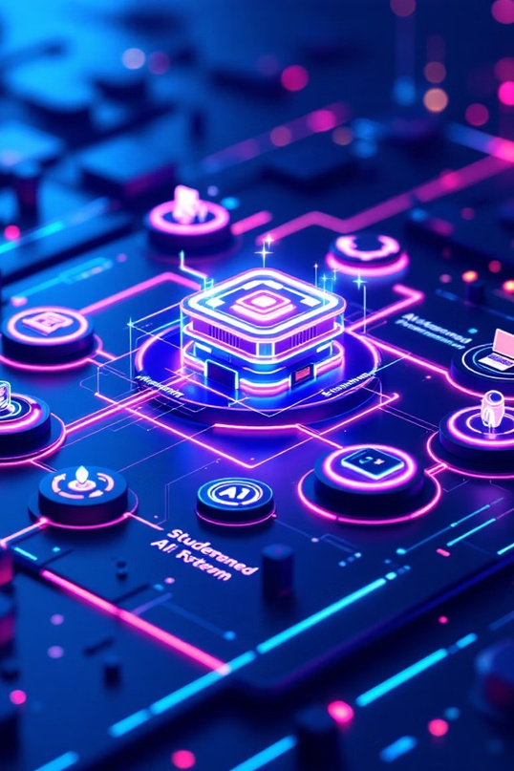
System Architecture
01
Student Profile Input
02
AI Processing Engine
Captures learning preferences,academic history, goals, and real-time interaction patterns from the learning management
system.
Multi-layer neuralnetworks analyze
student data, identify learning patterns, and predict optimal content matches
using trained recommendation models.
03
Personalized Recommendations
Delivers ranked list ofcourses, modules,andlearningresources tailored to individual
student needs with confidence scores.

Slide 7

Results & Model Performance
120
KeyPerformance Metrics
91% recommendation accuracyvs 65%baseline
80
40% increase in course completion rates 35% improvement in student engagement 28% faster learning objective achievement
40
0
Baseline
Collaborative
Content-Based
Hybrid Model

Slide 8

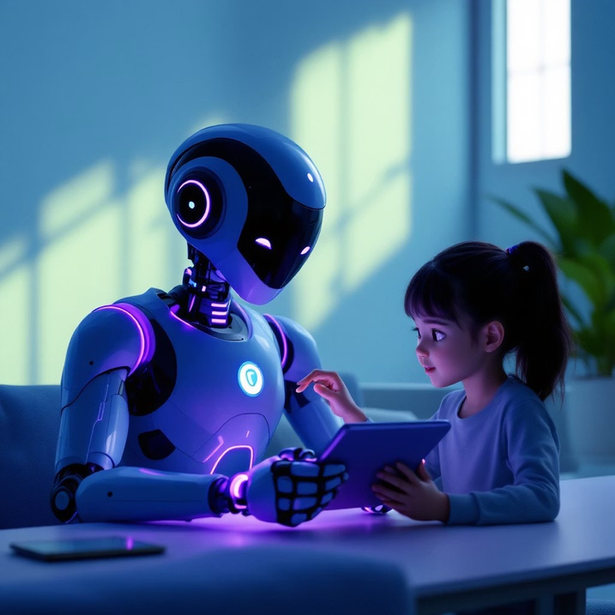
Applications & Future Scope
MOOC Platforms
University Systems
Corporate Training
Revolutionize employee development programs with targeted skill-building recommendations that align with career goals and organizational needs.
Transform massive openonline courses by providing personalized learning paths for millions of diverse learners worldwide, increasing completion rates and satisfaction.
Enhance traditional highereducation with AI-driven course recommendations, helping students optimize their academic journey and career preparation.
Future Innovations
AI Virtual Tutors: Intelligent tutoring systems with natural language processing
Adaptive Dashboards: Real-time learning analytics and progress
visualization
Predictive Analytics: Early intervention systems for at-risk students
Multi-modal Learning: Integration of VR, AR, and interactive content

Slide 9


Thank You
Questions &
Discussion
Successfully developed
AI-powered
personalized learning
system
Achieved 91% recommendation accuracy with significant improvements
in student engagement and outcomes.
Demonstrated real- worldimpactacross educational sectors
Established foundation for future educational AI innovations
ReadyfordeploymentinMOOCs, universities,andcorporatetraining environmentswithscalablearchitecture.
Positionedto integrate emerging
technologies like virtual tutoring and adaptive learning dashboards.
Ready to transform education through intelligent personalization

