Slide 1
Dashboard
File created on: 10/14/2022 10:31:49 PM

Slide 2
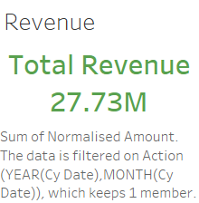

Slide 3
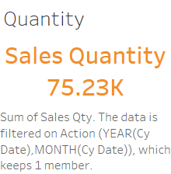

Slide 4
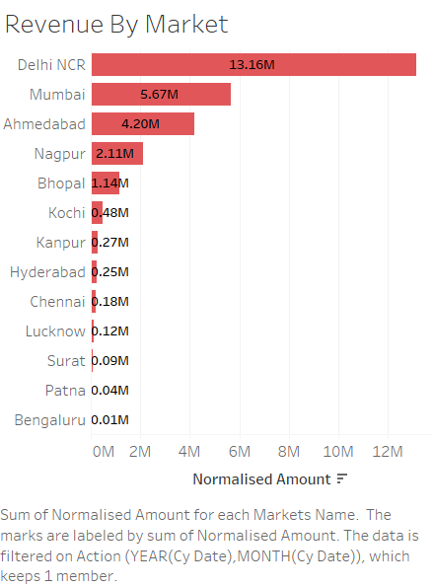

Slide 5
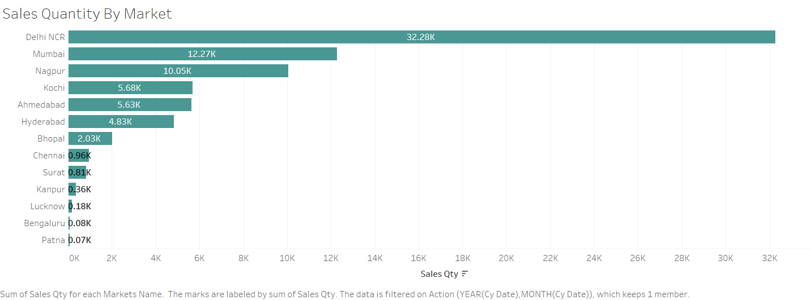

Slide 6


Slide 7


Slide 8
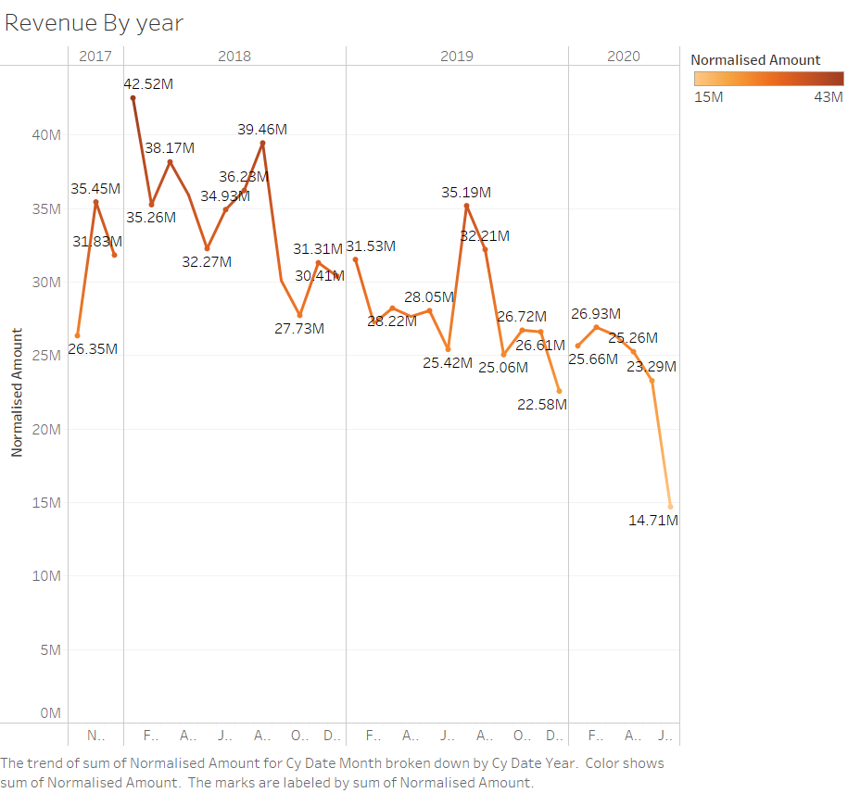

Slide 9


Slide 10


