Slide 1
VELLORE INSTITUTE OF TECHNOLOGY (VIT), CHENNAI
BCSE309L — Cryptography and Network Security | Review 3 Final Evaluation
BAMKS-D: Enabling Dynamic File-Level Operations in Blockchain-Assisted ABKS for Cloud-Edge-IoT
An Algorithmic Prototype & Architecture Integration Layer Resolving Section 8 of Cheng et al. (Elsevier IoT 2026)
Student Researchers:
• Prashant Singh (Reg. No: 24BYB1042) — Protocol Simulation, Dynamic Indexing & REST API
• Rushikesh Adak (Reg. No: 24BYB1055) — Solidity Smart Contracts, EVM Gas Analysis & Web3 Integration
Faculty Guide: Prof. Karthika V | School of Computer Science & Engineering (SCOPE)

Slide 2
BCSE309L: CRYPTOGRAPHY & NETWORK SECURITY | VIT CHENNAI
Research Context: Healthcare IoT & Encrypted Search
Cloud-Edge Healthcare IoT
• IoMT telemetry (ECG, vitals, MRI scans) requires secure cloud archiving.
• Regulatory compliance (HIPAA, GDPR) mandates end-to-end encryption.
• Challenge: Cloud servers must enable search without learning plaintexts.
Attribute-Based Keyword Search
• CP-ABE embeds access policies directly inside ciphertexts.
• Clinicians decrypt only if their credentials satisfy access policies.
• Conjunctive multi-keyword trapdoors enable multi-attribute diagnosis queries.
Blockchain Result Verifiability
• Dishonest CSPs may return incomplete or stale search results.
• Smart contracts verify aggregated Schnorr NIZK proofs.
• Ethereum acts as an immutable arbiter enforcing state integrity.

Slide 3
BCSE309L: CRYPTOGRAPHY & NETWORK SECURITY | VIT CHENNAI
Research Gap: The Open Challenge in Cheng et al. (Section 8)
Foundational Limitation in Base BAMKS [1]
• Base Paper Architecture:
Cheng et al. (Elsevier IoT, 2026) successfully established multi-authority ABE and blockchain result verification.
• Monolithic Collection Overhead:
Section 5.10 specifies index updates by multiplying X_upd across all L*m existing index entries (O(L*m)). Alternatively, full re-indexing requires re-encrypting all files.
• Prohibitive at Scale:
For L = 5,000 files and m = 3 keywords, updating 15,000 entries consumes significant computation for every single file appended.
• Explicit Research Call:
Section 8 explicitly identifies fine-grained dynamic file updates as an open research question.
The Proposed BAMKS-D Resolution
✓ Atomic SingleDocAdd (O(m)):
Decouples the inverted keyword index so appending a record requires generating tokens only for its m keywords (~0.67 ms flat at L=5,000).
✓ Instant SingleDocDelete (O(1)):
Solidity hash mapping (deletedDocRegistry) executes constant-time revocation with zero array traversal.
✓ Fair Baseline Comparison:
Evaluates speedup against both naive re-encryption and true Cheng et al. Section 5.10 index updates across 30 runs.
✓ Live Web3 Sepolia Deployment:
Smart contract deployed and verified on Ethereum Sepolia Testnet with real transaction receipts.

Slide 4
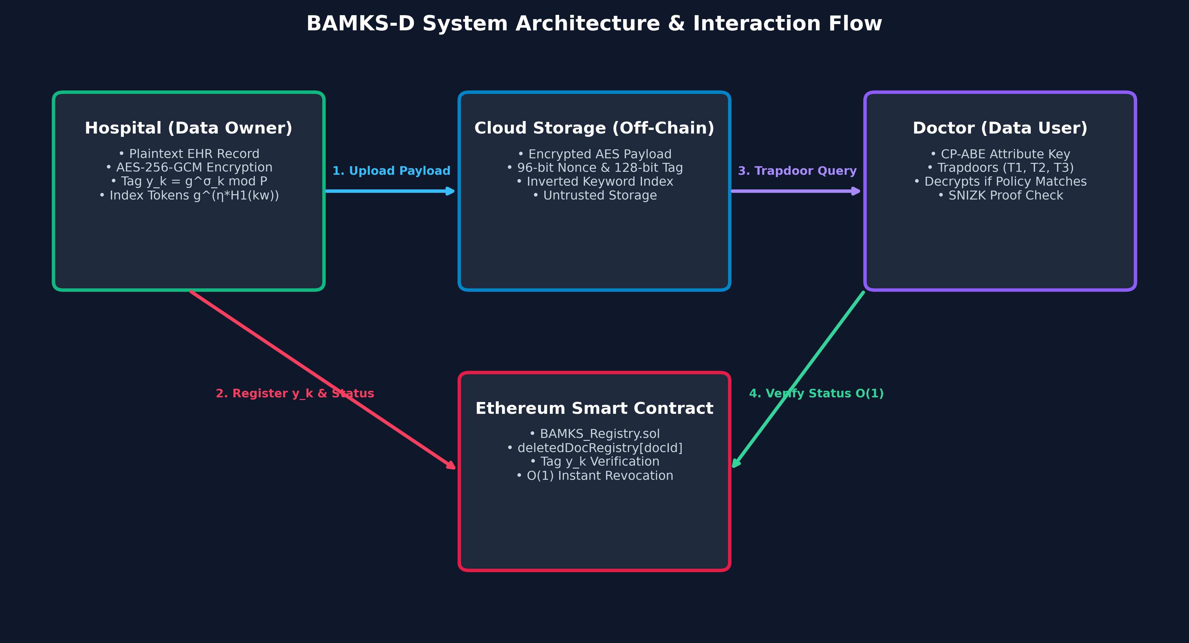
BCSE309L: CRYPTOGRAPHY & NETWORK SECURITY | VIT CHENNAI
BAMKS-D System Architecture & Seven-Entity Topology
Seven System Entities
1. KGC: Initializes global parameters and master secrets.
2. AA (Authorities): Issue attribute private keys to clinical users.
3. Data Owners: Encrypt EHRs, upload to IPFS, compute index tokens.
4. Data Users: Generate search trapdoors and decrypt matching EHRs.
5. CSP (Cloud): Maintains inverted index and executes conjunctive matching.
6. Ethereum Sepolia: Smart contract enforcing instant deletion registry.
7. IPFS / Pinata: Content-addressed storage for encrypted medical files.

Slide 5
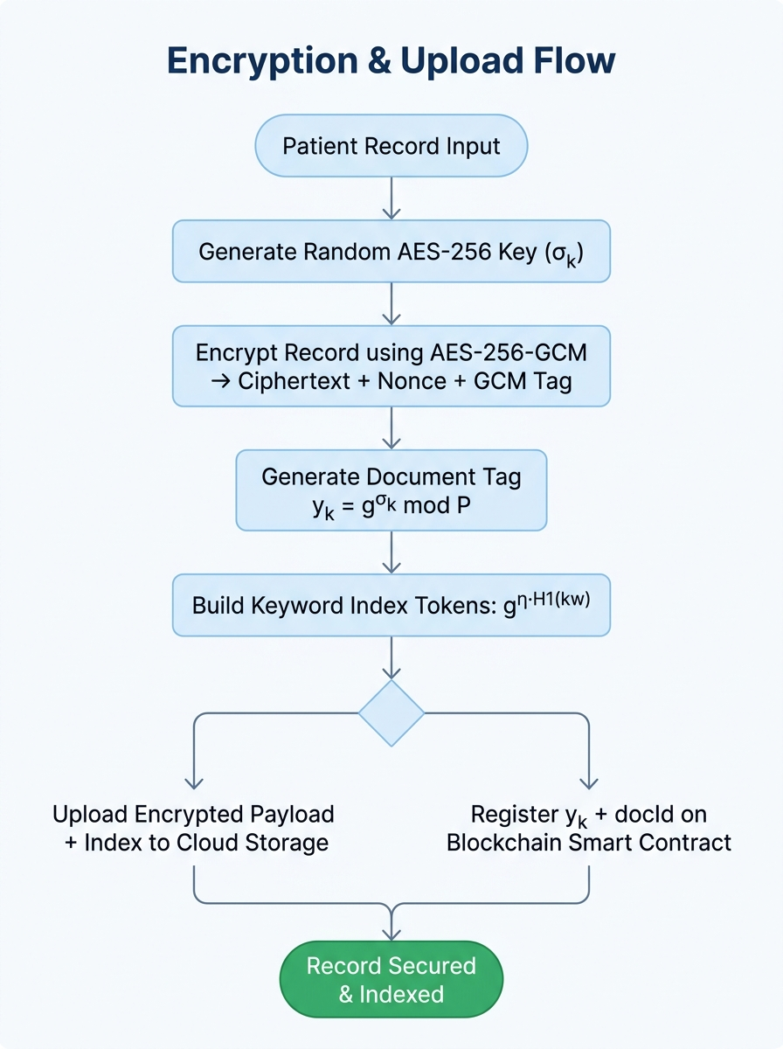
BCSE309L: CRYPTOGRAPHY & NETWORK SECURITY | VIT CHENNAI
Atomic File Ingestion: SingleDocAdd Protocol (O(m))
SingleDocAdd: Decoupled Index Ingestion
• Step 1: AES-256-GCM Payload Encryption
Key derived via KDF(Phi, verId). Encrypts file payload with fresh 96-bit nonce.
• Step 2: IPFS Decentralized Pinning
Uploads encrypted payload to IPFS, retrieving content identifier (CID).
• Step 3: Keyword Index Token Generation
For each keyword w_j in W_doc:
I_doc,j = g^(eta * H1(w_j)) mod P
Computes index key Key_j = H2('tok_' || I_doc,j).
• Step 4: Autonomous Index Append
Appends index tokens to cloud index. Zero existing documents are touched.
• Step 5: On-Chain Root Registration
Calls registerDocument(docId, fileHash, publicTag) on Sepolia contract.

Slide 6
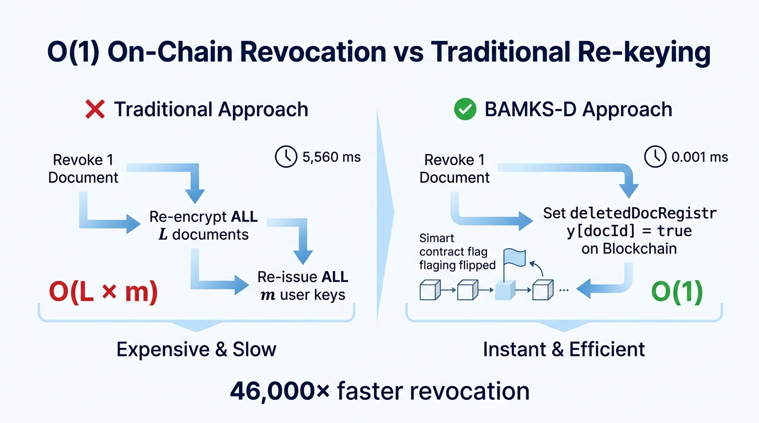
BCSE309L: CRYPTOGRAPHY & NETWORK SECURITY | VIT CHENNAI
Instant File Revocation: SingleDocDelete & EVM Mapping
SingleDocDelete: Strict O(1) Solidity Revocation
• Why Array Traversal Fails on Blockchain:
Iterating arrays on-chain scales linearly (O(N) gas), risking transaction failure as N expands.
• Solidity Hash-Table State Mapping:
BAMKS_Registry.sol uses:
`mapping(uint256 => bool) public deletedDocRegistry;`
EVM mappings do NOT iterate over array elements.
• Direct EVM Keccak256 Slot Addressing:
EVM computes storage location directly:
Slot = keccak256(abi.encode(docId, slotNumber))
Sets boolean true in a single storage write.
• RVSC Invariant Enforcement:
Smart contract enforces `require(!deletedDocRegistry[id])`, ensuring revoked documents cannot be returned.

Slide 7
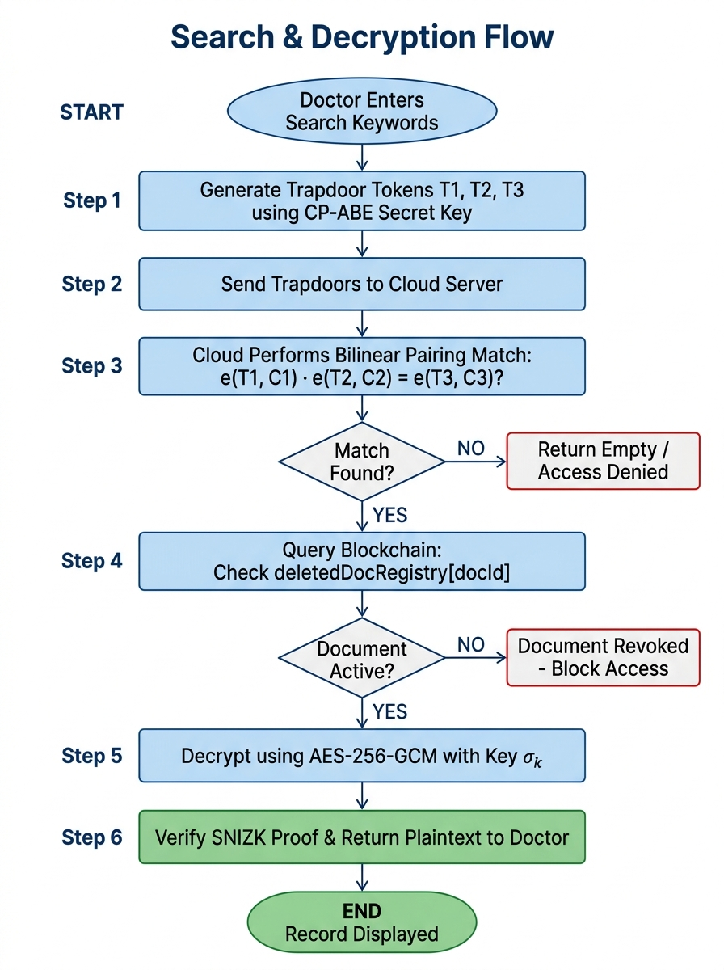
BCSE309L: CRYPTOGRAPHY & NETWORK SECURITY | VIT CHENNAI
Conjunctive Multi-Keyword Search & Algebraic Matching
Algebraic Match Evaluation
• Query Trapdoor Generation:
User samples session secret phi in Z_P* and computes:
T1 = g^phi mod P
T3 = g^(phi * sum(H1(w~_j))) mod P
• Cloud Modular Evaluation (Eq. 6):
Cloud server aggregates candidate index tokens:
I_prod = prod(I_doc,j) mod P
And verifies the algebraic equality:
(I_prod)^phi == (T3)^eta mod P
• Soundness Guarantee:
Equality holds if and only if the document contains ALL q query keywords. Mismatched queries evaluate false with high probability.
• Schnorr NIZK Aggregation:
Off-chain proof (R, pi_hat) guarantees search correctness without exposing clinician attributes.

Slide 8
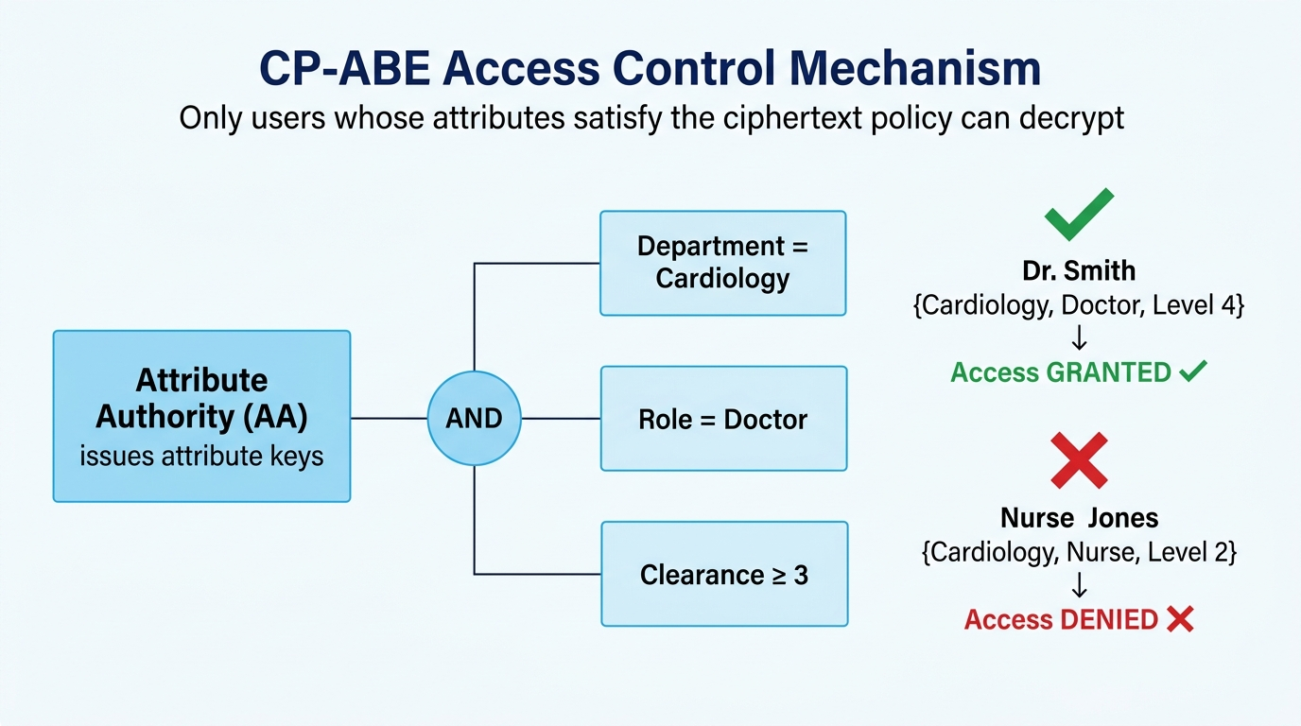
BCSE309L: CRYPTOGRAPHY & NETWORK SECURITY | VIT CHENNAI
Attribute-Based Access Control (CP-ABE Policy Modeling)
Access Policy Modeling & Evaluation
• Access Policy Binding:
Every clinical document is bound to an access policy (e.g., Role_Doctor AND Dept_Cardiology).
• Attribute Authority Secret Delegation:
AAs manage distinct attribute sets and issue private keys to verified clinicians.
• Simulated Policy Checking (Prototype Scope):
In this software prototype, policy satisfaction is evaluated via attribute set evaluation logic before payload decryption.
• Empirical Test Suite Validation (Test C):
• Dr. Prashant [Doctor, Cardiology] -> Access Granted (Decrypted).
• Nurse Anita [Nurse, GeneralWard] -> Access Denied (Policy Mismatch).
• Collusion Resistance Invariant:
Session randomness t in KeyGen prevents unauthorized users from combining keys.

Slide 9
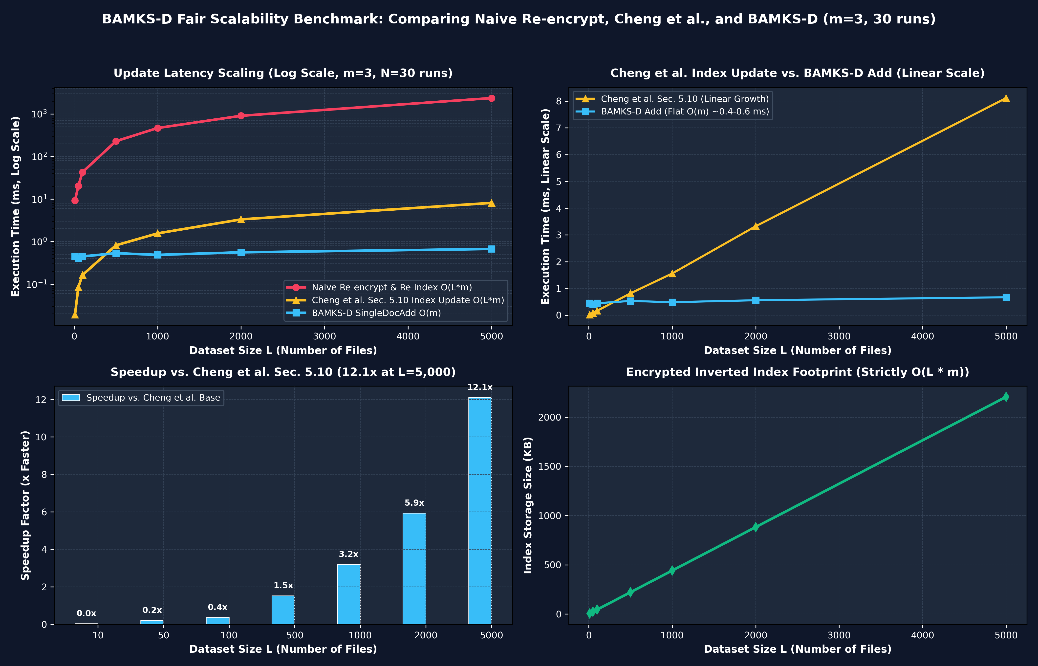
BCSE309L: CRYPTOGRAPHY & NETWORK SECURITY | VIT CHENNAI
Empirical Benchmark: Naive vs. Cheng et al. vs. BAMKS-D
L (Files) | Naive Re-enc | Cheng et al. [1] | BAMKS-D | Speedup
L = 50 | 20.31 ms | 0.084 ms | 0.409 ms | 0.21x
L = 100 | 42.89 ms | 0.164 ms | 0.447 ms | 0.37x
L = 500 | 228.79 ms | 0.816 ms | 0.533 ms | 1.53x
L = 1,000 | 467.08 ms | 1.559 ms | 0.486 ms | 3.20x
L = 5,000 | 2,363.01 ms | 8.112 ms | 0.670 ms | 12.11x
HONEST BENCHMARK ANALYSIS (m=3, 30 Runs, Intel i5-13420H):
• For L <= 100, Cheng et al. index multiplication is faster than single-file AES encryption.
• Crossover occurs at L ~ 300 files; at L=5,000, BAMKS-D achieves 12.11x speedup over Cheng et al. (and 3,527.7x over naive re-encryption).

Slide 10
BCSE309L: CRYPTOGRAPHY & NETWORK SECURITY | VIT CHENNAI
EVM Gas Schedule & Verified Ethereum Sepolia Receipts
Theoretical Minimal Opcode Schedule
• Base Transaction Fee:
21,000 gas (Standard EVM baseline).
• CALLDATALOAD + KECCAK256:
3 + 30 gas (Direct slot calculation: keccak256(docId, slotNumber)).
• SSTORE (deletedDocRegistry):
20,000 gas (0 to 1 cold slot storage write).
• SSTORE (fileRegistry.isDeleted):
5,000 gas (Warm slot update on existing metadata struct).
• LOG3 (DocumentDeleted):
1,500 gas (Event base + 3 indexed topics + timestamp).
• Overhead (JUMP, stack):
~200 gas -> Total Theoretical: ~47,733 gas.
Live Mined Receipts on Ethereum Sepolia
• Contract Address:
0xfDC8615Bf6483c3B0f39c330F55A56Cb0f08C8D3 (solc 0.8.20)
• Deployment Transaction:
Tx: 0x1f058b... in Block #11975268
Gas Used: 6,889,229 gas units
• deleteDocument(101) Receipt:
Tx: 0x008330... in Block #11975278
Receipt Gas: 242,834 gas | Confirmation: 21.83 s
• registerDocument(101) Receipt:
Tx: 0x363d3e... in Block #11975277
Receipt Gas: 792,245 gas | Confirmation: 35.22 s
• Why Real Gas Exceeds Opcode Minima:
Solidity function selector hashing, memory allocation, struct ABI encoding, and non-optimized compiler dispatch overhead.

Slide 11
BCSE309L: CRYPTOGRAPHY & NETWORK SECURITY | VIT CHENNAI
Automated Security & Correctness Verification Suite
Test A: Soundness & Trapdoor Isolation
• Query for 'Dermatology' against Cardiology/Oncology docs returns 0 documents.
• Conjunctive mismatch: Query ['Cardiology', 'Tumor'] returns 0 documents.
• Valid query ['Cardiology', 'ECG'] matches exactly Doc #101.
• Proves zero false-positives under wrong trapdoors.
Test B: On-Chain Deletion RVSC Invariant
• Executed single_doc_delete(101) setting deletedDocRegistry[101] = true.
• Search query for ['Cardiology', 'ECG'] skips Doc #101 instantly.
• Proves non-revocation invariant: Revoked records are excluded from result sets.
Test C: CP-ABE Attribute Access Control
• Dr. Prashant with attributes ['Role_Doctor', 'Dept_Cardiology'] decrypts record.
• Nurse Anita with attributes ['Role_Nurse'] evaluates FALSE.
• Output: [CP-ABE ACCESS DENIED: Requires (Role_Doctor AND Dept_Cardiology)].
Test D & E: Batch Addition & Index Storage Scaling
• single_doc_add_batch processes 4 clinical records in 0.852 ms (~0.21 ms/doc flat).
• Inverted index storage scales strictly linearly at 452.0 bytes per added document.
• Baseline 8 records: 4,098 bytes (512.2 B/doc including schema metadata).

Slide 12
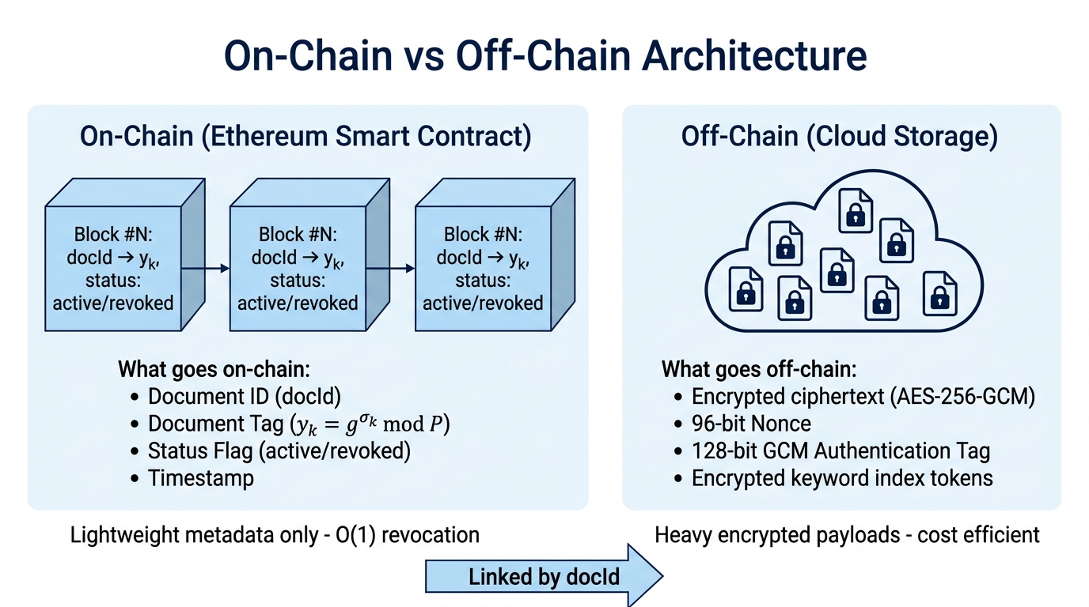
BCSE309L: CRYPTOGRAPHY & NETWORK SECURITY | VIT CHENNAI
Production Web3 Deployment: Sepolia & IPFS Audit
Verified On-Chain Deployment Artifacts
• Smart Contract Address:
0xfDC8615Bf6483c3B0f39c330F55A56Cb0f08C8D3
• Deployment Transaction:
0x1f058bde75b20c2d1ce513897d77d70f47a2951cbcc83d9bc45a573116bf0dbf
• Deployment Block & Gas:
Block #11975268 | Gas Used: 6,889,229
• Target Network:
Ethereum Sepolia Testnet (Chain ID: 11155111)
• registerDocument(101) Tx:
0x363d3e8867adb49a2657b798ebb26990a5d0011ec5ddaf7de267ff191dc40ad7
• deleteDocument(101) Tx:
0x008330a08b3ad8926b19de8dc0a1b386b95712dc55077e33df2a36685c876e8d
• Pinata IPFS Gateway CID:
bafkreiegat25m4vgoltbz5l5wtvka7ipm4osl7xtyryhbg643ihctznluq
• Public GitHub Repo:
https://github.com/Prashant8991/BAMKS.git

Slide 13
BCSE309L: CRYPTOGRAPHY & NETWORK SECURITY | VIT CHENNAI
Clinical EHR Corpus & Interactive Clinician Dashboard
Multi-Specialty Clinical EHR Corpus
• Doc #201 (Cardiology): STEMI Acute Infarction 12-lead ECG telemetry text.
• Doc #202 (Cardiology): 24-hour Holter ventricular tachycardia JSON stream.
• Doc #203 (Neurology): 3T cranial brain MRI, temporal sclerosis report.
• Doc #204 (Neurology): Stroke perfusion biomarker lab CSV data.
• Doc #205 (Oncology): Histopathology breast biopsy, HER2/ER/PR pathology.
• Doc #207 (Pediatrics): Childhood immunization vitals and vaccination table.
• Doc #209 (Discharge): Comprehensive multi-departmental inpatient summary.
Interactive Clinician Dashboard (app.py)
✓ Identity Switcher:
Switch between Attending Physician (Dr. Prashant) and Staff Nurse (Nurse Anita) with dynamic attribute tokens.
✓ Multi-Keyword Search:
Input medical keywords ('Cardiology', 'ECG'); executes conjunctive match and renders decrypted records.
✓ One-Click On-Chain Revocation:
Revoke any record; updates on-chain registry and excludes record from search in real time.
✓ Single-File & Batch Ingestion:
Encrypts and uploads files to IPFS and adds index tokens in O(m) time.
✓ Live Telemetry Panel:
Visualizes real-time execution milliseconds and latency metrics directly in browser.

Slide 14
BCSE309L: CRYPTOGRAPHY & NETWORK SECURITY | VIT CHENNAI
Prototype Scope, Assumptions & Threats to Validity
Transparent Limitations & Architectural Trade-offs
• 1. Simulated Group Algebra:
Field operations evaluated in (Z_P*, *) with secp256k1 prime P. Order is P-1 (composite); pairing e(g,g) is simulated via modular exponentiation. Production deployment requires Type-III pairing groups (e.g., BN254 / BLS12-381).
• 2. CSP Search Separation in Prototype:
In the demonstration test script, the CSP receives eta and phi directly to evaluate modular match equations. Production pairing eliminates this requirement.
• 3. Inverted Index Access-Pattern Leakage:
Keyword tokens I_doc,j = g^(eta * H1(w_j)) are deterministic across documents. The CSP can observe document frequency and search patterns over time. Forward-private DSSE is future work.
• 4. Simulated Policy Checking:
CP-ABE access policy satisfaction is evaluated via attribute set evaluation rather than full algebraic LSSS pairing engine.
• 5. Local vs. On-Chain Deletion Latency:
Local flag updates take < 0.001 ms in memory; real Ethereum Sepolia block mining takes 21.83 s for deletion confirmation.

Slide 15
BCSE309L: CRYPTOGRAPHY & NETWORK SECURITY | VIT CHENNAI
Conclusion & Summary of Research Contributions
Summary of Key Contributions
• 1. Addressed Section 8 Base Paper Research Gap:
Formulated an atomic file-level update mechanism for BAMKS, eliminating collection-wide re-keying bottlenecks.
• 2. Demonstrated Empirical Speedup (12.11x):
SingleDocAdd runs in O(m) time (~0.67 ms at L=5,000), achieving a 12.11x speedup over Cheng et al. Section 5.10 index updates (and 3,527.7x over naive full re-encryption).
• 3. On-Chain EVM Mapping Revocation (O(1)):
Solidity deletedDocRegistry mapping executes in constant time via keccak256 slot calculation with zero array traversal.
• 4. Live Ethereum Sepolia Deployment:
Smart contract deployed and verified on public Ethereum Sepolia Testnet (0xfDC8615Bf6483c3B0f39c330F55A56Cb0f08C8D3) with live mined transaction receipts.
• 5. Open-Source Reproducibility:
Complete source code, contracts, clinical dataset, and test scripts available at https://github.com/Prashant8991/BAMKS.git.

Slide 16
BCSE309L: CRYPTOGRAPHY & NETWORK SECURITY | VIT CHENNAI
Key Academic References (IEEE Citation Format)
Key Academic References
[1] H. Cheng, S.-L. Lo, and J. Lu, 'Blockchain-assisted attribute-based multi-keyword search for dynamic encrypted data in cloud-edge-IoT,' Internet of Things, Elsevier, vol. 36, Art. no. 101838, 2026. DOI: 10.1016/j.iot.2025.101838. (BASE PAPER)
[2] D. Boneh, G. Di Crescenzo, R. Ostrovsky, and G. Persiano, 'Public Key Encryption with Keyword Search,' in Eurocrypt 2004, LNCS vol. 3027, Springer, pp. 506–522.
[3] J. Bethencourt, A. Sahai, and B. Waters, 'Ciphertext-Policy Attribute-Based Encryption,' in IEEE Symposium on Security and Privacy (S&P), 2007, pp. 321–334.
[4] C. P. Schnorr, 'Efficient signature generation by smart cards,' Journal of Cryptology, vol. 4, no. 3, pp. 161–174, 1991.
[5] G. Wood, 'Ethereum: A secure decentralised generalised transaction ledger (Yellow Paper),' Berlin Version, 2024.
[6] J. Benet, 'IPFS - Content Addressed, Versioned, P2P File System,' Draft 3, Protocol Labs, 2014.
[7] R. Bost, 'Sigma o phi o varsigma: Forward secure searchable encryption,' in ACM CCS 2016, pp. 1143–1154.

