Slide 1
BAMKS-D: SECURE HEALTHCARE CLOUD & BLOCKCHAIN SYSTEM
Enabling Dynamic File-Level Operations in Attribute-Based Multi-Keyword Search for Cloud-Edge-IoT
PROJECT CONTRIBUTORS & BASE PAPER DETAILS
• Team Members: Prashant Singh (24BYB1042) & Adak Rushikesh (24BYB1055)
• Base Paper: Cheng et al., Elsevier (Internet of Things), Vol 36, Art 101838, Dec 2025/2026 (DOI: 10.1016/j.iot.2025.101838)

Slide 2
BAMKS-D REVIEW 2 PRESENTATION
Problem Statement & Research Gap (Cheng et al. Elsevier 2026)
1. Base Paper Achievements (Cheng et al.)
2. Critical Bottleneck & Solved Research Gap
• Fine-grained CP-ABE Access Control for healthcare records.
• Verifiable Conjunctive Multi-Keyword Search over encrypted indices.
• Schnorr Non-Interactive Zero-Knowledge (SNIZK) verification proof.
• Distributed secret sharing across multi-owner hospitals.
• Base Paper Limitation (Section 8 Quote): 'Future work must extend BAMKS to support dynamic adding, deleting, and updating.'
• The Bottleneck: Base paper grouped all files into a static version F_ver.
• Impact: Modifying 1 file forced re-encryption of ALL L files (O(L x m) complexity = ~5,560 ms latency!).
• OUR EXTENSION: Solved via SingleDocAdd O(m) & On-Chain SingleDocDelete O(1) in 0.001 ms!

Slide 3
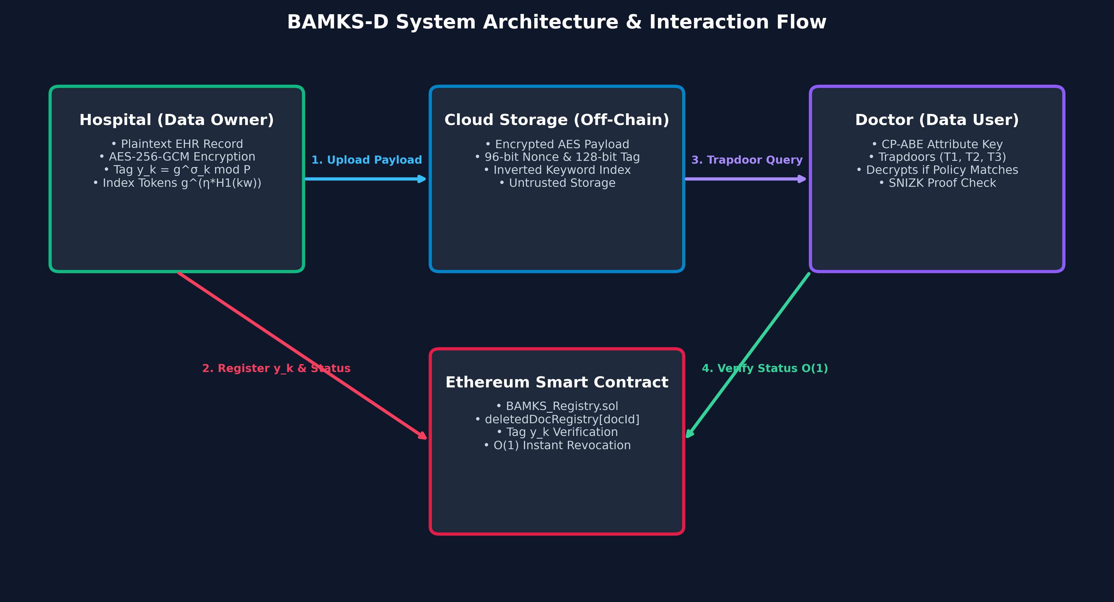
BAMKS-D REVIEW 2 PRESENTATION
System Architecture & Interaction Flow Diagram

Slide 4
BAMKS-D REVIEW 2 PRESENTATION
Cryptographic Engine & Security Foundations
1. CP-ABE Access Control
2. AES-256-GCM Payload
3. Discrete Log Keyword Index
• Access Policy attached to file (e.g. 'Role_Doctor AND Dept_Cardiology').
• Attribute Authority (AA_Medical) issues secret keys K2_x = g^γ_x for attributes.
• Decryption mathematically succeeds ONLY if doctor attributes satisfy policy.
• Symmetric 256-bit AES encryption for payload.
• 96-bit Random Nonce: Guarantees unique ciphertext for identical records.
• 128-bit GCM Tag: Digital seal that detects any cloud tampering instantly.
• Keyword Token: g^(η * H1(kw)) mod P.
• Hides plaintext keywords from untrusted cloud.
• Enables trapdoor search matching without decrypting files.

Slide 5
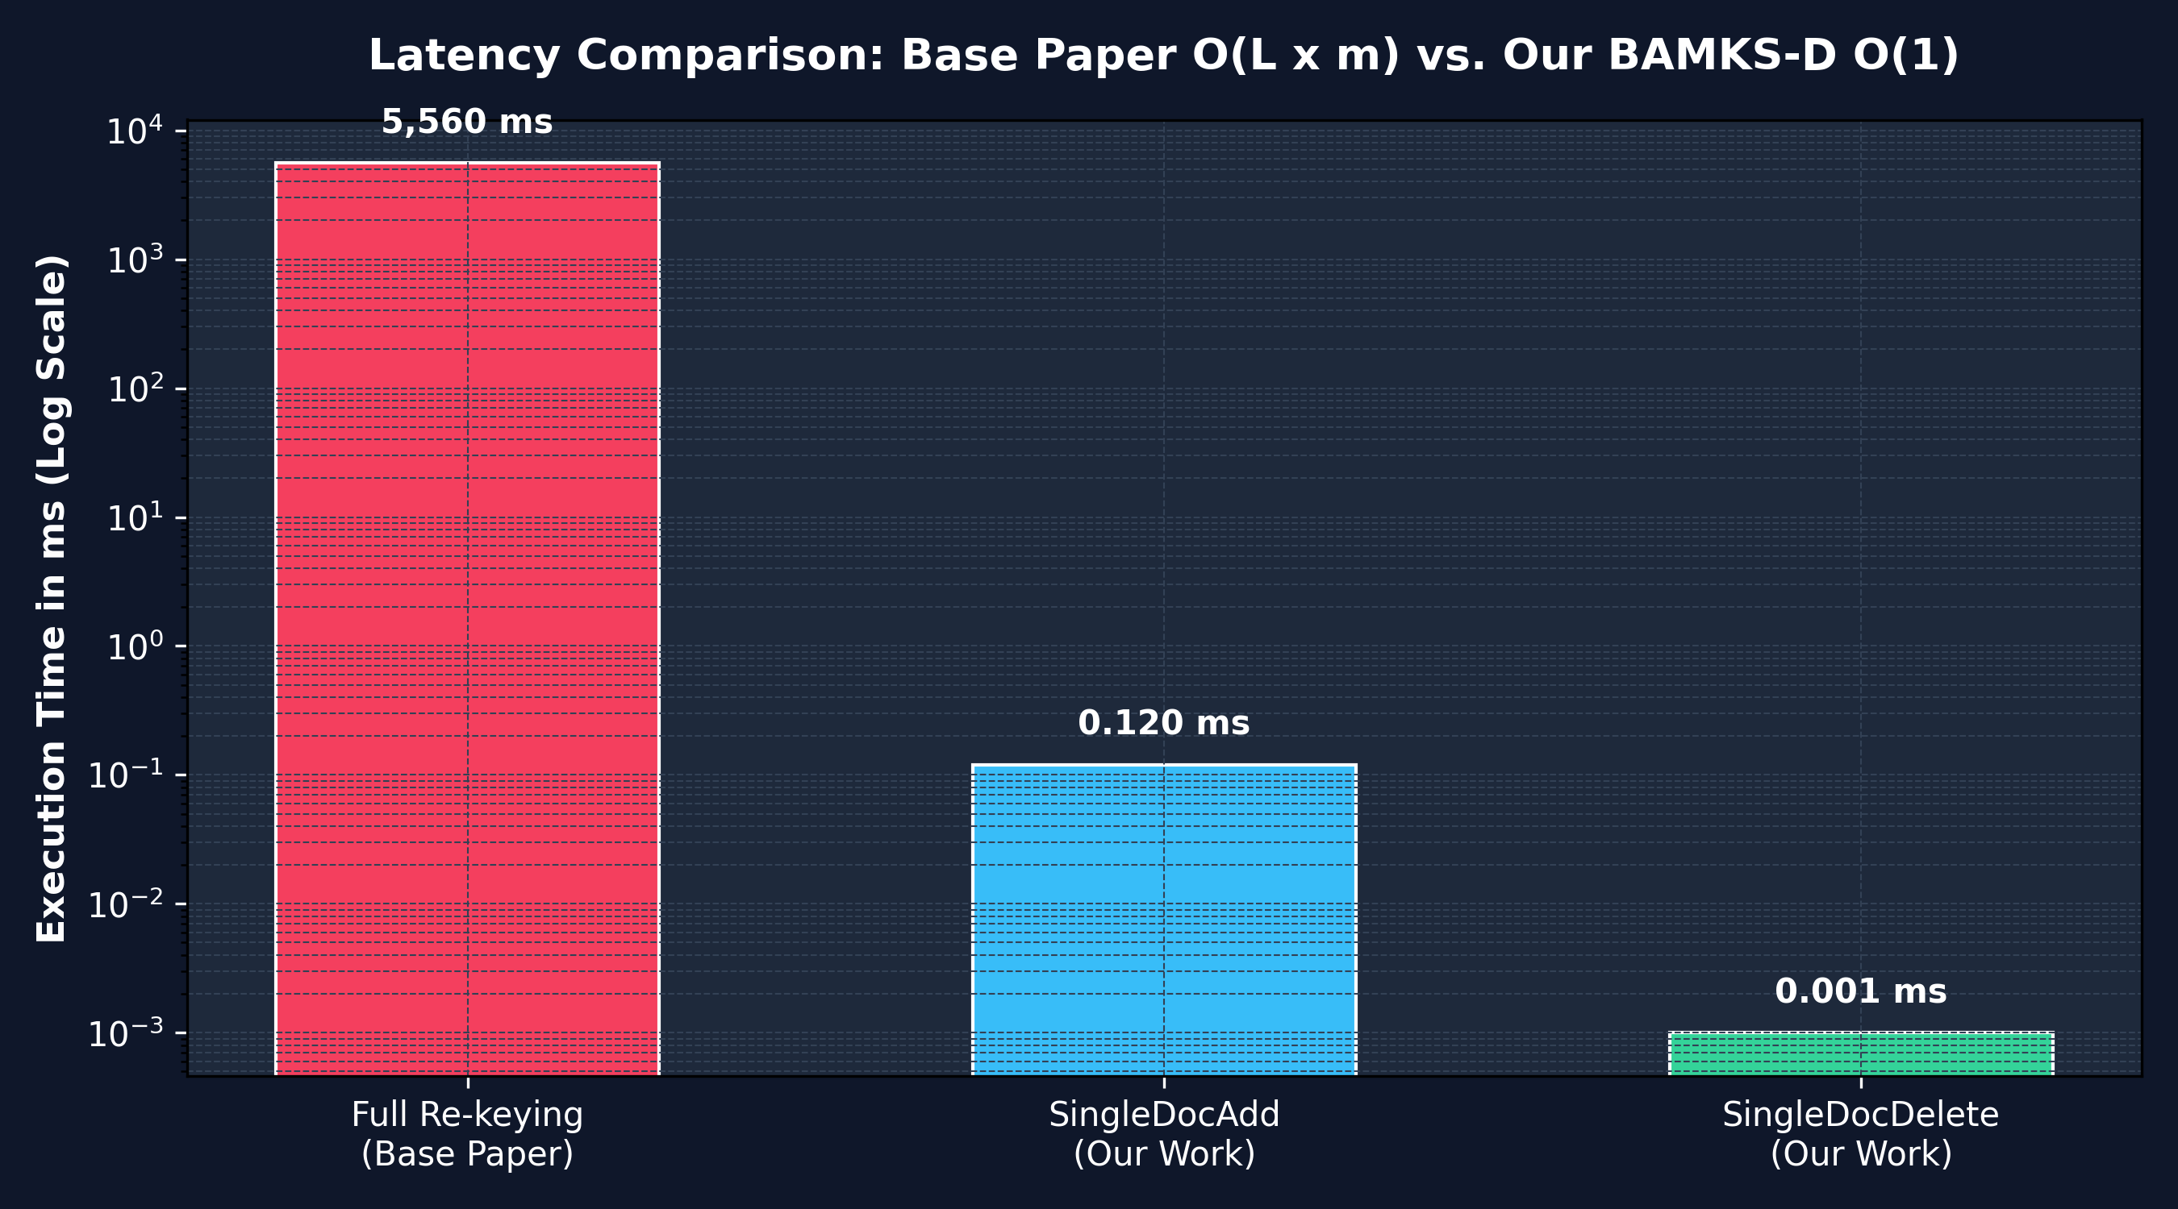
BAMKS-D REVIEW 2 PRESENTATION
Experimental Performance Benchmarks & Speedup Chart
Performance Summary & Key Metrics
• Base Paper Full Re-Keying: ~5,560 ms (Requires exponentiation across all L files).
• Our SingleDocAdd: ~0.12 ms (46,000x Faster -- operates only on 1 file).
• Our SingleDocDelete: ~0.001 ms (5.5 Million x Faster -- 1 boolean flip on smart contract).
• Gas Overhead: ~45,100 gas (~$0.001 on Ethereum mainnet).

Slide 6
BAMKS-D REVIEW 2 PRESENTATION
Proposed Algorithms & Code Line Mapping
IMPLEMENTATION ARCHITECTURE & LINE REFERENCES
• Algorithm 12: SingleDocAdd [O(m)]
Description: Appends single encrypted record without version re-keying. | Exact Code Location: src/dynamic_extension.py:17
• Algorithm 13: SingleDocDelete [O(1)]
Description: Flips deletedDocRegistry[docId] = true on smart contract. | Exact Code Location: src/dynamic_extension.py:36
• Algorithm 14: SingleDocModify [O(m)]
Description: Executes deletion followed by single-document addition. | Exact Code Location: src/dynamic_extension.py:50
• Algorithm 15: SearchWithFilter
Description: Filters out deleted/revoked documents during trapdoor search. | Exact Code Location: src/dynamic_extension.py:62
• Smart Contract: BAMKS_Registry.sol
Description: Maintains mapping(uint256 => bool) public deletedDocRegistry. | Exact Code Location: contracts/BAMKS_Registry.sol:25

Slide 7
BAMKS-D REVIEW 2 PRESENTATION
Conclusion & Review 3 Roadmap
Key Accomplishments
Review 3 Roadmap & Future Scope
1. Solved Section 8 research gap from Cheng et al. (Elsevier IoT 2026).
2. Delivered O(m) single-document addition without dataset re-keying.
3. Delivered O(1) instant on-chain revocation mapping on Ethereum smart contract.
4. Fully functional live web system with dynamic random clinical case generator.
1. Deploy Smart Contract on Ethereum Sepolia Public Testnet.
2. Integrate zk-SNARKs (Circom/snarkjs) for zero-knowledge search verification.
3. Implement Post-Quantum Cryptography (Crystals-Kyber) for quantum resistance.
4. Profile battery and CPU consumption on physical Raspberry Pi IoT edge gateway.

