Slide 1

Inventory Management System
Mini-Project 2k19

Slide 2

What is Inventory Management System?
An inventory management system is the combination of technology (hardware and software) and processes and procedures that oversee the monitoring and maintenance of stocked products, whether those products are company assets, raw materials and supplies, or finished products ready to be sent to vendors or end consumers.

Slide 3
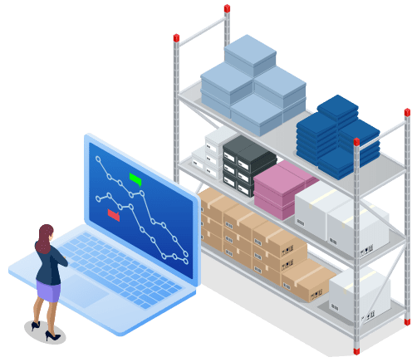
System Used/Requirement
Database server (MySQL)
Technology (Python)
Console (CLI) based

Slide 4
Functional Hierarchy Diagram of IMS
IMS Home
Stock
Sale
Product
Profit Details
* ) Update Product
Quantity in stock
* ) View Stock
* ) Insert Product
Sale details
* ) Update Product
Sale details
* ) View Product
Sale details
* ) Add new Product
* ) View all Products
* ) Remove Products
* ) Compute net
Profit

Slide 5
Made by:
Neha & Prashant
Under Supervision:
Mr. Rajiv Kumar Gupta (IITK)
Mr. Bhanu Pratap Rai (IITK)
Mr. Santosh Kumar (IITK)

