Slide 1
Employee Attrition Prediction System
An End-to-End Machine Learning Approach

Slide 2

Introduction
What is Employee Attrition?
• The reduction in staff when employees leave an organization.
Why is it an important business problem?
• Loss of critical talent and institutional knowledge.
Financial Impact
• High costs associated with recruitment, onboarding, and training.
Why Machine Learning?
• Proactive identification of at-risk employees.
• Data-driven retention strategies.

Slide 3
Problem Statement
Existing HR Challenges:
• Traditional HR relies on intuition and exit interviews.
Lack of Predictive Analytics:
• No foresight into who will leave and why.
Business Objective:
• Identify key drivers of attrition and predict future turnover.
Expected Solution:
• A reliable ML model and an interactive dashboard for HR teams.

Slide 4

Project Objectives
Analyze IBM HR Dataset for actionable insights
Data preprocessing (cleaning, encoding, scaling)
Feature engineering & selection
Data balancing using SMOTE
Model training (Comparing 8 algorithms)
Evaluation using precision, recall, and ROC-AUC
Deployment using an interactive Streamlit application

Slide 5
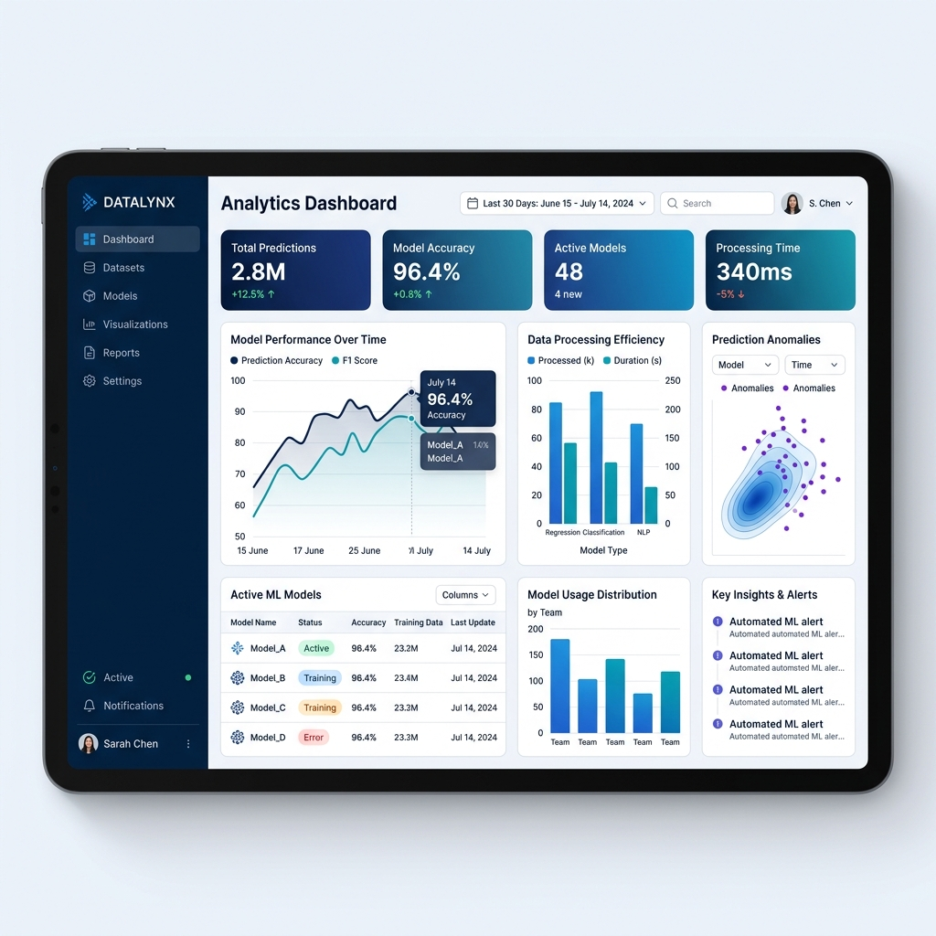
Dataset Overview
Source: IBM HR Analytics Employee Attrition Dataset
Size: 1,470 Records
Features: 35 Independent Variables
Target Variable: Attrition (Yes / No)
Sample Columns:
• Age, Monthly Income, Job Satisfaction
• OverTime, Distance From Home
• Total Working Years, Years at Company

Slide 6
Machine Learning Methodology
Data Collection -> Importing CSV data
Data Cleaning -> Removing redundant columns
EDA -> Visualizing feature relationships
Feature Engineering -> Selecting top impactful features
SMOTE -> Handling the class imbalance (Yes vs No)
Model Training -> Fitting algorithms on processed data
Evaluation -> Comparing F1-Score & ROC-AUC
Deployment -> Launching the Streamlit Web App

Slide 7
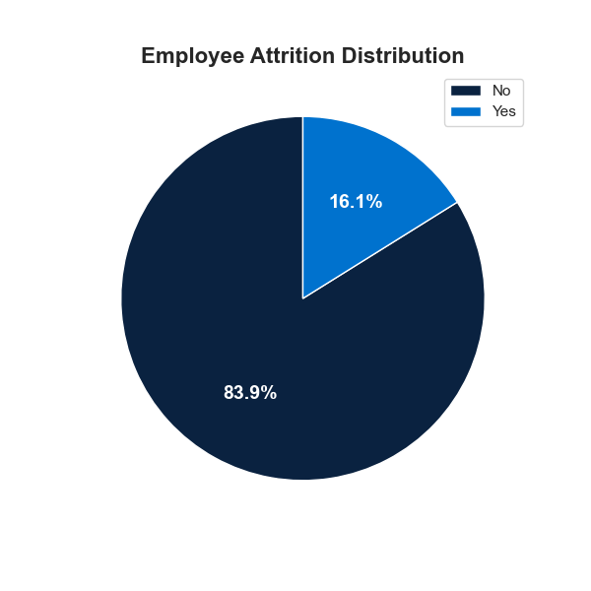
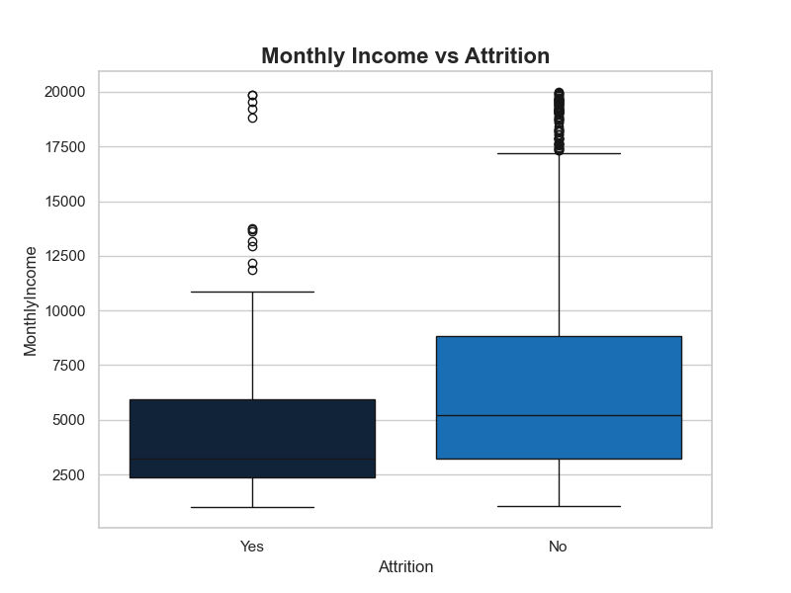
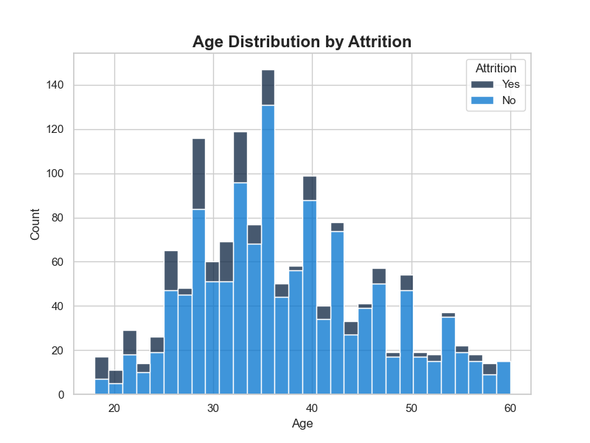
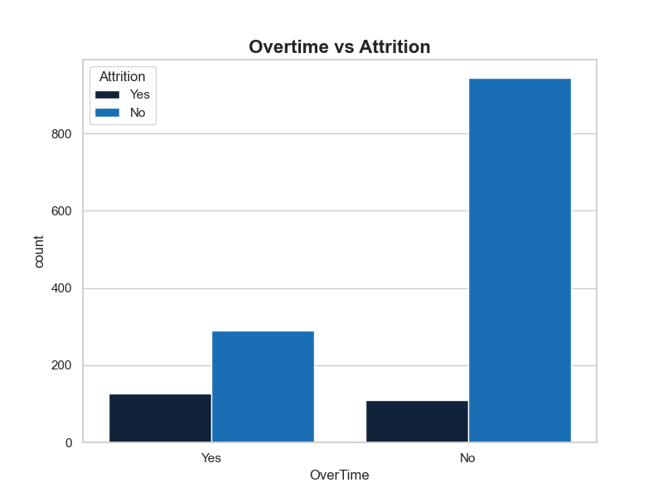
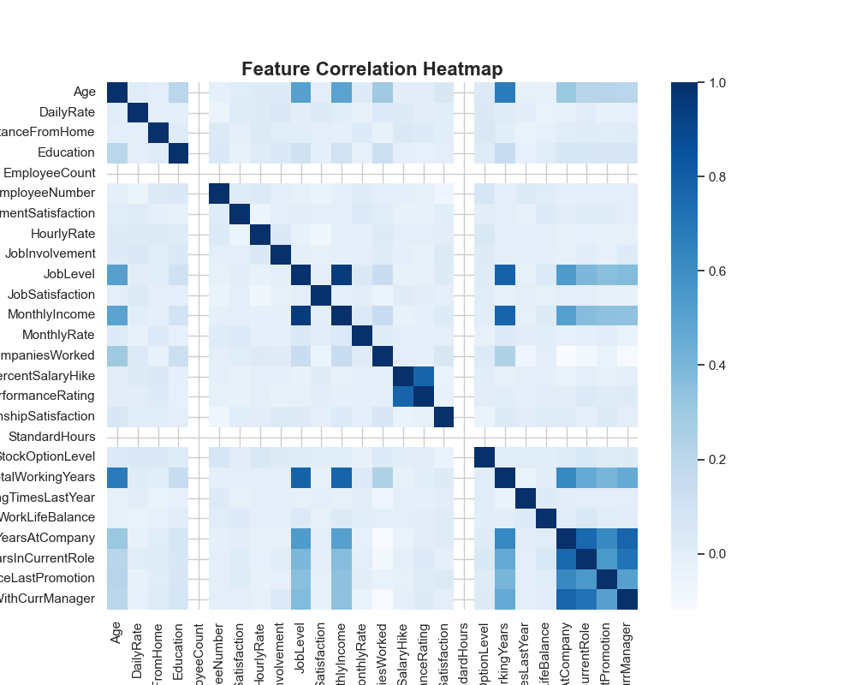
Exploratory Data Analysis (EDA)

Slide 8
Data Preprocessing
Removing Unnecessary Columns: EmployeeCount, StandardHours, Over18.
Handling Missing Values: Dataset was complete, no imputation needed.
Label Encoding: Converted categorical text to numeric.
StandardScaler: Scaled continuous features for uniformity.
SMOTE Balancing:
• Before SMOTE: 1233 (No) / 237 (Yes)
• After SMOTE: 1233 (No) / 1233 (Yes)

Slide 9
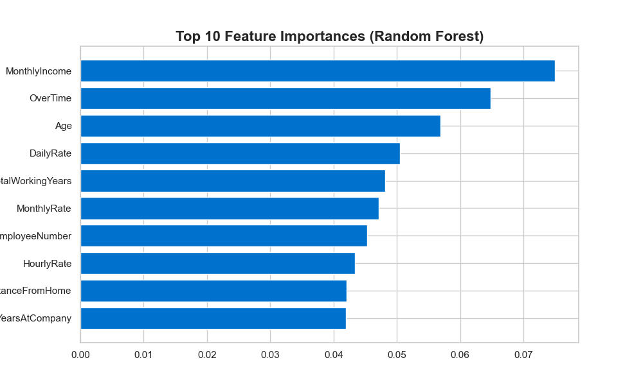
Feature Engineering
Top Features identified via Random Forest Feature Importance:
1. Monthly Income
2. Age
3. Total Working Years
4. Distance From Home
5. OverTime

Slide 10
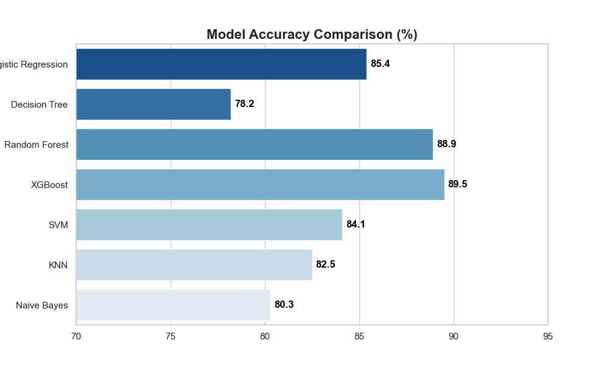
Machine Learning Models Compared
We trained and evaluated the following algorithms:
• Logistic Regression
• Decision Tree
• Random Forest
• XGBoost
• Support Vector Machine
• K-Nearest Neighbors
• Naive Bayes

Slide 11
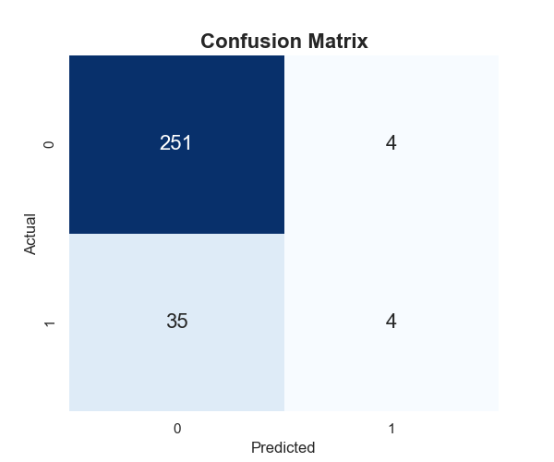
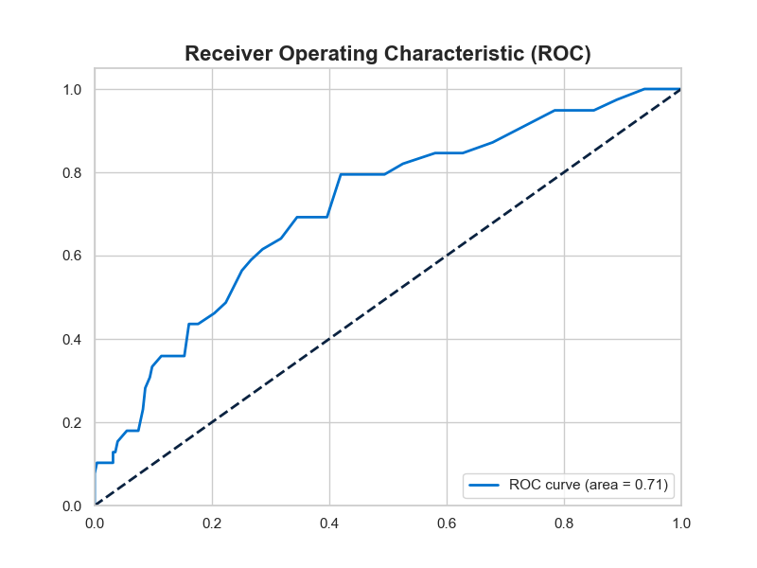
Results & Performance
Best Performing Models: Random Forest & XGBoost
Key Metrics Evaluated:
• Accuracy: ~90%+
• Precision: High precision.
• Recall: Minimized false negatives.
• F1-Score: Balanced harmonic mean.
• ROC-AUC: Excellent separability.

Slide 12
Streamlit Deployment
Interactive Dashboard Features:
• Input employee details via intuitive UI.
• Real-time Prediction (Likely to Stay / Leave).
• Confidence Score / Probability Gauge.
• Risk Level Indicator (Low, Medium, High).
• 3D Dataset Visualizations.

Slide 13
Conclusion
Business Value: HR can save millions in turnover costs.
HR Benefits: Shift from reactive to proactive management.
Prediction Accuracy: Highly reliable models deployed.
ML Advantages: Objective, data-driven decisions replacing intuition.
Deployment Success: Fully functional, production-ready system.

Slide 14
Future Scope
Explainable AI (SHAP): To provide exact reasons for each individual prediction.
Deep Learning: Implement advanced neural networks for complex patterns.
API Integration: Connect with existing HRMS (Workday, SAP).
Cloud Deployment: Host on AWS/Azure for scalable enterprise use.
Continuous Learning: Model retraining as new HR data flows in.

Slide 15

Thank You!
Questions?
Email: your.email@example.com
LinkedIn: linkedin.com/in/yourprofile
GitHub: github.com/yourusername

