Slide 1

REAL-TIME MESSENGER
USING Django

Slide 2
SUBMITTED BY: PRASHANT ASTHANA(181500487) TANISHQ TRIPATHI(181500751) SHRIYANSHI BARANWAL(181500691)
UNDER SUPERVISION OF:
MR. AMIR KHAN

Slide 3
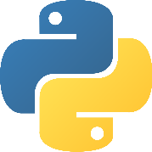
OBJECTIVE
The main objective of creating this real-time messenger is:
Firstly, we are creating a platform where a particular person can send a mail to different ids at a same time without having to check the database of their employees. This saves a lot of time.
Secondly, this project saves a lot of storage as there would be no use of creating any other database for sending mail to a large number of people.
Thirdly, it creates a database of the details entered. This data can be updated any time, very easily and be securely saved.

Slide 4

TECHNOLOGIES USED
DJANGO:
Django is a high-level Python Web framework that encourages rapid development and clean, pragmatic design.
Django makes it easier to build better Web apps more quickly and with less code.
The Web framework with perfectionists with deadlines.

Slide 5

WEBSOCKETS:
Web sockets are defined as a two-way communication between the servers and the clients, which mean both the parties, communicate and exchange data at the same time.
This protocol defines a full duplex communication from the ground up.
Web sockets take a step forward in bringing desktop rich functionalities to the web browsers.

Slide 6
HOW WEBSITES WORK?
CLIENT SIDE
VIEW
CONTROLLER
MODEL
CLIENT SIDE
[HTML]
[CSS]
[JS]
WEB SERVER
[APACHE]
[NGINX]
[TOMCAT]
SERVER CODES
[PHP]
[JSP]
[DJANGO]
[NODE JS]
DATABASE
SERVER
[MySQL]
[MongoDB]
PC Browser
Mobile
Browser
SERVER SSIDE
These are all the processes done when we visit a website:
First browser requests website from URL then URL requests data from server return the data process by code and database.

Slide 7
MVC PATTERN
URL Routing: When we open any link URL Routing pass request to controller then controller return back the response.
Model
View
Controller
All Database tables and structures comes in Model
All templates file comes in VIEW Part
(HTML,CSS,JS)
All client side
All process which return data and process, our logic is done by controller

Slide 8
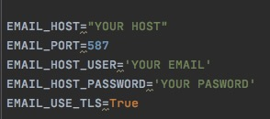
WE OUTSET THE PROJECT BY:
Setting up a host in setting.py, and adding senders email address, for e.g.- trophy@gmail.com, and password.

Slide 9
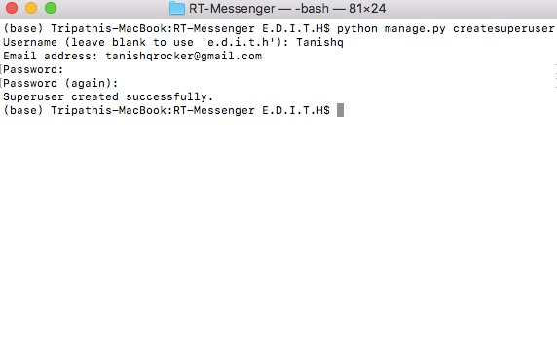
2. Creating super user for login page access using command:
python manage.py createsuperuser

Slide 10
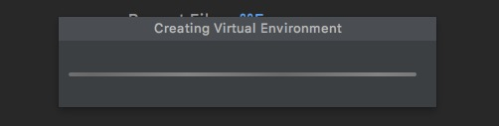
3. Creating a virtual environment for the project.

Slide 11
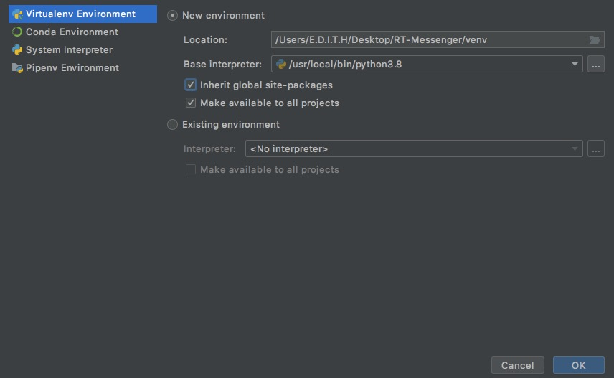
4. Adding interpreter or virtual environment(venv).

Slide 12
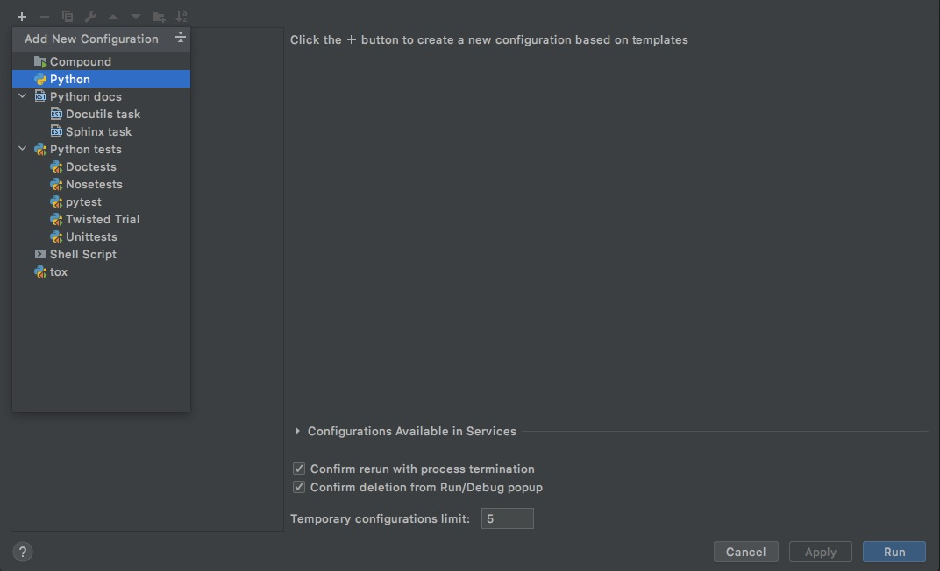
5. Adding new configuration for manage.py

Slide 13
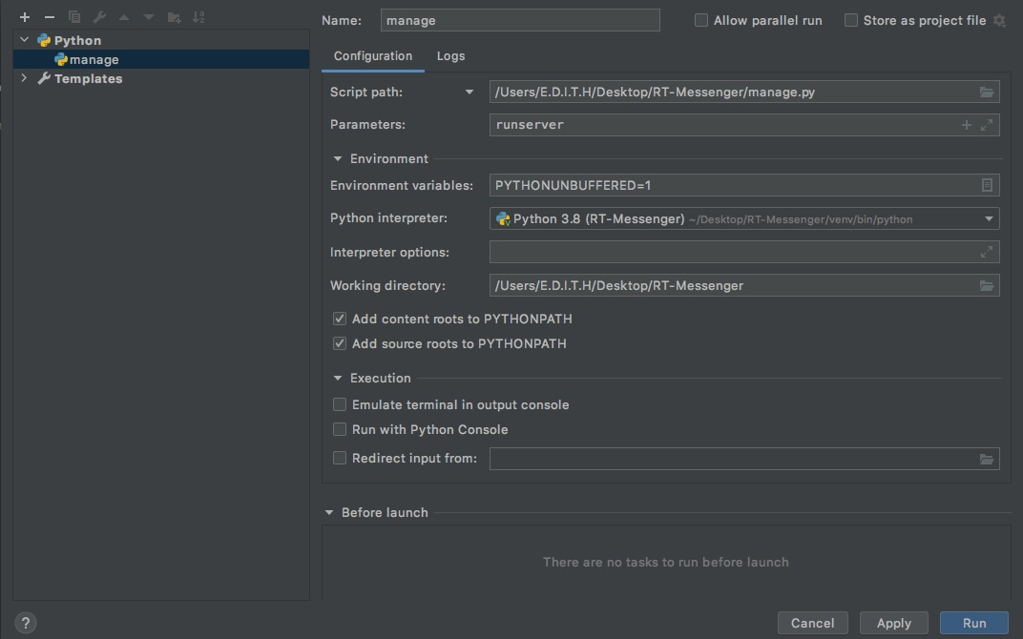
Setting the script path browsed to manage.py and
adding runserver as a parameter.

Slide 14


