Slide 1


Med-RAG
A RETRIEVAL-AUGMENTED GENERATION SYSTEM FOR MEDICAL REPORT ANALYSIS
GUIDED BY: DR. PON HARSHWARDHANAN

Slide 2


Team Members
23BHI10176
223BAI11327
22MIM10122
M K Nandhini
Gourikripa M V
Prashant Kakde
23BHI10174
22MIM10008
Ananthalekshmi JS
Aditya Kakade
23BHI10032
22MIM10100
Amita Maria Abraham
Yashpal Singh Chouhan

Slide 3
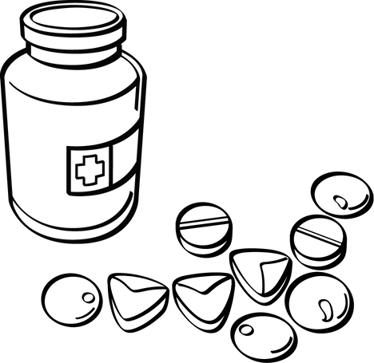
Table of Contents
1
4
7
Problem Statement
System Architecture
Advantage
2
5
8
Motivation & Objective
Implementation
Future Scope
3
6
9
Proposed Solution
Results & demo
Conclusion

Slide 4

Introduction and Agenda
The healthcare industry generates a massive amount of unstructured data, particularly in the form of patient reports.
Manually sifting through these PDFs to find specific information is time-consuming and prone to human error.
Our project aims to automate this process using a Retrieval-Augmented Generation (RAG) system.
3

Slide 5

Problem Statement
The Challenge:
Medical reports, such as pathology results, discharge summaries, and radiology scans, are typically stored as unstructured PDF documents.
Clinicians and researchers need to quickly access specific information (e.g., lab values, diagnoses, medication history) but this requires manual review.
This leads to inefficiency, delays in patient care, and the risk of missing crucial data.
The Problem: How can we build an intelligent system that can understand and answer questions about the contents of a patient's PDF medical report?
3

Slide 6
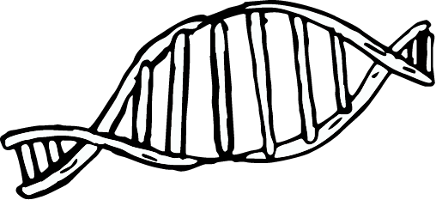
Motivation & Objectives
Motivation:
Enhance Clinical Efficiency: Provide clinicians with rapid access to patient data, allowing them to focus on diagnosis and treatment.
Improve Patient Outcomes: Ensure no critical information is overlooked.
Enable Medical Research: Facilitate the analysis of large datasets of anonymized patient reports for research purposes.
Objectives:
Develop a system to ingest and process PDF medical reports.
Extract key information and semantically index it.
Integrate a pre-trained medical LLM for medical query answering.
Create a user-friendly interface to ask questions and receive accurate, context-aware answers based on the patient's data.
3

Slide 7
Proposed Solution (Overview)
RAG Architecture: We will use a Retrieval-Augmented Generation (RAG) framework.
Key Steps:
Ingestion: The PDF medical report is uploaded to the system.
Chunking & Embedding: The PDF content is split into smaller, manageable 'chunks'. Each chunk is then converted into a numerical vector (an embedding) that captures its semantic meaning.
Indexing: These embeddings are stored in a vector database. This creates a searchable index of the medical report's content.
3

Slide 8
Proposed Solution (Overview)
4. Retrieval: When a user asks a question, the query is also converted into an embedding. The system then searches the vector database to retrieve the most relevant chunks from the original report.
5. Generation: The retrieved chunks (the context) are provided to a medical LLM along with the user's question. The LLM synthesizes an answer based on both the provided context and its own pre-trained knowledge.
3

Slide 9
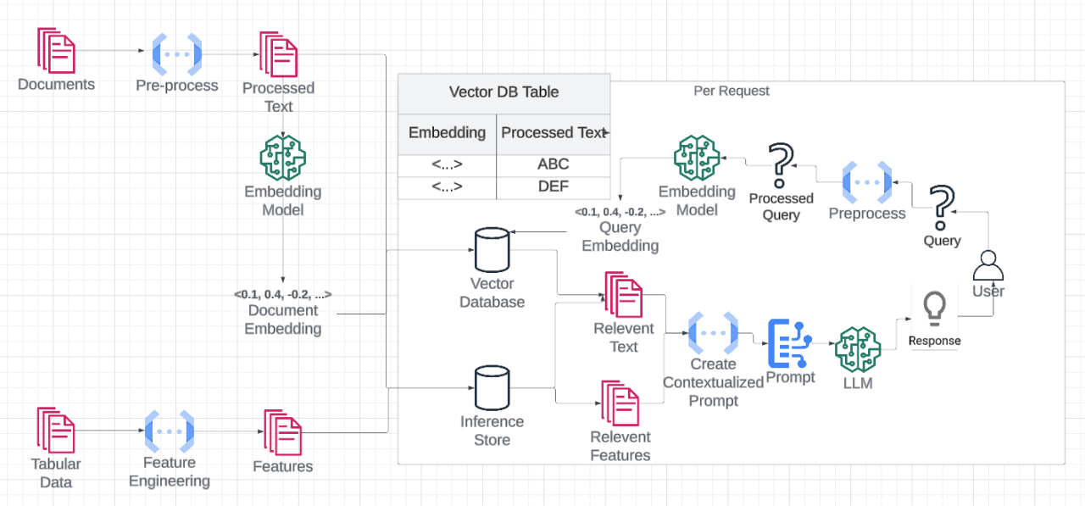
System Architecture
3

Slide 10
System Architecture
User Interface: A web-based application where the user uploads the PDF and types their query.
PDF Ingestion Module:
Uses a library like PyMuPDF or Tesseract for text extraction.
Embedding Model:
A pre-trained model (e.g., sentence-transformers) that converts text to numerical vectors.
Vector Database:
A specialized database (e.g., ChromaDB, Pinecone) designed for efficient similarity search of vectors.
3

Slide 11
System Architecture
Medical LLM:
A Large Language Model fine-tuned on medical data (e.g., BioGPT, or a fine-tuned version of a general model).
API/Backend:
Manages the data flow between all components.
3

Slide 12
Implementation (Tech Stack)
Language: Python is the primary programming language.
Frameworks:
LangChain: A powerful framework for building LLM applications, which will help us chain together the various components (retriever, LLM, etc.).
Flask/Streamlit: For building the user interface and backend API.
Libraries:
PyMuPDF: For robust text and image extraction from PDFs.
Sentence-Transformers: For generating high-quality embeddings.
ChromaDB: Our chosen open-source vector database.
Transformers: For interacting with the pre-trained medical LLM from Hugging Face.
3

Slide 13
Implementation (Process)
Step 1: Data Preparation: Load the PDF using PyMuPDF. Clean and preprocess the extracted text.
Step 2: Chunking: Split the text into overlapping chunks of a specific size (e.g., 500 characters) to preserve context.
Step 3: Embedding: Use a pre-trained sentence-transformer model to convert each text chunk into a dense vector.
Step 4: Indexing: Create an in-memory vector store using ChromaDB and add the embeddings and their corresponding text chunks.
Step 5: Querying: When a user asks a question, we embed the query. We then perform a similarity search in the vector store to find the most relevant document chunks.
Step 6: LLM Augmentation: Pass the user's query and the retrieved chunks to the medical LLM. The LLM generates the final answer.
3

Slide 14
Results & Demo
Demo Scenario:
Upload: Upload a sample PDF medical report.
Ask 1: Ask a simple question like, "What is the patient's blood pressure?"
Result 1: The system should quickly retrieve the relevant section from the PDF and provide the specific value.
Ask 2: Ask a more complex, inferential question like, "Are there any signs of infection?"
Result 2: The system will find relevant lab values (e.g., White Blood Cell count) and use the LLM to provide a coherent summary or answer.
Highlight the speed and accuracy of the system compared to manual searching.
3

Slide 15
Advantages
Accuracy: Reduces the chance of human error by automatically extracting and synthesizing information directly from the source.
Efficiency: Saves time for healthcare professionals, allowing them to make faster, more informed decisions.
Context-Awareness: The RAG approach ensures answers are grounded in the specific patient data, not just general LLM knowledge.
Scalability: The system can handle a large number of reports and queries, making it suitable for clinical and research settings.
Cost-Effective: Uses a smaller, specialized LLM, which is more economical to run and fine-tune than a massive general-purpose model.
3

Slide 16
Future Scope
Integration with Electronic Health Records (EHR): Directly connect the system to EHR databases for real-time data access.
Multi-modal Analysis: Extend the system to process not just text but also images (e.g., X-ray scans, MRI results) and audio (e.g., doctor-patient conversations).
Personalized Summaries: Develop features to generate concise, personalized summaries of a patient's medical history.
API for Developers: Create a robust API that allows other healthcare applications to integrate our RAG functionality.
Enhanced Security: Implement advanced encryption and access control to ensure patient data privacy and compliance with regulations like HIPAA.
3

Slide 17
Conclusion
Summary: We have successfully built a RAG-based system that effectively extracts, indexes, and answers questions about patient data from PDF medical reports.
Impact: This project demonstrates a practical application of AI in healthcare, improving efficiency, accuracy, and patient care.
Final Thoughts: The integration of Retrieval-Augmented Generation with specialized medical LLMs holds immense potential to revolutionize how we interact with and utilize medical data.
Thank You! Q&A
3

Slide 18
Thank You

