Slide 1
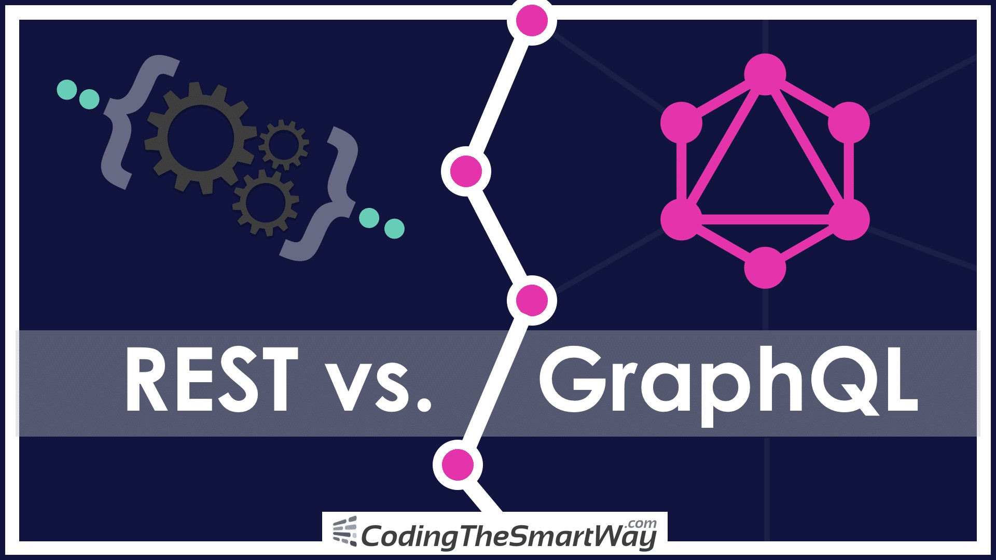

Slide 2
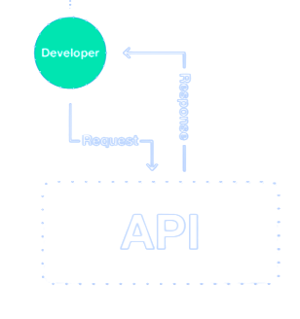
API ?
API Stands for (Application Programming interface)
An Application program interface that provides developer with programmatic access to a proprietary software application. A software intermediary that
makes it possible for application programs to interact with each other and share data

Slide 3
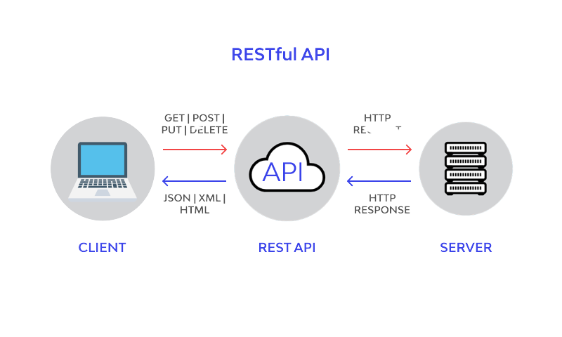

What is
{ REST:API }
REST is an API(Application Programming interface) design architecture
It uses HTTP to get data and perform various operations (POST, GET, PUT, and DELETE)
It uses JSON format,allowing better and faster parsing of data

Slide 4

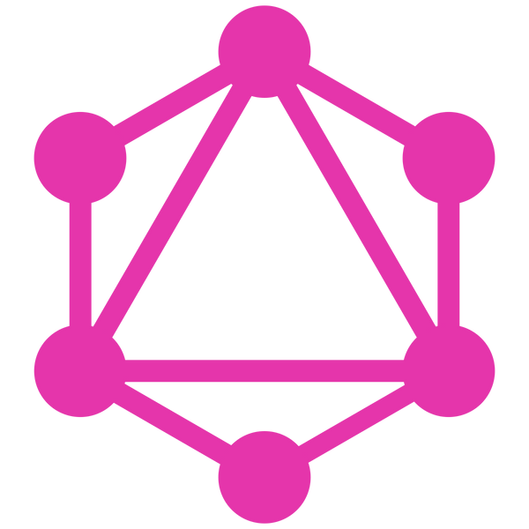
There are some disadvantages of REST
It fetches all data, whether required or not (“over-fetching”)
It makes multiple network requests to get multiple resources.
Sometimes resources are dependent, which causes waterfall network requests.
To overcome these
Developed
GraphQl

Slide 5
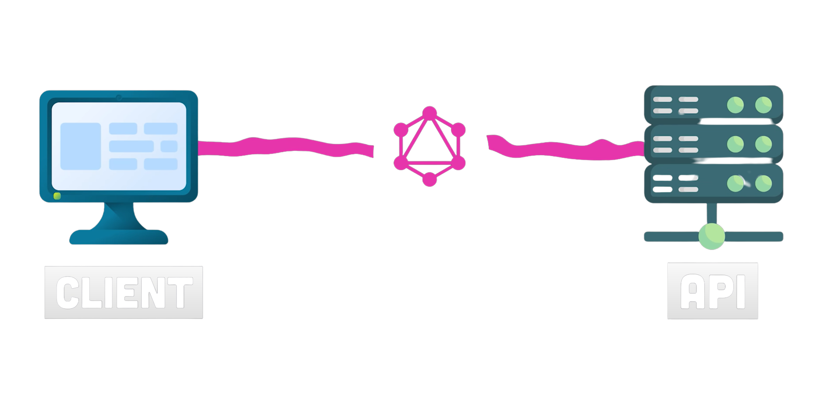
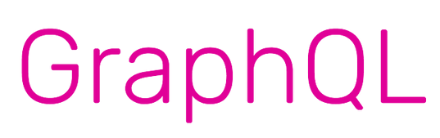
Graphql a query language for reading and mutating data in apis as a back-end developer graphql provides a type system where you can describe a schema for your data in turn.

Slide 6
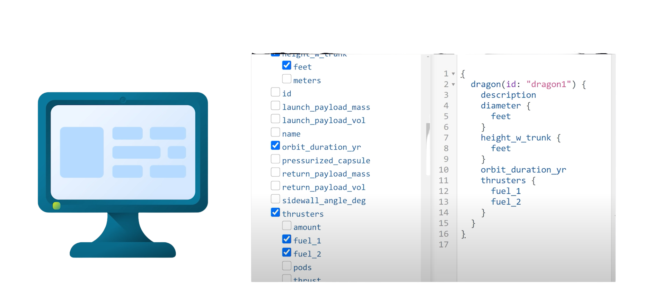
With the help GraphQL we can request the exact data

Slide 7
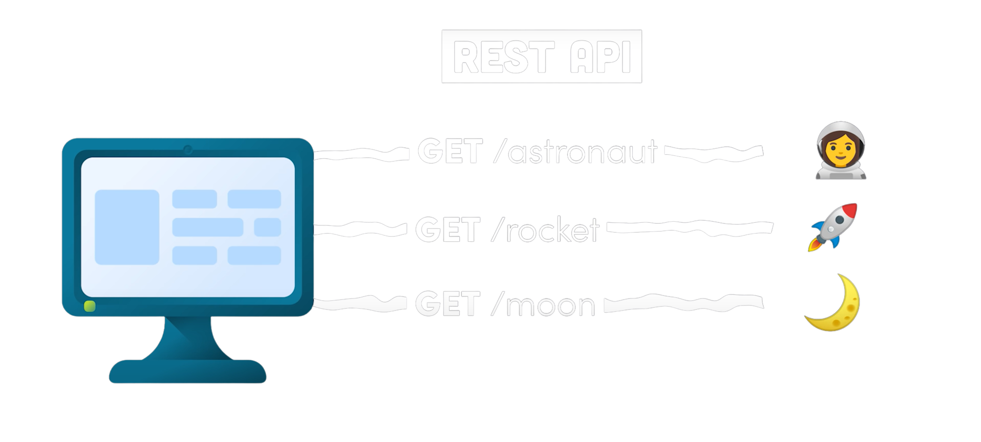

Slide 8
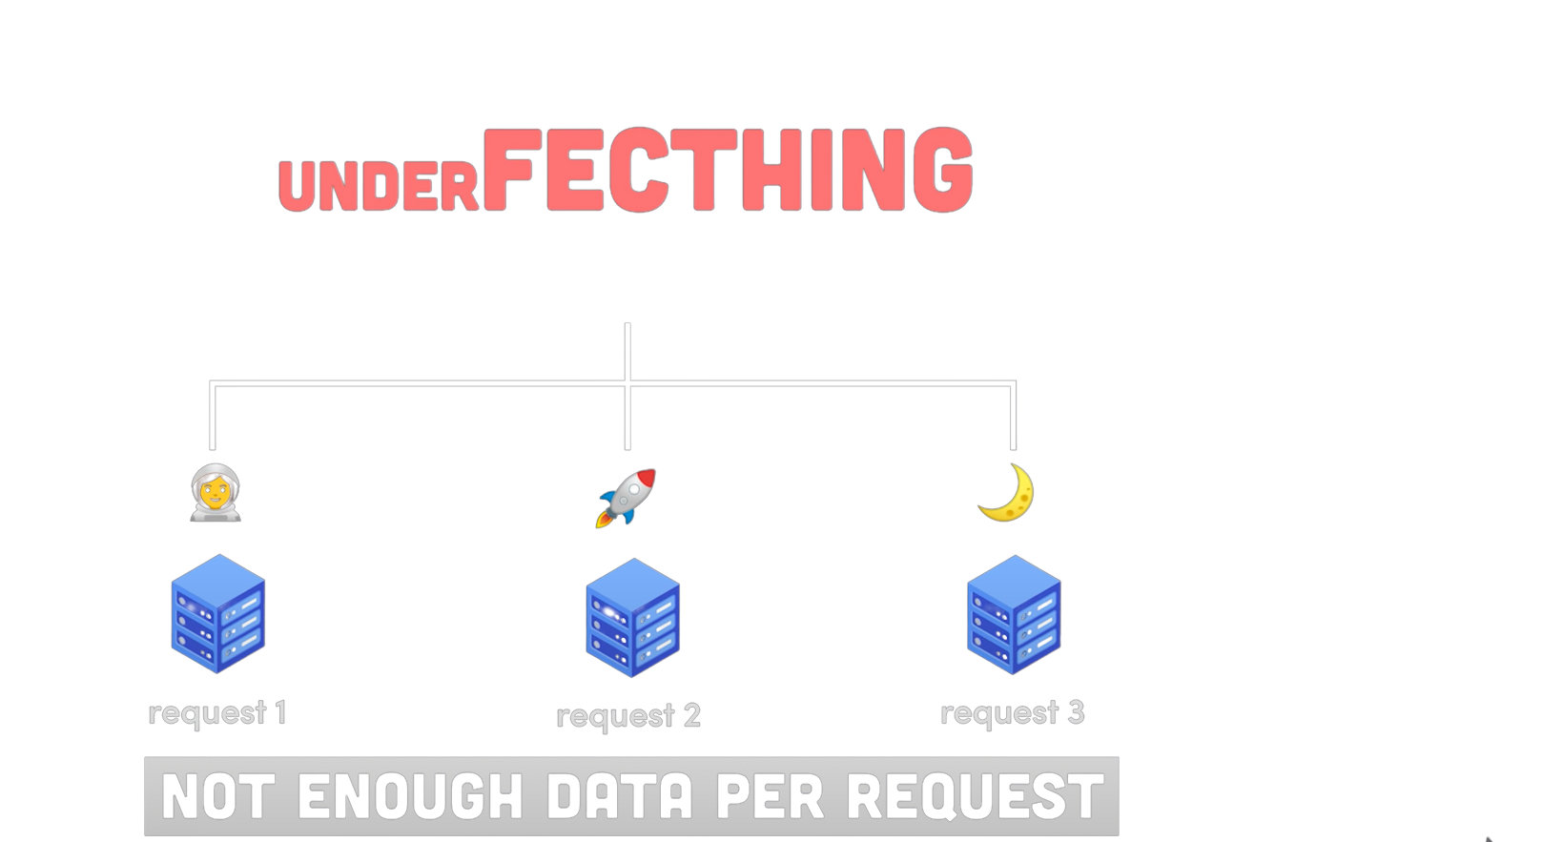


Under-fetching is not fetching adequate data in a single API request.
The under-fetching resposnse doesn't have enough data with a call to an endpoint

Slide 9
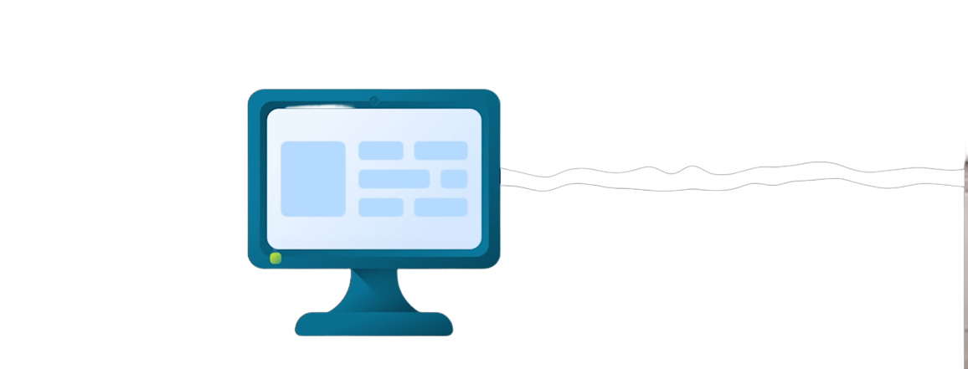
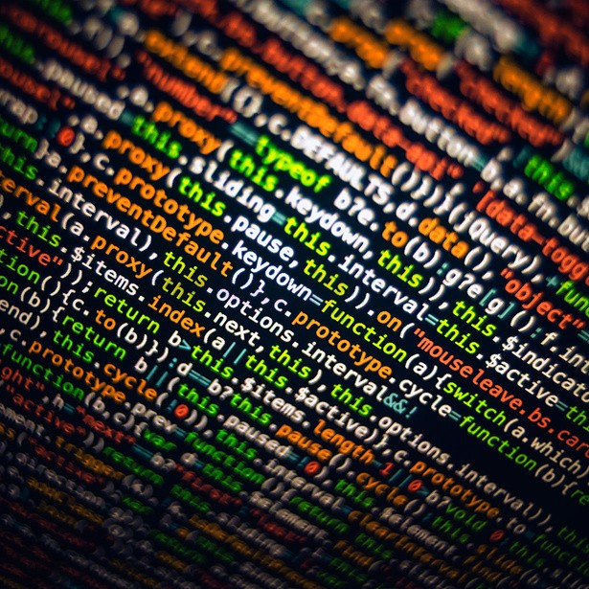
OVERFETCHING
Over-fetching happens when the response fetches more than what is required.

Slide 10
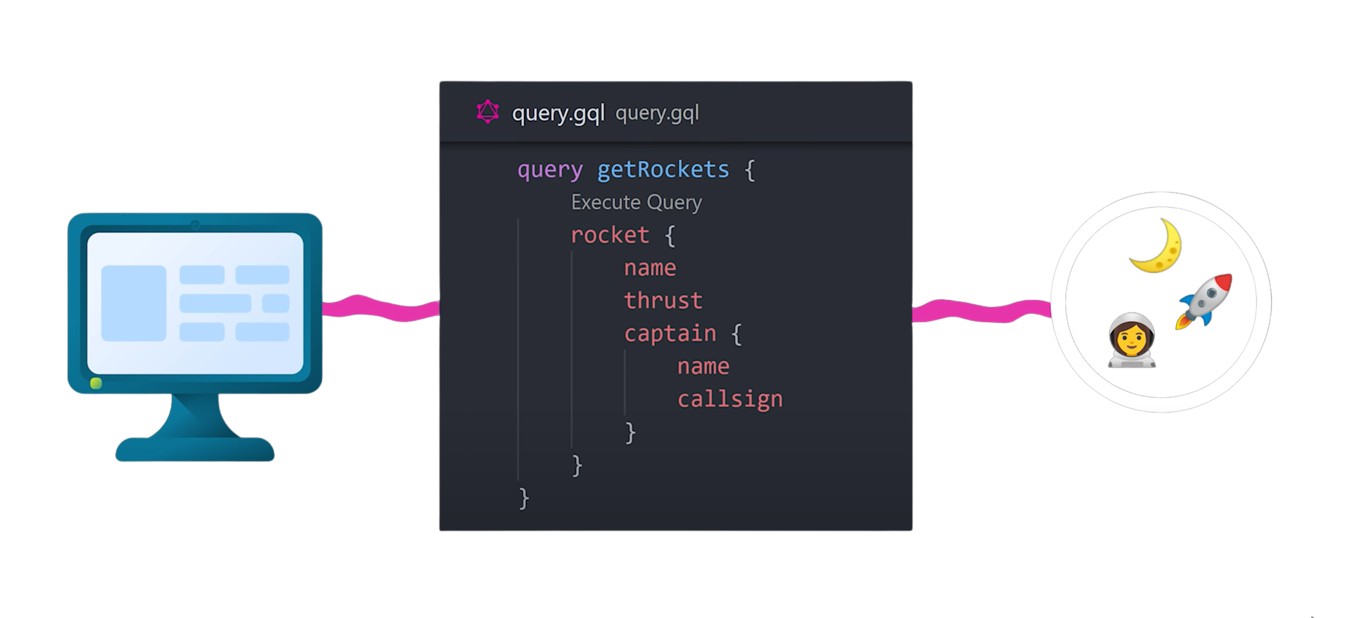

Slide 11
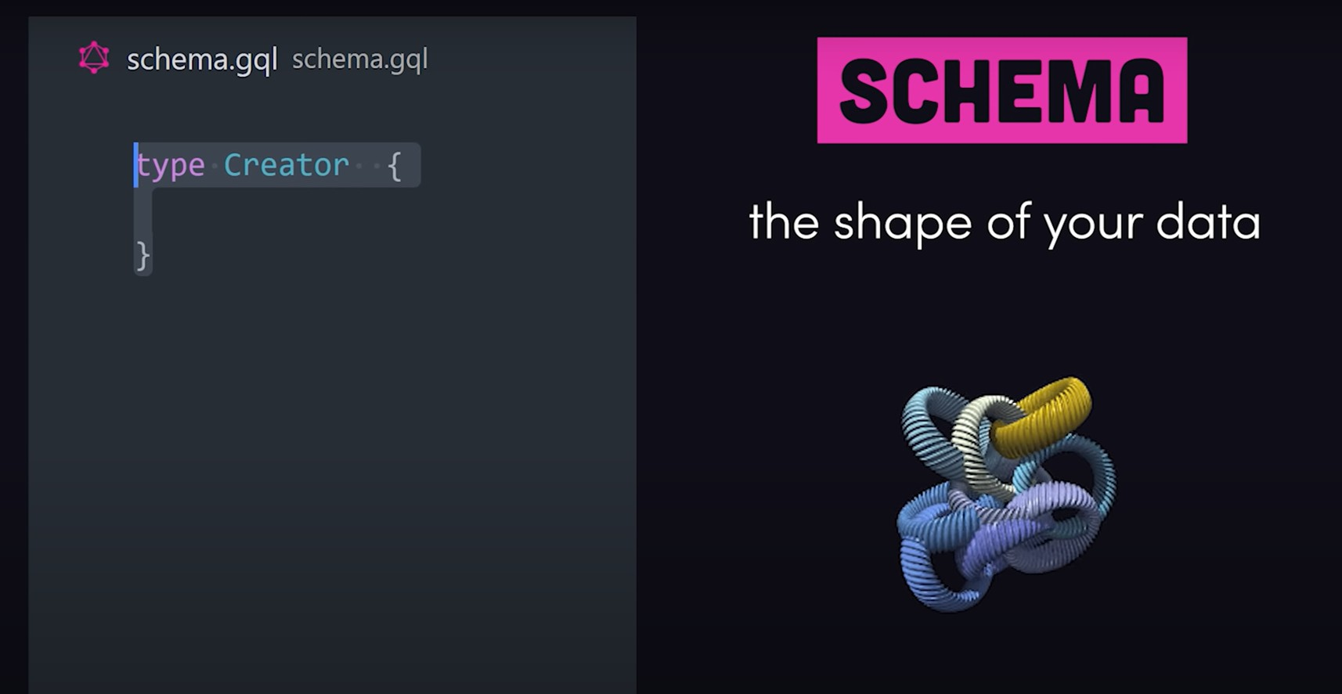

Slide 12
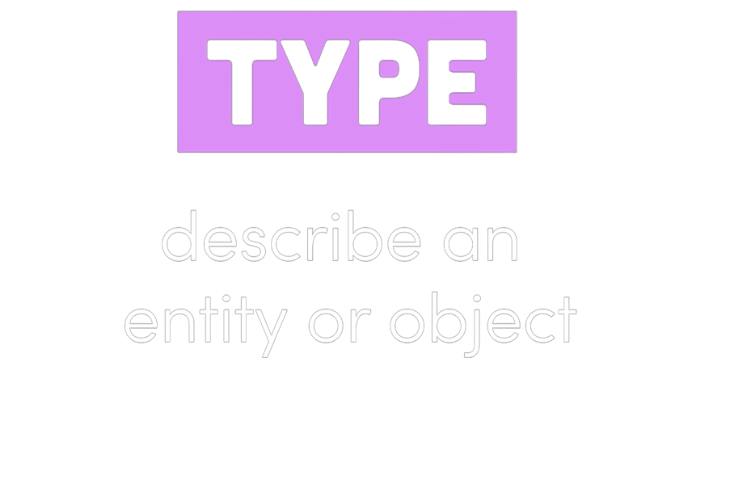
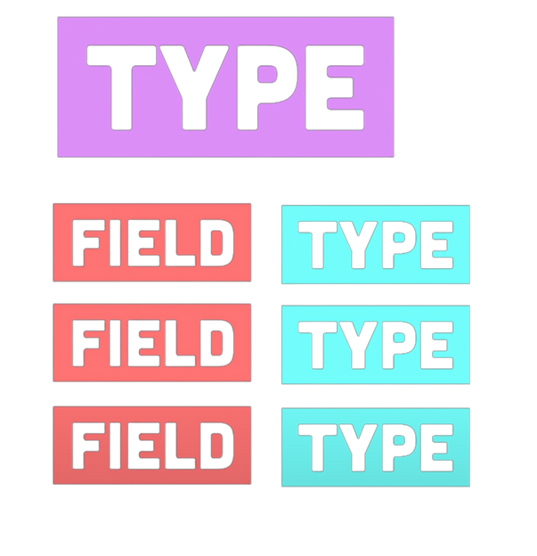
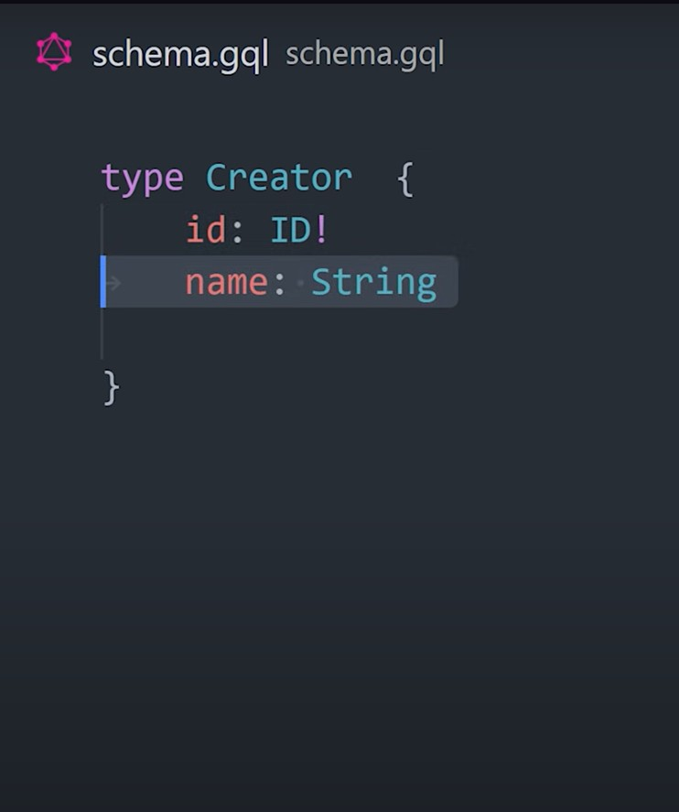

Slide 13
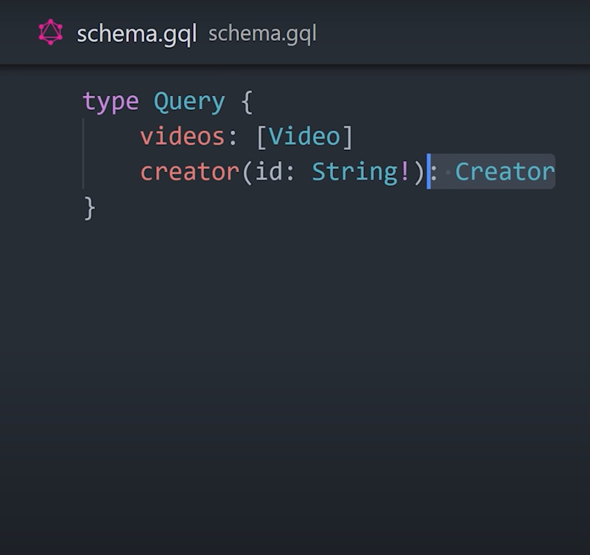


entry point to
read data

Slide 14
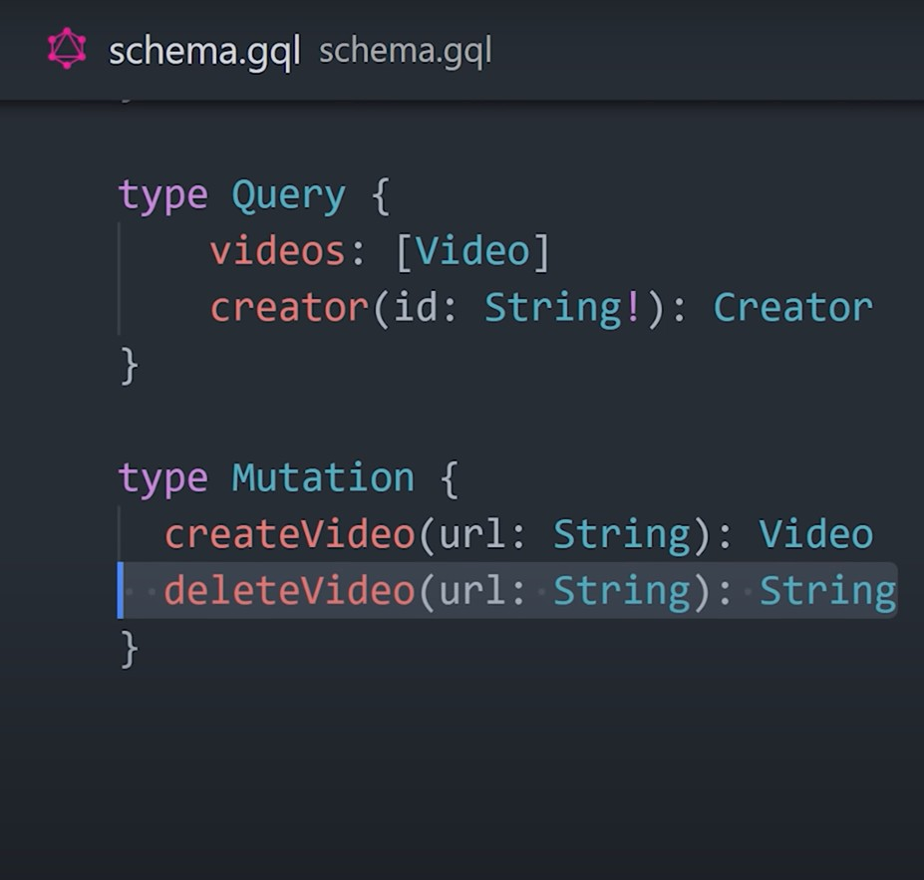


entry point to
Write data

Slide 15
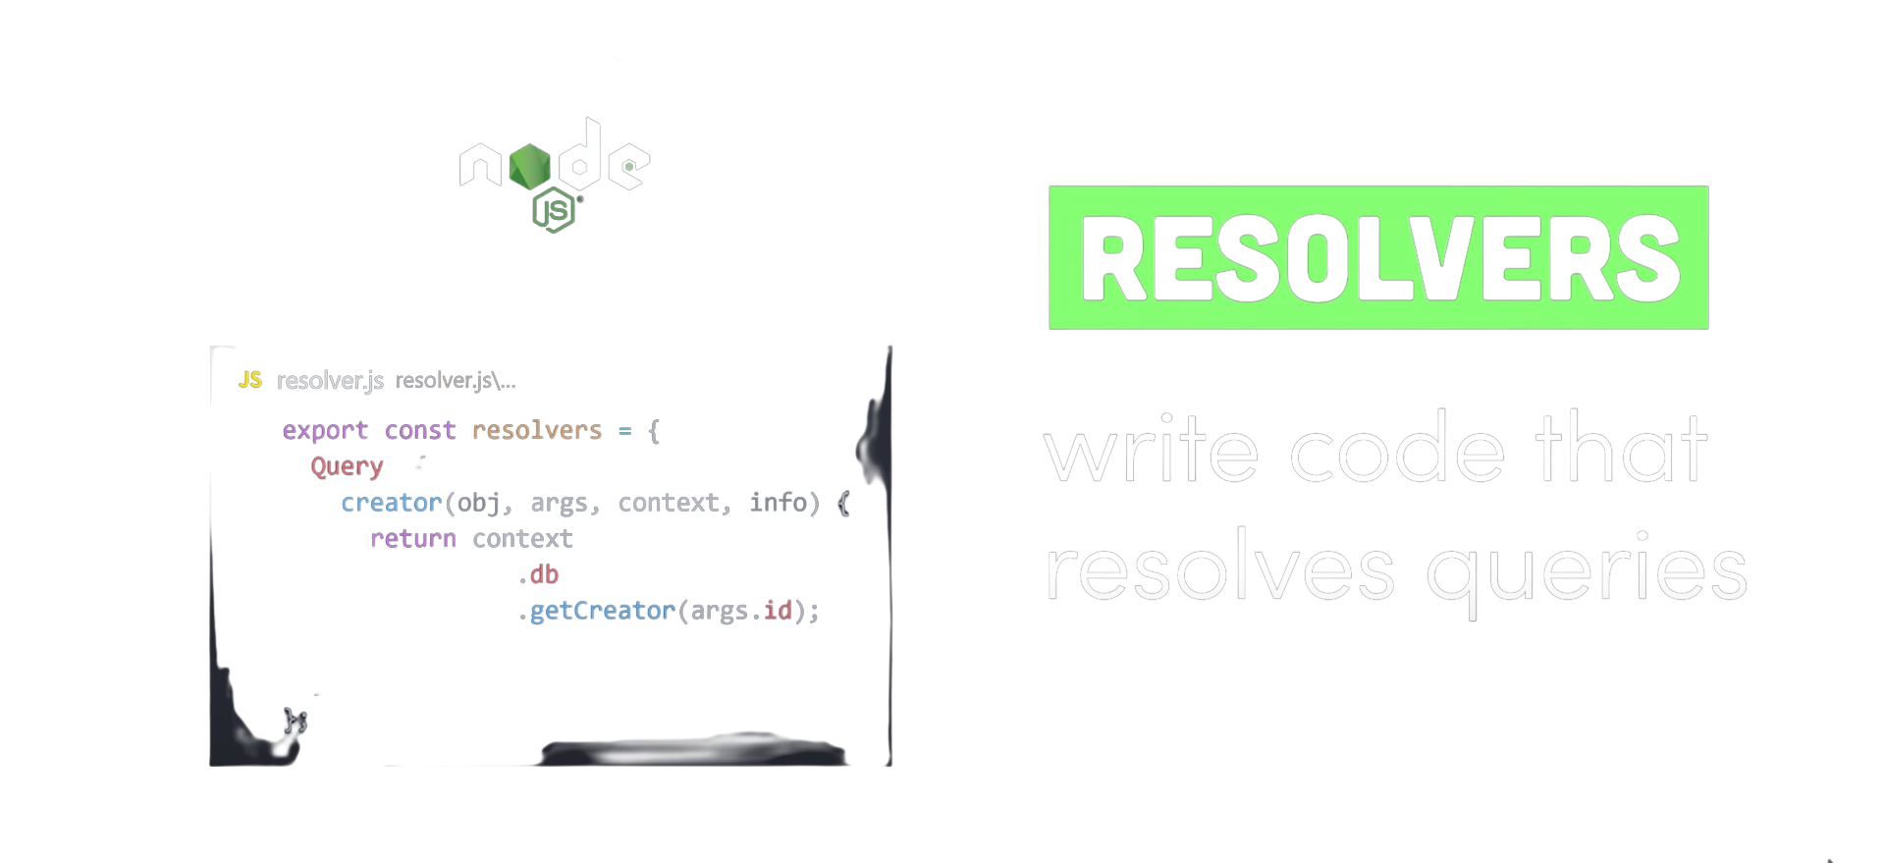
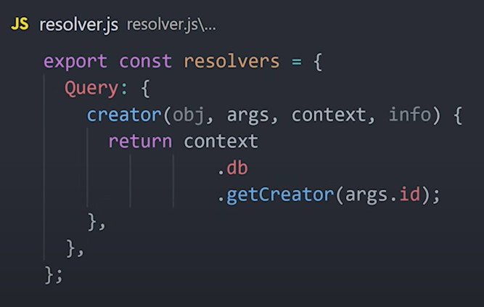

Slide 16



