Slide 1



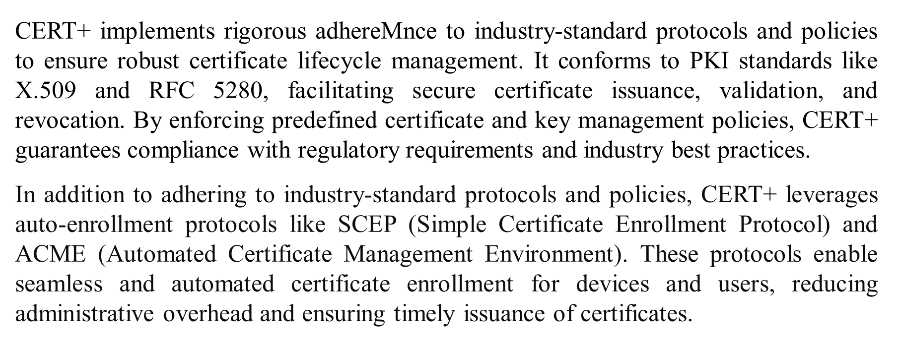
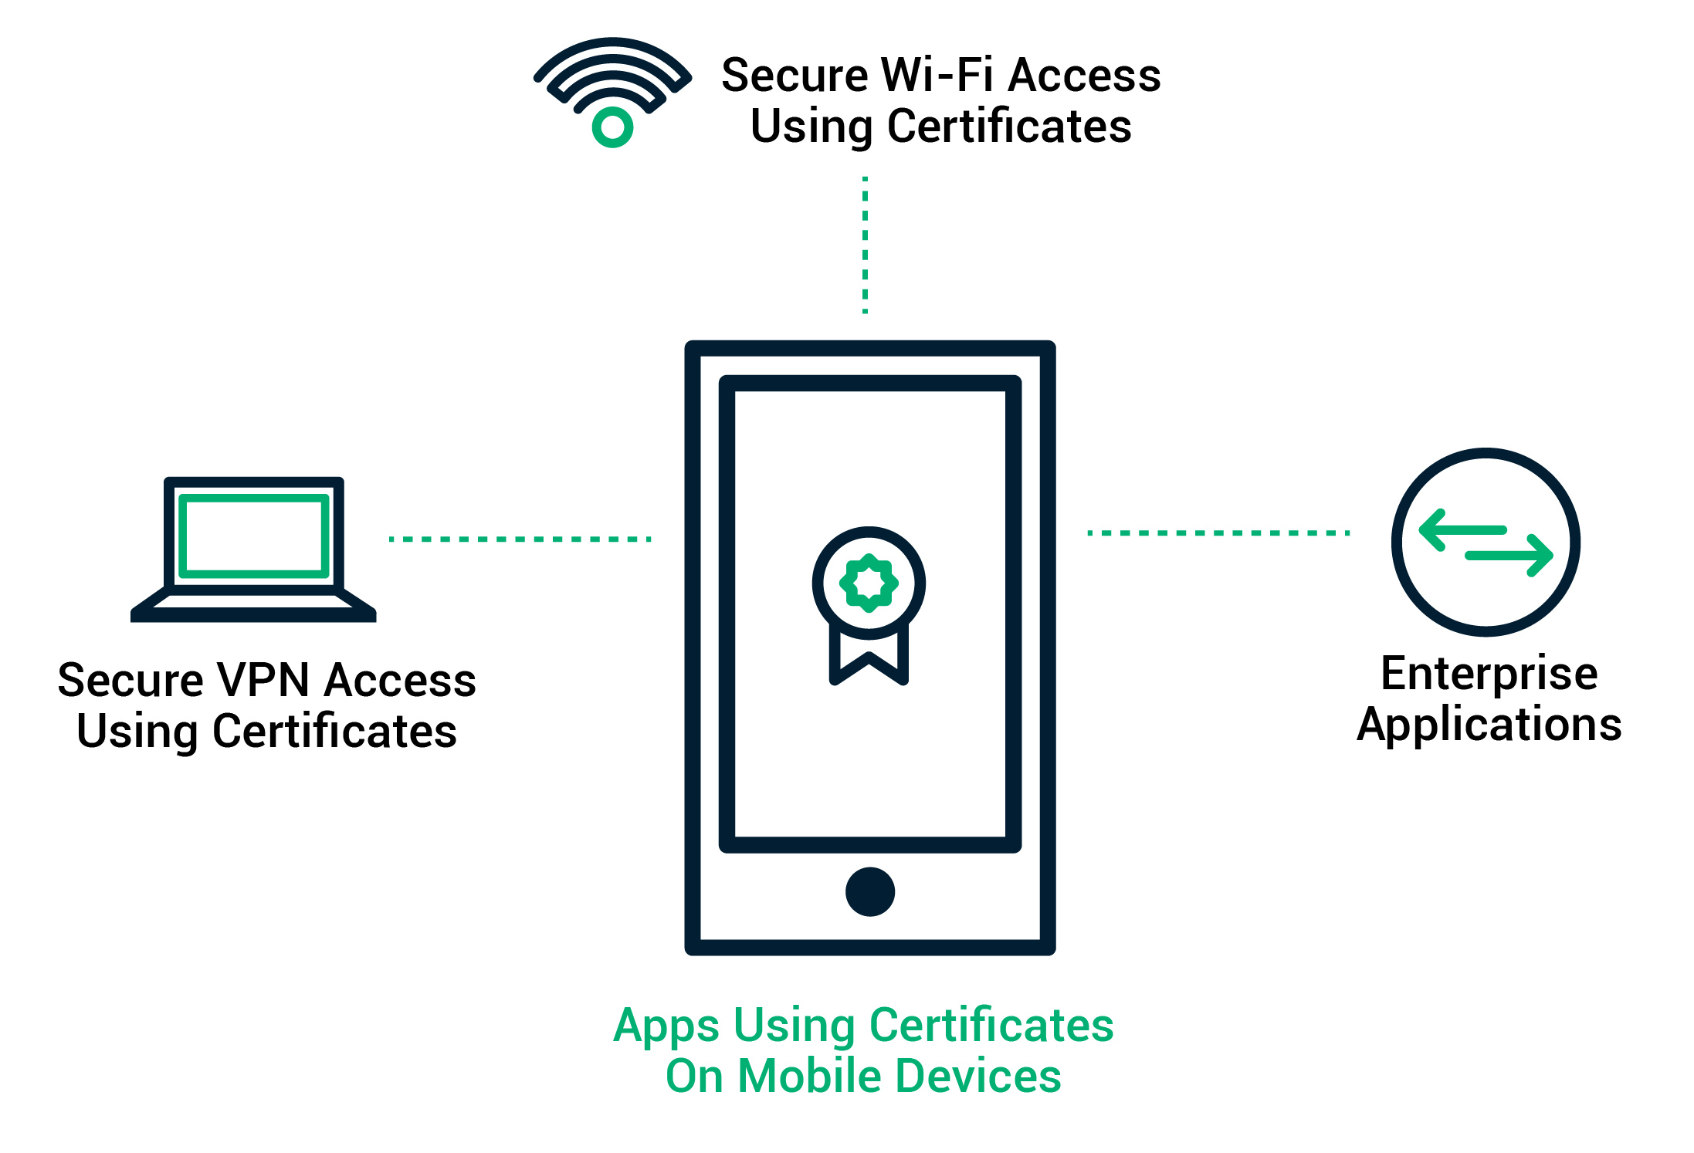
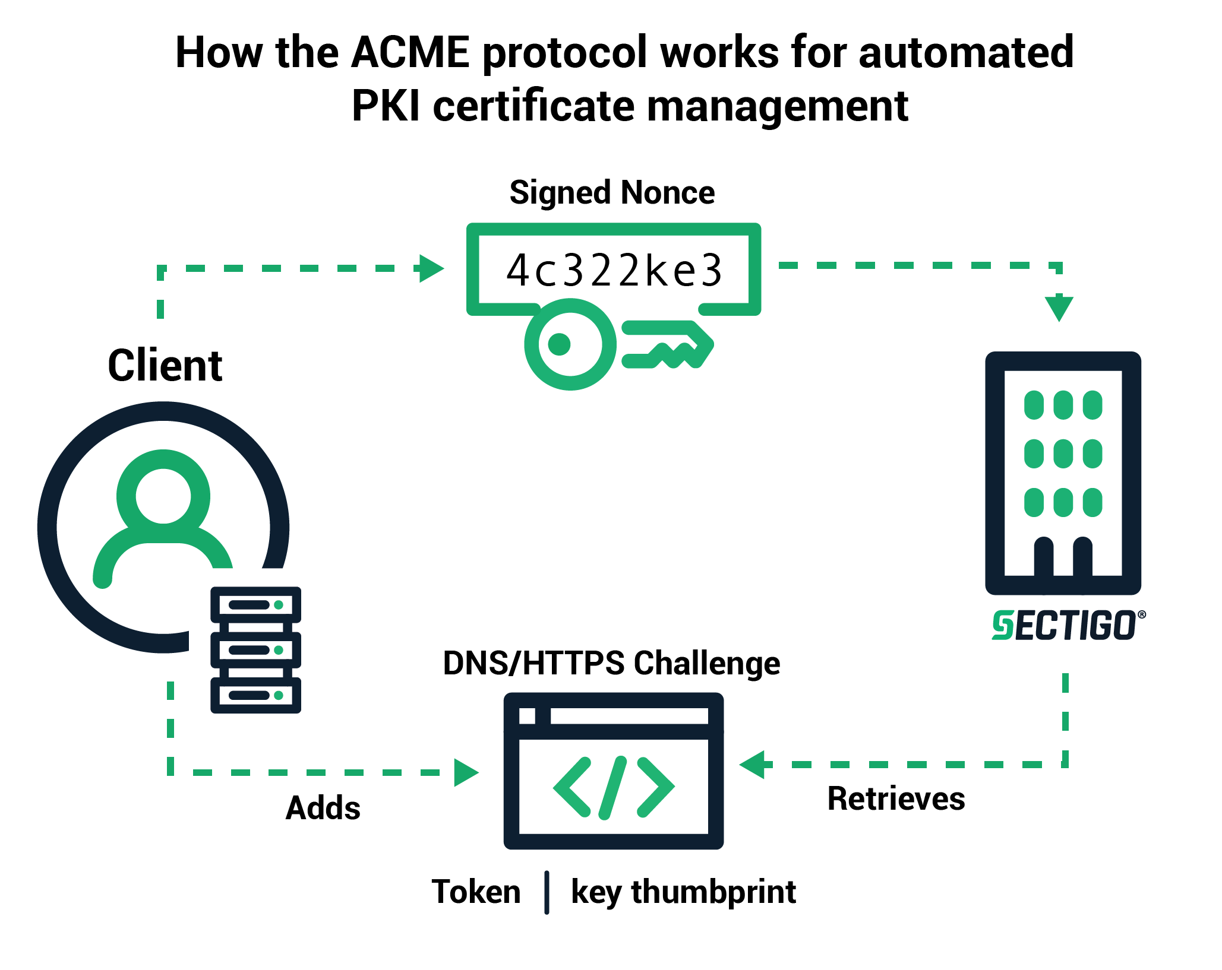
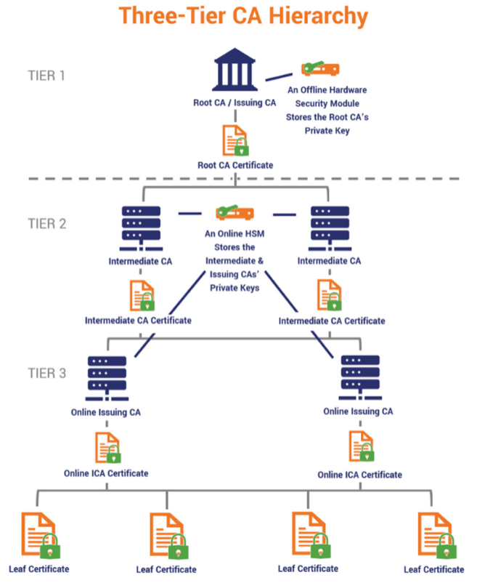
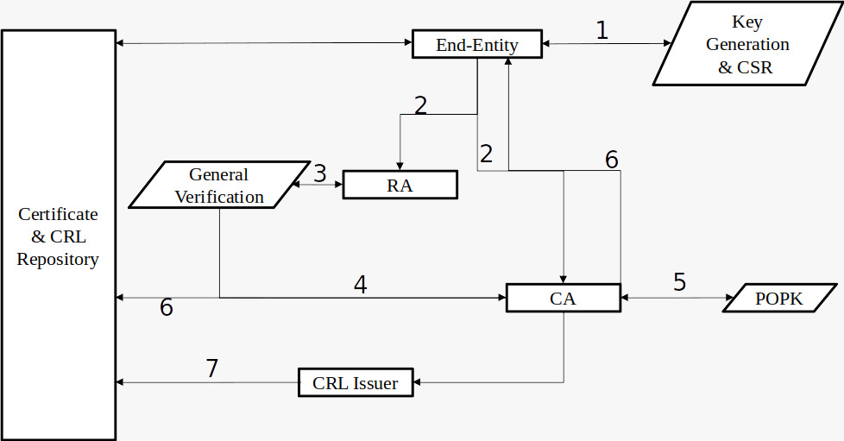
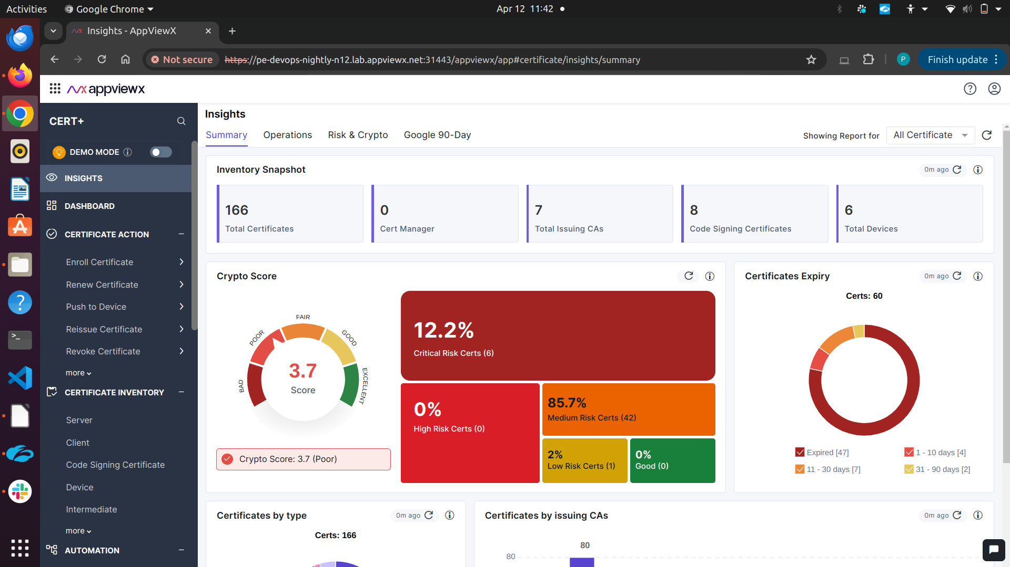
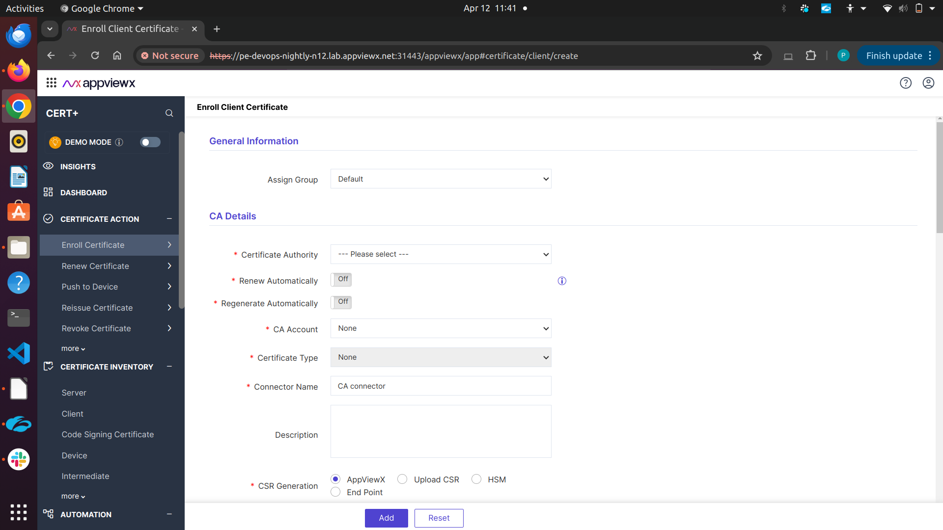
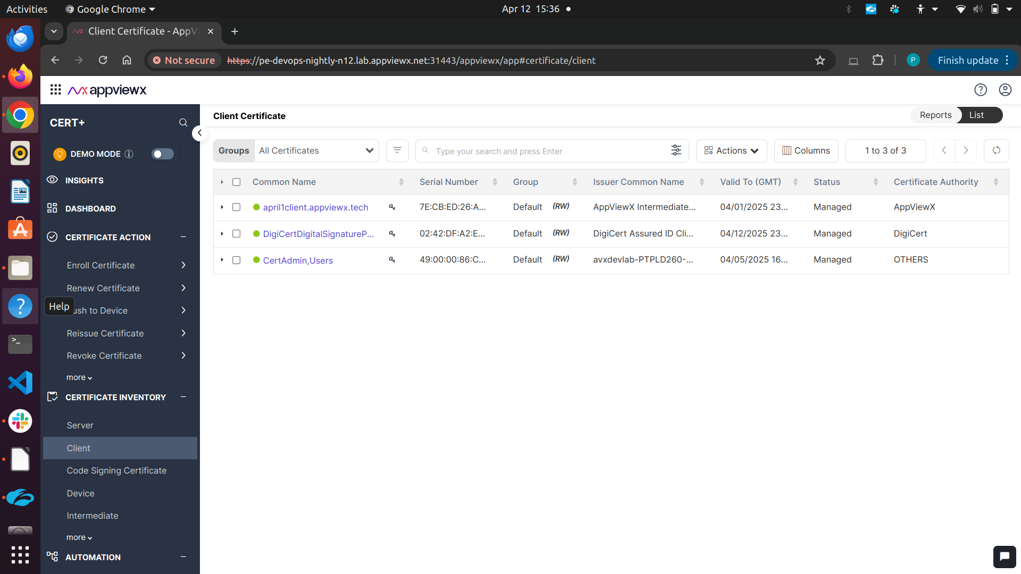
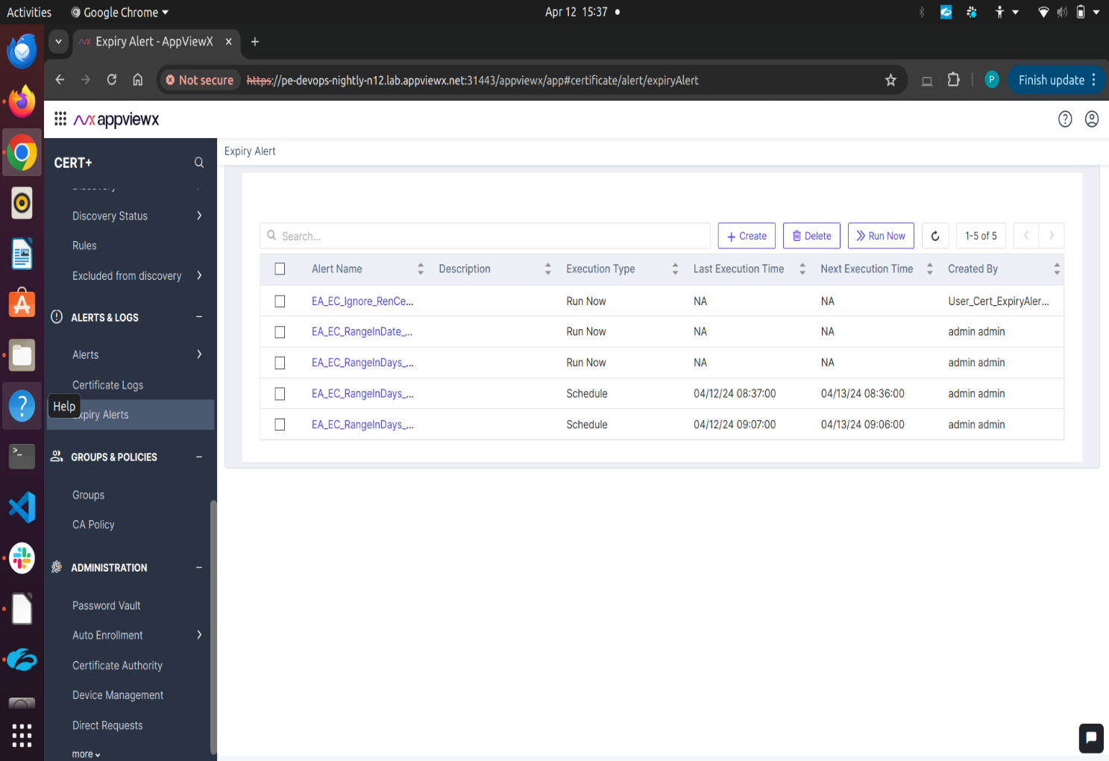
CERT+ : CERTIFICATE LIFECYCLE MANAGEMENT
Department of Information Technology Batch: (2020-2024)
School of Computing
1156IT701-MAJOR PROJECT
INTERNSHIP THROUGH DIND/PLACEMENT/ABROAD
APPVIEWX PRIVATE LTD
WINTER SEMESTER 2023-2024
ABSTRACT
INTRODUCTION
STANDARDS AND POLICIES
CERT+ is designed to address the complexities of modern cybersecurity with a focus on efficient and scalable certificate lifecycle management (CLM). By employing robust algorithms such as RSA and Elliptic Curve Cryptography (ECC), CERT+ ensures secure encryption and authentication of digital certificates. The integration of various Certificate Authorities (CAs) enables organizations to manage and validate certificates across diverse environments, whether on-premises or in the cloud.
Furthermore, CERT+ offers seamless synchronization of certificate operations, creating a cohesive CryptoMesh that centralizes control and oversight. This innovative approach streamlines the automation of certificate lifecycles, reducing manual errors and improving operational efficiency. Auto-enrollment protocols like Simple Certificate Enrollment Protocol (SCEP) and Automated Certificate Management Environment (ACME) facilitate the smooth issuance and renewal of certificates, enhancing the security posture of organizations.
In addition to its core functionalities, CERT+ places a strong emphasis on addressing emerging technologies’ security challenges. With features tailored for containers,
Internet of Things (IoT), and DevOps environments, CERT+ enables organizations to adapt to evolving IT landscapes while maintaining a dynamic and secure crypto-agility strategy.
Keywords: CERT+, CLM, CAs, IoT, RSA, ECC, SCEP, ACME, Encryption, CryptoMesh
In today’s digital landscape, the secure management of machine and application identities is a critical aspect of any organization’s cybersecurity strategy. With the increasing complexity of IT environments, there arises a need for efficient and scalable solutions to manage certificate lifecycles effectively. CERT+ addresses this challenge by offering a ready-to-consume solution that streamlines the automation and management of certificates, ensuring a robust and secure infrastructure.
The CERT+ project aims to revolutionize Certificate Lifecycle Management (CLM) by providing a comprehensive solution for managing machine and application identities securely. The project focuses on improving the existing system, proposing a robust system, and conducting a feasibility study to ensure the viability of the proposed solution.
CERTIFICATE SIGNING AND DEPLOYMENT
This module handles the critical processes of certificate signing and deployment following the validation of certificate requests. The system orchestrates the following steps:
Certificate Authority Selection
Certificate Signing
Deployment to Target System
CERTIFICATE REQUEST AND VALIDATION
Module 4, ”Certificate Lifecycle Monitoring,” plays a crucial role in ensuring the continuous integrity and security of certificates throughout their lifecycle. This module encompasses the following key functionalities:
Expiration & Revocation Tracking
Automated Renewal
Authorities Involved
METHODOLOGIES
RESULTS
The CERT+ project delivers a robust certificate management system. Users can enroll new client certificates for authentication, renew existing ones for ongoing security, and revoke compromised certificates. A centralized inventory tracks all certificates with details like issuer and validity. Proactive expiry alerts prevent service disruptions. A potential dashboard offers a visual summary of certificate health, including distribution and security strength.
Figure 7. SCME Block diagram
Figure 8. ACME Block Diagram.
CONCLUSIONS
In conclusion, the CERT+ project marks a significant advancement in certificate lifecycle management, offering automation, efficiency, and security. By streamlining processes such as certificate request submission, validation, signing, and deployment, CERT+ has greatly reduced manual effort and minimized the potential for errors. Its centralized control and scalability ensure effective management of certificates across diverse environments, enhancing overall organizational security posture.
Figure 1. General Architecture Diagram of CERT+
Figure 2. Datflow diagram of CERT+
TEAM MEMBER DETAILS
KEY GENERATION
This module is responsible for generating cryptographic keys used in the certificate
lifecycle. The system offers various options for key generation, including:
HSM
Key-Vaults
CERTIFICATE REQUEST AND VALIDATION
This module handles the initial step of the certificate lifecycle. When a user sub-
mits a certificate request through the CERT+ user interface, the system performs the
following:
Certificate Request Submission
Validation
Figure 3. Certificate Dashboard
Figure 4. Certificate Action
ACKNOWLEDGEMENT
Project Supervisor : Mrs. J. Deepa/Assistant Professor
Project supervisor Contact No : 7200186865
Project supervisor Mail ID : jdeepa@veltech.edu.in
<Student 1. VTU16998/PRASHANT KUMAR SINGH>
<Student 1. 7357205191>
<Student 1. vtu16998@veltech.edu.in>
Figure 5. Certificate Inventory
Figure 6. Expiry Alert

