Slide 1

Bluestock Mutual Fund Analytics Capstone
Final Project Presentation
Prepared By: Prashant Nikhare
Data Analytics Internship
August 2026

Slide 2
Problem Statement
Mutual fund data is spread across multiple datasets.
Raw data is difficult to analyze directly.
Investors need meaningful insights for decision-making.
A complete analytics solution with dashboard was required.

Slide 3
Project Objectives
Build ETL Pipeline
Clean and Validate Data
Store Data in SQLite Database
Perform Exploratory Data Analysis
Calculate Financial Performance Metrics
Develop Interactive Power BI Dashboard
Build Recommendation System

Slide 4
Data Sources
Dataset | Description
Fund Master | Mutual fund scheme details
NAV History | Daily Net Asset Value
AUM Data | Assets Under Management
SIP Inflows | Monthly SIP investment data
Category Inflows | Category-wise fund inflows
Investor Transactions | Investor purchase and redemption details
Portfolio Holdings | Fund holdings and sector allocation
Benchmark Indices | Benchmark index performance

Slide 5
Project Architecture
Raw CSV Files
│
▼
Data Cleaning
│
▼
SQLite Database
│
▼
EDA
│
▼
Performance Analytics
│
▼
Power BI Dashboard
│
▼
Recommendation System
The project follows a complete end-to-end
data analytics pipeline from raw data ingestion to
dashboard visualization and recommendation generation.

Slide 6
ETL Process
Transform
1. Removed missing values
2. Standardized formats
3. Calculated financial metrics
Load
1. Stored processed data in SQLite
2. Prepared datasets for analysis and dashboard
Extract
1. Imported raw CSV datasets
2. Validated source files

Slide 7
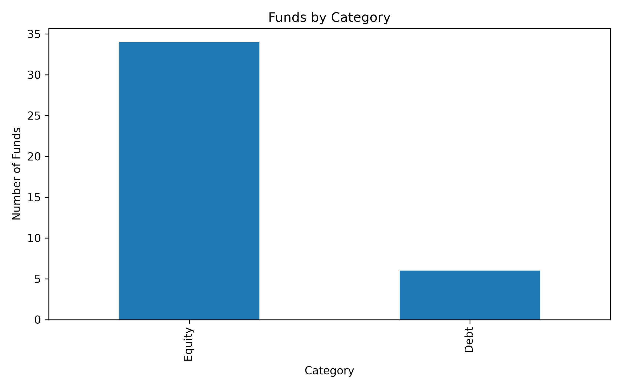
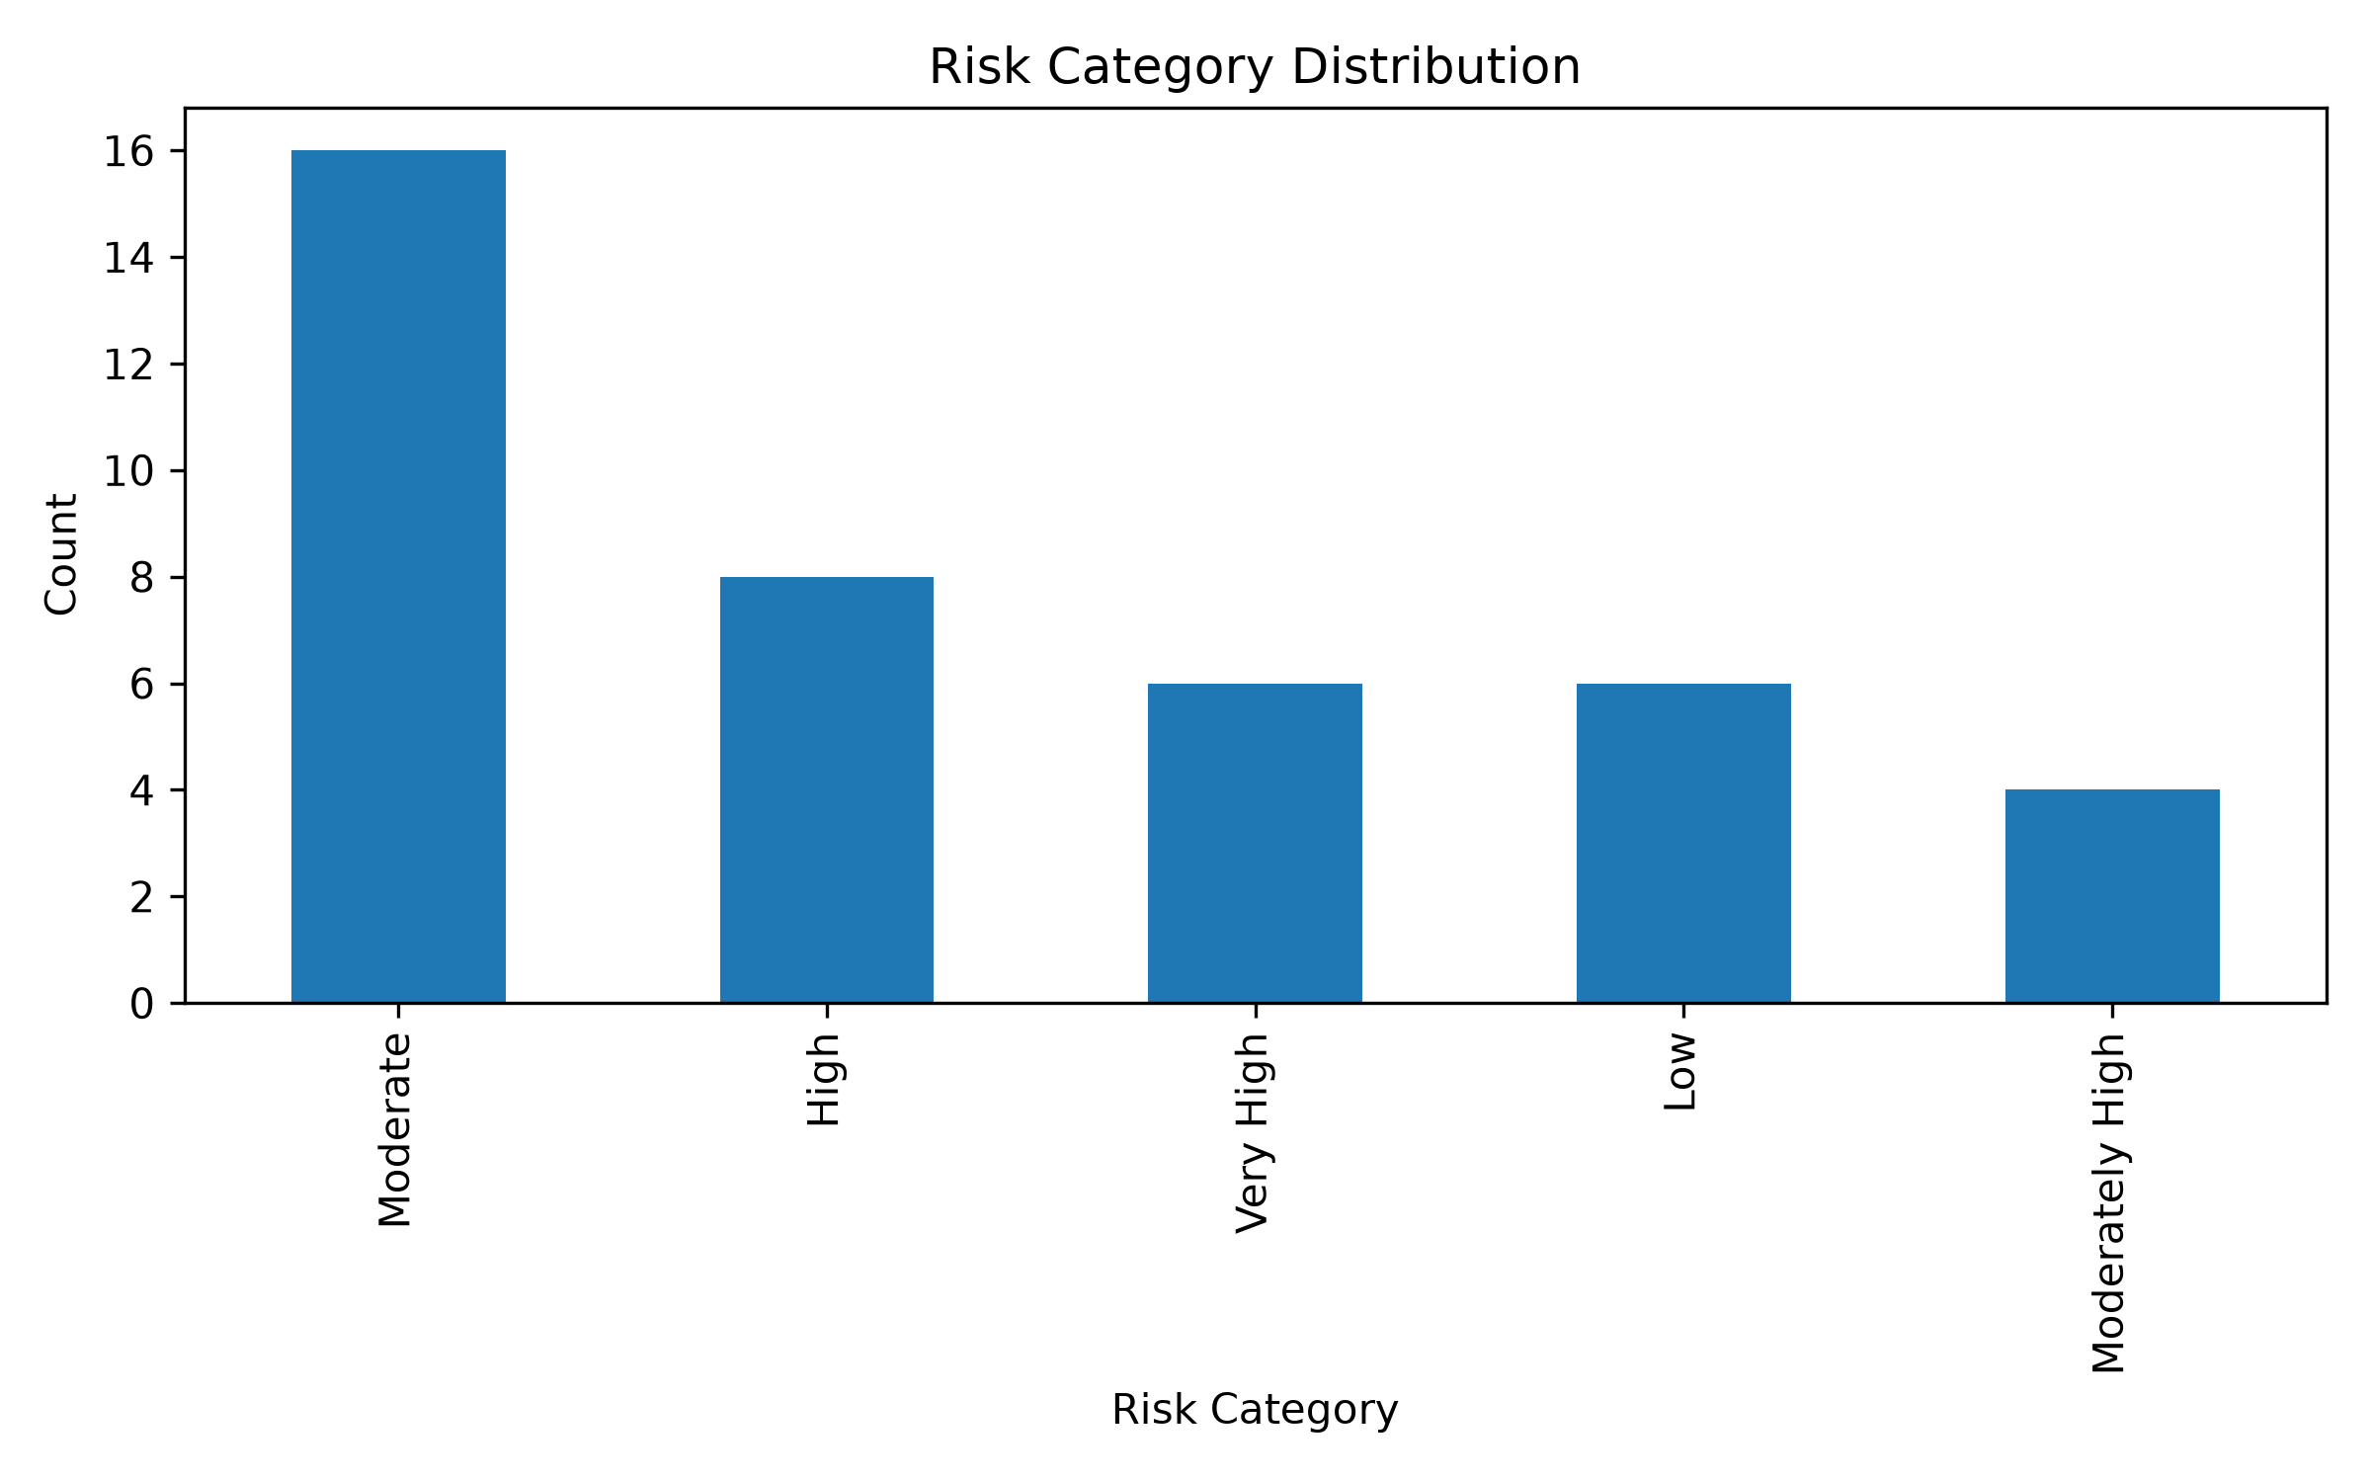
Exploratory Data Analysis (EDA)
Key Analysis Performed
Fund Category Distribution
Risk Category Distribution
NAV Trend Analysis
Investor Transaction Analysis
SIP Flow Analysis
Key Insights
Equity funds have the highest number of schemes.
Most schemes fall under the High and Very High risk categories.
Investor activity is concentrated in equity-oriented funds.

Slide 8
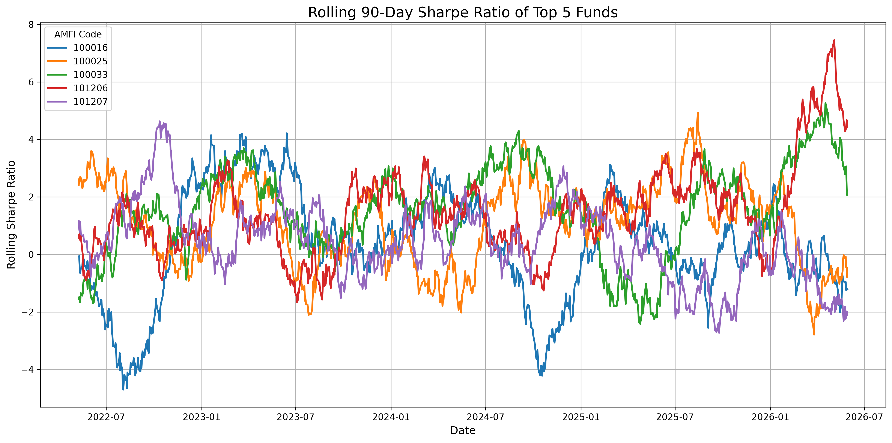
Financial Performance Analytics
Metrics Calculated
CAGR
Annualized Return
Annualized Volatility
Sharpe Ratio
Sortino Ratio
Maximum Drawdown
Alpha
Beta
Tracking Error
VaR & CVaR
Key Findings
Large-cap funds showed stable performance.
Some funds generated higher risk-adjusted returns.
Performance varied significantly across categories.

Slide 9
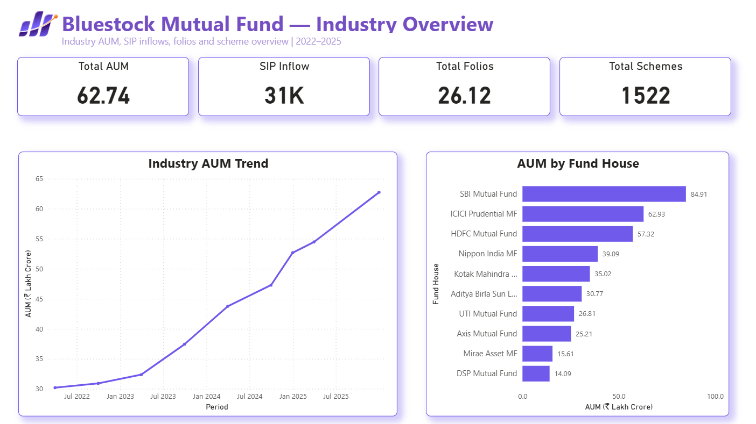
Interactive Dashboard
Features
KPI Cards
Filters
Interactive Charts
Fund Comparison
Category Analysis
Insight
The dashboard provides an interactive view of mutual fund performance and investor trends.

Slide 10
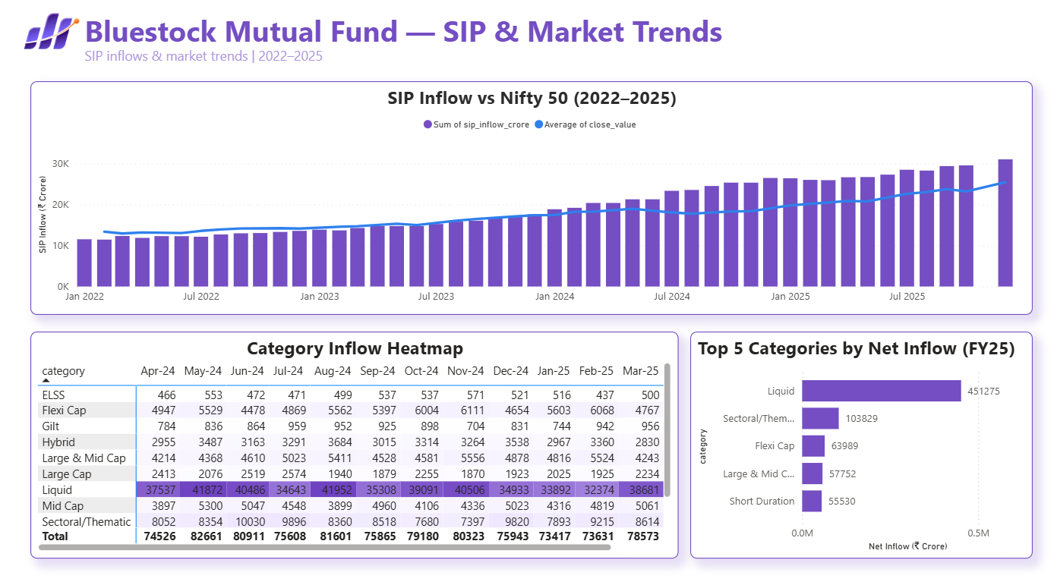
Dashboard Insights
Key Insights
Equity funds dominated investments.
SIP inflows showed consistent growth.
Risk categories influenced fund selection.
Large-cap funds attracted more investors.
Portfolio allocation varied across schemes.

Slide 11
Advanced Analytics
Techniques Implemented
Historical Value at Risk (VaR)
Conditional Value at Risk (CVaR)
Rolling Sharpe Ratio
Cohort Analysis
Portfolio Concentration (HHI)
Mutual Fund Recommendation System
Key Insights
Historical VaR and CVaR were used to estimate downside risk.
Rolling Sharpe Ratio tracked risk-adjusted performance over time.
HHI measured portfolio diversification across schemes.
Recommendation system suggested funds based on investor risk preference.

Slide 12
Conclusion & Future Scope
Project Outcomes
Successfully developed an end-to-end Mutual Fund Analytics solution.
Built an automated ETL pipeline using Python.
Stored processed data in SQLite database.
Performed EDA and financial performance analysis.
Developed an interactive Power BI dashboard.
Implemented advanced analytics including VaR, CVaR, Rolling Sharpe Ratio, HHI, and Cohort Analysis.
Created a mutual fund recommendation system based on risk category.
Business Value
Improved fund performance analysis.
Simplified investor decision-making.
Automated data processing workflow.
Delivered interactive business dashboards.

Slide 13
Thank You
Prepared by:
Prashant Nikhare

