Slide 1
Data Science
DSC 500-T301, Introduction to Data Science
Prashant Raghuwanshi

Slide 2
Outline
Data
Data Generation
Data Science
Evolution of Data Science
Data Science Vs traditional Reporting
Data Scientists

Slide 3
Data
Data is a collection of facts, such as numbers, words, measurements, observations or just descriptions of things.
As per the famous Mathematician “Clive Humby”
“Data is the new oil. Like oil, data is valuable, but if unrefined it cannot really be used. It has to be changed into gas, plastic, chemicals, etc. to create a valuable entity that drives profitable activity. so, must data be broken down, analyzed for it to have value.”

Slide 4
Data Genaration
Big Data
Applications, Web, Social Media
Images/Audio, Surveys
Devices, Sensors
Notes:
The below is a list of some common ways data is generated:
Applications – ex Face book or the computer system(s) you use at organizations (ex walmart sales transaction data)..
Sensors –Example car sensors, it has all kinds of sensors – gas, blind spots, back up cameras – every time you do something in your car, it is being logged. You don’t have to manually key in that you put gas in your car – but the sensor is logging this information so that auto manufactures know what you are doing, when you are doing it and use the information to improve their products.
Devices –Example phone data generation
Surveys – This type of data collection is when someone asks you to answer a question or they send you a survey and you fill it out – more manual in nature.
Images/Audio – Example images and audio data even in these forms of media. We can analyze the date and figure out the sentiments.
Big Data – collection of all above source of data and stored it in a system for analyzing

Slide 5
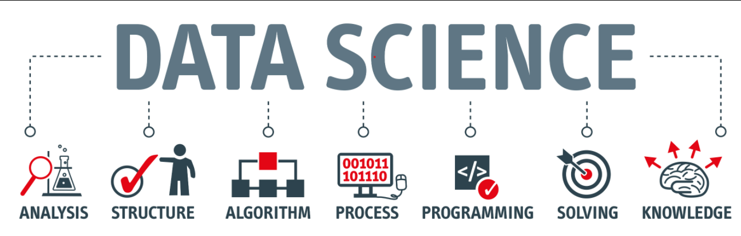
Data Science
Data Science is the Art of finding unknown business questions and their answers by analyzing the different data sources and using the data-driven decision-making process.

Slide 6
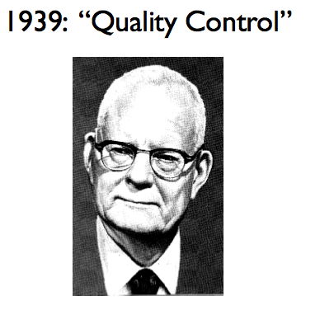
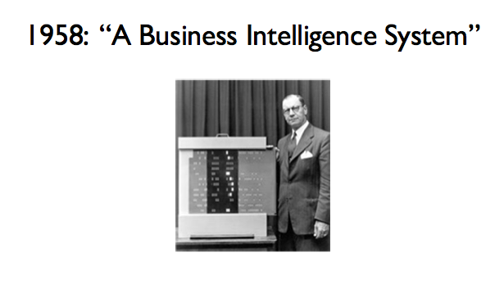
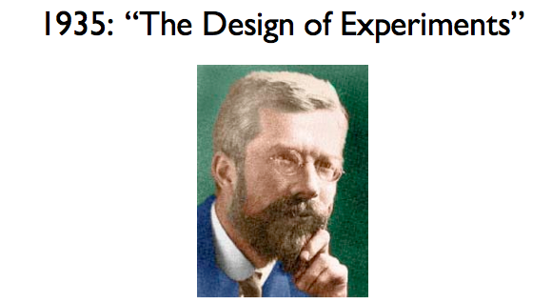
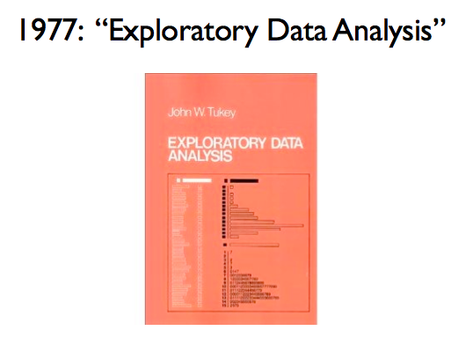
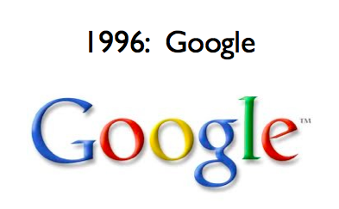
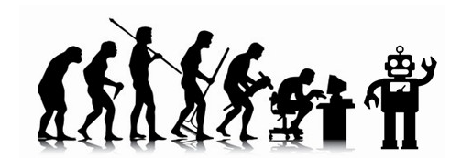
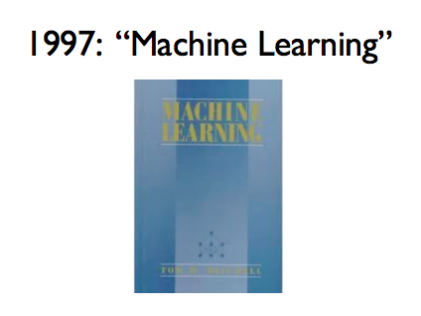
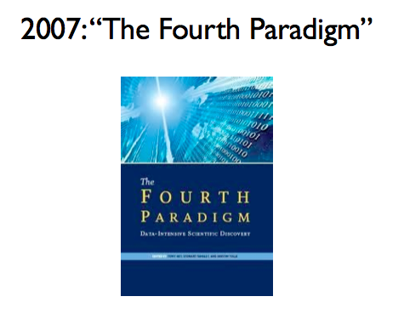
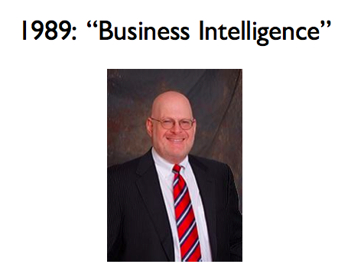
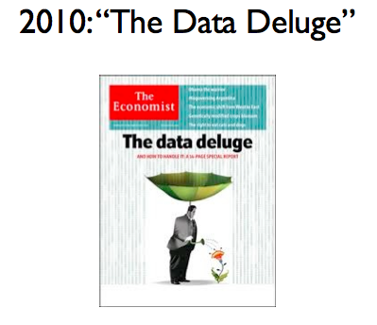
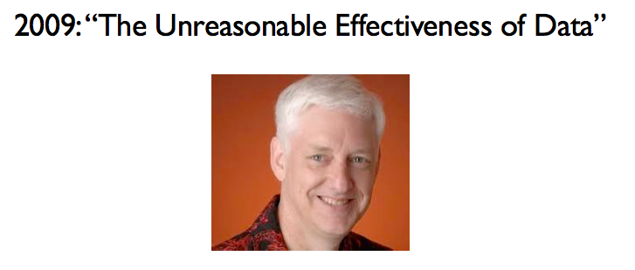
Evolution of Data Science
R.A. Fisher
W.E. Deming
Peter Luhn
Howard
Dresner
Notes:
Fisher: ANOVA (analysis of variance: a collection of statistical models, used to analyze the differences among group means and their associated procedures (such as "variation" among and between groups)), Fisher’s exact test.
Also credited with quote “correlation does not imply causation” – lifetime pipe smoker, he derided papers showing a link between smoking and cancer.
Deming – quality control – statistical sampling
Luhn – indexing, IR principles – use text and data to inform Business Decisions
Tukey – exploratory data analsysis – led to S, S+ and R
Howard Dresner – modern proponent of BI
Tom Mitchell’s ML book – still a best-seller
Fourth Paradigm – data driven scientific discovery – inspired by Jim Gray’s work at MSR. His primary research interests are in databases and transaction processing systems -- with particular focus on using computers to make scientists more productive. He and his group are working in the areas of astronomy, geography, hydrology, oceanography, biology, and health care.
Other scientific discovery paradigms: empiricism, analysis and simulation
Google Inc → alphabet Inc. Google began in January 1996 as a research project by Larry Page and Sergey Brin when they were both PhD students at Stanford University in Stanford, California.^{[33]}
Peter Norvig – simple models + lots of data > complex models
Data Deluge – exponential growth in data volume, the Economist 2010, Businesses, governments and society are only starting to tap its vast potential

Slide 7
Data Science Vs Reporting Vs Data Analytics Vs Business Intelligent -1
Reporting provides information while analytics give you insights,
Reporting raises questions while analytics attempts to answer them.
Business Intelligent focuses on the "what" and the "how" of past events, while business analytics focuses on the "why" of past events.
BI focuses on improving operations at present, while Data analytics focuses on what will happen in the future based on past and present company data.

Slide 8
Data Science Vs Reporting Vs Data Analytics Vs Business Intelligent -2
Data science lays necessary foundations and parses big datasets to create initial observations, future trends, and potential insights that can be important.
Data science asks essential questions that we were unaware of before while providing little in the way of complex answers.
By adding data analytics into the mix, we can turn those things we know we don't know into actionable insights with practical applications

Slide 9
Data Scientists
Data scientists are analytical experts who utilize their skills in both technology and social science to find trends and manage data.
They use industry knowledge, contextual understanding, skepticism of existing assumptions – to uncover solutions to business challenges.

Slide 10
Refrences
https://www.mastersindatascience.org/careers/data-scientist/
https://cyberactive.bellevue.edu/ultra/courses/_500210_1/cl/outline
https://www.kdnuggets.com/
Chapter 1 in Designing Data Science Handbook
Chapters 1-4 in Everybody Lies
What is Data Science? Quora
A Very Short History of Data Science. Forbes
Data Science vs Business Intelligence: Same but Completely Different. Toward Data Science
Data Science’s Most Used, Confused, and Abused Jargon. KD Nuggets
Data Is The New Oil -- And That's A Good Thing. Forbes

Slide 11
Thank you

