Slide 1
Term Project Milestone-2
DSC500-T301 Introduction to Data Science (2215-1)
Prashant Raghuwanshi
Bellevue University
Guided by Professor Catherine Williams

Slide 2
Outline
Background
Topics of Research
Data Gathering for Topic 1
Data Gathering for Topic 2
Data Gathering for Topic 3
Data Gathering for Topic 4
Data Gathering for Topic 5

Slide 3
Background
Data Science (DS) is the Art of finding unknown business questions and their answers by analyzing the different data sources and using the data-driven decision-making process.
This Presentation is the Part of Term End DS project Milestone -2
This presentation is focused on preparing the datasets for solving problems
Find below the end goal of Term-end project
Prepare datasets for solving problems.
Recommend appropriate data modeling techniques to test hypotheses.
Communicate data science results into answers for domain challenges.
Identify ethical considerations in dataset preparation and modeling.

Slide 4
Topics of Research
Does Weather forecasting information helps in reducing the road accidents (during winter weather)

Slide 5
Data Gathering for Topic 1- Step 1
Questions for topic 1
Do we have related blogs or articles in Google search for initial information?
Do we have winter season road accident data
How the weather temperature are correlate with accident counts
Do we have summer season road accident data
Search the public reported road accident records of specific area or city by months
Dose extreme weather impacts search trends for weather
Do we have any data related to yearly increasing vehicles counts in a road
Find the interrelations on the search for emergency care with accident data

Slide 6
Data Gathering for Question 1
Do we have related blogs or articles in Google search for initial information?
Data Collected from Google search:
https://accidenttreatmentcenters.com/surprising-winter-weather-driving-statistics/
https://www.vaisala.com/en/case/using-weather-information-reduce-accidents-and-improve-traffic-flow
https://weatherspark.com/y/14091/Average-Weather-in-Chicago-Illinois-United-States-Year-Round
Extracted below information from above pasted articles links
Over 70% of US roads are in snowy regions.
About 70% of the US population lives in snowy regions.
17% of all vehicle crashes happen in winter conditions.
1,836 people die annually due to snowy and icy pavement.
There are 156,164 crashes annually due to icy roads.
More than 1,300 people are killed in car crashes on snowy or icy roads every year.
Over 116,800 people get injured in car accidents on snowy or icy roads every year.
Every year, about 76,000 people are injured in traffic accidents during snowfall.
About 70% of accidental fatalities that occur during winter happen in cars.
800 Americans die in car crashes annually while driving in winter weather conditions.

Slide 7
Data Gathering for Question 2
Do we have winter season road accident data
https://highways.dot.gov/
Attached accident data for DEC,JAN, FEB,MARCH months (2011 to 2019)

Slide 8
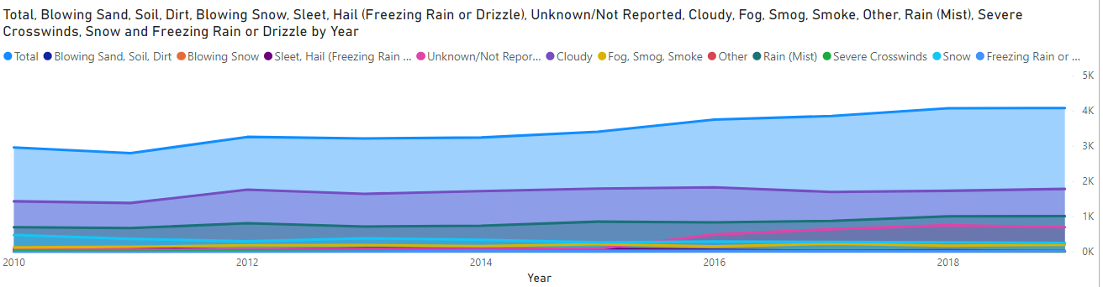
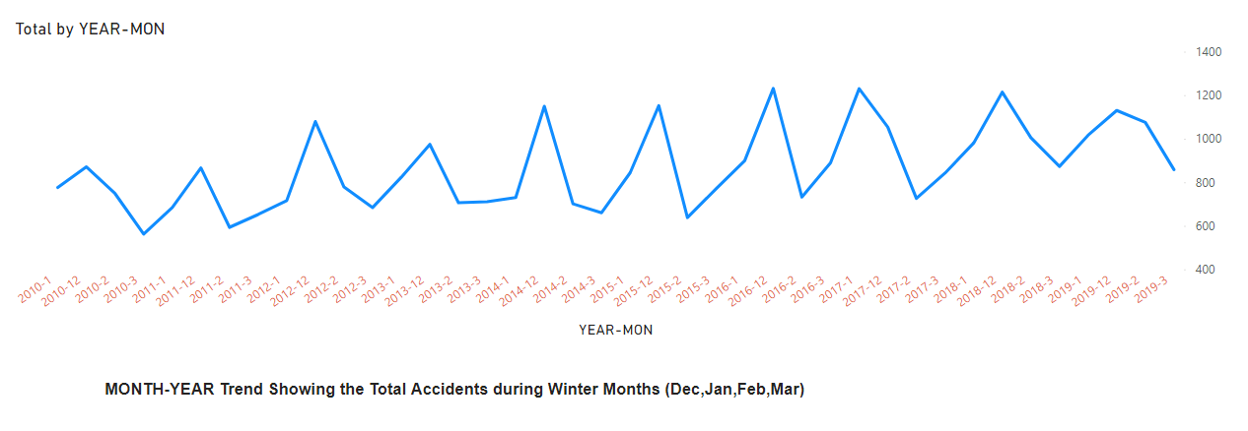
Created Visuals from accident data -1

Slide 9
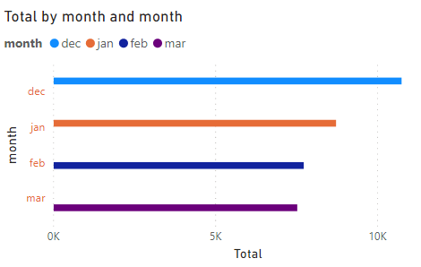
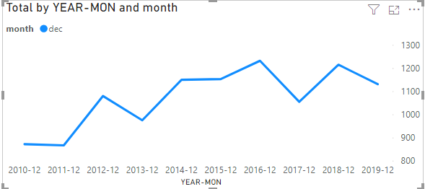
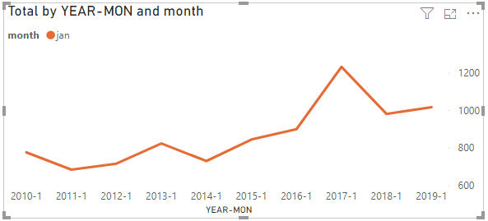
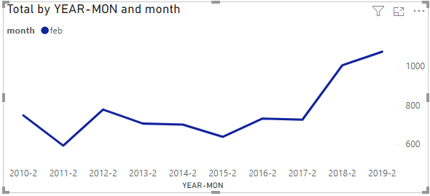
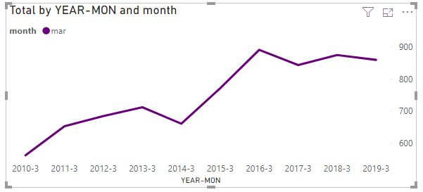
Created Visuals from accident data -2

Slide 10
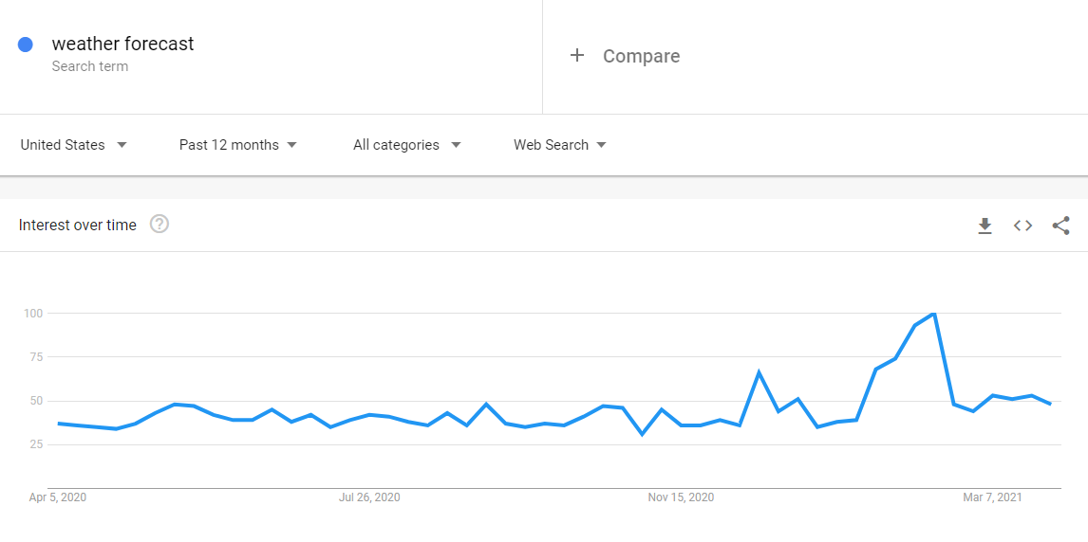
Data Gathering for Topic 1- Step 2
Data collected from Google trends

Slide 11
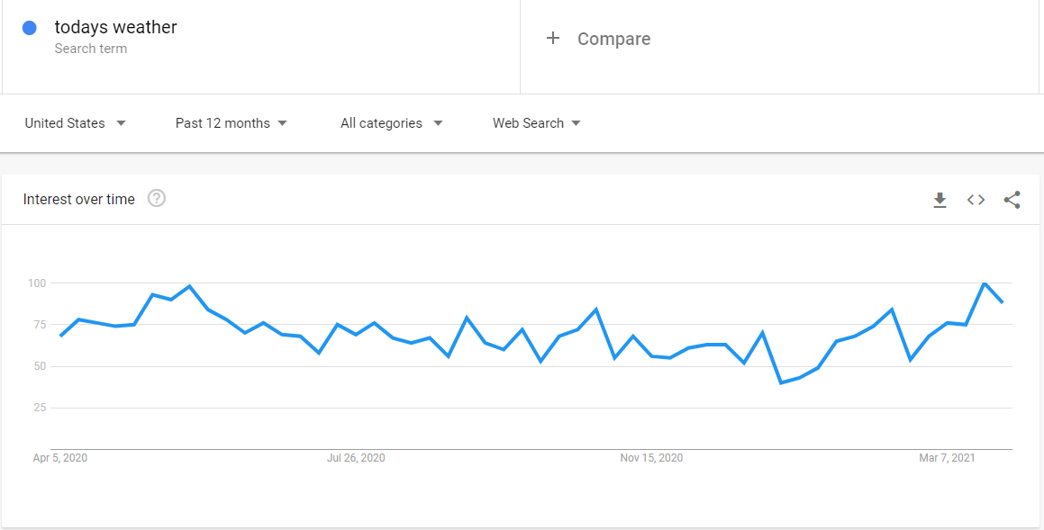
Data Gathering for Topic 1- Step 2
Data collected from Google trends

Slide 12
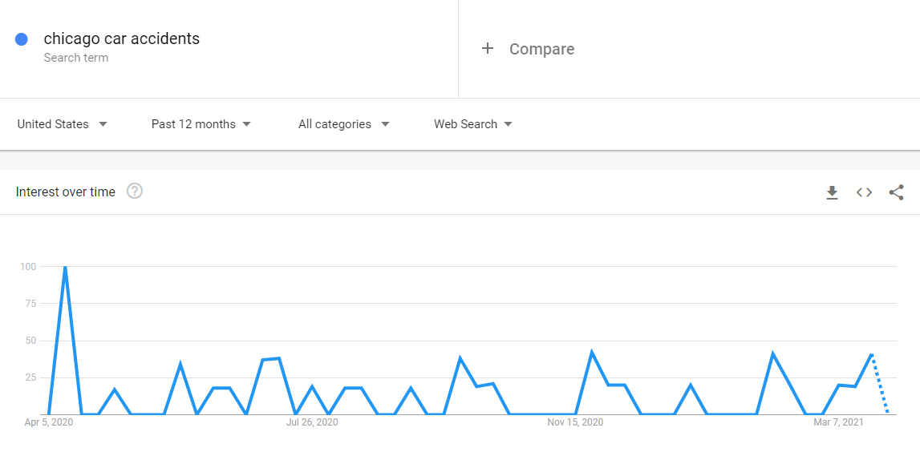
Data Gathering for Topic 1- Step 2
Data collected from Google trends

Slide 13
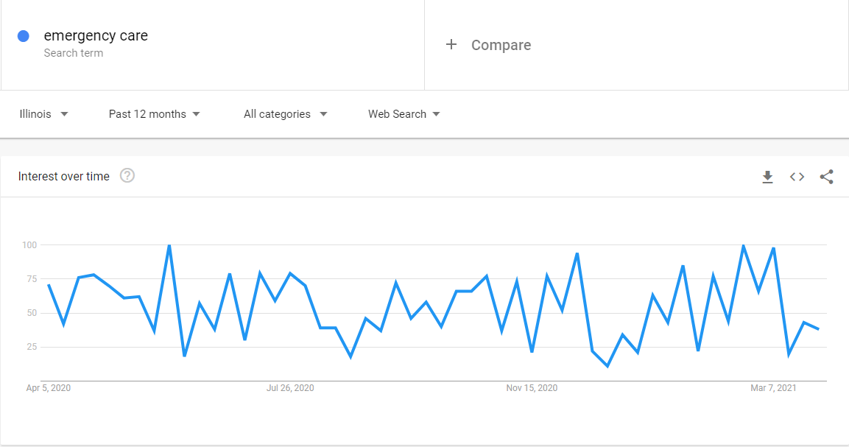
Data Gathering for Topic 1- Step 2
Data collected from Google trends

Slide 14
Data Gathering for Topic 2- Step 1
Questions for topic 2
Do parents want to send their kinder garden kid to in-person classes?
What is the trending sentiment for the kinder garden during the covid period
How trending sentiments look for covid search during that period
How trending sentiments look for handling kids or engage kids during the covid period
How trending sentiments look for kids online hobby classes
How trending sentiments look for kinder garden assignments
Trending sentiment for keywords like safe schools, a vaccine for kids
Trending search for pets near me

Slide 15
Data Gathering for Topic 2- Step 2
Data Collected from Google search:
https://wamu.org/story/21/02/04/how-five-families-decided-to-send-their-children-back-for-in-person-learning-or-not/
https://washingtonstatewire.com/poll-2-3rds-of-parents-likely-to-send-their-children-to-school-if-schools-re-open-for-in-class-learning/
https://labblog.uofmhealth.org/rounds/13-of-parents-3-states-may-not-send-children-to-school-because-of-covid-19
https://kidshealth.org/en/parents/coronavirus-school.html

Slide 16
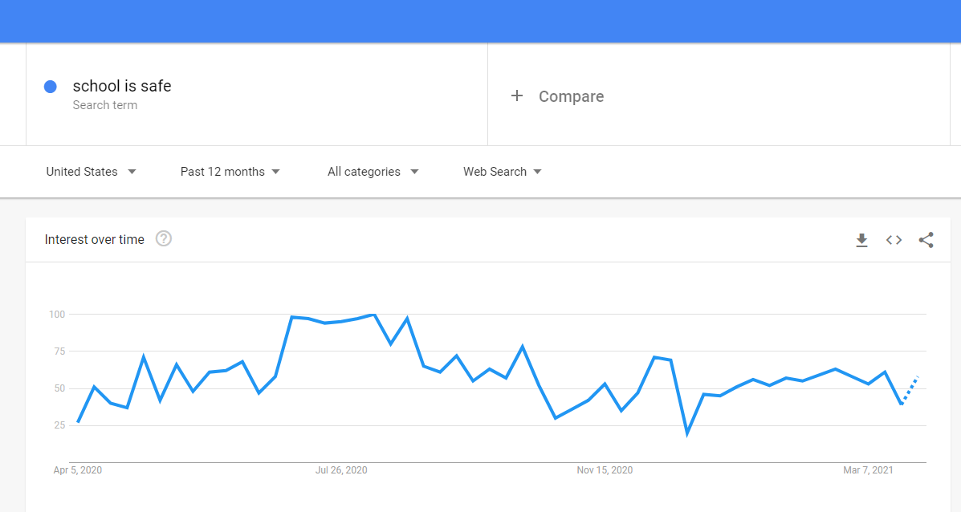
Data Gathering for Topic 2- Step 2
Data Collected from Google Trends:

Slide 17
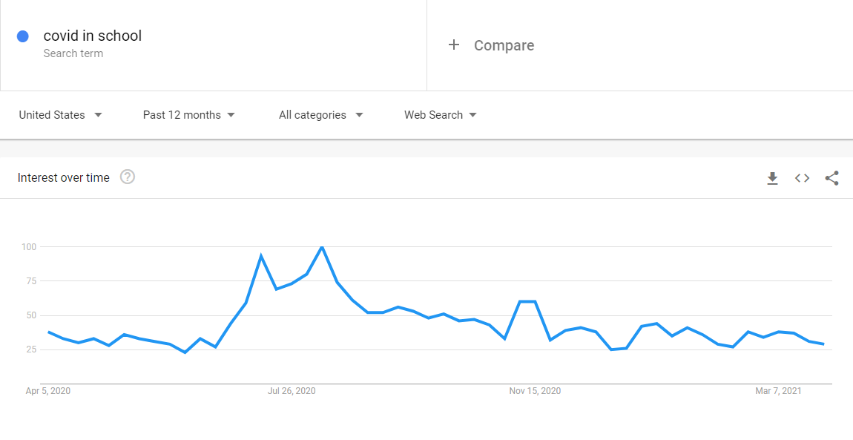
Data Gathering for Topic 2- Step 2
Data Collected from Google Trends:

Slide 18
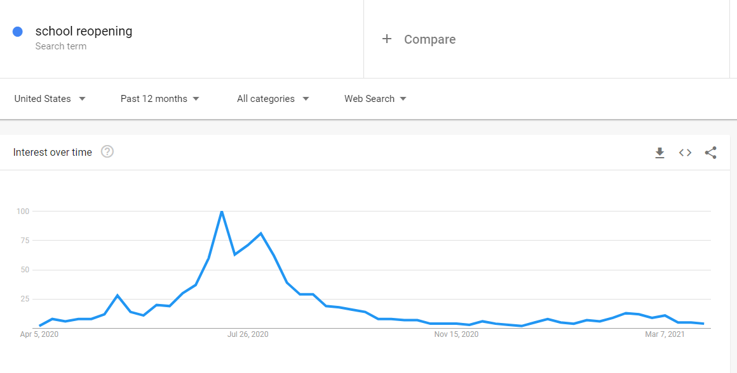
Data Gathering for Topic 2- Step 2
Data Collected from Google Trends:

Slide 19
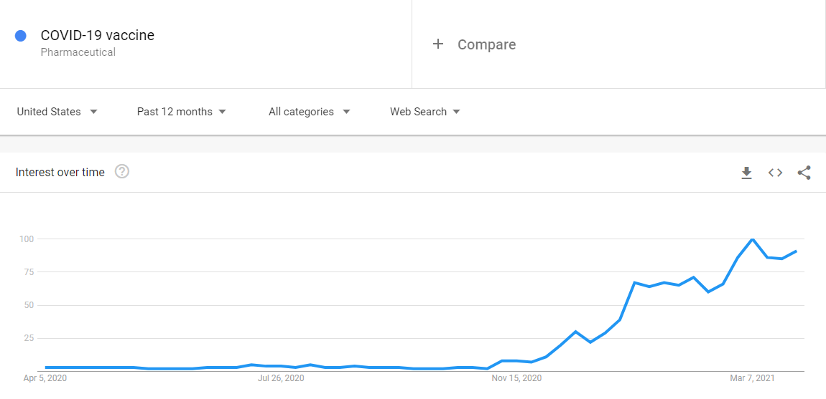
Data Gathering for Topic 2- Step 2
Data Collected from Google Trends:

Slide 20
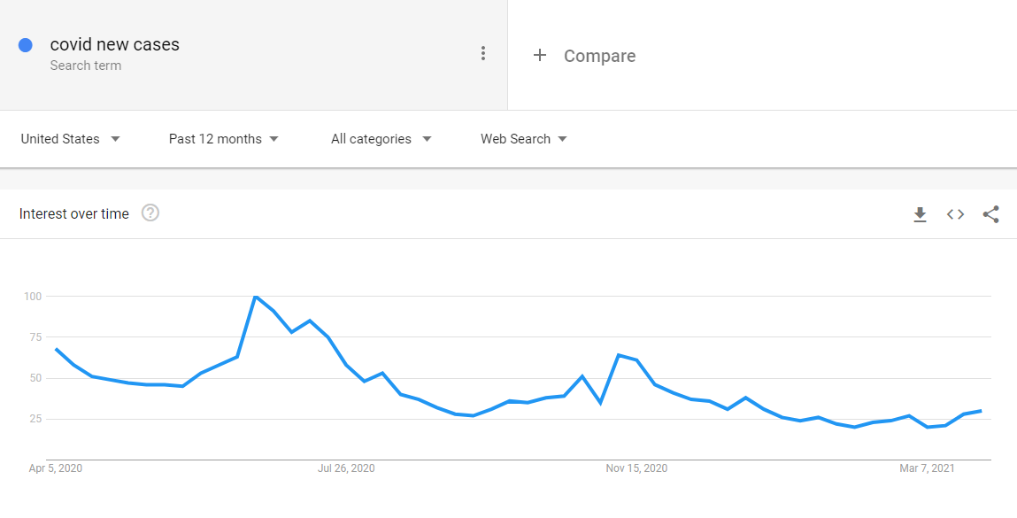
Data Gathering for Topic 2- Step 2
Data Collected from Google Trends:

Slide 21
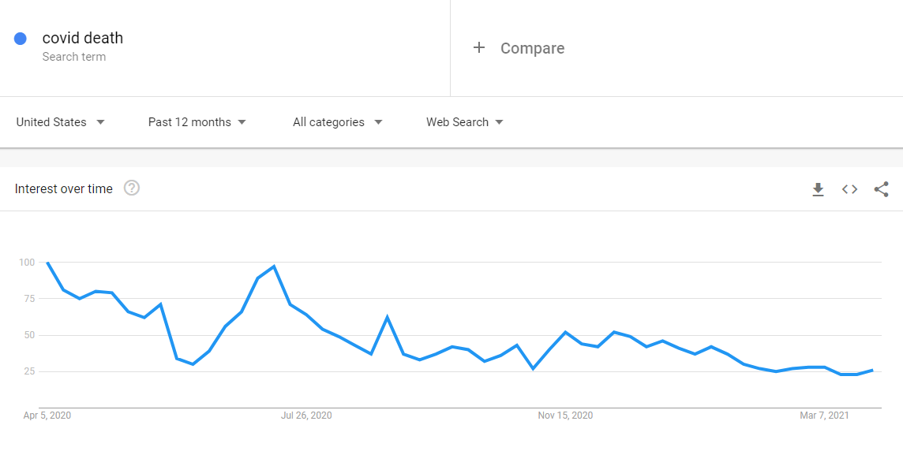
Data Gathering for Topic 2- Step 2
Data Collected from Google Trends:

Slide 22
Data Gathering for Topic 2- Step 2
Data Collected from Google Trends:

Slide 23
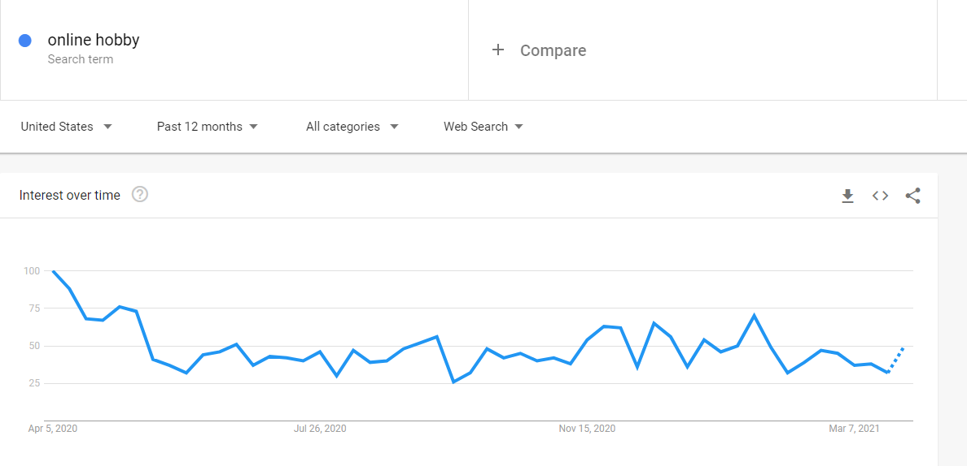
Data Gathering for Topic 2- Step 2
Data Collected from Google Trends:

Slide 24
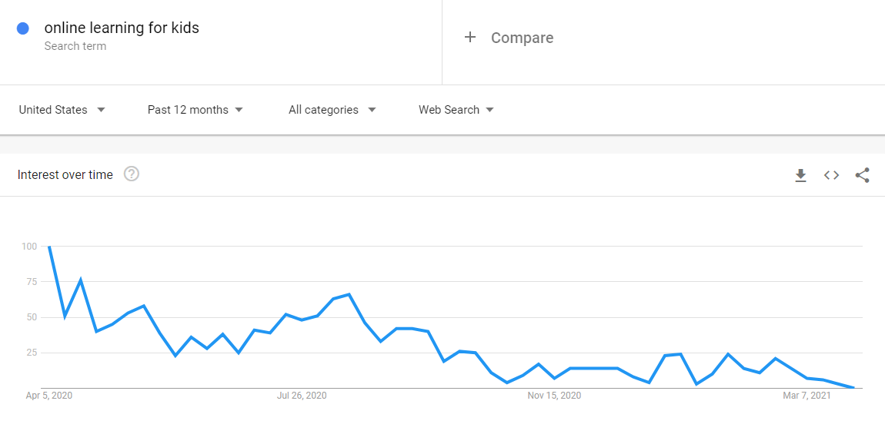
Data Gathering for Topic 2- Step 2
Data Collected from Google Trends:

Slide 25
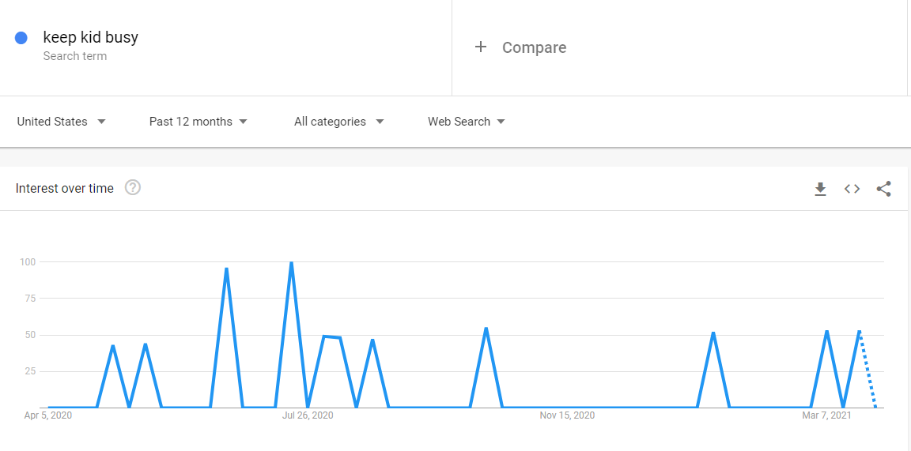
Data Gathering for Topic 2- Step 2
Data Collected from Google Trends:

Slide 26
Data Gathering for Topic 3- Step 1
Data Collected from Google Trends:

Slide 27
Data Gathering for Topic 3- Step 1
Questions for topic 2
Before registering for covid vaccination appointments, do peoples are considering vaccine manufacturers too.
Trends for covid vaccine registration search for a state
Trends for covid new cases search for a state
Trends for Pfizer, Moderna
Search for state government vaccine days for Pfizer and Moderna
Comparing Pfizerve vs. Moderna sentiments
Trends for travelling search for a state

Slide 28
Data Gathering for Topic 3- Step 2
Before registering for covid vaccination appointments, do peoples are considering vaccine manufacturers too
Data Collected from Google Search:
https://www.yalemedicine.org/news/covid-19-vaccine-safety
https://www.statnews.com/2021/02/02/comparing-the-covid-19-vaccines-developed-by-pfizer-moderna-and-johnson-johnson/
https://www.vox.com/22362894/which-covid-vaccine-is-better-moderna-vs-pfizer-video
https://www.dph.illinois.gov/covid19/vaccinedata?county=Illinois#InventoryReporting

Slide 29
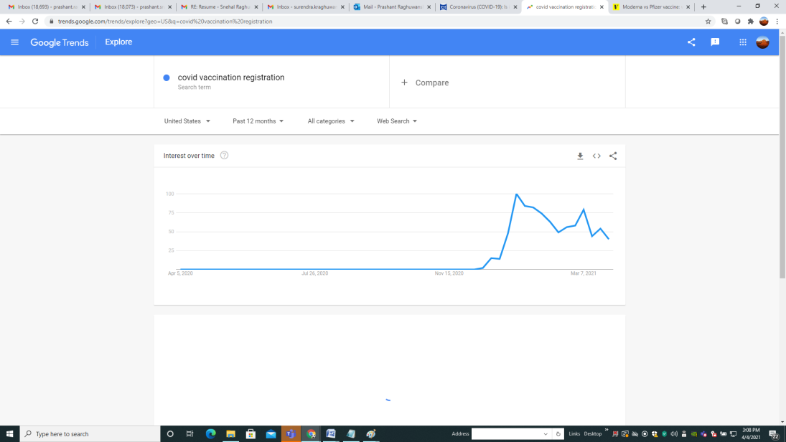
Data Gathering for Topic 3- Step 2
Data Collected from Google Trends:

Slide 30
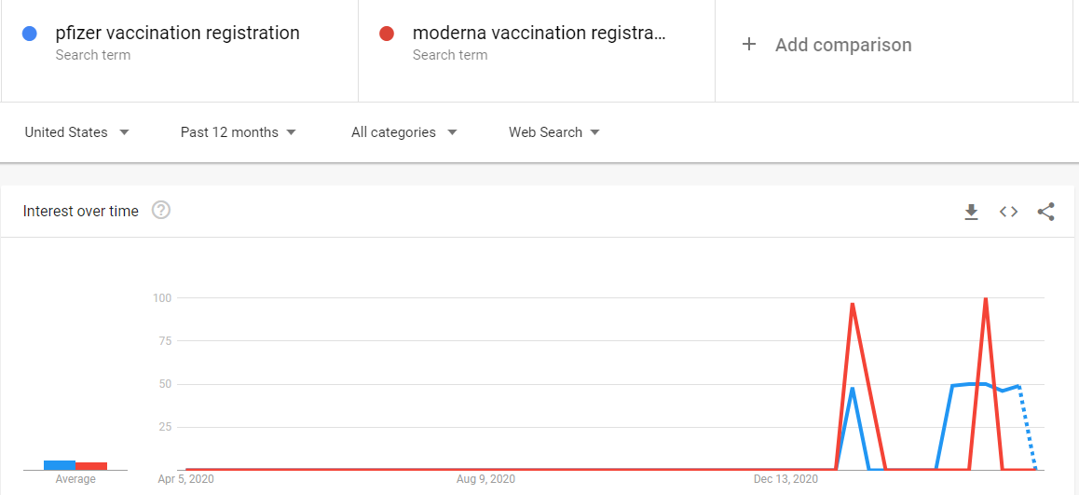
Data Gathering for Topic 3- Step 2
Data Collected from Google Trends:

Slide 31
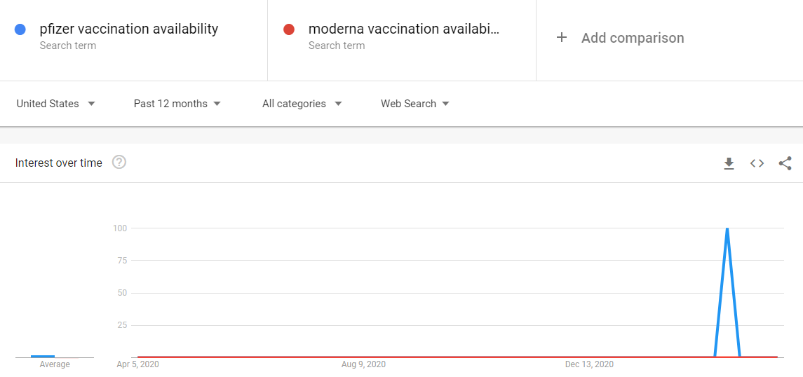
Data Gathering for Topic 3- Step 2
Data Collected from Google Trends:

Slide 32
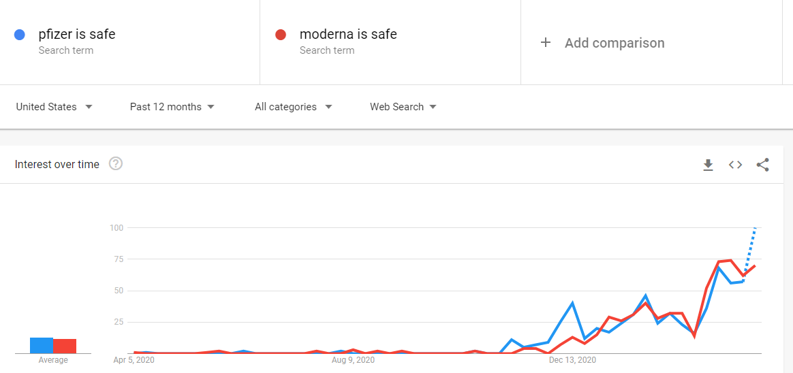
Data Gathering for Topic 3- Step 2
Data Collected from Google Trends:

Slide 33
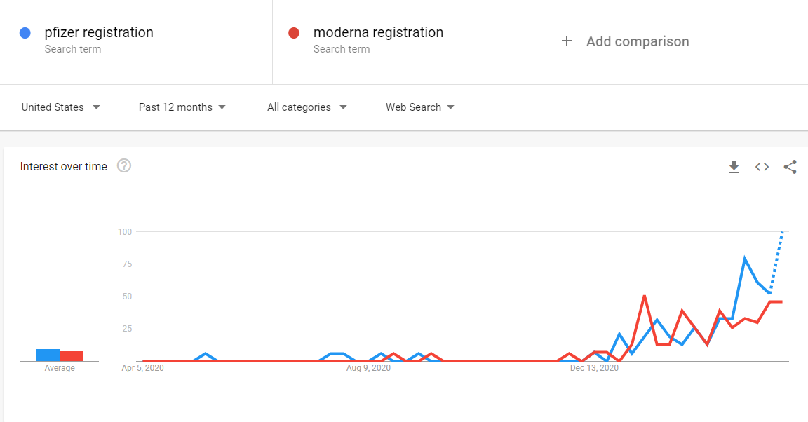
Data Gathering for Topic 3- Step 2
Data Collected from Google Trends:

Slide 34
Data Gathering for Topic 3- Step 2
Data Collected from Google Trends:

Slide 35
Data Gathering for Topic 4- Step 1
Questions for topic 4
Which is the preferred pet in the USA (Cat or Dog)
How trending sentiments look for cat keyword
How trending sentiments look dog trend
How trending sentiments look new pets
How trending sentiments look car food
How trending sentiments look dog food
How trending sentiments look vet hospitals
How trending sentiments look for cat training and dog training
How trending sentiments look for cat breeds vs. dog breeds

Slide 36
Data Gathering for Topic 4- Step 2
Which is the preferred pet in the USA (Cat or Dog)
Data collected from google search
https://easypetfence.com/pages/do-people-like-dogs-or-cats-better
https://www.petsecure.com.au/pet-care/a-guide-to-worldwide-pet-ownership/
https://www.usatoday.com/story/tech/reviewedcom/2020/05/04/15-most-popular-pet-products-you-can-get-petco/111649590/

Slide 37
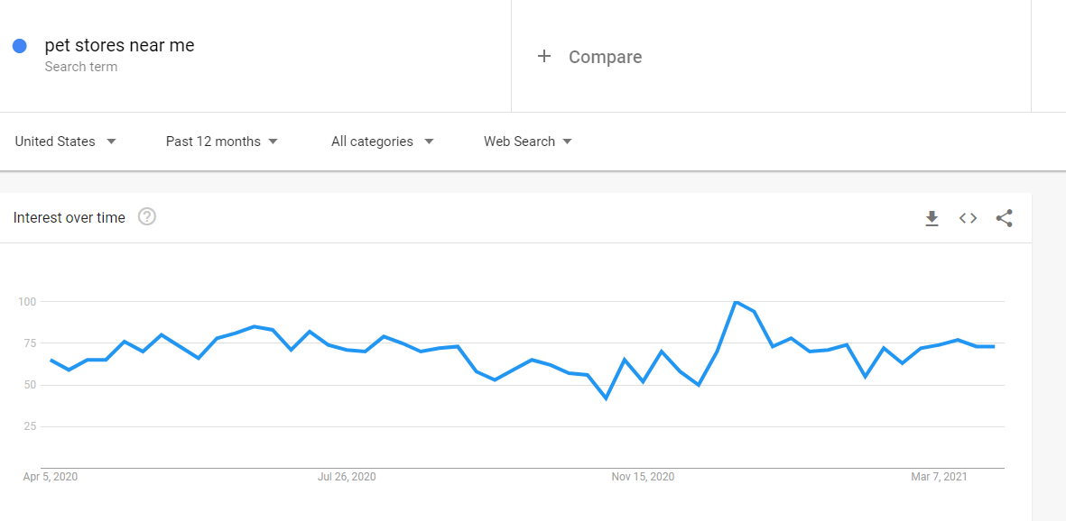
Data Gathering for Topic 4- Step 2
Data Collected from Google Trends:

Slide 38
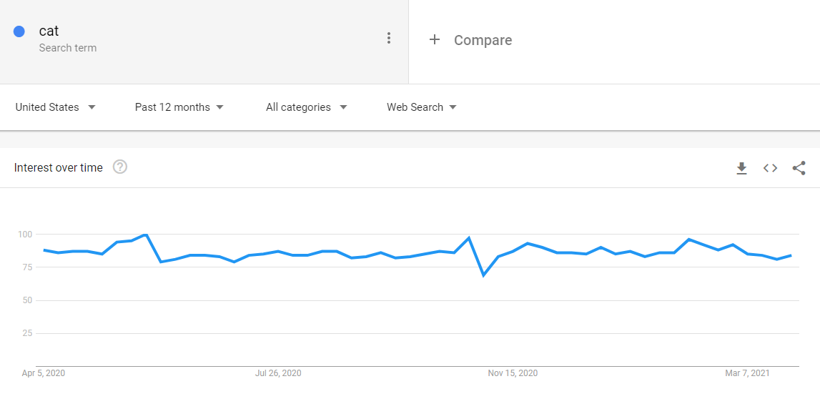
Data Gathering for Topic 4- Step 2
Data Collected from Google Trends:

Slide 39
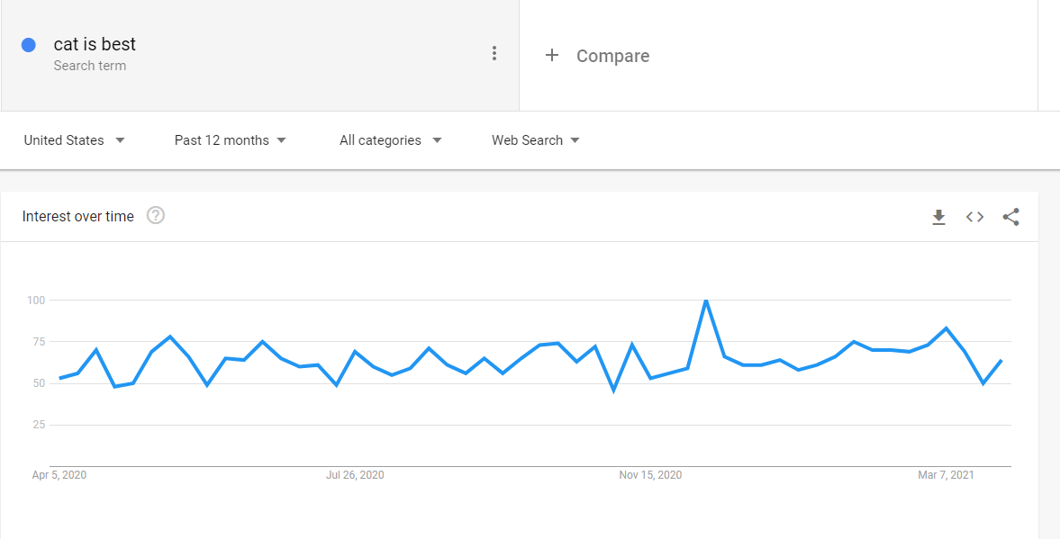
Data Gathering for Topic 4- Step 2
Data Collected from Google Trends:

Slide 40
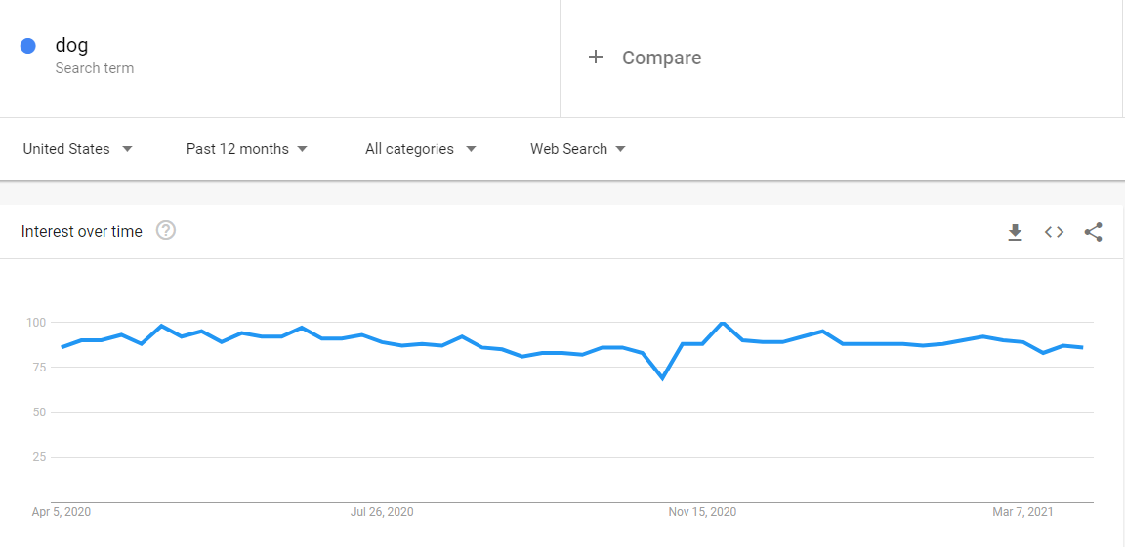
Data Gathering for Topic 4- Step 2
Data Collected from Google Trends:

Slide 41
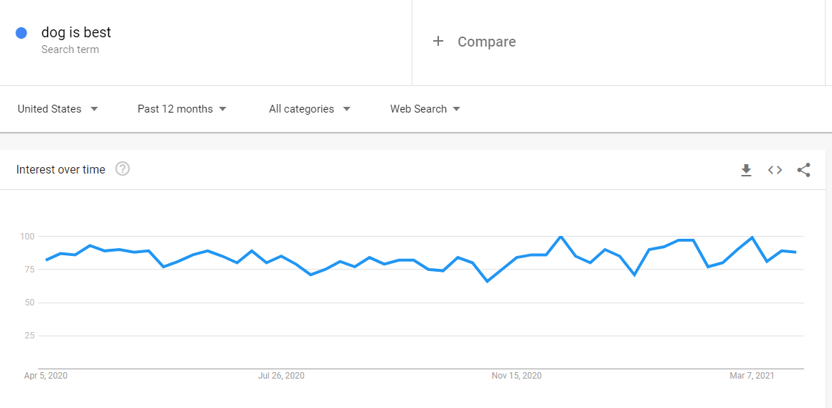
Data Gathering for Topic 4- Step 2
Data Collected from Google Trends:

Slide 42
Data Gathering for Topic 5- Step 1
Questions for topic 5
Dose an economic downturn impact peoples questions for a night dream
Find trends for dream search in united state
Find dow, Nasdaq, coronavirus cases, job data graph for a YTD.
Find trends for good dreams graph for a YTD
Find for trends for bad dreams graph for a YTD
Find correlation between graphs
Find trends for Psychiatrists or Psychologists
Find the trends for a search like not getting sleep
Find articles related to sleep and dream

Slide 43
Data Gathering for Topic 5- Step 2
Dose an economic downturn impact peoples questions for a night dream
https://www.bea.gov/news/2021/gross-domestic-product-4th-quarter-and-year-2020-advance-estimate#:~:text=Real%20GDP%20decreased%203.5%20percent,in%202019%20(table%201).
https://www.investing.com/

Slide 44
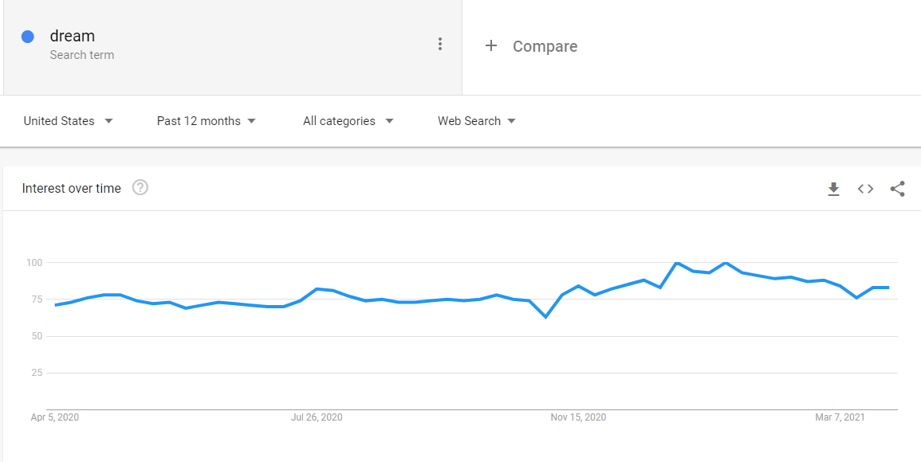
Data Gathering for Topic 5- Step 2
Data Collected from Google Trends:

Slide 45
Data Gathering for Topic 5- Step 2
Data Collected from Google Trends:

Slide 46
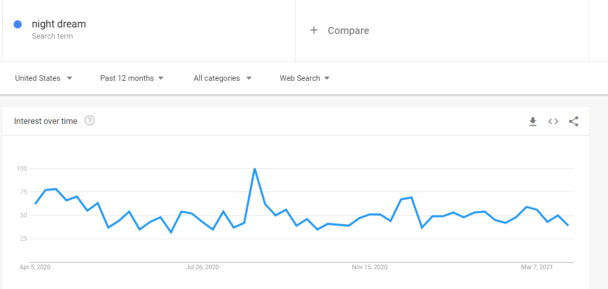
Data Gathering for Topic 5- Step 2
Data Collected from Google Trends:

Slide 47
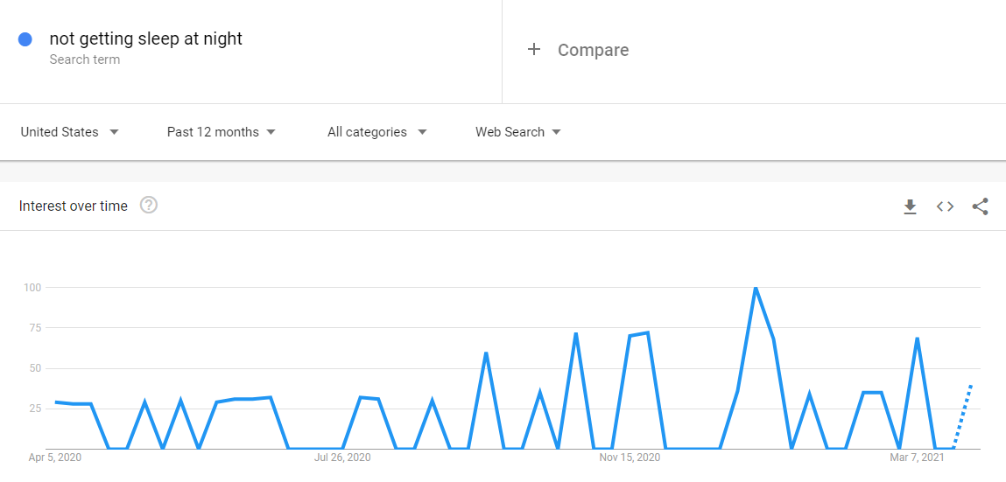
Data Gathering for Topic 5- Step 2
Data Collected from Google Trends:

Slide 48
Data Gathering for Topic 5- Step 2
Data Collected from Google Trends:

Slide 49
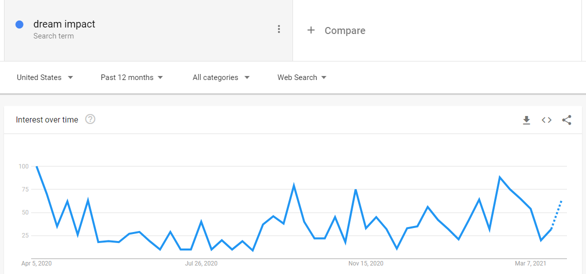
Data Gathering for Topic 5- Step 2
Data Collected from Google Trends:

Slide 50
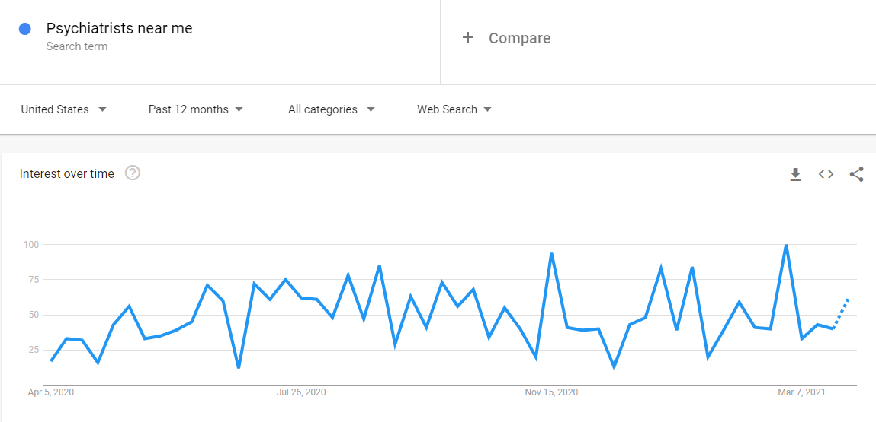
Data Gathering for Topic 5- Step 2
Data Collected from Google Trends:

Slide 51
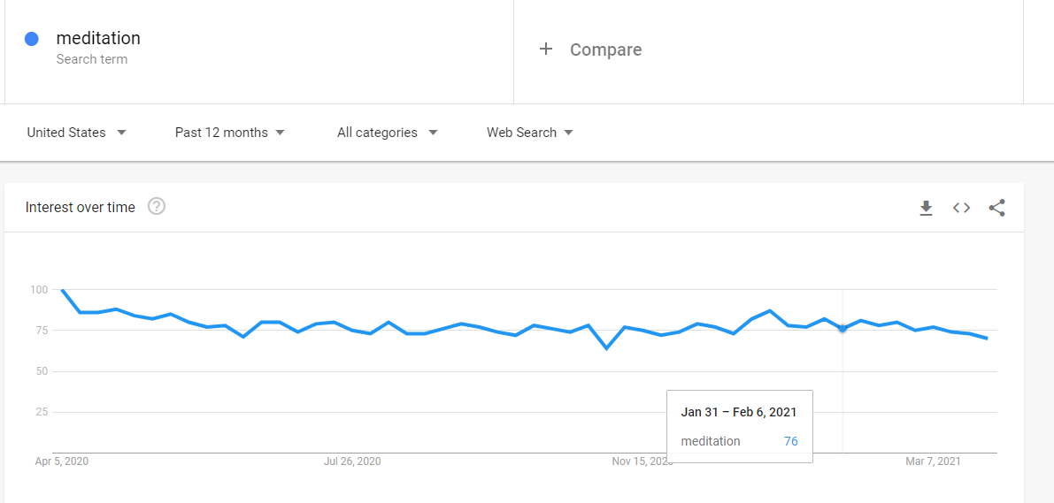
Data Gathering for Topic 5- Step 2
Data Collected from Google Trends:

Slide 52
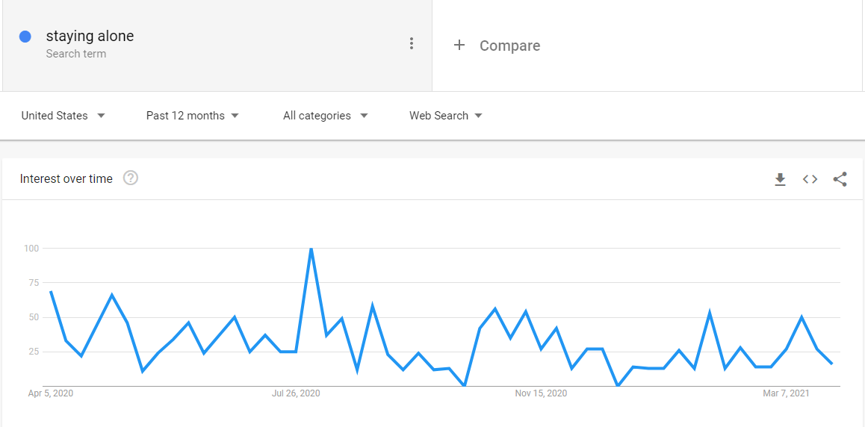
Data Gathering for Topic 5- Step 2
Data Collected from Google Trends:

Slide 53
Refrences
Seth Stephens (2017). Everybody Lies. DEY ST.
Web references:
https://trends.google.com/trends/yis/2011/US/

Slide 54
Thank you

