Slide 1
Term Project Milestone-3
DSC500-T301 Introduction to Data Science (2215-1)
Prashant Raghuwanshi
Bellevue University
Guided by Professor Catherine Williams

Slide 2
Outline
Background
Final Topic of Research
List Of Questions
Data Gathering for Question 1
Data Gathering for Question 2
Data Gathering for Question 3
Data Gathering for Question 4
Data Gathering for Question 5
Data Gathering for Question 6
Assumptions
Ethical consideration
References

Slide 3
Background
Data Science (DS) is the Art of finding unknown business questions and their answers by analyzing the different data sources and using the data-driven decision-making process.
This Presentation is the Part of Term End DS project Milestone -3
This presentation is focused on preparing the datasets for solving problems
Find below the end goal of Term-end project
Prepare datasets for solving problems.
Recommend appropriate data modeling techniques to test hypotheses.
Communicate data science results into answers for domain challenges.
Identify ethical considerations in dataset preparation and modeling.

Slide 4
Final Topics of Research
Does Weather forecasting information helps in reducing the road accidents (Analyzing winter weather or summer weather Data)

Slide 5
List Of Questions
Questions for Research Topic
Do we have related blogs or articles in Google search for initial information?
Do we have winter season road accident data (Only accidents due to weather conditions)
Do we have summer season road accident data (Only accidents due to weather conditions)
How much the weather temperature are correlate with accident counts
How much the Google trend search data is correlated with accident count data
Do we have vehicles Volume traffic data for last 10 years

Slide 6
Data Gathering for Question 1
Do we have related blogs or articles in Google search for initial information?
Purpose behind above question → with the help of collected research data , I want to figure out the additional information's available in web related to my research topic ,also want to make sure that my research question is not biased or not matching with searched articles in public web.
Data Collected from Google search:
https://accidenttreatmentcenters.com/surprising-winter-weather-driving-statistics/
https://www.vaisala.com/en/case/using-weather-information-reduce-accidents-and-improve-traffic-flow
https://weatherspark.com/y/14091/Average-Weather-in-Chicago-Illinois-United-States-Year-Round
Extracted below information from above pasted articles links
Over 70% of US roads are in snowy regions.
About 70% of the US population lives in snowy regions.
17% of all vehicle crashes happen in winter conditions.
1,836 people die annually due to snowy and icy pavement.
About 70% of accidental fatalities that occur during winter happen in cars.
800 Americans die in car crashes annually while driving in winter weather conditions
Road Authority is already using weather forecasting to plan the road safety team & required infrastructure to control accidents during winter conditions

Slide 7
Data Gathering for Question 2
Do we have winter season road accident data
Purpose behind above question → want to analyse the ground reality of accident data (due to winter weather condition) for a decade, it helps in figuring out the impact of weather forecasting during mild & extreme winter in road accidents
https://highways.dot.gov/
Attached winter accident data for DEC,JAN, FEB,MARCH months (2011 to 2019)

Slide 8
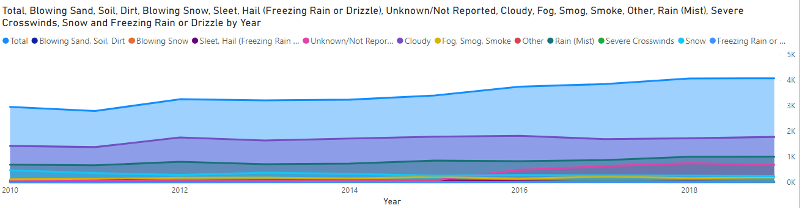
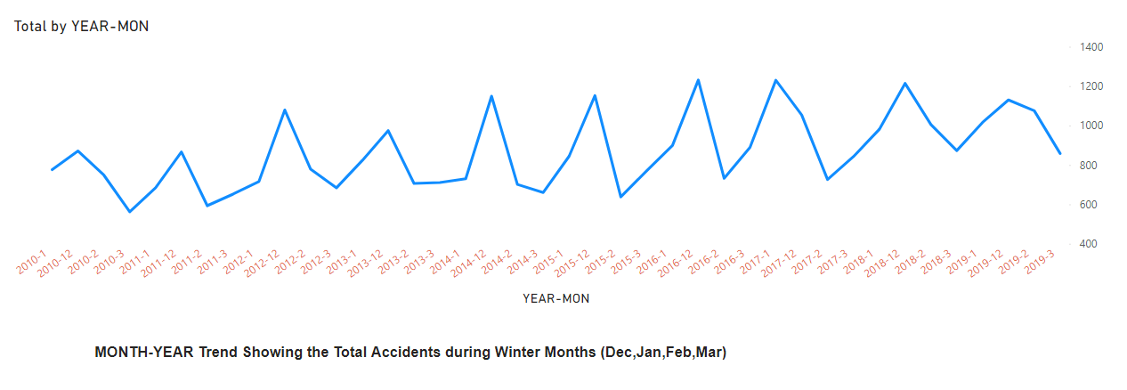
Created Visuals from Winter accident data -1

Slide 9
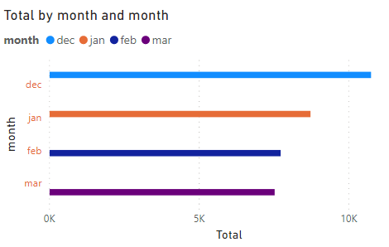
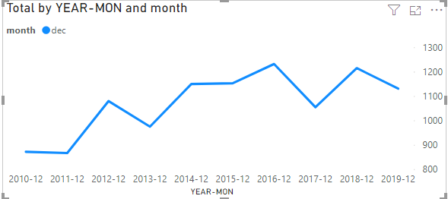
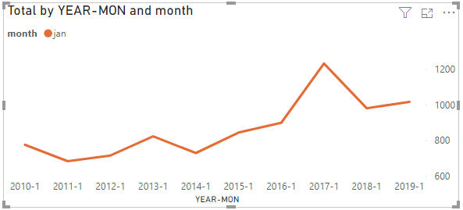
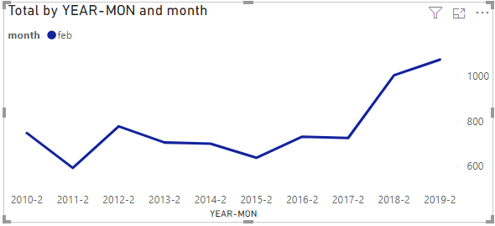
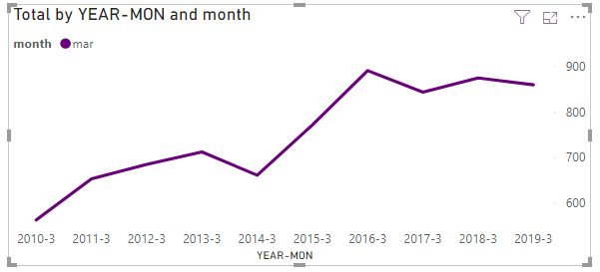
Created Visuals from Winter accident data -2

Slide 10
Data Gathering for Question 3
Do we have summer season road accident data (Only accidents due to weather conditions)
Purpose behind above question → want to analyse the ground reality of accident data (due to summer weather condition) for a decade, it helps in figuring out the impact of weather forecasting during mild & extreme summers in road accidents
https://highways.dot.gov/
Attached summer accident data for May,Jun,July months (2011 to 2019)

Slide 11
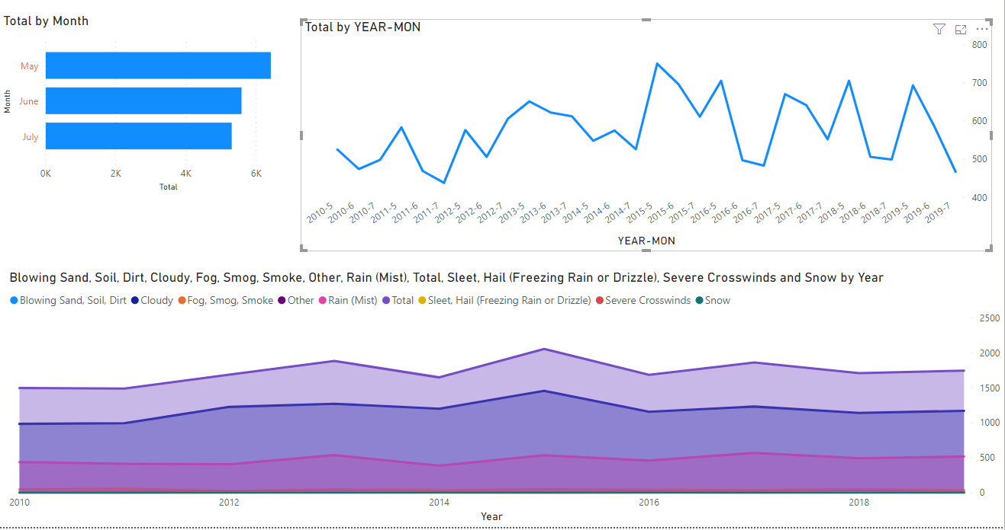
Created Visuals from Summer accident data -3

Slide 12
Data Gathering for Question 4
How the weather temperature are correlate with accident counts
https://www.usclimatedata.com/climate/chicago/illinois/united-states/usil2527
Attached average temperature sheet and consolidate date for question 2 & 3 to find correlation of temperate with accidents

Slide 13
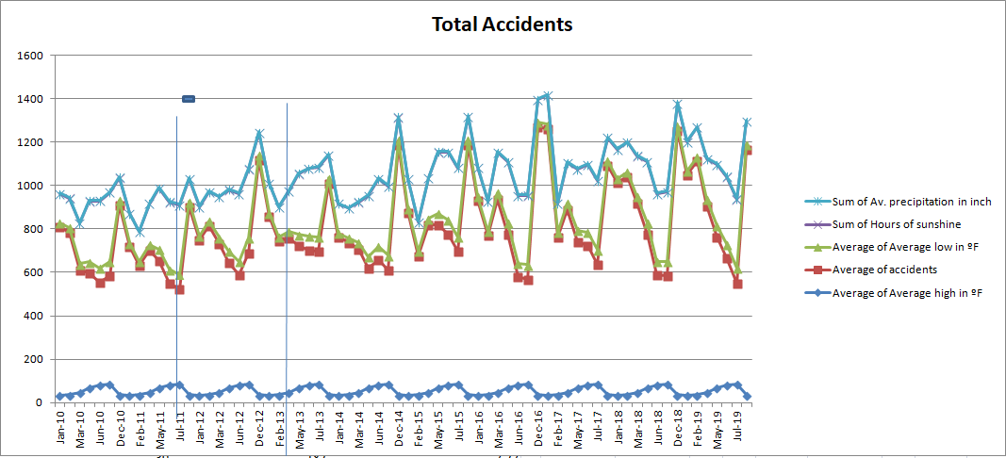
Created Visuals to find correlation between accident & temp data -4

Slide 14
Data Gathering for Question 5
How the Google trend search data is correlated with accident count data
Attached Google trend extract and consolidate data for question 2 & 3 to find correlation of Google trend with accidents

Slide 15
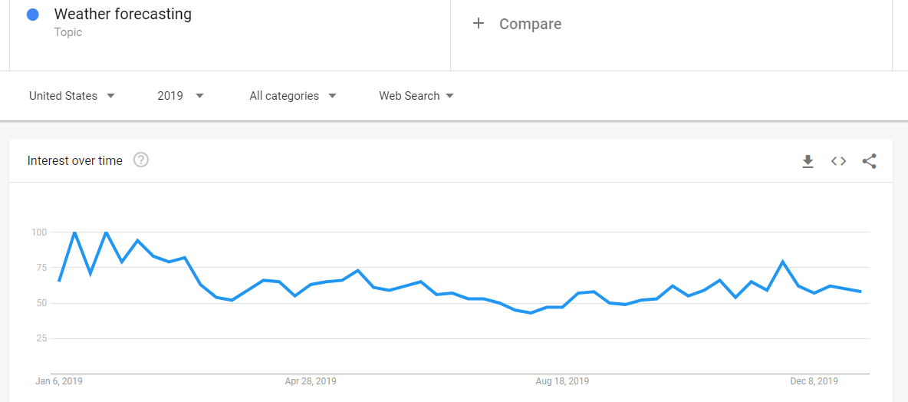
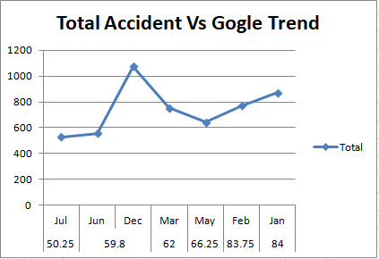
Created Visuals to find correlation between accident & Google trend data -5

Slide 16
Data Gathering for Question -6
Do we have any vehicles Volume traffic data for last 10 years
https://www.fhwa.dot.gov/resources/pubstats/
Attached extract sheet for vehicle volume analysis yearly data:

Slide 17
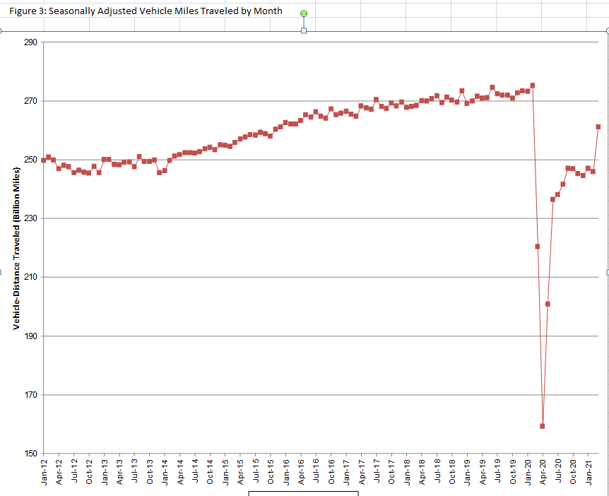
Created Visuals to find Vehicles traveled data & season accidental data-6

Slide 18
Assumptions
To correlation monthly temperature data with 10 years of seasonal accident data, I have used the monthly average temperature for 2019 year and Assumed that we have same monthly average temperature in between 2010 to 2019
To correlation monthly trend data with 10 years of seasonal accident data, I have used the monthly average 2019 Google trend search data and Assumed that we have same monthly average trend search for weather keyword in between 2010 to 2019
I have consider the winter & summer session accident data for my research (extreme cold & hot weather)

Slide 19
Ethical consideration
Haven't used any secure or paid data for my research
Only used the free Data available in fed public departments websites

Slide 20
References
Seth Stephens (2017). Everybody Lies. DEY ST.
Web references:
https://trends.google.com/trends/yis/2011/US/

Slide 21
Thank you

