Slide 1

Prospect Predictor Model
Team Galaxy – Term End Project Presentation
(Prashant Raghuwanshi & Jay Pfister)
DSC630-T301 Predictive Analytics (2223-1)

Slide 2
Introduction
We are targeting a sub set of survey respondents who we have identified as gainfully and regularly employed and potentially in need of financial services such as savings accounts or CDs.
Business Application - The goal of this project is to assist in the marketing of financial services to customers based on self identified demographic data from the Bureau of Labor Statistics, allowing for the creation of pools of demographically sorted candidates for client services.
Based on our findings, we can craft tailored survey data to better target ideal customers for our clients.
This goal is met by creating a predictive model to determine if a given group of respondents is likely to be a good fit for our clients’ financial products and as a result an ideal target for marketing campaigns attempting to solicit customers for those products.

Slide 3
Questions to answer
Can we identify survey respondent segments that are candidates for potential packaging as demographic data to sell to our customers?
What traits make an individual most suitable for the financial services for our customers?
Which of the survey respondents are good fits for the financial products of our customers?

Slide 4
Business Application
This project is aimed at providing a means of targeting clients for financial institutions such as banks.
For a fee, we can provide analysis of potential client data and identify demographic most suitable for targeting by advertisement of services.
Through the use of our algorithm, financial institutions will be able to determine which characteristics are most closely associated with potential clients for their products.

Slide 5
Challenges
We faced a number of challenges working with this data set.
To begin with the data was recorded in a somewhat difficult format to work with. Data cleaning and wrangling steps were taken to shape the data into a form that could be used in the pursuit of our goals.
Difficulty finding a model that was best suited to the data.
Determining the best interpretation for the results of our modeling.

Slide 6
Methodology
CRISP-DM
The Cross-Industry Standard Process for Data-Mining – CRISP-DM is a model of a data mining process used to solve problems by experts. The model identifies the different stages in implementing a data mining project, as described bellow
The model proposes the following steps:
Business Understanding – to understand the rules and business objectives of the company.
Understanding Data – to collect and describe data.
Data Preparation – to prepare data for import into the software.
Modeling – to select the modeling technique to be used.
Evaluation – Evaluate the process to see if the technique solves modeling and creating rules.
Deployment – to deploy the system and train its users

Slide 7
Process
Acquire data from Bureau of Labor Statistics
Clean/Wrangle the data
Explore the data and perform basic analysis
Create a train and a test subset from the data
Apply learning model

Slide 8
Risks Associated
Risks include potential PII issues with respondents, which can largely be mitigated by anonymized respondent IDs. As long as a particular individual is never personally identified the risk of PII information leaking is mitigated.
Potential for respondents to misrepresent their individual situations in their survey replies. Survey responses are to some extent unverifiable. For example, if a respondent indicates that the reason they remain unemployed is a long term medical issue, we can't verify that claim and that could potentially skew results.
Lack of suitable candidates for a given application based on survey responses. This can be mitigated by the model indicating viability within the candidate pool.

Slide 9
The Data
ATUS (American Time Use Survey) Respondent File This file contains case-specific variables collected in ATUS (that is, variables for which there is one value for each respondent). These include, for example, labor force and earnings information, total time providing secondary childcare, and ATUS statistical weights.
There is one record for each ATUS respondent

Slide 10
The Data
Data description report - ATUS Respondent File This file contains case-specific variables collected in ATUS (that is, variables for which there is one value for each respondent). These include, for example, labor force and earnings information, total time providing secondary childcare, and ATUS statistical weights.
There is one record for each ATUS respondent.
Below is a simplified example. The variable TUCASEID identifies each household, and the variable TULINENO identifies each individual within the household. The example contains responses from five individuals; note that the respondent always has TULINENO = 1. In the example, each respondent has a corresponding statistical weight for use in generating estimates representative of the U.S. civilian, noninstitutionalized population (TUFINLWGT), and values for school enrollment (TESCHENR), labor force status (TELFS), and total number of minutes spent alone on the diary day (TRTALONE). The actual ATUS Respondent file contains more variables and records.

Slide 11
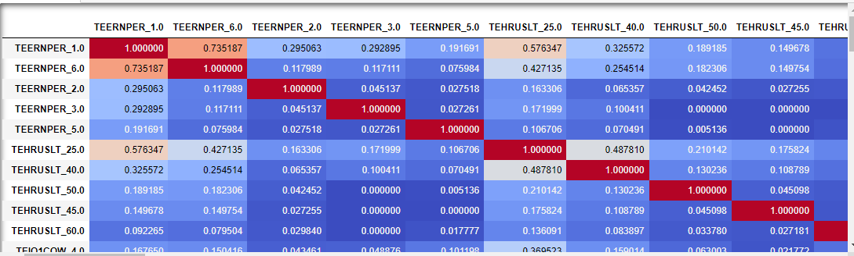
The Data (Correlation)

Slide 12
Data Management
Removing null values through mean value imputation
Removing unnecessary columns from the data set
Accounting for outliers
Converting continuous variables to categorical variables
Applying One Hot Encoding

Slide 13
Modeling
We opted for an unsupervised learning approach to our data, specifically clustering. We chose this method because with unsupervised learning, you can find relationships in data that aren't immediately apparent. It does this by comparing the data based on similarity. In clustering, this is used to group the unlabeled data into clusters that represent patterns that were found in the data.
Our current focus is using K – Mode clustering, an extension of K-Means clustering, to determine the relationships that exist between our variables by presenting them as a group of visually clustered data points which reveal relationships not immediately apparent from the data set. The number of clusters is determined by the K value provided to the method, with several ways to determine the correct K value including an Elbow Chart or a Silhouette Graphs that can provide a visual representation of ideal K values for our data set.

Slide 14
Modeling
We chose K-Mode clustering because of the nature of our data. K-Mode clusters are extremely efficient when working with large amounts of categorical data. K-Mode doesn't need to calculate all of the pair wise distances between data points. Additionally, it is distribution free, meaning that it does not require imposing distribution assumptions on the data in order to work.
K-Means clustering on the other hand does not work well with categorical data sets, primarily because it has the issues above that K-Mode does not, and ultimately it's objective function simply doesn't work with categorical data.

Slide 15
Modeling
Clustering is a means of grouping data based on characteristics. The clusters will form based on relationships between the individual data points and potentially reveal new relationships that were not previously apparent.
Clustering also allows for data compression when working with large data sets. After the data is clustered it can be referred to by cluster ID rather than the individual data points themselves.
Another use of clustering is the preserve the privacy of the respondent. Data grouped in clusters is practically anonymized by its presence in the cluster and future reference by cluster ID. In our example, no individual respondent ID will need to be used going forward as we can refer to the groups by their cluster IDs.
Here we used K-Mode clustering, which is similar to K - Means clustering but is based on the the Mode of K. K-Mode clusters are a good choice when working with large amounts of categorical data like what is present in our data set.

Slide 16
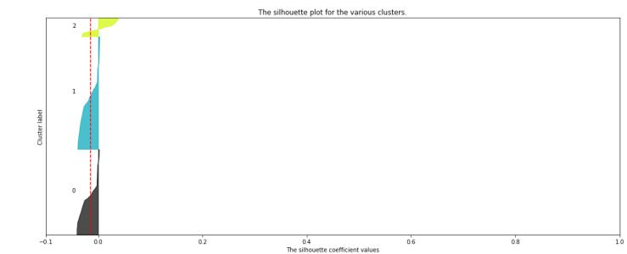
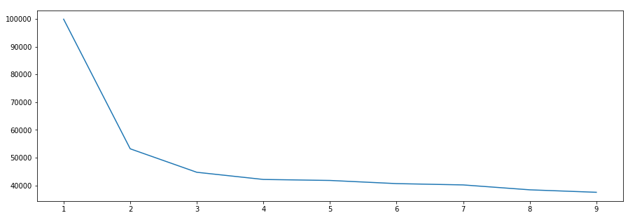
Modeling

Slide 17
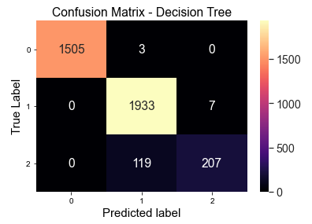
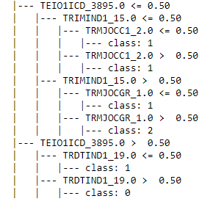
Model Accuracy

Slide 18
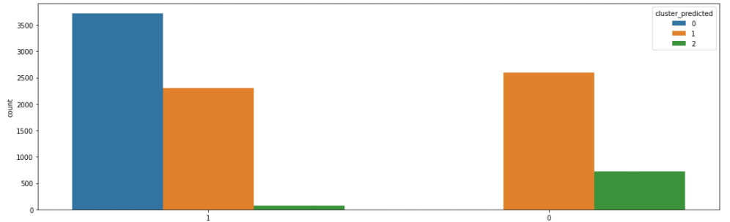
Respondent Data Grouped Demographically
Members of one of these groups is likely to be a strong candidate for our clients’ services based on survey responses. Allowing us to build customer profiles for our clients to better market their products.

Slide 19
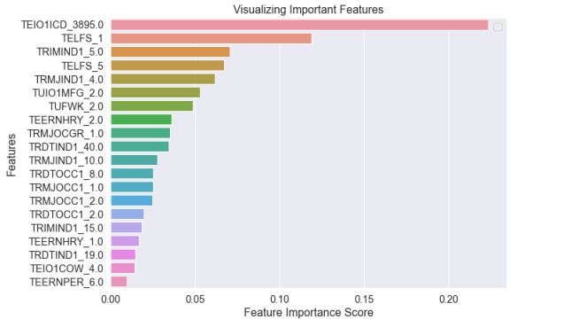
Important Features

Slide 20
Findings
Based on Employment Survey response from individuals, it seems our unsupervised Learning model suggested to divide the individuals in three different groups (clusters).
first group of individuals are seeming to have full employment in manufacturing sectors (most of then are serving Furniture and fixtures manufacturing).
Most of the individuals belongs to first group are having Management, professional, and related occupations
In the similar way our model had decoded the characters for other groups too.
We have used unsupervised learning to predict the clusters and its accuracy is very low , so definitely we need to use an additional Ensemble techniques to increase its accuracy

Slide 21
Recommendations:
Our model provides the initial steps toward grouping the respondent data in order to identify untargeted individuals with traits suitable for targeting.
After forming the required groups from existing individual financial datasets with more additional features (like flag for CDs or loans), we will be able to easily visualize which groups are most suitable for targeting for our clients’ services.

Slide 22
Thank you for your time

