Slide 1
Introduction
Established at 20th Century
Creates Intersection
Prevents Accidents

Slide 2
What does Automatic Railway Gate does?
Decrease Accidents
Minimizing errors of Human Guard
Automating the process

Slide 3
Requirements
Arduino Uno R3
L293D motor driver kit
IR sensor Pair Modules
Buzzer
Geared DC Motor
LEDs
Jumper Wires
NodeMCU ESP8266

Slide 4
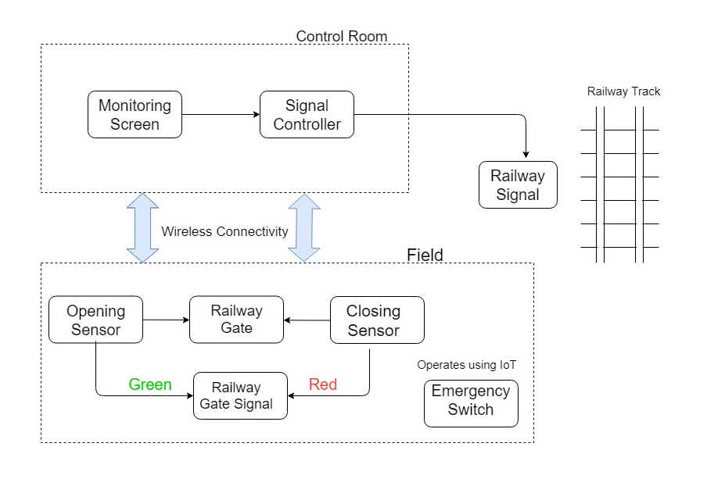
Block Diagram

Slide 5
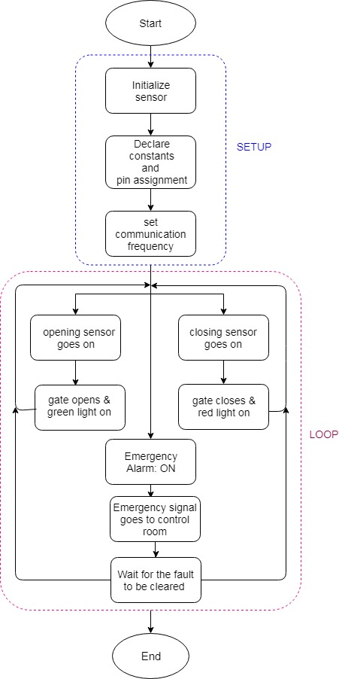
FLOW CHART

Slide 6
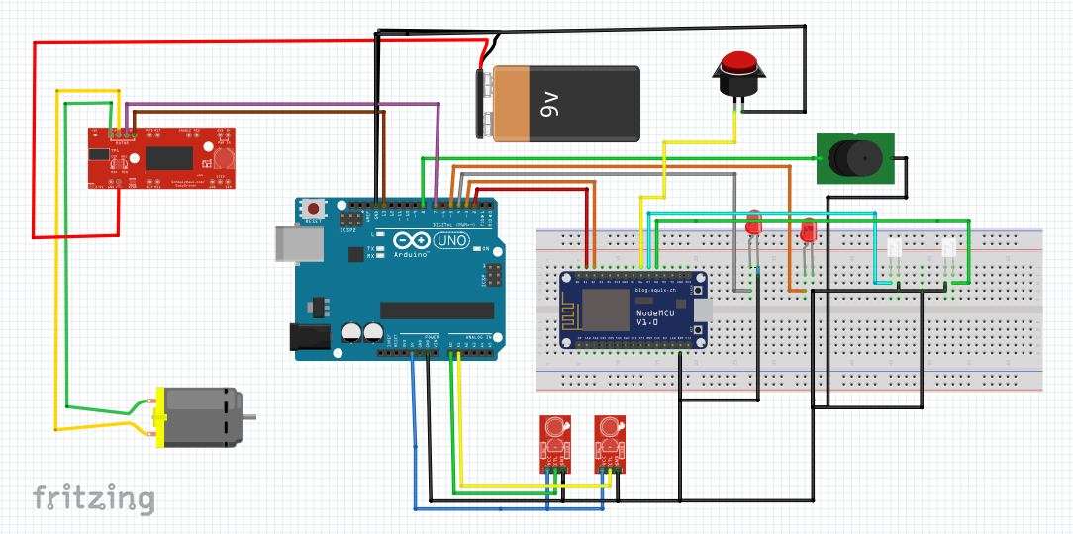
Circuit Prototype

Slide 7
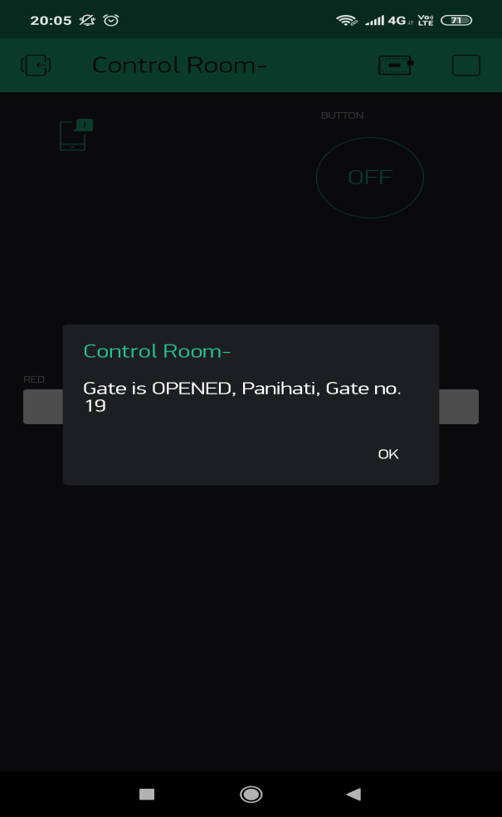
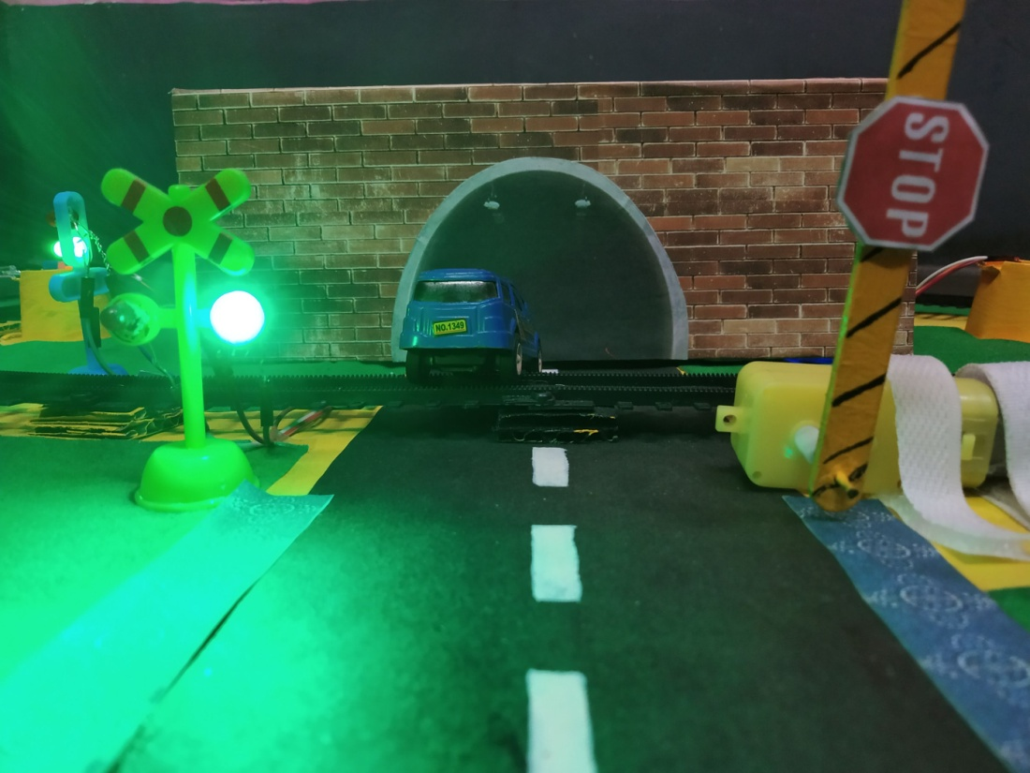
Working
1. Gate open, Crossing signal Green, control room message

Slide 8
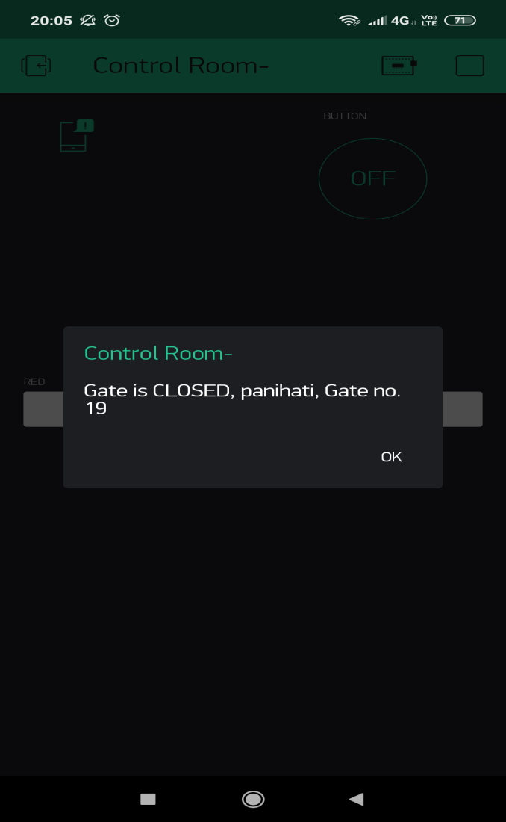
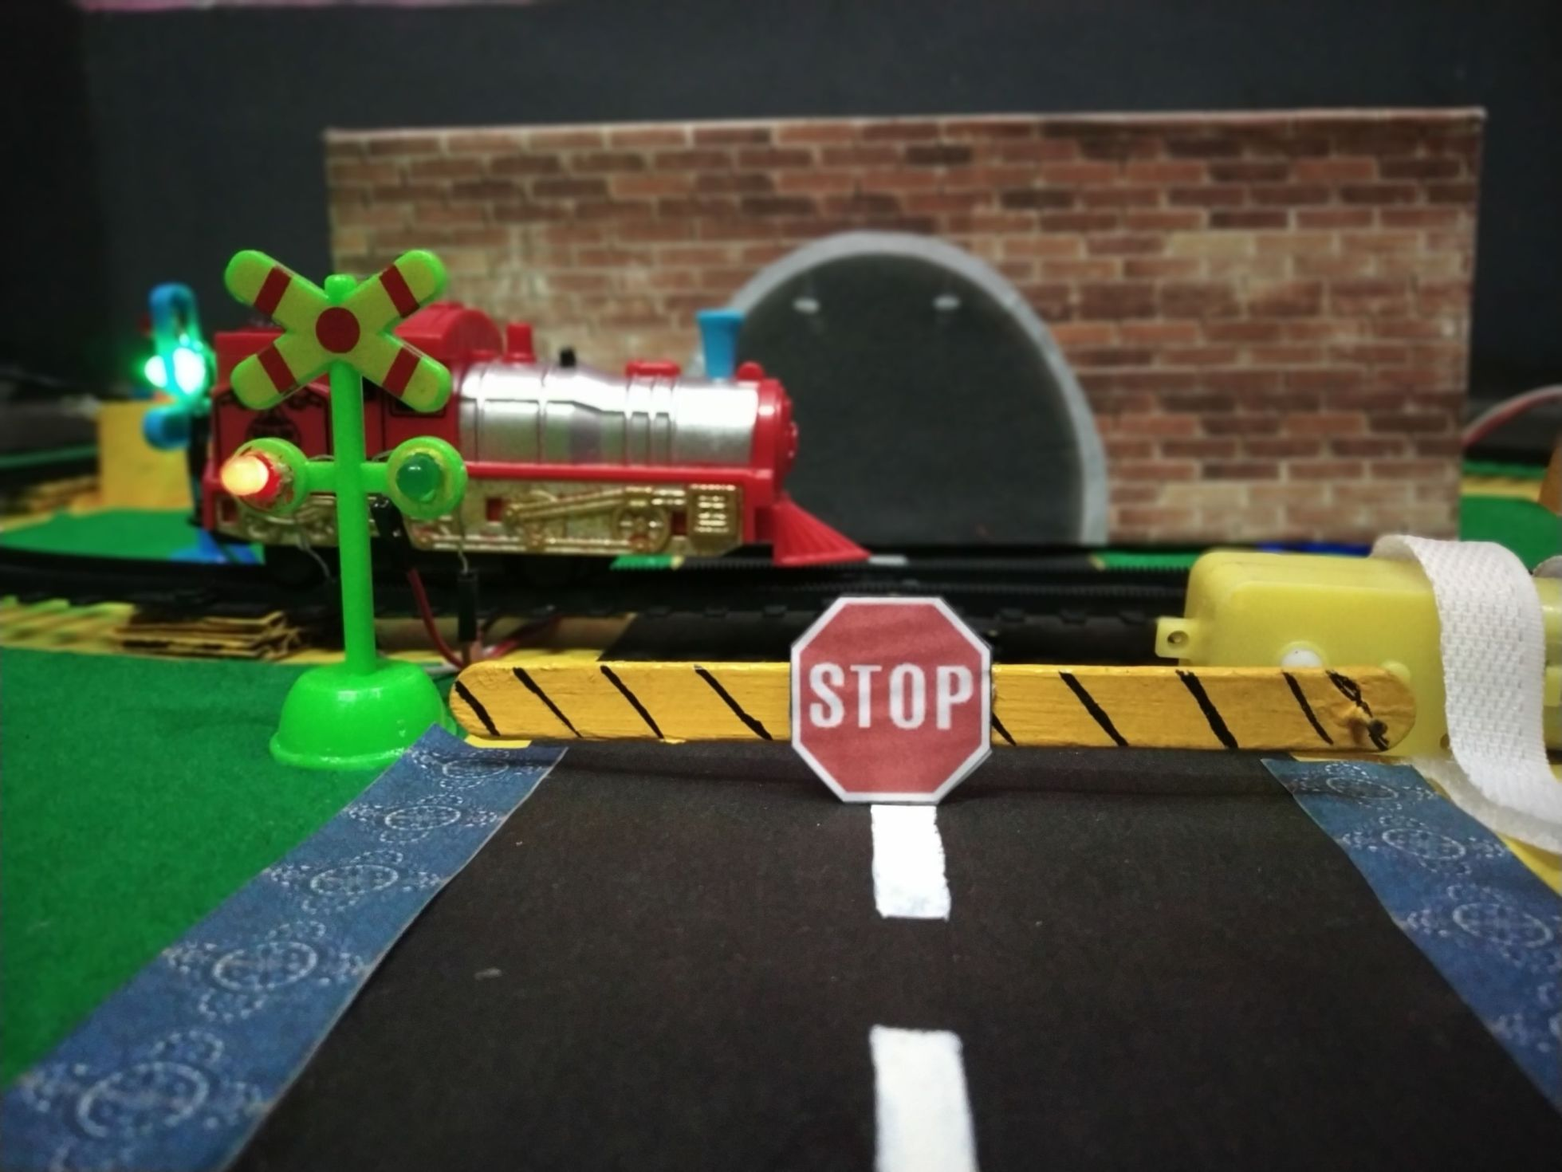
2. Gate close, Crossing signal Red, control room message

Slide 9
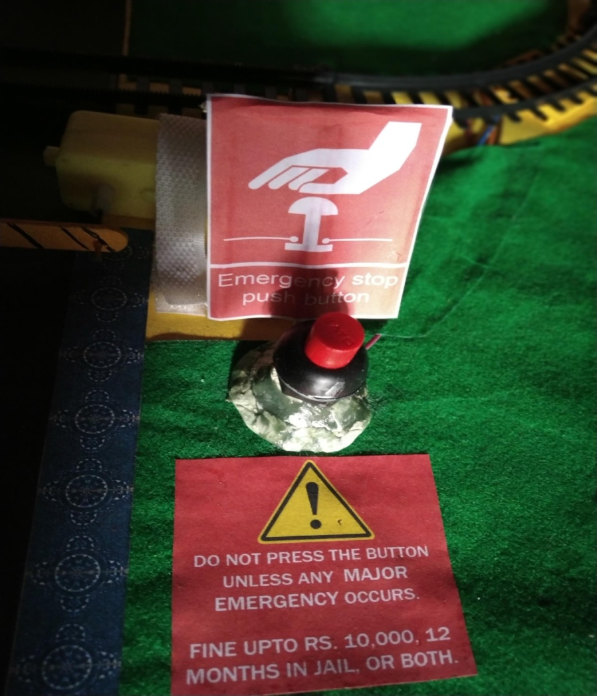
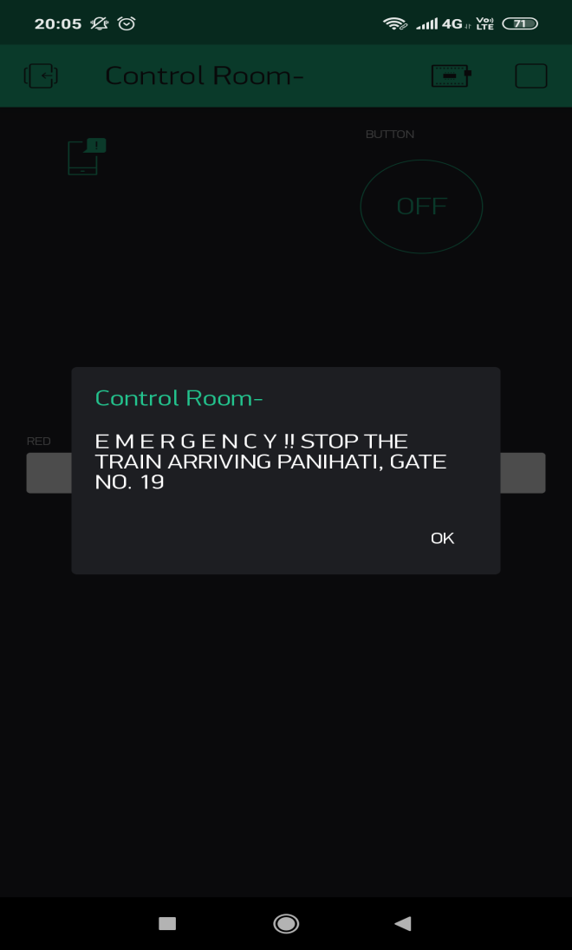
3. Emergency switch, control room message

Slide 10
FUTURE SCOPE
Flexible for further enhancements
Reducing manpower
Eliminating loopholes

Slide 11
CONCLUSION
avoids manual errors
Safe
cost-efficient
FUTURE

Slide 12
* THANK YOU *

