Slide 1
Project
BUAN 6340.003 – Programming for Data Science
Name: Prashant Shivaji Bhapkar
Net Id: pxb170130

Slide 2
Table of Contents
Problem Statement
Data Description
EDA – Exploratory Data Analysis
Model Design – Application of various Machine Learning Algorithms and doing final classifications

Slide 3
Problem Statement

Slide 4
This is a Multi Class Classification Problem and we (machine, to be precise, hence Machine Learning) need to learn from the features and classify a given person (sample) into one of the 3 classes/categories:
Unemployed
Employed
Not In Labor Force

Slide 5
Data Description
The data set comprises of various people and their employment status, which is the target attribute. As mentioned earlier, this is a multi-class classification problem. There are various other independent variables which are present in the data set which are in the next slide.

Slide 6
TOTAL ATTRIBUTES / FEATURES : 25
ID: An Id that represents a person within the training set
Education: It represents Education level of a person (9th, 10th, 11th, 12th grade, Associate, bachelor’s, master’s degree etc.)
Age: Age of a person
Age range: Age Range of a person (0-19, 20-29, 30-39………70-79, 80+)
Employment: Whether that person is employed or not
Children: Number of children a person has
Weekly earnings: Earnings in dollars/week
Column k - Column x: Average time spend by a person on a particular activity per day in minutes
Total: Total of average time spend (In hours) by a person in a day.
Note: values of this column may exceed above 24hrs (2 activities may have been considered twice). Like Food & drink prep is considered individually as well as in housework (Assumption). Also, the data set doesn’t have any null values.

Slide 7
EDA – Exploratory Data Analysis (Feature by feature)

Slide 8
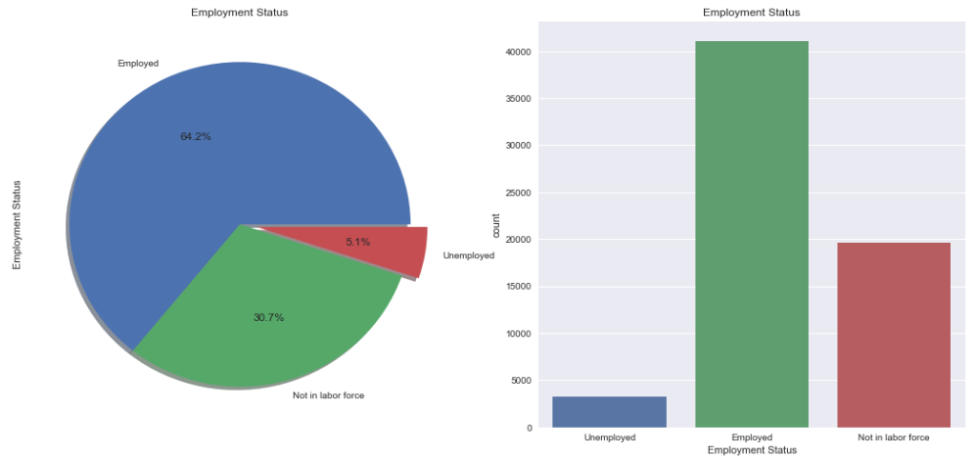
Distribution of Employment Status
Looks like the majority of people are/were employed according to this data. This accounts for 64.2% of the sample size, which is quite high given 3 classes. 30.7% of people are/were 'Not in labor force', while only 5.1% of the entire population(sample) were unemployed.

Slide 9
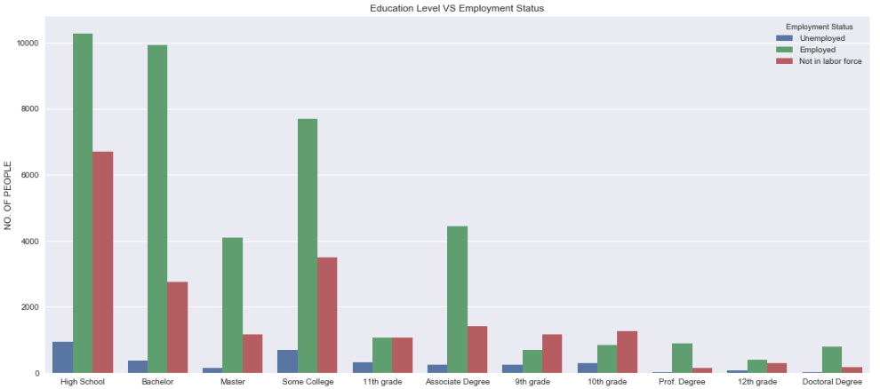
Distribution of Employment Status across Education Level
It looks like there are high number of samples that are employed for education levels : high school , Bachelor, Master. This trend tends to decrease as the education level decreases, explaining the obvious relation - you'll earn more (be employed) if you'll study more (higher education level) (A thought shared by my parents. Some relevance here :) )

Slide 10
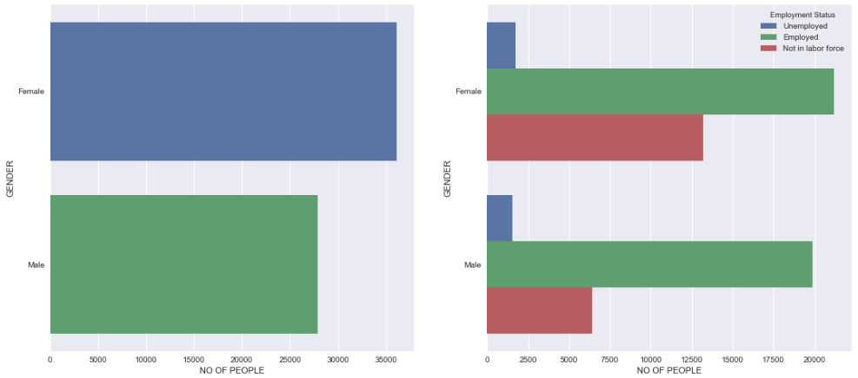
Distribution of Employment Status across Gender
Distribution looks kind of even across both the GENDERs as far as EMPLOYMENT STATUS is concerned. For both the genders (Male and Female), number of people that are 'EMPLOYED' is highest compared to other classes. There is a common trend for both the genders. For both the genders, No of people (EMPLOYED) > No of people (NOT IN LABOR FORCE) > No of people (UNEMPLOYED)

Slide 11
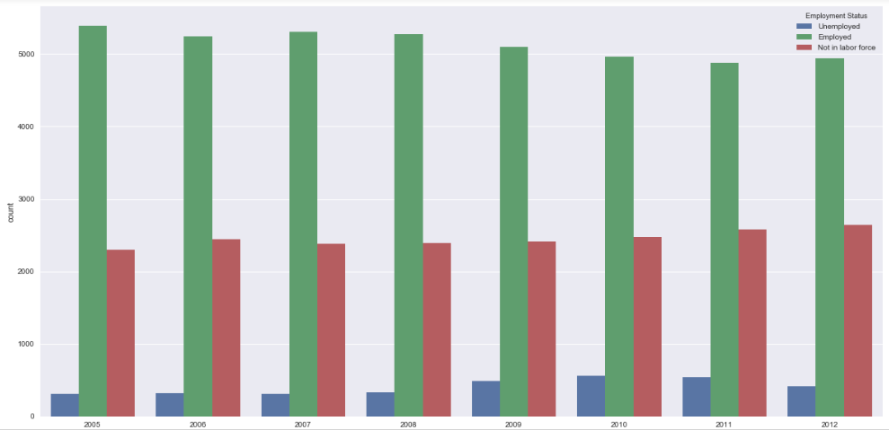
Year distribution across Employment Status
Number of UNEMPLOYED people tend to increase over the years on average until 2010, after which it decreases by a smaller margin.
Number of EMPLOYED people have decreased over the years on average.
Number of people NOT IN LABOR FORCE have increased over the years on average.

Slide 12
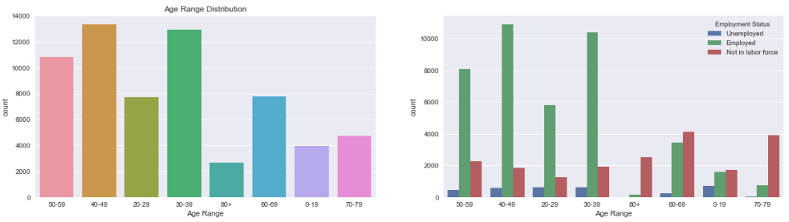
Age Range distribution across Employment Status
There are more number of samples for age ranges: 20-29, 30-39, 40-49, and 50-59. This also explains the fact that most people work when their ages are in these ranges. This is supported by the bar chart on the right. We can see that there are indeed more number of samples(people) that are employed compared to other classes for these age ranges.
As one would expect, the trend tends to invert when the age range increases. That is, for higher age ranges (60-69, 70-79 and 80+) as well as lowest age range (0-19, denoting children), most of the samples(people) are unemployed.

Slide 13
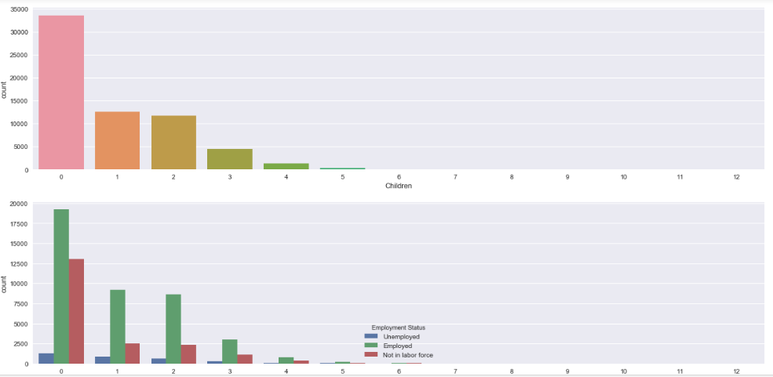
Children distribution across Employment Status
There are too many samples where people don't have children. Also, for these samples, there's a really high percentage of pepople that are employed. Also, somewhat similar, but a bit lesser percentage of people are unemployed.
A trend that is visible in this chart is that - Almost for every case the proportion of EMPLOYED:UNEMPLOYED:NOT IN LABOR FORCE remains same. However, the number of samples decreases as number of children increases.

Slide 14
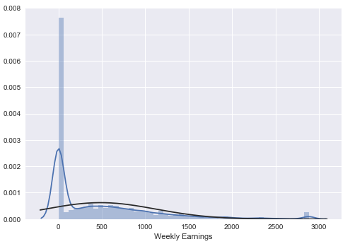
Weekly Earnings
Looks like the data is positively skewed. Disproportionately, a very high number of samples are there that don't earn anything.

Slide 15
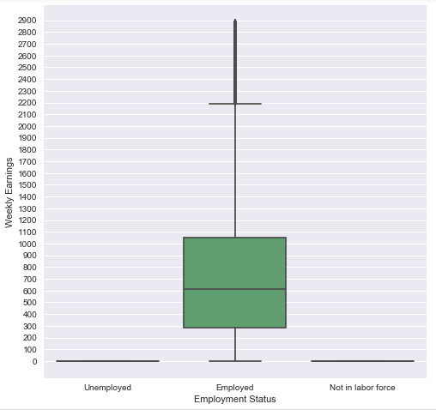
Weekly Earnings across Employment Status
As we can see, on average, employed people earn about 610 with the maximum and minimum weekly earnings being 2200 and 0 respectively.

Slide 16
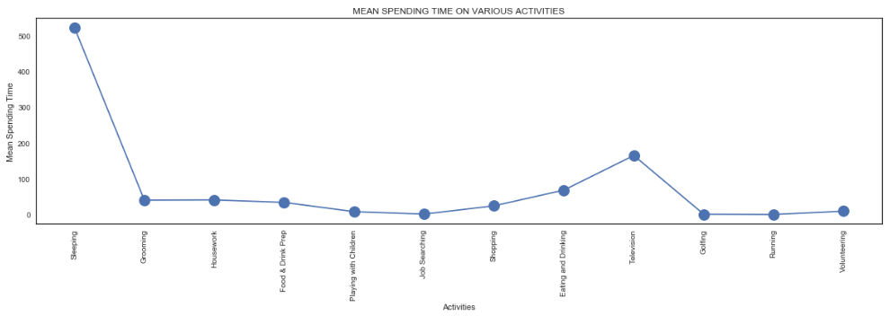
Time spent in various activities (in minutes) on average

Slide 17
On average most time of the day is spent in sleeping – 550 minutes
Then, it’s watching Television – 200 minutes
Then, it’s eating or drinking – 90 minutes
Then, after these, for almost all the activities the spending time is between 0 to 70 minutes

Slide 18
Model Design

Slide 19
Following Models were implemented
Logistic Regression
Random Forest
Support Vector Machines (SVM)
Naïve Bayes
K-Nearest Neighbours (KNN)
Decision Trees

Slide 20
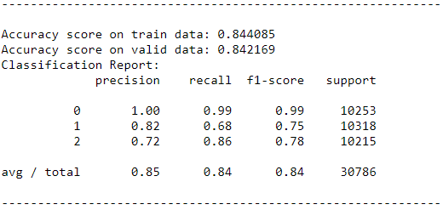
Logistic Regression

Slide 21
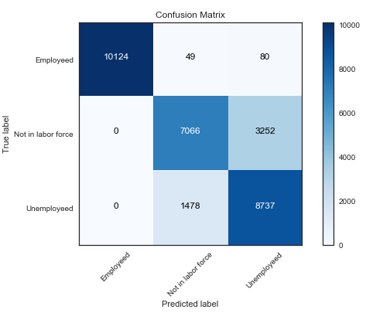
Logistic Regression Confusion Matrix

Slide 22
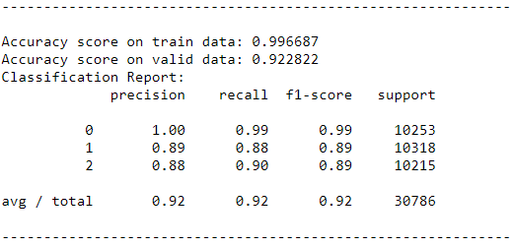
RANDOM FOREST

Slide 23
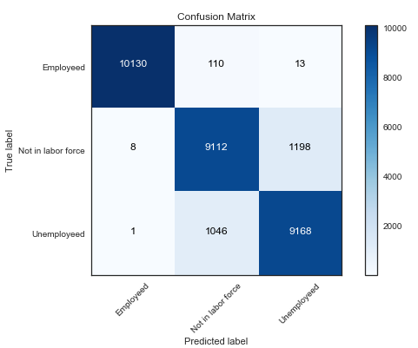
RANDOM FOREST CONFUSION MATRIX

Slide 24
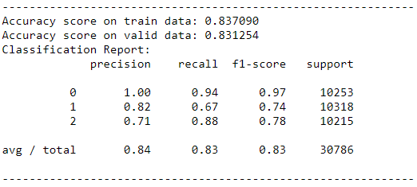
SUPPORT VECTOR MACHINES

Slide 25
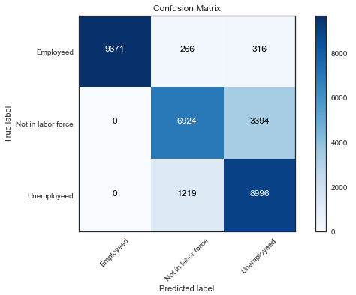
SVM CONFUSION MATRIX

Slide 26
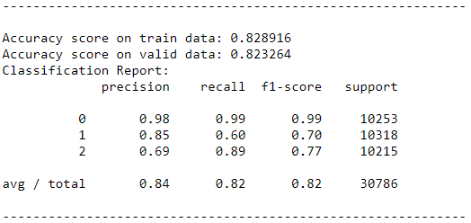
NAIVE BAYES CLASSIFIER

Slide 27
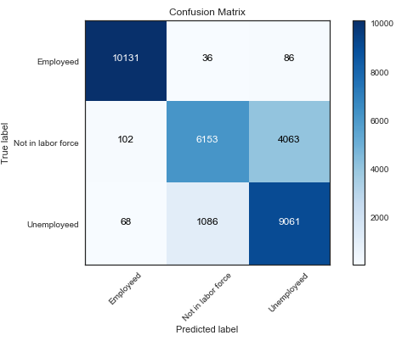
NAÏVE BAYES CONFUSION MATRIX

Slide 28
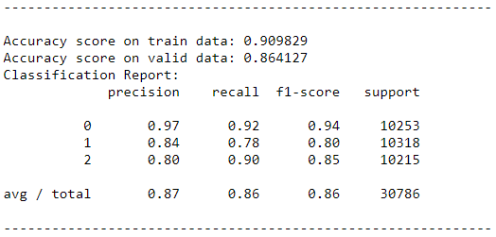
K-NEAREST NEIGHBOURS

Slide 29
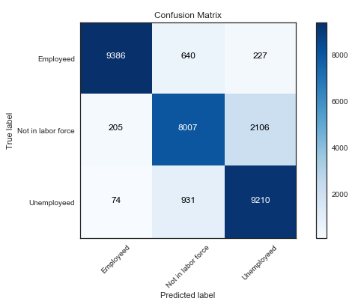
K-NEAREST NEIGHBOURS CONFUSION MATRIX

Slide 30
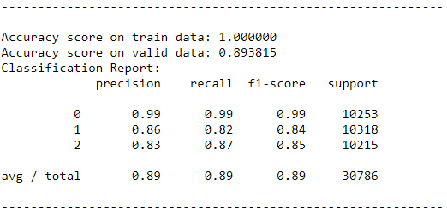
DECISION TREES

Slide 31
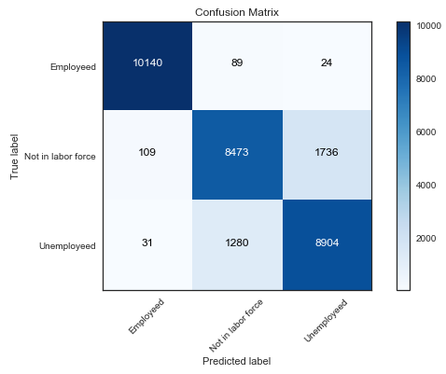
DECISION TREES CONFUSION MATRIX

Slide 32
Conclusion / Takeaways

Slide 33
We become familiar with the data set and studied various features.
We then did dome exploration formally called as EDA – Exploratory Data Analysis where we plotted all the features one by one against the target variable (Employment Status) and saw the relation and distribution of each. It helped in getting various helpful insights into the dataset.
We then studied the correlation between various features and removed one of the highly correlated features making sure that only one is left behind.
We then did some data-preprocessing which included label encoding to target variable, doing oversampling with SMOTETomek, creating dummy variables and scaling features.
We then defined a function to plot confusion matrix.
Finally, we implemented various Classification Machine Learning Algorithms on our dataset and assessed each with the help of
Accuracy on the training dataset
Accuracy on the validation dataset
Precision
Recall
F-1 Score

Slide 34
We also plotted confusion matrix for each of the models.
We saw that almost all the models performed well. But, Random Forest in particular demonstrated best results - 99% accuracy on the training set and 92% on the validation set. The mean F-1 score was 92%.
Thus, this project helped us(me) in understanding the flow of data science work (data science pipeline), how to perform EDA, how to do data pre-processing, how to write Python functions and many other things as mentioned earlier. It gave a really good hands on experience. Also, lectures by you (professor) helped in learning various data science concepts and technicalities related to Python.
THANK YOU

