Slide 1



Python + MySQL
Data Analytics Project
Title: Zudio Sales Analysis Integrating Python & MySQL
Project Overview: The Zudio Sales Analysis project integrates MySQL for data storage and querying with Python for advanced analysis and EDA. The primary objective is to derive actionable insights into Zudio's sales performance across stores, products, and customers.

Slide 2
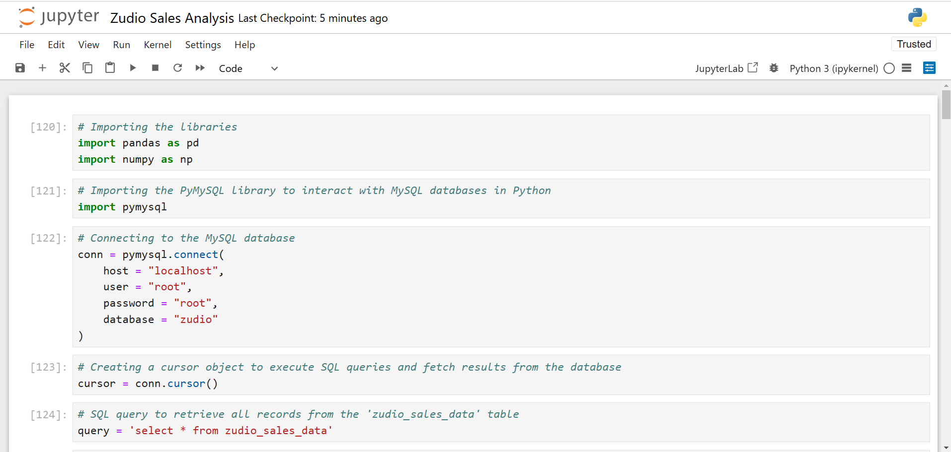

Slide 3
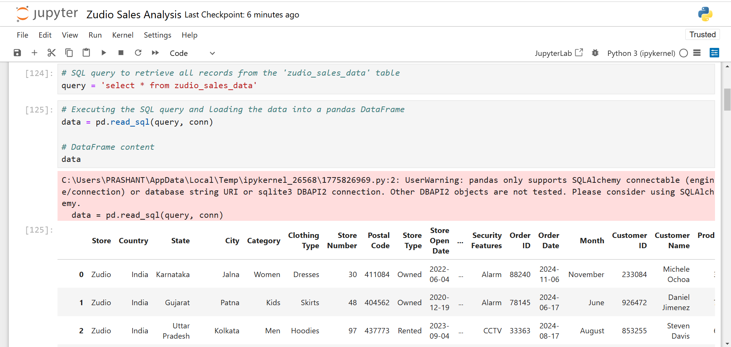

Slide 4
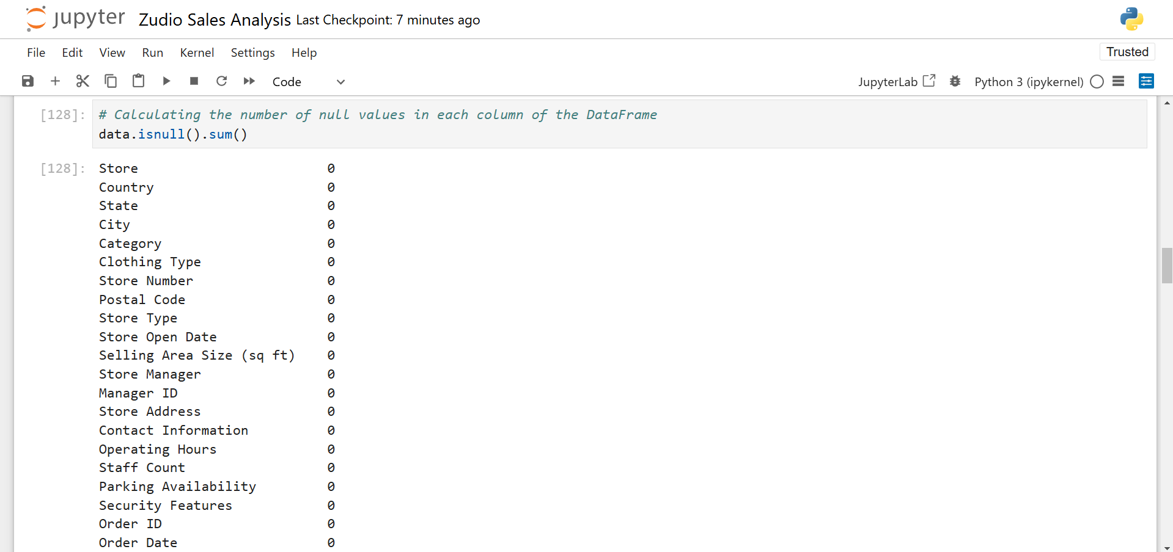

Slide 5
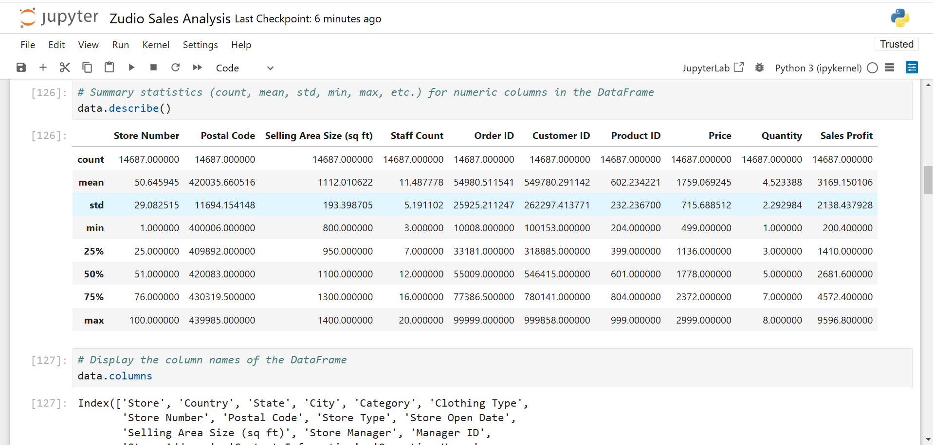

Slide 6
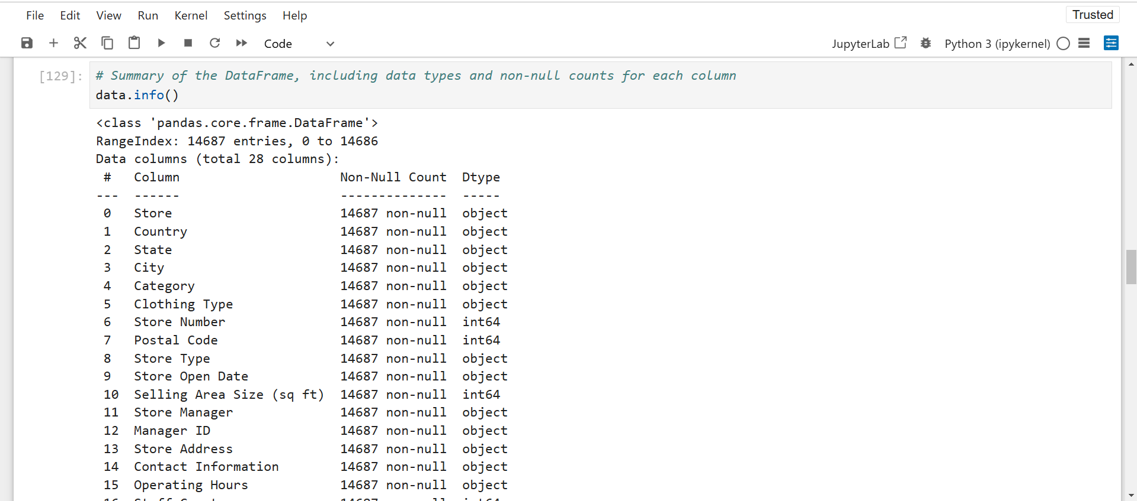

Slide 7

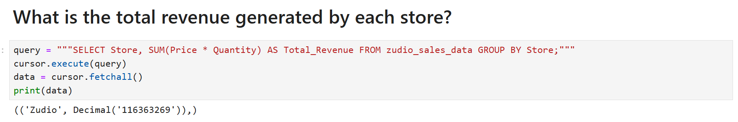
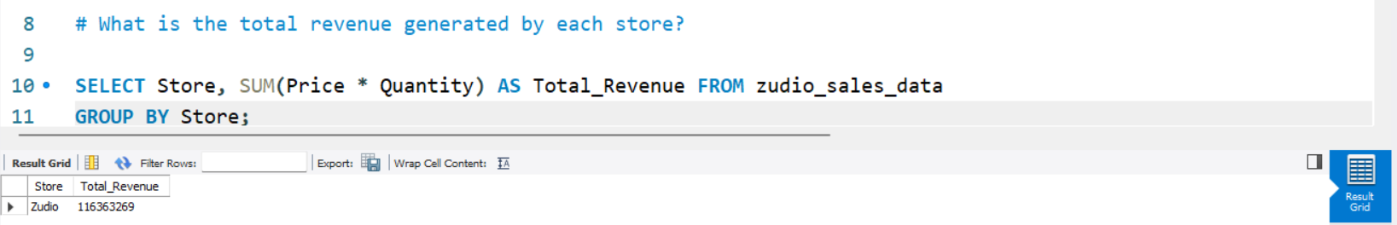
_________________________________________________________________________________________________________________________

Slide 8
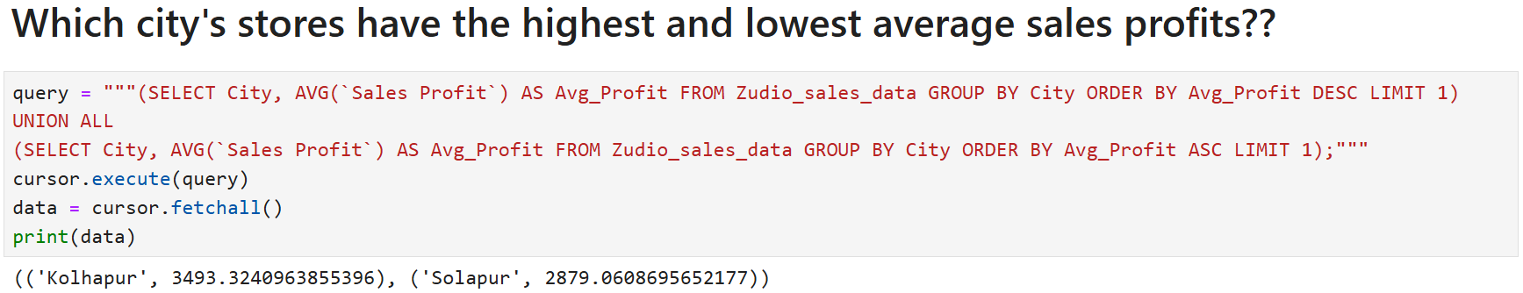
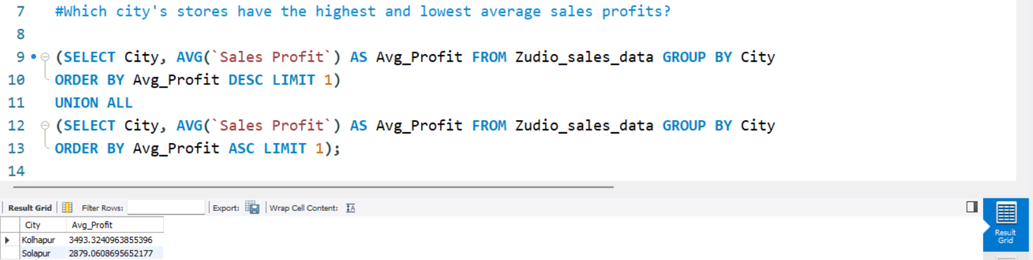
_________________________________________________________________________________________________________________________

Slide 9
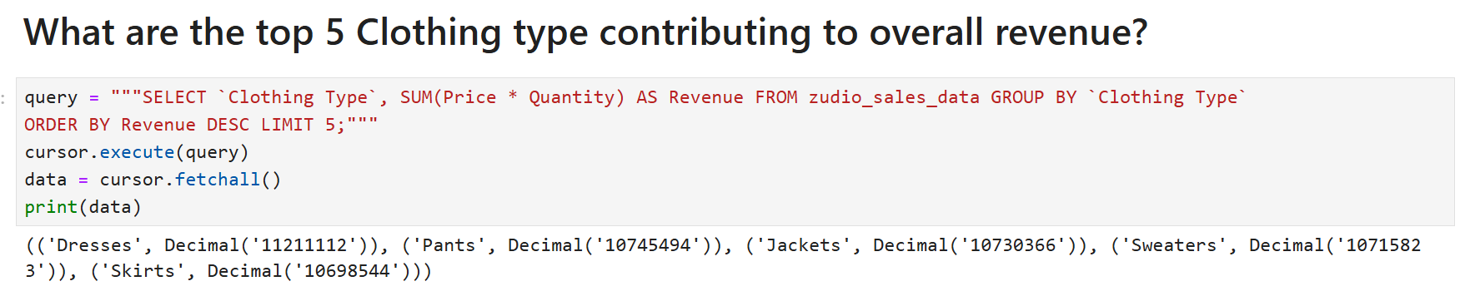
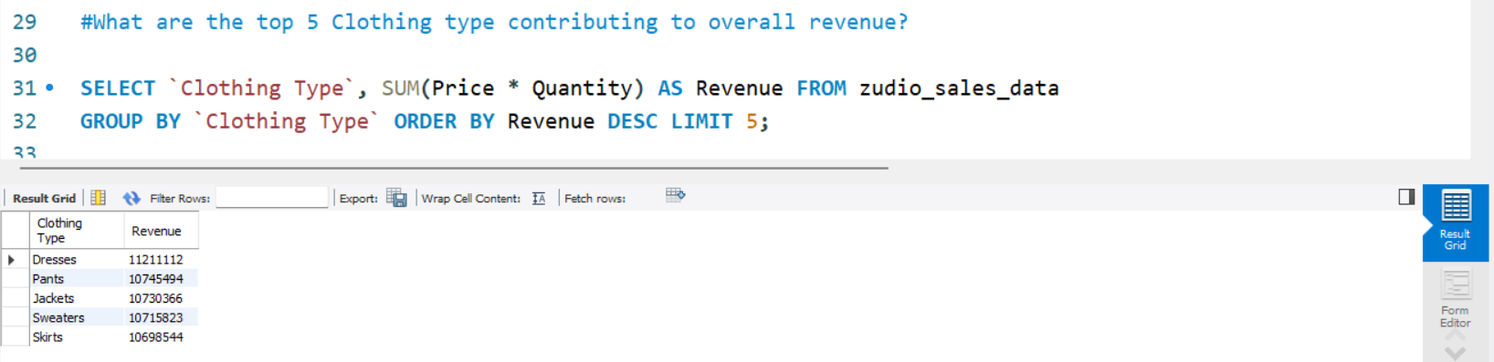
_________________________________________________________________________________________________________________________

Slide 10
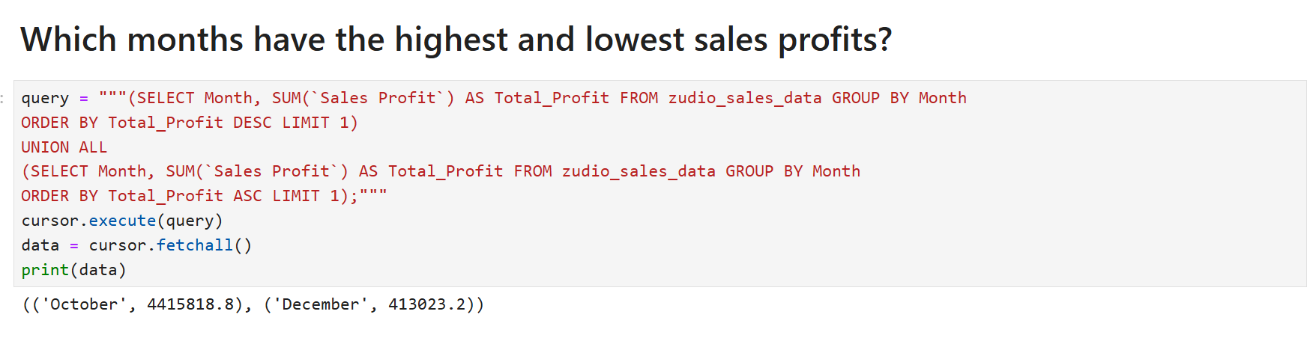
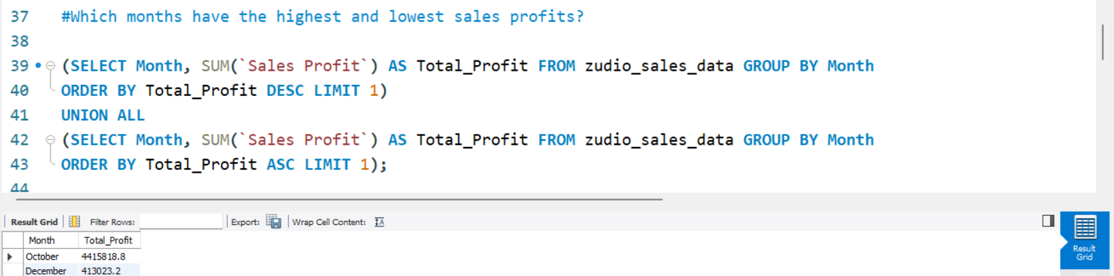
_________________________________________________________________________________________________________________________

Slide 11
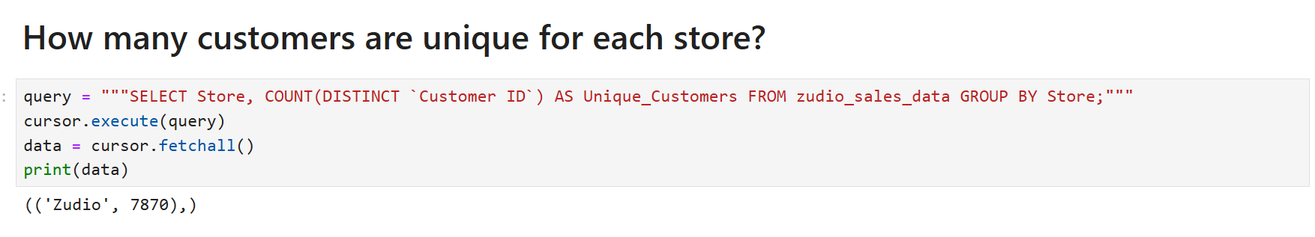
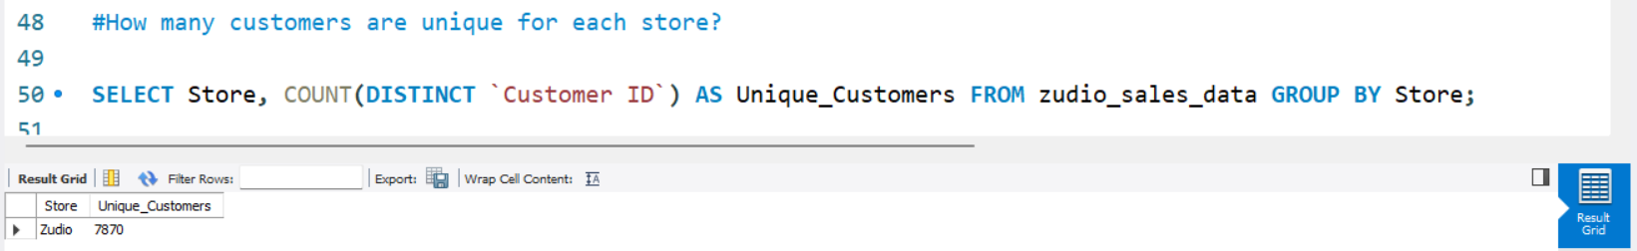
_________________________________________________________________________________________________________________________

Slide 12
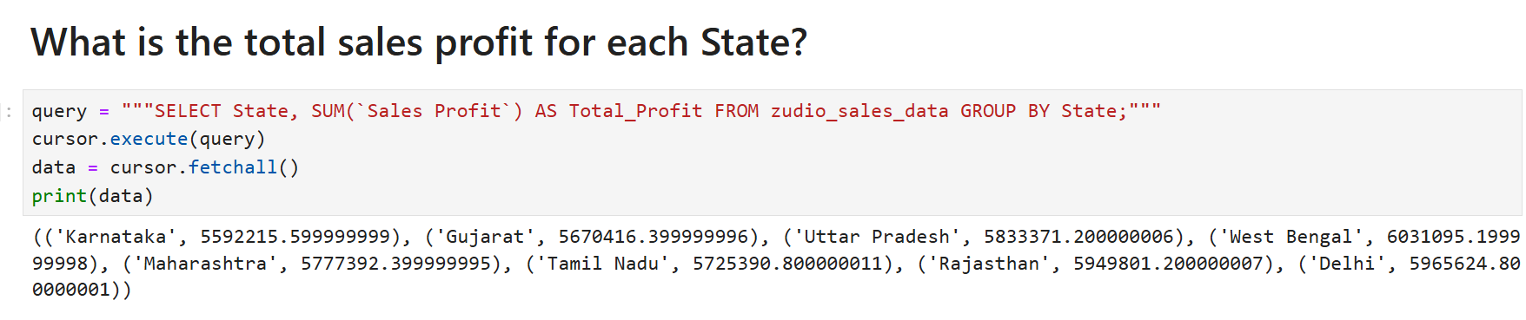
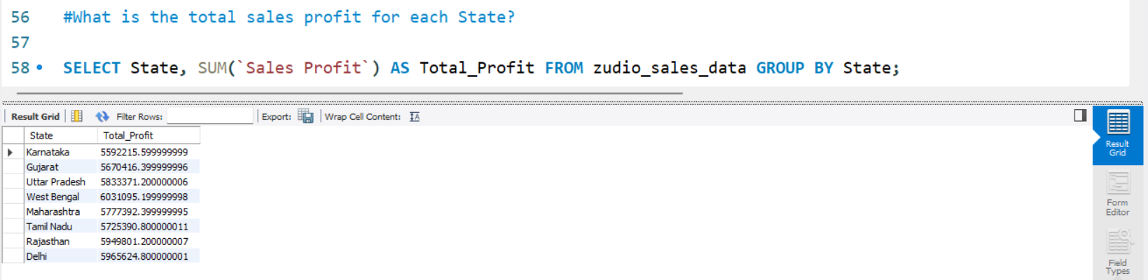
_________________________________________________________________________________________________________________________

Slide 13
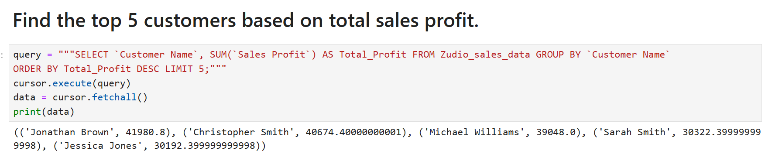
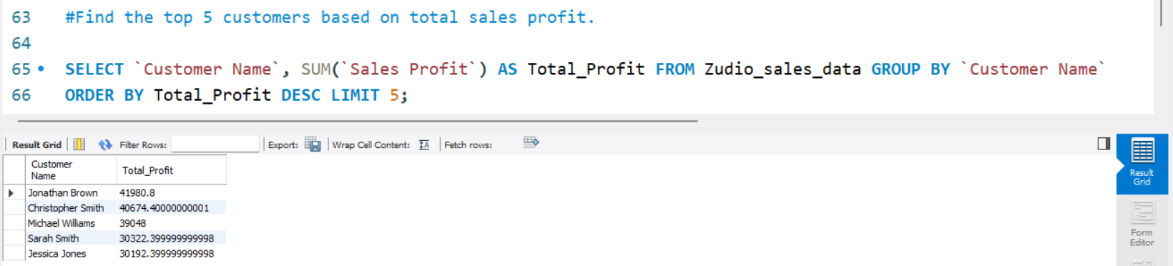
_________________________________________________________________________________________________________________________

Slide 14
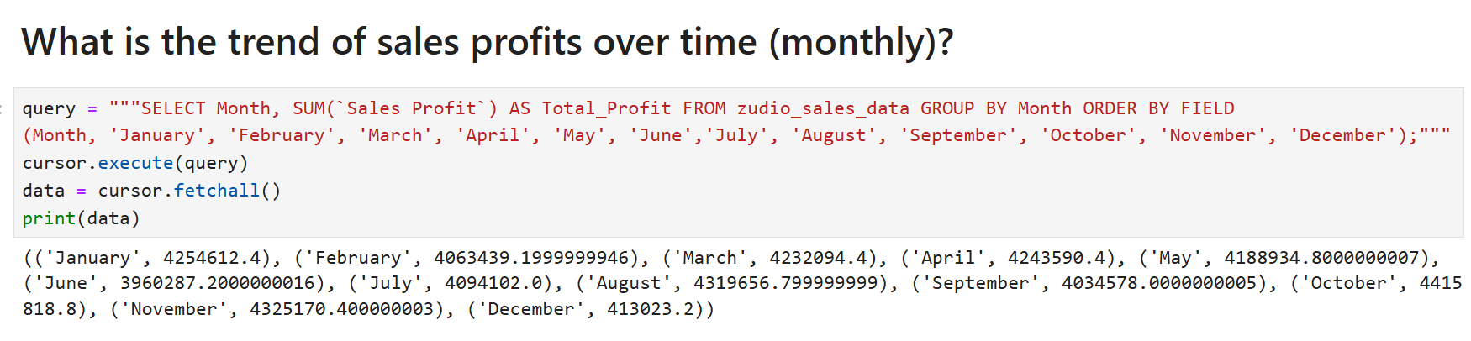
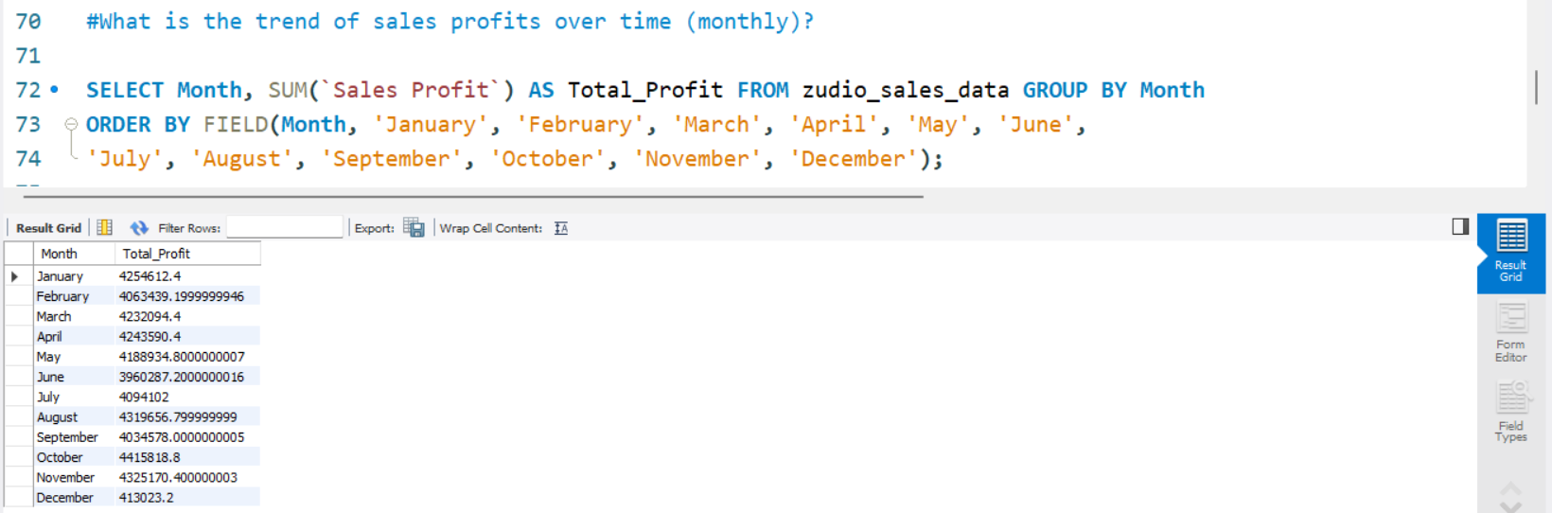
_________________________________________________________________________________________________________________________

Slide 15
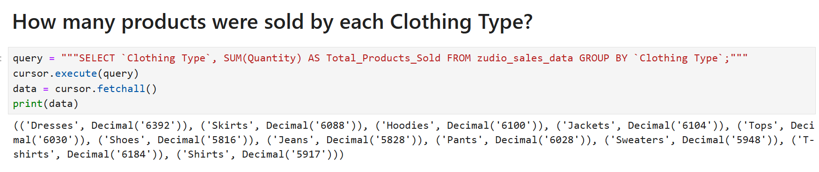
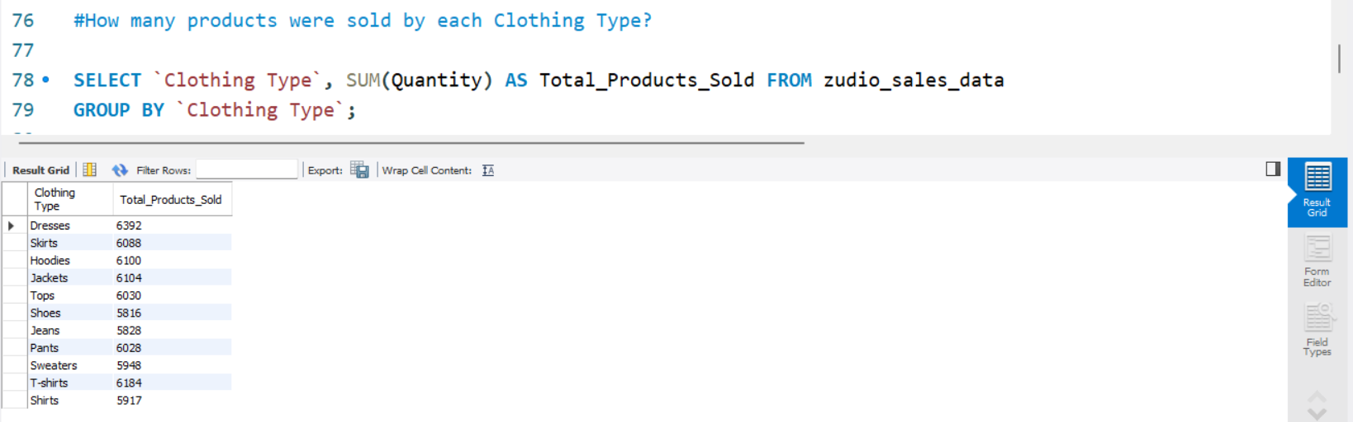
_________________________________________________________________________________________________________________________

Slide 16
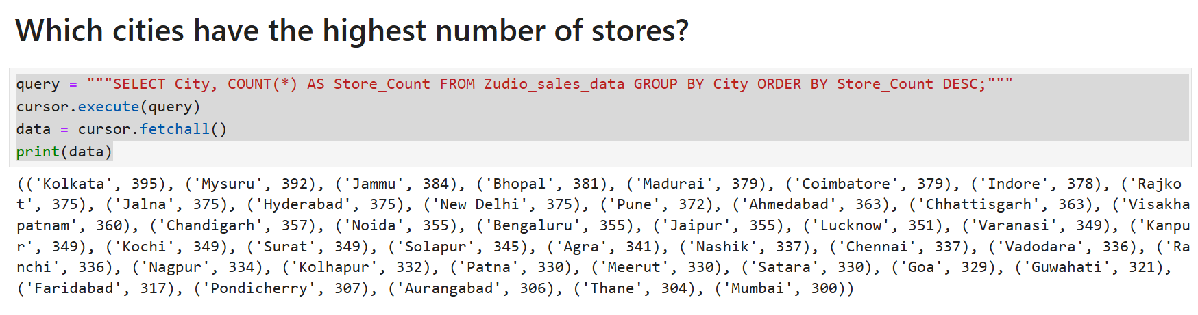
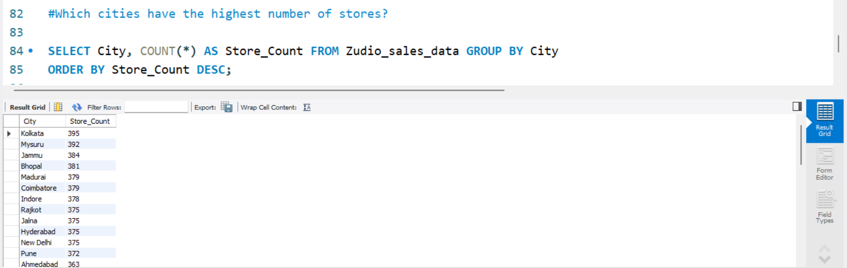
_________________________________________________________________________________________________________________________

Slide 17
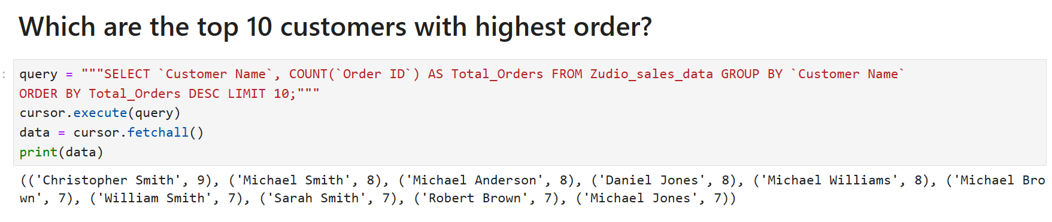
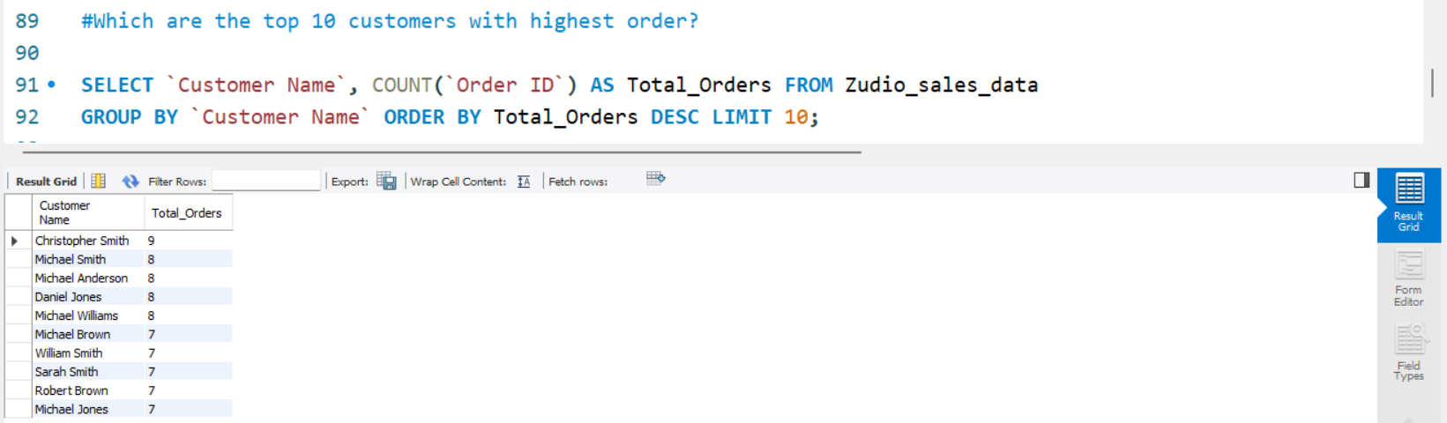
_________________________________________________________________________________________________________________________

Slide 18



