Slide 1
SCRUM MODEL
GROUP NO : 17
PROJECT SUPERVISOR : DR. MUKESH KUMAR
Team members
NAME ROLL NO
PRASHANT THAKUR 1706001
NEHAL KUMAR 1706049
ATUL RAJ 1706090
VAIBHAV JAISWAL 1706137

Slide 2
SCRUM
Scrum is an agile development methodology used in the development of Software based on an iterative and incremental processes.
Scrum is adaptable, fast, flexible and effective agile framework that is designed to deliver value to the customer throughout the development of the project.
The primary objective of Scrum is to satisfy the customer’s need through an environment of transparency in communication, collective responsibility and continuous progress.
The development starts from a general idea of ​​what needs to be built, elaborating a list of characteristics ordered by priority (product backlog) that the owner of the product wants to obtain.

Slide 3
History
In 1993, Jeff Sutherland and his team at Easel Corporation created the Scrum process to be used in software development processes by combining the concepts of the 1986 article with the concepts of object-oriented development, empirical process control, iterative development and incremental, software processes and productivity improvement, as well as the development of complex and dynamic systems.

Slide 4
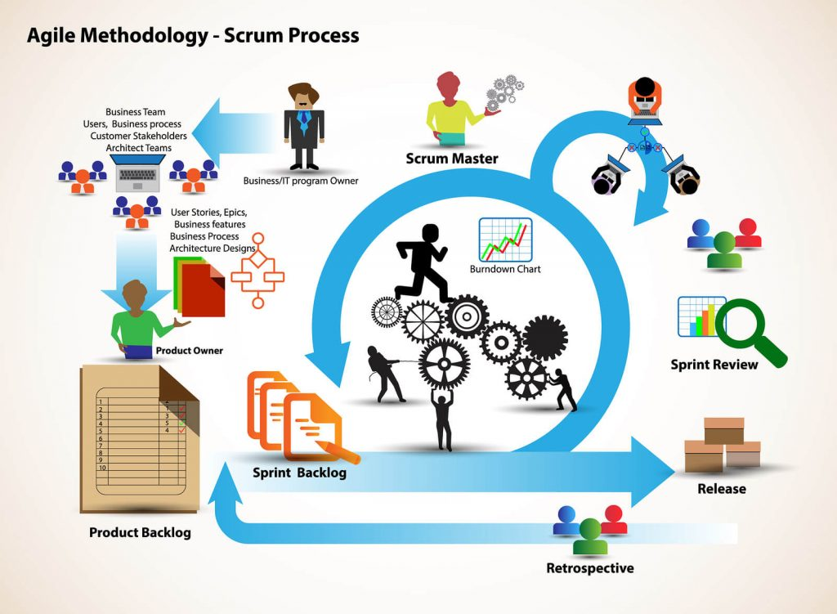

Slide 5
Methodology
Scrum is precisely an evolution of Agile Management. Scrum methodology is based on a set of very defined practices and roles that must be involved during the software development process.
It is a flexible methodology that rewards the application of the 12 agile principles in a context agreed by all the team members of the product.

Slide 6
Sprints
Scrum is executed in temporary blocks that are short and periodic, called Sprints, which usually range from 2 to 4 weeks, which is the term for feedback and reflection.
Each Sprint is an entity in itself, that is, it provides a complete result, a variation of the final product that must be able to be delivered to the client with the least possible effort when requested.

Slide 7
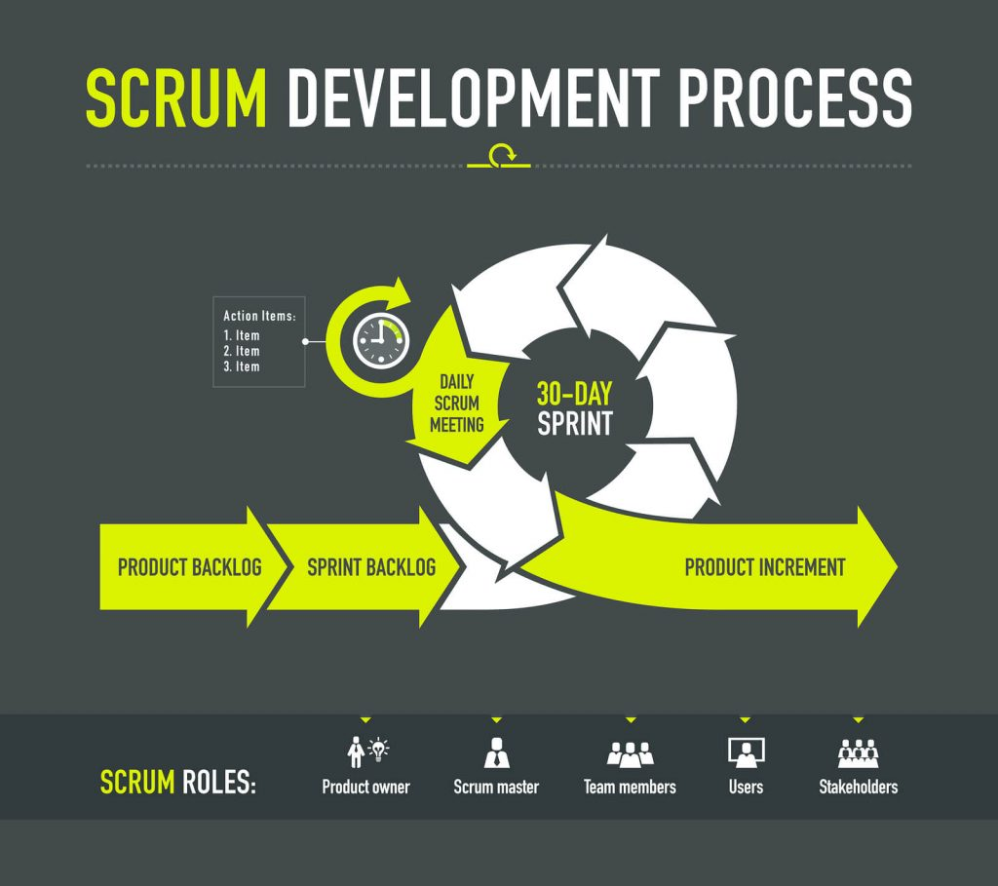
Development process

Slide 8
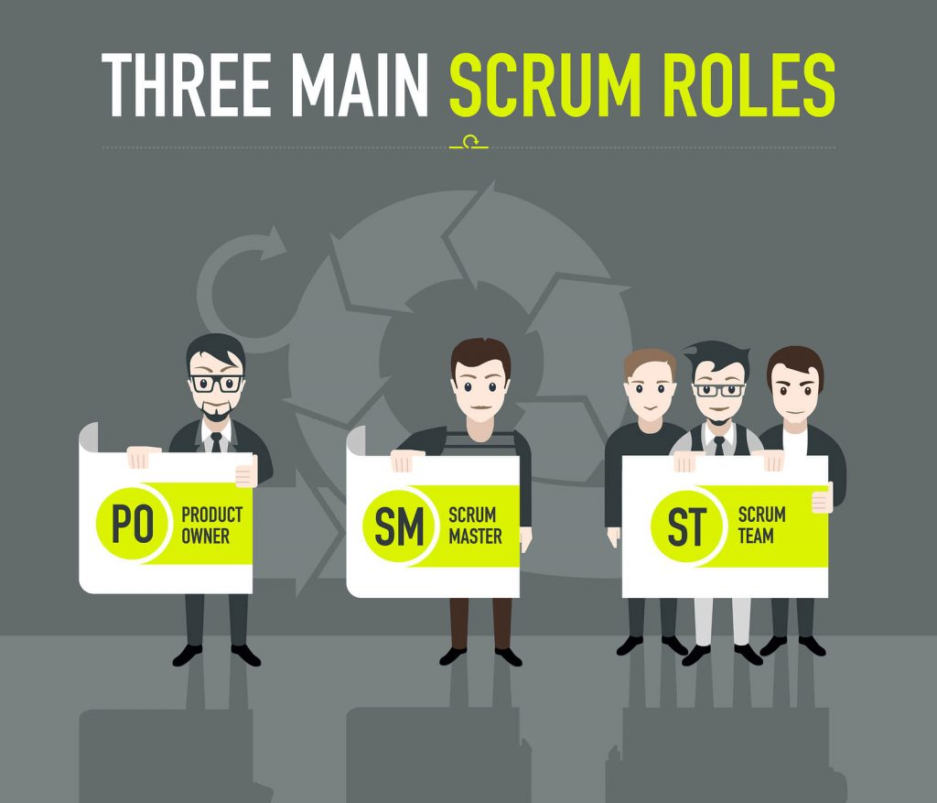
Different Roles in Scrum

Slide 9
Scrum master:
The person who leads the team guiding them to comply with the rules and processes of the methodology. Scrum master manages the reduction of impediments of the project and works with the Product Owner to maximize the ROI.
The Scrum Master is in charge of keeping Scrum up to date, providing coaching, mentoring and training to the teams in case it needs it.

Slide 10
Product owner (PO):
Product owner (PO) is the representative of the stakeholders and customers who use the software. They focus on the business part and is responsible for the ROI of the project.
They Translate the vision of the project to the team, validate the benefits in stories to be incorporated into the Product Backlog and prioritize them on a regular basis.

Slide 11
Team:
Team is a group of professionals with the necessary technical knowledge who develop the project jointly carrying out the stories they commit to at the start of each sprint.

Slide 12
Benefits of Scrum Methodology
Easily Scalable:
Compliance of expectations:
Flexible to changes:
Time to Market reduction:

Slide 13
Benefits of Scrum Methodology
Higher software quality
Timely Prediction:
Reduction of risks

Slide 14
Events in Scrum
Sprint:
Sprint Planning:
Daily Scrum:

Slide 15
Scrum Artifacts
Sprint Review
Sprint Retrospective:

Slide 16
Scrum Artifacts
Product Backlog (PB): The product backlog is a list that collects everything the product needs to satisfy the potential customers. It is prepared by the product owner and the functions are prioritized according to what is more and less important for the business. The goal is for the product owner to answer the question “What should be done”.

Slide 17
Scrum Artifacts
Sprint Backlog (SB): It is a subset of items of the product backlog, which are selected by the team to perform during the sprint on which they are going to work. The team establishes the duration of each Sprint. Usually the sprint backlog, is displayed on physical boards called as Scrum board – that makes the development process visible to everyone who enters the development area.

Slide 18
Scrum Artifacts
Increment: The Increment is the sum of all the tasks, use cases, user stories, product backlogs and any element that was developed during the sprint and that will be made available to the end user in the form of Software.

Slide 19
Planning in Scrum
The Sprint Planning Meeting is held at the beginning of each Sprint. All the members of the Team participate in the meeting, i.e., the Product Owner, Scrum Master and all the Development Team.
The client shows the result to be achieved in that Sprint and the requirements of the deliverable product.
Both the Scrum Master and the Product Owner must collaborate to clarify any aspect of the requirements

Slide 20
