Slide 1
MULTI-MODAL FAKE NEWS AND TAMPERED IMAGE DETECTION USING TRANSFORMER AND CNN-BASED ALGORITHMS
Prashant Digambar Waghela
Student ID: x20207786
Project Supervisor: Prof. Vladimir Milosavljevic

Slide 2
INTRODUCTION
Increase in fake news and spam messages due to digitization.
Need for a refined fake news detection technique
Aim to reduce the spread of misinformation among people.
Research Question:
How do multimodal Transformer-based text and CNN-based image classifier models detect fake news and fabricated photos simultaneously, thereby reducing the spread of misinformation?

Slide 3
OBJECTIVE & RESEARCH MOTIVATION
Fake news detection and tampered image identification are the areas that are researched individually.
2-factor verification based on text and images of the news at the same can provide better performance for the fake news detection.
Unique multimodal approach using Transformer-based text classifier and a CNN-based image classifier.

Slide 4
KEY LITERATURE REVIEW PAPERS
Rodríguez, Á.I. and Iglesias, L.L., 2019. Fake news detection using deep learning. arXiv preprint arXiv:1910.03496.
Performed fake news detection using transformer-based model.
Diallo, B., Urruty, T., Bourdon, P. and Fernandez-Maloigne, C., 2020. Robust forgery detection for compressed images using CNN supervision. Forensic Science International: Reports, 2, p.100112.
Implemented a CNN-based image classifier for forged image detection
Sharma, D.K. and Garg, S., 2021. IFND: a benchmark dataset for fake news detection. Complex & Intelligent Systems, pp.1-21.
Validation of multimodal approach to improve the performance in comparison to individual algorithms.

Slide 5
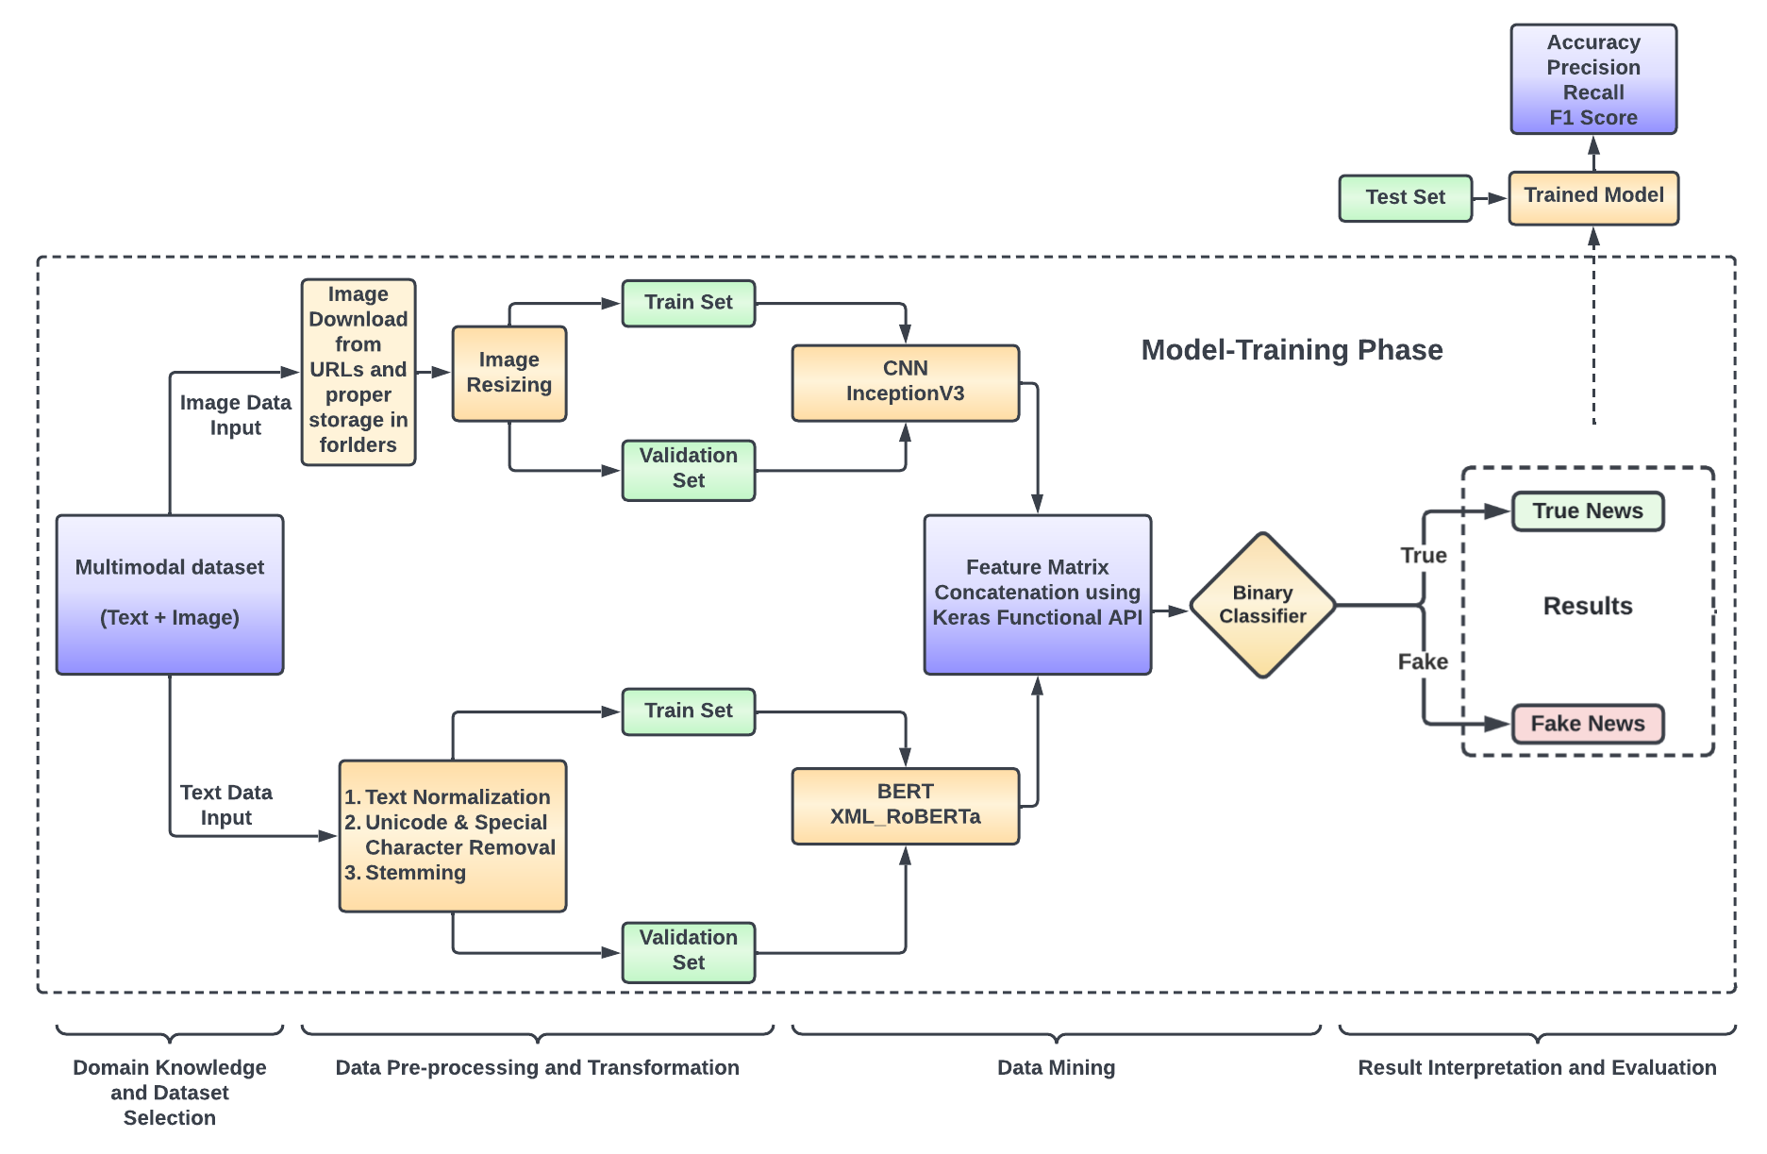
PROCESS FLOW

Slide 6
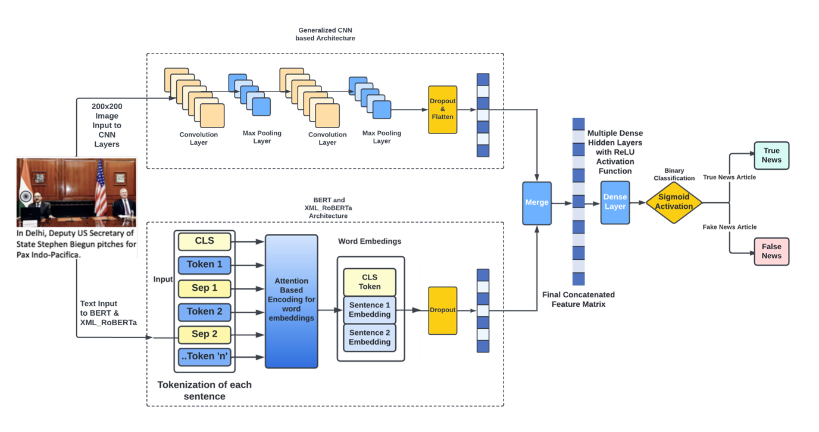
DETAILED MULTIMODAL ARCHITECTURE

Slide 7
IMPLEMENTED MODEL SPECIFICATIONS
Multimodal Algorithm Parameters
Model Parameters | BERT + CNN | BERT + InceptionV3 | XML_RoBERTa + CNN
Trainable Parameters | 74,71,745 | 1,73,69,601 | 3,54,34,945
Optimizer with Learning Rate | Adam (0.001) | Adam (0.001) | Adam (0.001)
Loss Function Used | Binary Cross Entropy | Binary Cross Entropy | Binary Cross Entropy
Early Stopping Patience | 3 | 3 | 3
Batch Size | 64 | 128 | 128
Epochs | 10 | 10 | 10
Unimodal Algorithm Parameters
Model Parameters | BERT | XML_RoBERTa
Trainable Parameters | 769 | 769
Optimizer with Learning Rate | Adam (0.001) | Adam (0.001)
Loss Function Used | Binary Cross Entropy | Binary Cross Entropy
Early Stopping Patience | 3 | 3
Batch Size | 32 | 32
Epochs | 10 | 10

Slide 8
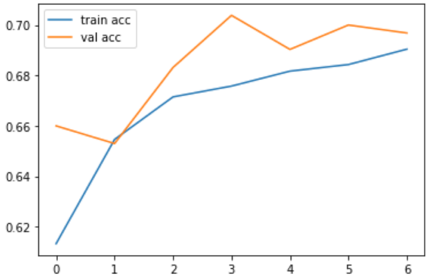
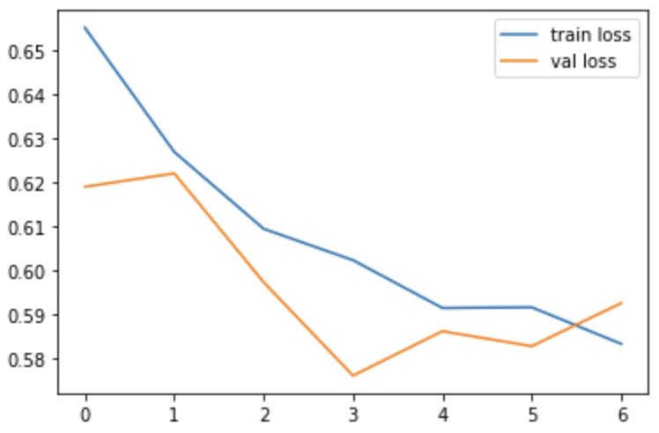
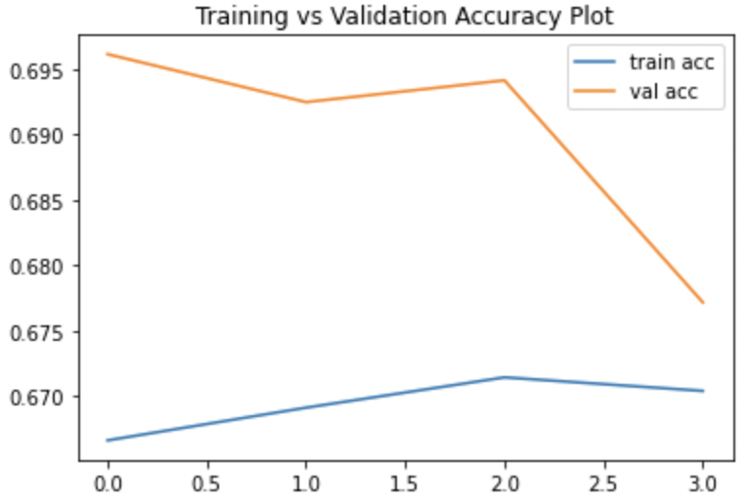
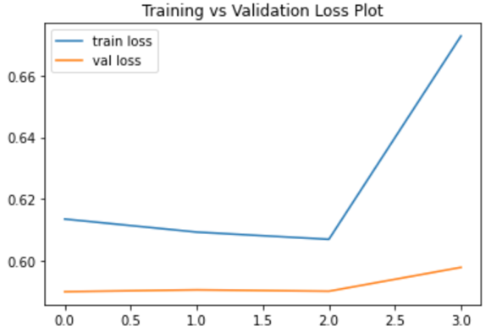
RESULTS AND EVALUATION
BERT_CNN Multimodal Accuracy and Loss Plots
Among the 3 multimodal algorithms, the BERT + CNN model provided the best accuracy and loss plots. The first graph showed that, as the epochs increased, so did the accuracy for both the train and validation datasets which was close to 69%. Moreover, the corresponding loss in the 2nd plot for both these datasets decreased below 0.59, indicating that the model trained itself correctly. Because of the early stopping, this model stopped at the 6th epoch which indicated no new feature extraction from the available data.
BERT_InceptionV3 Multimodal Accuracy and Loss Plots
The model training for the BERT + InceptionV3 model lasted for only 3 epochs because of the use of early stopping. The accuracy plot indicated that the accuracy increased a bit for the first 2 epochs and then reduced and converged to approximately 67% for both the train and validation sets. However, in the loss plot, it was observed that after the 2nd epoch, the model showed an unusual behaviour where the loss increased for both the training and validation data.

Slide 9
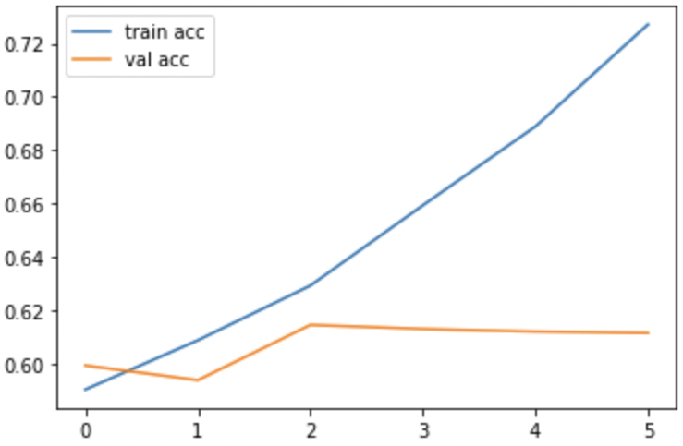
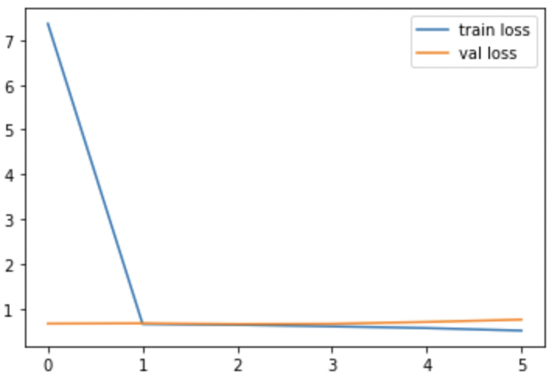
RESULTS AND EVALUATION
XML_RoBERTa_CNN Multimodal Accuracy and Loss Plots
The accuracy and loss plots for the final XML_RoBERTa + CNN multimodal algorithm lasted for 5 epochs because of the early stopping patience defined in the model training. The accuracy values for the train and validation data diverged substantially after the 2nd epoch wherein the training accuracy reached close to 73% and the validation accuracy reduced below 62% which represented overfitting of training data. The loss plot depicted that it reduced throughout the model training and reached a value of 0.51 and 0.72 at the final epoch for the train and validation data, respectively.

Slide 10
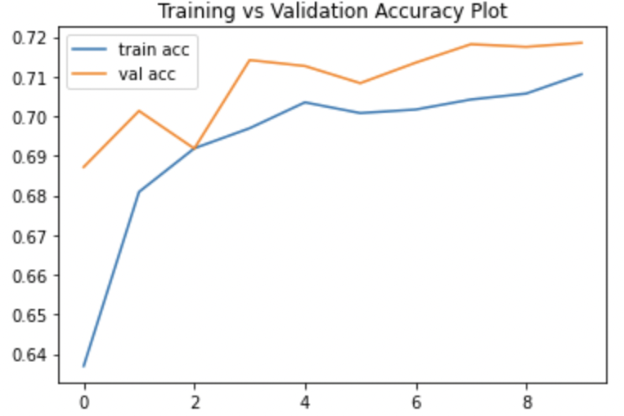
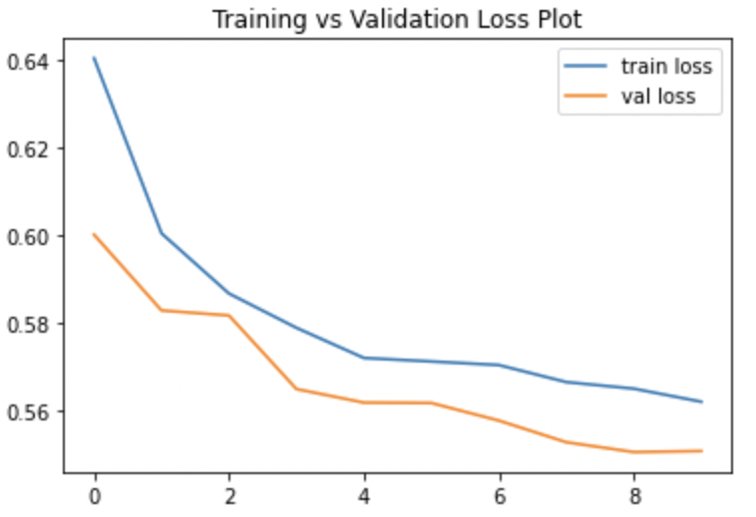
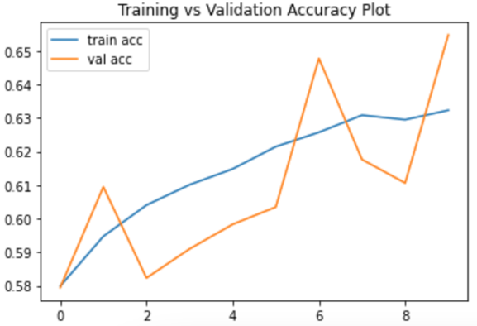
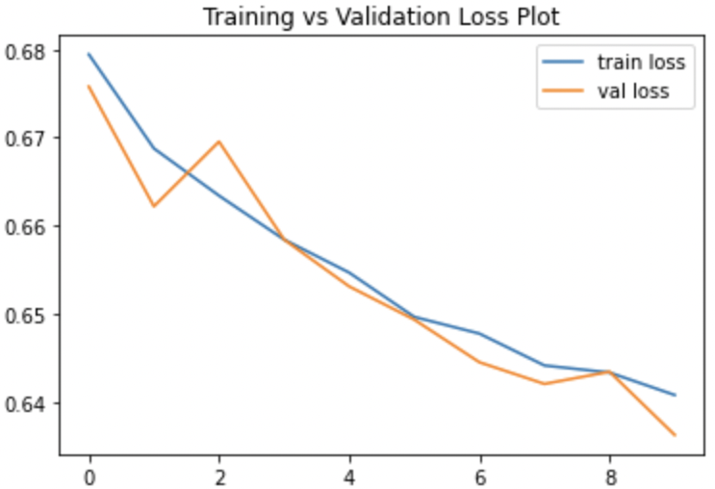
RESULTS AND EVALUATION
BERT Accuracy and Loss Plots
The unimodal BERT model produced a better performance for the fake news classification in comparison to the XML_RoBERTa algorithm. Here the model training lasted for 9 epochs after which the early stopping kicked in to stop the model training process. The BERT model trained itself appropriately and this evaluation was supported by the continuous increase in accuracy of train and validation data. Moreover, the loss values reduced below 0.57 for both the datasets.
XML_RoBERTa Accuracy and Loss Plots
The model training for the XML_RoBERTa text classifier occurred till 9 epochs, and it showed an ideal behaviour for both the accuracy and loss plots. The accuracy increased throughout the training phase and its values at the final epoch were close as well for both the train and validation sets. The loss plot showed ideal behaviour too however, the loss values at the final epoch were close to 0.64 which was comparatively higher than the unimodal BERT model.

Slide 11
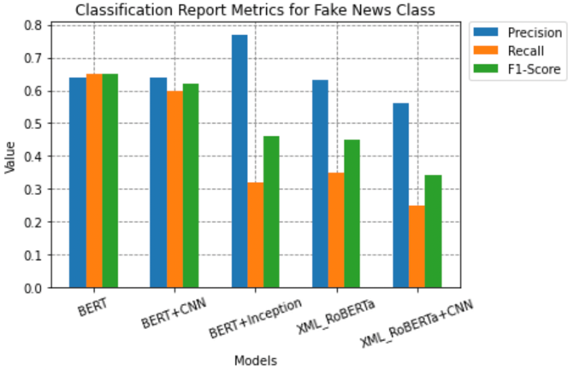
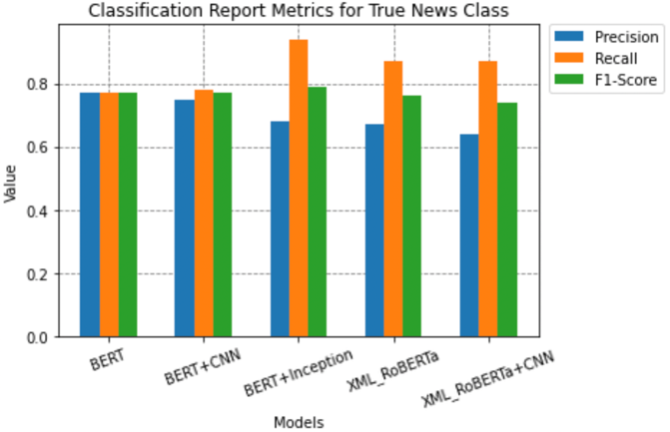
RESULTS AND EVALUATION
The best overall performance in predicting both the news classes in a balanced manner was achieved by the unimodal BERT and the multimodal BERT+CNN models wherein the weighted F1 score was close to 0.71 for both these algorithms.
The prediction of the true news category was done more correctly by all the developed models where the F1 score achieved for the predicted true news class was greater than 0.75 for all the implemented techniques.
BERT+Inception, XML_RoBERTa, and the XML_RoBERTa+CNN models performed poorly in predicting the fake news class and it was evident from their F1 score which was below 0.45 for all three models.

Slide 12
DISCUSSION
The research project primarily aimed at implementing a unique multi-modal algorithm that could handle both the text and image data simultaneously to perform the fake news classification inspired by Sharma, D.K. and Garg, S., (2021).
Based on the literature study, a research experiment to perform 3 custom multimodal combinations including a transformer-based text classifier and a CNN-based image classifier namely BERT+CNN, BERT+InceptionV3, and XML_RoBERTa+CNN were finalized to conduct this research.
The performance of these algorithms had to be compared to the two unimodal BERT and XML_RoBERTa algorithms that only used the textual features to classify the news as true or fake. This comparison was done to validate if the addition of visual data in the multimodal algorithms improved the fake news detection performance as compared to the unimodal text-based models.
These results were crucial in analyzing the research goal of implementing a multimodal architecture to enhance the performance of fake news detection. However, it was observed that the best performing BERT+CNN multimodal architecture provided comparable results to a normal BERT model that only consumed text features.
Models Implemented | Accuracy
BERT | 72%
BERT + CNN | 71%
BERT + Inception | 70%
XML_RoBERTa | 66%
XML_RoBERTa + CNN | 63%

Slide 13
DISCUSSION & CONCLUSION
There could be multiple reasons for this occurrence but, as per the understanding, there was one reason why the multimodal accuracy did not exceed the normal BERT results. The dataset used included news from a variety of domains hence, it could be difficult for the model to extract similar patterns from both the text and image data simultaneously to classify the news with high accuracy.
In other words, this research work for fake news prediction could have been improved if the models were trained separately using single domain data to achieve better results.
Moreover, in terms of execution time as well, the multimodal architecture approximately required 10 times the training time in comparison to the normal text-based model even though the web-based Google Colab Pro was utilized.
This research experiment signified that the addition of visual features did not elevate the performance of the multimodal algorithm to detect fake news instead, it provided similar results as the text-based model.
This comparison also indicated that most of the critical information in the fake news classification task is present within the text data.

Slide 14
FUTURE WORKS
In conclusion, the use of generalized data which included news from multiple domains posed a difficulty in similar feature extraction from the concurrent supply of varied text and image data during the model training phase. A potential future solution to this limitation would be training models on domain-specific data to identify if it achieved higher detection accuracy than the generalized multi-domain data.
Moreover, an introduction of a pre-trained Vision Transformer for image classification may yield interesting results for this multimodal fake news detection task.
Another possible research area for this project would be the addition of text-related metadata, which could be useful in improving the classification performance of multimodal algorithms.

Slide 15
THANK YOU

