Slide 1
Suicidal Content Classification using Transformer-Based Algorithms
Module: data mining and machine learning 2
Lecturer: DR. anu sahni
Student Name: Prashant Waghela (x20207786)
Tanmay Paranjape (x20101015 )
Vishal Patwardhan (x18190839 )
ankit nandwani (x20221266 )

Slide 2
Introduction
The high suicide rate among people is due to multiple reasons. (Root Cause - Depression)
If detected early a likely suicide attempt can be prevented
Research question:
To what extent will a Transformer based BERT and USE models effectively identify suicidal thoughts from the social media posts?

Slide 3
Literature Review
Multiple ideas from the literature review were incorporated such as the use of NLTK for ideal text transformation, target class balancing, and the use of pre-trained Transformer based models for robust performance.
Papers:
[3] “Fake news detection: A hybrid CNN-RNN based deep learning approach,” International Journal of Information Management Data Insights, vol. 1, no. 1, p. 100007, Apr. 2021, doi: 10.1016/j.jjimei.2020.100007. (NLTK)
[15] Nikhileswar, K., Vishal, D., Sphoorthi, L., & Fathimabi, S. (2021). Suicide Ideation Detection in Social Media Forums. 2021 2nd International Conference on Smart Electronics and Communication (ICOSEC), 1741–1747. https://doi.org/10.1109/ICOSEC51865.2021.9591887 (USE and target column balance)

Slide 4

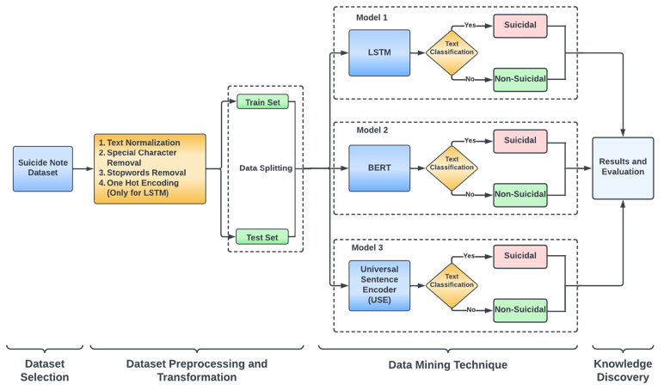
Implementation FLow
The diagram represents complete implementation flow mapped into 5-step KDD

Slide 5
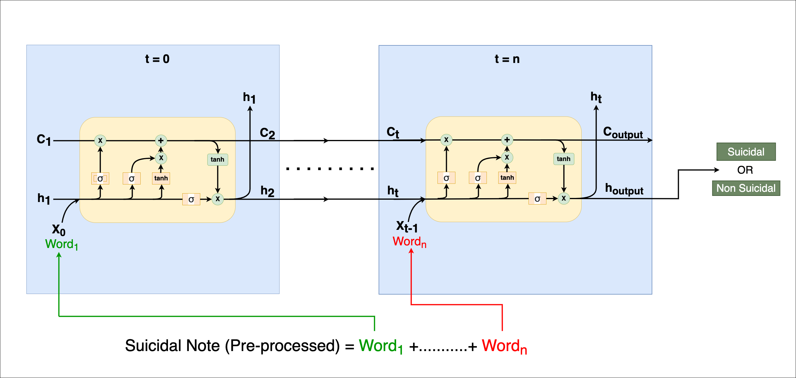
Data Mining Technique Model 1 - LSTM
What is LSTM (Long Short-Term Memory)?
How LSTM works?

Slide 6
Data Mining Technique Model 1 - LSTM
Model Building
1st layer - Embedded layer which defines each word with a vector length of 40.
2nd layer – LSTM layer with 200 memory units
3rd layer – Dropout layer with the rate of 0.7
4th layer – Dense layer with 64 neurons with sigmoid function
5th layer - Dropout layer with the rate of 0.7
6th layer – Dense layer with single neuron with sigmoid function to predict the output in the between -1 and 1

Slide 7
Data Mining Technique Model 1 - LSTM
Model Compilation
Log Loss function – binary crossentropy
Optimizer – ADAM
Epochs – 10
Batch size - 12

Slide 8
How BERT Works ?
BERT ( Bidirectional Encoder Representations from Transformers)
Developed by Google using 2500M words of wikipedia
Pretrained using Mask Language Modeling (MLM) & Next sentence prediction (NSP)
Widely used for Language representations, sensitive content detection as well as for Time series Analysis.

Slide 9
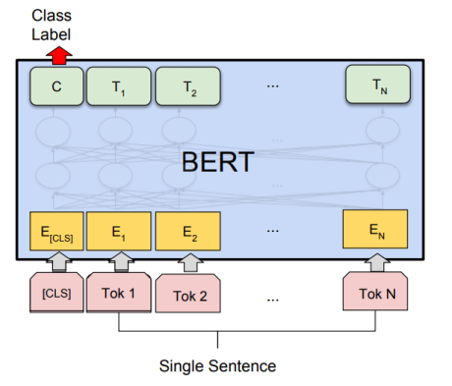
Basic Understanding of BERT

Slide 10
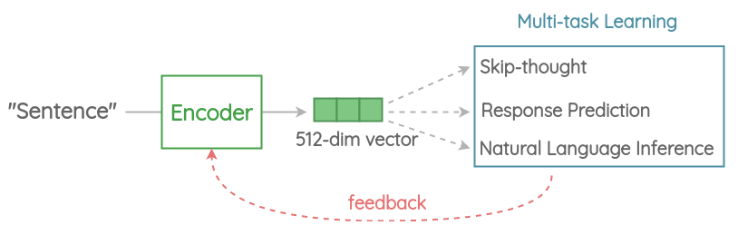
Basic Understanding of USE

Slide 11
Universal Sentence Encoder
Specifically trained for sentence Embedding
It supports 16 different languages
USE supports large texts hence it was ideal for this problem
USE version 3 has been used which is of 800 MB
The output of USE is in the form of 512 dimensional vector

Slide 12
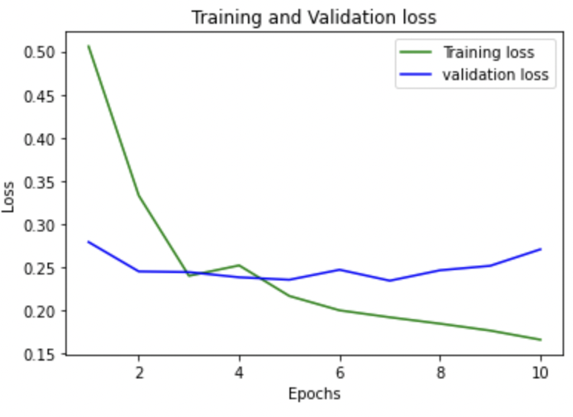
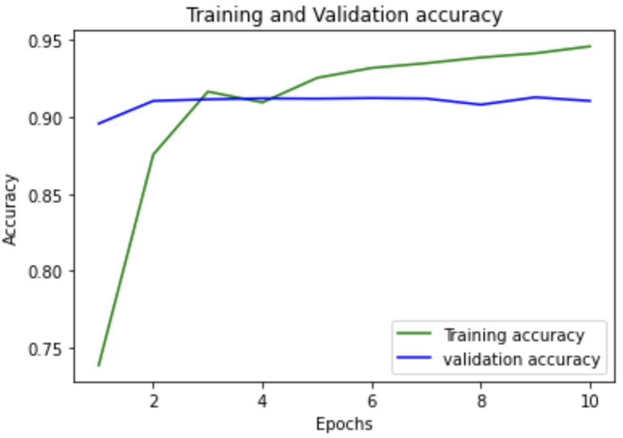
Results
LSTM with NLTK Results
Overall Accuracy:- 91%

Slide 13
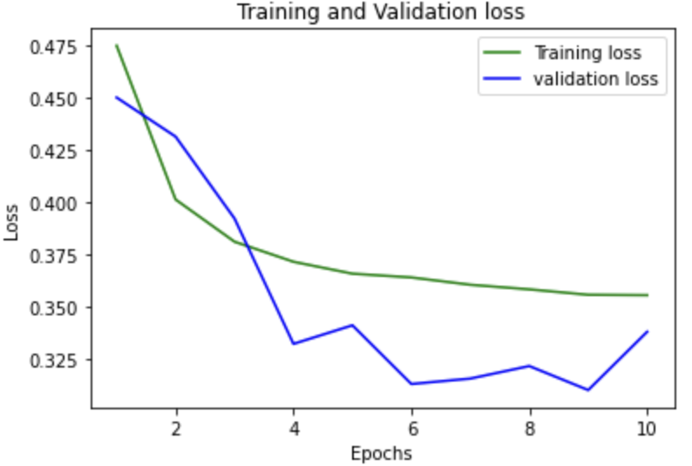
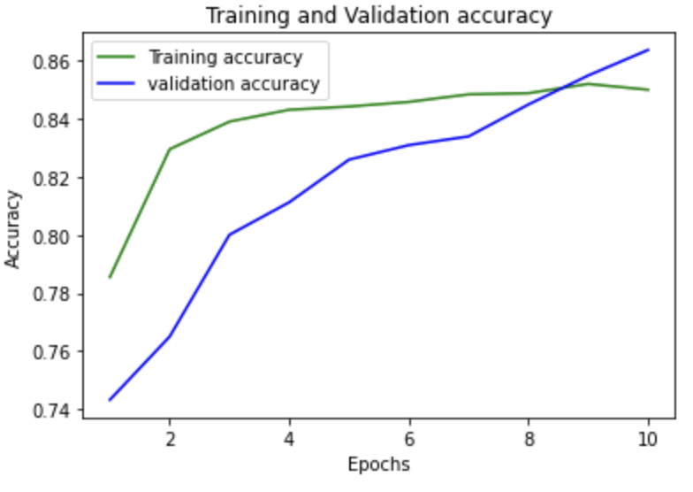
Results
BERT with NLTK
Overall Accuracy:- 86.38%

Slide 14
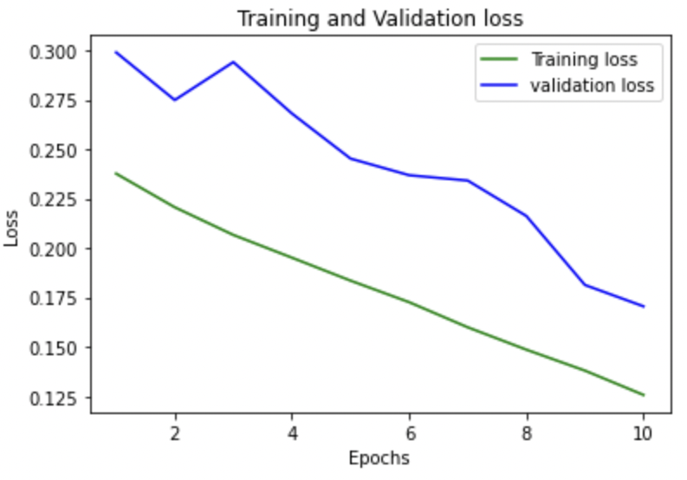
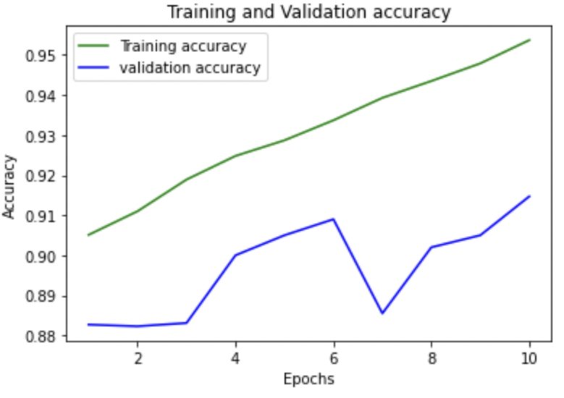
Results
USE with NLTK
Overall Accuracy:- 91%

Slide 15
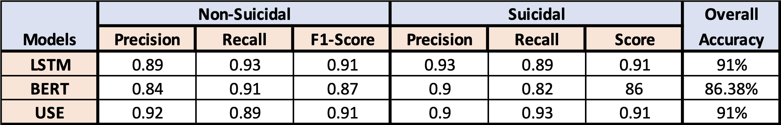
Conclusion & Future Work
Accuracy is high and validation loss is comparatively low for the USE model in both testing and training phases.
USE outperforms both LSTM & BERT.
For future reference, the USE model can be implemented with a notification module.

Slide 16
Thank You

