Slide 1
Diagnosis vs. Planning
Diagnosis is typically a data-driven problem and planning is goal-driven
The idea behind planning is to generate a sequence of operations that, when taken, will fulfill the given goals
  so the process is one of given goals and generating operators in a proper sequence
  like previous problems, we can view this as a state space to search, but we can be more intelligent about how we generate our plan to reduce the complexity
  instead of viewing it as a state space like a tree, we will instead use a production-system type of approach
  all of our operations will have
    preconditions to tell us if the given action is applicable at this state of the problem
    postconditions to tell us what goals they can fulfill when applied

Slide 2
Planning by Subgoaling
This lets us view planning as a process of subgoaling
  given a goal
    find an operator that accomplishes that goal
    but the operator must first be in the proper state before it can be selected
  generate the conditions that need to be true to select that operator
    these are new goals, or subgoals
    add these subgoals to our list of goals
  repeat until the conditions are met by the initial state
We may use a goal stack – to accomplish goal g1, we select operator o1, which itself requires goals g2 and g3, so we push g2 and g3 on to the stack
  when we eventually solve g3, we pop it off the stack, when we accomplish g2, we pop it off the stack, now we can pop g1 off the stack because we accomplished the preconditions for o1 and thus g1

Slide 3
Example: Blocks World Robot
Operators:
  goto(x, y, z) – move robot to location x, y, z
  pickup(w) – pickup the block w, block w must be clear and robotic hand empty to apply this operator
  putdown(w) – place w on the table, block w must already be in the robotic hand
  stack(u, v) – stack block u on top of block v, block u must already be in the robotic hand and v must be clear
  unstack(u, v) – place block u in the robotic hand, block u must be clear and on top of v and the robotic hand must be empty
A state of the world may be given using predicates like
  on(b, a), on(c, b), ontable(a), clear(c), gripping( )
To accomplish unstack(b, a) we must first achieve clear(b),
  so clear(b) becomes a subgoal of unstack(b, a)

Slide 4
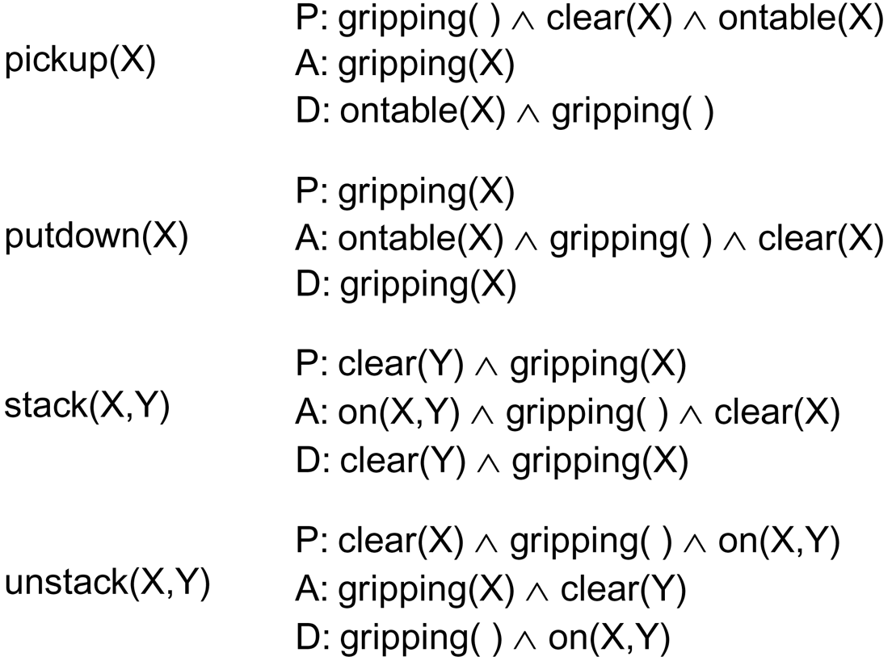
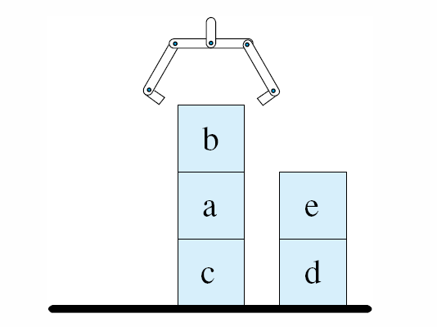
STRIPS
The Stanford Research Institute (SRI) Planning System
  a subgoaling system used to control a robotic arm that could plan and carry out blocks world actions to accomplish stated goals
  The STRIPS operators were denoted with preconditions (what had to be true to perform the operator), add actions and delete actions (how to modify the current state)
defined as on(b, a), on(a, c),
ontable(c), on(e, d), ontable(d),
gripping( )

Slide 5
Non-Linear Planning
STRIPS uses simple linear planning which means that the selection of one operator to accomplish a goal could “clobber” a previously obtained goal
  non-linear planning does not generate the plan in a sequence but instead generates plan solution segments, and then attempts to order them
  in the previous example, imagine that we want to achieve the goal on(e, b), on(b, a), on(a, c), on(c, d), ontable(d)
  we might place e on top of b as an early step only to have to remove b from e when it is realized that we have to remove b from a and a from c so that we can place c on d
Another example is cleaning your kitchen
  Consider operators like “move X”, “clean X”, “mop X”
    you would not want to clean the floor, mop the floor, then move the refrigerator and clean and mop under the fridge because moving the refrigerator will most likely make the rest of the floor dirty again

Slide 6
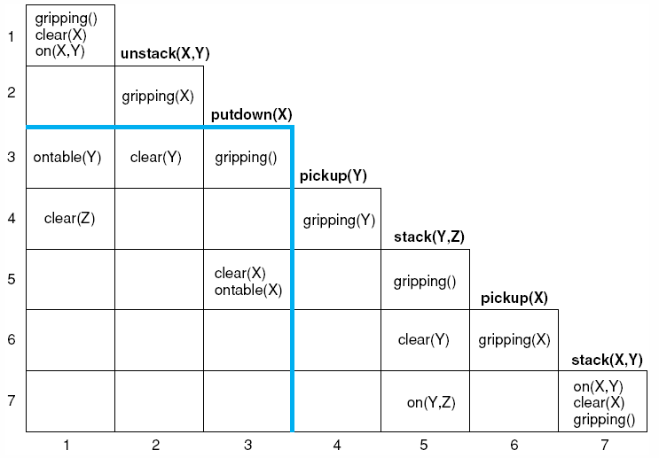
Non-Linear Strategies
Nilsson developed the triangle table representation to solve the problem of non-linear planning
  the table demonstrates dependencies among operators
  an operator’s preconditions are shown in the row to its left and its postconditions are shown below it
Putdown(X) has a dependency with
Pickup(X) as can be seen by finding
two conditions in the intersection

Slide 7
Least Commitment
Another strategy is least commitment where operators are selected but their sequence (order) is not determined until necessary
  first, generate all operators (or as many as possible)
  next, generate any needed operators and sequence those that can clearly be sequenced
  continue until all operators and sequences are sequenced
Example: daily planning
  your daily goals include going to class, work, running errands (grocery store and dry cleaners) and the typical tasks of showering, getting dressed, eating, etc

Slide 8
Continued
Some aspects of your day are dictated by hard constraints
  you have to be at work from 8 am to 12 pm
  you have to be on campus from 1-2 pm and 6:15-7:30 pm for classes and you need an extra 15-20 minutes to park and 15 minutes to drive there from work
  grocery shopping will take you 45 minutes (including travel time)
  the dry cleaners will take you 20 minutes (including travel time)
While the various tasks dictate the operators
  drive to work, work, drive to campus, go to class, drive to the grocery store, do shopping, drive home, put groceries away
Pre- and post-conditions dictate some of the ordering
  you won’t go from the grocery store right to campus, or you won’t go to work, go to campus, and then go home to shower

Slide 9
Other Planning Strategies
Constraint satisfaction – apply constraints whenever possible to prune away possible choices
  for instance, some operators would not be applicable because they would take too much time or cost too much
    consider that you need to pick up your lawnmower, but you brought your small car to work, so this constrains when you can pick up the lawnmower – you must first go home from work to get your larger car
Operator Preference – operators that are more likely to be of use, or to succeed, might be tried first
  operator preference might be dictated by the programmer or it might be specified as part of user input
  operator preference might also be learned, for instance based on statistical usage (operator X has been used more often in the past so X is considered before Y)

