Slide 1






1. Constraint satisfaction problems
Degree of a variable
Arity of a restriction
Degree of a problem
Arity of a problem

Slide 2
1.1 CSP Instances
One solution or all solutions
Total CSP
Partial CSP
Binary CSP binara – constraint graph
CSP – serach problem, in NP
sub-classes with polynomial time complexity
Reduce the search time (search space)

Slide 3
Algorithm: Nonrecursive Backtracking
1. OPEN ← {S_{i}} /* S_{i} is the initial state*/
2. if OPEN = { }
then return FAIL /* no solution /*
3. Be S the first state in OPEN
4. if all successor states of S have been generated
then
4.1. Remove S from OPEN
4.2. repeat from 2
5. else
5.1. Obtain S', the new successor of S
5.2. Insert S' at the beginning of OPEN
5.3. Make link S’→ S
5.4. Mark in S that S' was generated
5.5. if S' final state
then
5.5.1. Display solution by following S’→ S ..
5.5.2. return SUCCESS /* a solution was found*/
5.6. repeat from 2
end.

Slide 4
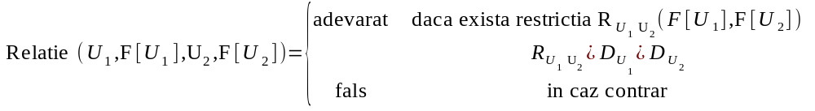
1.2 Conventions
X₁, …, X_{N} problem variables, N no of problem variables,
U – integer, the index of the current var
F – a vector indexed by the variable indeces, in which we store the selections for variable values from the first one to the current variable

Slide 5
Algorithm: Recursive Backtracking
BKT (U, F)
for each value V of X_{U} do
1. F[U] ← V
2. if Verify (U,F) = true
then
2.1. if U < N
then BKT(U+1, F)
2.2. else
2.2.1. Display the values in F
/* F is a solution */
2.2.2. break the for
end.

Slide 6
Verify (U,F)
1. test ← true
2. I ← U - 1
3. while I > 0 do
3.1. test ← Relatie(I, F[I], U, F[U])
3.2. I ← I - 1
3.3. if test = false
then break the while
4. return test
end.

Slide 7
1.3 Improving the BKT
Algorithms to improve the representation
Local consistency of arcs or paths in the constraint graph
Hybrid algorithm
Reduce no of tests
    Look ahead techniques:
- Full look-ahead
- Partial look-ahead
- Forward checking
    Look back techniques:
- backjumping
- backmarking
Using heuristics

Slide 8

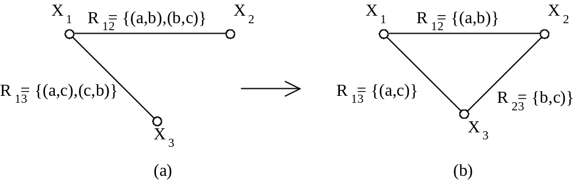
Algorithms to improve the representation
Constraint propagation

Slide 9
1.4 Local constraint propagation
values x and y for X_{i} and X_{j} is allowed by R_{ij}(x,y).
An arc (X_{i}, X_{j}) in a directed constraint graph is called arc-consistent if and only if for any value x ∈ D_{i}, domain of var X_{i}, there is a value y ∈ D_{j}, domain of X_{j}, such that R_{ij}(x,y).
arc-consistent direct contraint graph

Slide 10
algorithm: AC-3: arc-consistency for a constraint graph
1. make a queue Q ← { (X_{i}, X_{j}) | (X_{i}, X_{j}) ∈ Set of arcs, i≠j}
2. while Q is not empty do
2.1. Remove from Q an arc (X_{k}, X_{m})
2.2. Check(X_{k}, X_{m})
2.3. if Check made any changes in the domain of X_{k}
then
Q ← Q ∪ { (X_{i}, X_{k}) | (X_{i}, X_{k})∈ Set of arcs, i≠k,m}
end.
Check (X_{k}, X_{m})
for each x ∈ D_{k} do
1. if there is no value y ∈ D_{m} such that R_{km}(x,y)
then remove x from D_{k}
end.

Slide 11
Path consistency
A path of length m through nodes i₀,…,i_{m} of a directed constraint graph is called m-path-consistent if and only if for any value x ∈ D_{i0}, domain of var i₀ and a value y ∈ D_{jm}, domain of var i_{m}, for which R_{i0im}(x,y), tehre si a sequence of values z₁∈ D_{i1} … z_{m-1} ∈ D_{im-1} such that R_{i0i1}(x,z₁), …, R_{im-1im}(z_{m-1},y)
Directed constraint graph m-path-consistent
Minimal constraint graph
m-path-consistency

Slide 12
Complexity
N – no of variables
a - cardinality max of variables domains
e – no of constraints
arc-consistency - AC-3: time complexity O(e*a³); space complexity: O(e+N*a)
Even one of O(e*a²) – AC-4
2-path-consistency - PC-4: time complexity O(N³*a³)

Slide 13
1.5 CSP without bkt - conditions
Directed constraint graph
Width of a node
Width of an ordering
Width of a graph
A
B
C
R_{AC}
A
B
A
C
A
R_{CB}
B
B
C
C

Slide 14
Theorems
if an arc-consistent graph has the width equal to 1 (i.e. is a tree), then the problem has a solution without backtracking.
if a 2-path-consistent graph has the width equal to 2, then the problem has a solution without backtracking.

Slide 15
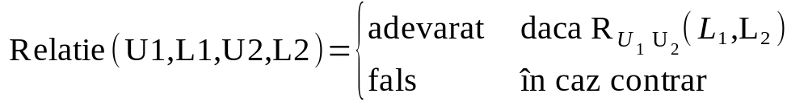
1.6 Look-ahead techniques
Conventions
U, N, F (F[U]), T (T[U] … X_{U}), TNOU
Forward_check
Future_Check
Full look ahead
Partial look ahead
Forward checking

Slide 16
algorithm: Backtracking Full look ahead
Prediction(U, F, T)
for each element L in T[U] do
1. F[U] ← L
2. if U < N then //chack consistency of assignment
2.1 TNOU ← Forward_Check (U, F[U], T)
2.2 if TNOU ≠ LINIE_VIDA
then TNOU ← Future_Check(U, TNOU)
2.3 if TNOU ≠ LINIE_VIDA
then Prediction (U+1, F, TNOU)
3. else display assignments in F
end

Slide 17
Forward_Check (U, L, T)
1. TNOU ← empty table
2. for U2 ← U+1 to N do
2.1 for each element L2 in T[U2] do
2.1.1 if Relatie(U, L, U2, L2) = true
then insert L2 in TNOU[U2]
2.2 if TNOU[U2] is empty
then return LINIE_VIDA
3. return TNOU
end

Slide 18
Future_Check (U, TNOU)
if U+1 < N then
1. for U1 ← U+1 to N do
1.1 for each element L1 in TNOU[U1] do
1.1.1 for U2 ← U+1 to N, U2≠U1 do
i. for each element L2 in TNOU[U2] do
- if Relatie (U1, L1, U2, L2) = true
then break the cycle //of L2
ii. if no consistent value was found for U2
then
- remove L1 from TNOU[U1]
- break the cycle // of U2
1.2 if TNOU[U1] empty line
then return LINIE_VIDA
2. return TNOU
end

Slide 19
BKT partial look ahead
Modify Verifica_Viitoare with the steps marked in red
Future_Check (U, TNOU)
if U+1 < N then
1. for U1 ← U+1 to N - 1 do
1.1 for each element L1 in TNOU[U1] do
1.1.1 for U2 ← U1+1 to N do
i. for each element L2 in TNOU[U2] do
- if Relatie (U1, L1, U2, L2) = true
then break the cycle //of L2
ii. if no consistent value was found for U2
then
- remove L1 from TNOU[U1]
- break the cycle // of U2
1.2 if TNOU[U1] este vida
then return LINIE_VIDA
2. return TNOU
end

Slide 20
BKT forward checking
Remove the call Future_Check(U, TNOU) in sub-program Prediction
algorithm: Backtracking forward checking
Prediction(U, F, T)
for each element L in T[U] do
1. F[U] ← L
2. if U < N then
2.1 TNOU ← Forward_check (U, F[U], T)
2.2 if TNOU ≠ LINIE_VIDA
then TNOU ← Future_Check (U, TNOU)
2.2 if TNOU ≠ LINIE_VIDA
then Prediction (U+1, F, TNOU)
3. else display assignments in F
end

Slide 21
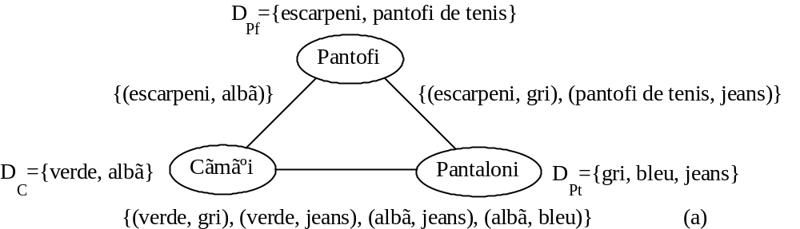
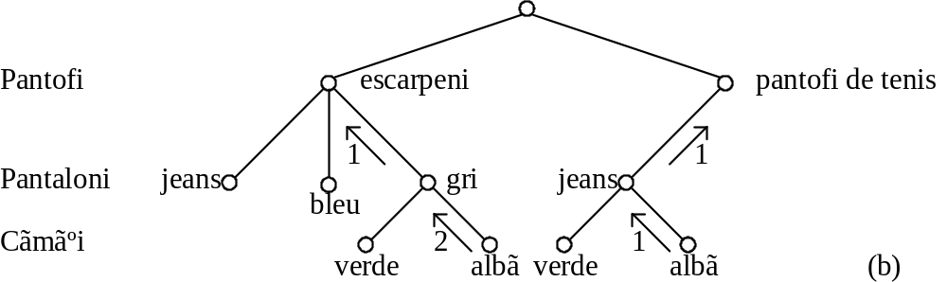
1.7 Look back techniques
Backjumping
(pantofi de tens, gris) (pantofi tenis, alba)
gris
bleu
verde
alba
verde
alba

Slide 22
algorithm: Backjumping
Backjumping(U, F, Nivel)
/* NrBlocari, NivelVec, I, test, Nivel1 – var locale */
1. NrBlocari ← 0, I ← 0, Nivel ← U
2 for each element V of X_{U} do
2.1 F[U] ← V
2.2 test, NivelVec[I] ← Verify (U, F)
2.3 if test = true then
2.3.1 if U < N then
i. Backjumping (U+1, F, Nivel1)
ii. if Nivel1 < U then jump to end
2.3.2 else display the values in F // solution
2.4 else NrBlocari ← NrBlocari + 1
2.5 I ← I + 1
3. if NrBlocari = no of values of X[U] and
all elements in NivelVec are equal
then Nivel ← NivelVec[1]
end

Slide 23
Verify (U, F)
1. test ← true
2. I ← U-1
3. while I>0 do
3.1 test ← Relatie(I, F[I], U, F[U])
3.2 if test = false
then break the cycle
3.3 I ← I –1
4. NivelAflat ← I
5. return test, NivelAflat
end

Slide 24
1.8 Heuristics
All solutions – try finding first blocking
One solution - try most promising paths
variable ordering – variables that are linked by explicit constraints should be sequential - all solutions – prefer vars that goes in a small no of contraints and have small domains
value ordering - all solutions – start with the most constraint value of a variable
test ordering – all solutions – start testing with the most constraint previous var

Slide 25
2. Game playing
2 payers
  player
  opponent
Investigate all search space
Cannot investigate all search space

Slide 26
2.1 Minimax for search space that can be investigated exhaustively
Player – MAX
Opponent – MIN
Minimax principle
Label each level in GT with MAX (player) and MIN (opponent)
Label leaves with evaluation of player
Go through the GT
  if father node is MAX then label the node with the maximal value of its successors
  if father node is MIN then label the node with the minimal value of its successors

Slide 27
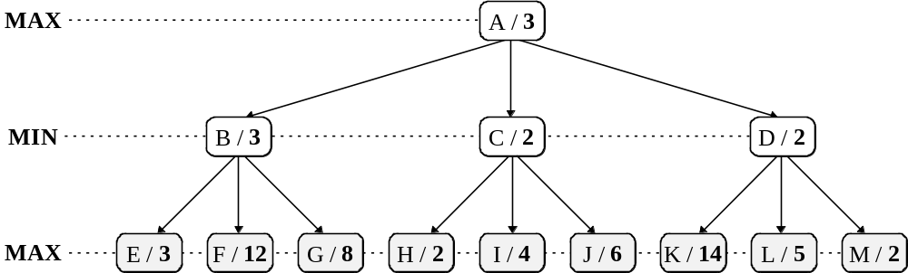
Minimax Search space (GT)

Slide 28
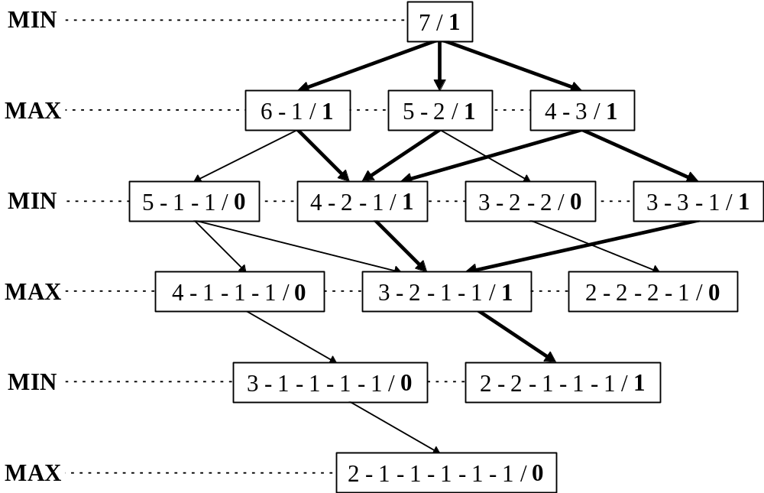
Minimax Search space (GT)
Nim with 7 sticks

Slide 29
algorithm: Minimax for all search space
Minimax( S )
1. for successor S_{j} of S (obtained by a move op_{j}) do
val( S_{j} ) ← Minimax( S_{j} )
2. apply op_{j} for which val( S_{j} ) is maximal
end
Minimax( S )
1. if S is a final node then return eval( S )
2. else
2.1 if MAX moves in S then
2.1.1 for each successor S_{j} of S do
val( S_{j} ) ← Minimax( S_{j} )
2.1.2 return max( val( S_{j} ), ∀j )
2.2 else { MIN moves in S }
2.2.1 for each successor S_{j} of S do
val( S_{j} ) ← Minimax( S_{j} )
2.2.2 return min( val( S_{j} ), ∀j )
end

Slide 30
2.2 Minimax for search space investigated up to depth n
Minimax principle
algorithm Minimax up to a depth n
level(S)
A heuristic evaluation function eval(S)

Slide 31
algorithm: Minimax with finite depth n
Minimax( S )
1. for each successor S_{j} of S do
val( S_{j} ) ← Minimax( S_{j} )
2. apply op_{j} for which val( S_{j} ) is maximal
end
Minimax( S ) { returns an estimation of S }
0. if S is final node then return eval( S )
1. if level( S ) = n then return eval( S )
2. else
2.1 if MAX moves in S then
2.1.1 for each successor S_{j} of S do
val( S_{j} ) ← Minimax( S_{j} )
2.1.2 return max( val( S_{j} ), ∀j )
2.2 else { MIN moves in S }
2.2.1 for each successor S_{j} of S do
val( S_{j} ) ← Minimax( S_{j} )
2.2.2 return min( val( S_{j} ), ∀j )
end

Slide 32
Evaluation function
Tic‑Tac‑Toe (X si O)
Heuristic function eval( S ) – conflict in state S.
eval( S ) = total possible of winning lines of MAX in state S - total possible of winning lines of MIN in state S.
if S is a state from which MAX can win with one move, then eval( S ) = ∞ (big value)
if S is a state from which MIN can win with one move, then eval( S ) = -∞ (small value).

Slide 33
eval(S) in Tic-Tac-Toe
X
X has 6 possible winning lines
O has 5 possible winning lines
O
eval( S ) = 6 - 5 = 1

Slide 34
2.3 Alpha‑beta pruning
It is possible to have the correct decision in Minimax without going through all nodes always
Eliminating part of the search tree = pruning the tree

Slide 35
Alpha‑beta pruning
Be α the best value (biggest) found for MAX and β the best value (smallest) found for MIN.
The alpha-beta algorithm updates α and β while going through the search tree and cuts all sub-trees for which α or β are worst.
Search is finished along a branch according to 2 rules:
  Stop searching bellow any node MIN with a value β smaller than or equal to the value α of any node MAX predecessors to the current MIN node.
  Stop searching bellow any node MAX with a value α greater than or equal to the value β of any node MIN predecessors to the current MAX node.

Slide 36
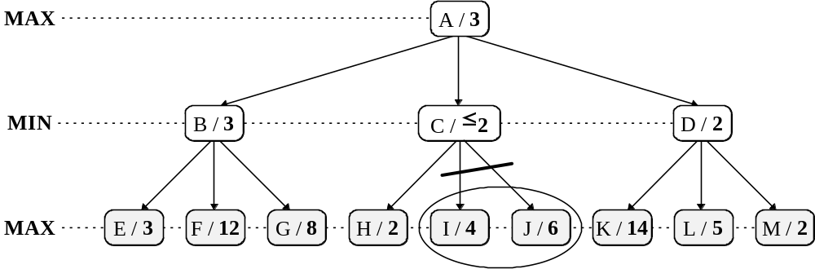
Alpha-beta pruning of the tree

Slide 37
algorithm: Alpha-beta
MAX(S, α, β) { return the maximum value of a state. }
0. if S is a final node then return eval( S )
1. if level( S ) = n then return eval( S )
2. else
2.1 for each successor S_{j} of S do
2.1.1 α ← max(α, MIN(S_{j}, α, β))
2.1.2 if α ≥ β then return β
2.2 return α
end
MIN(S, α, β) { return the minimum value of a state. . }
0. if S is a final node then return eval( S )
1. if level( S ) = n then return eval( S )
2. else
2.1 for each successor S_{j} of S do
2.1.1 β ← min(β, MAX(S_{j}, α, β))
2.1.2 if β ≤ α then return α
2.2 return β
end

Slide 39
2.4 Games that include an element of chance
The player does not know the possible moves of the opponent (e.g. backgammon)
3 types of nodes:
MAX
MIN
Chance nodes

Slide 40
EXPECTMINIMAX(S) =
Utility(S) if n is a terminal node
Max _{Sj suc S}[EXPECTMINIMAX(Sj)]
Min _{Sj suc S}[EXPECTMINIMAX(Sj)]
Sum _{Sj suc S}[ P(Sj)*EXPECTMINIMAX(Sj)]
36 ways to roll 2 dice
21 distinct roles (5-6 same as 6-5)
The 6 doubles have a chance of - > 1/36
Distinct roles a chance of -> 1/18
MAX
Decision nodes
Dice
MIN
1/36
1/18
Dice
Chance nodes
MAX
1/36
1/18

