Slide 1

Case study To Increase the Time Spent listening on Spotify app
Prashnat Bisht
231050065

Slide 2



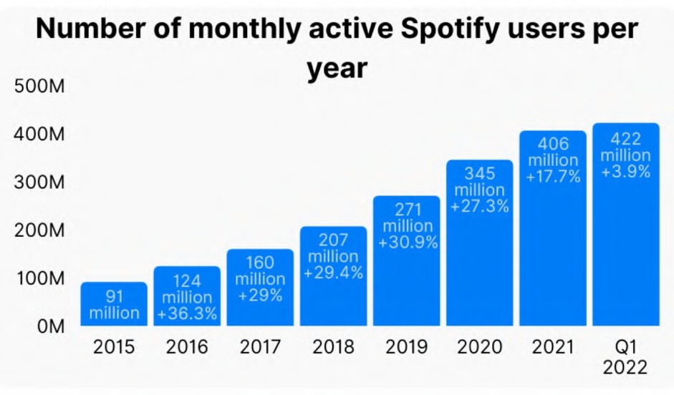
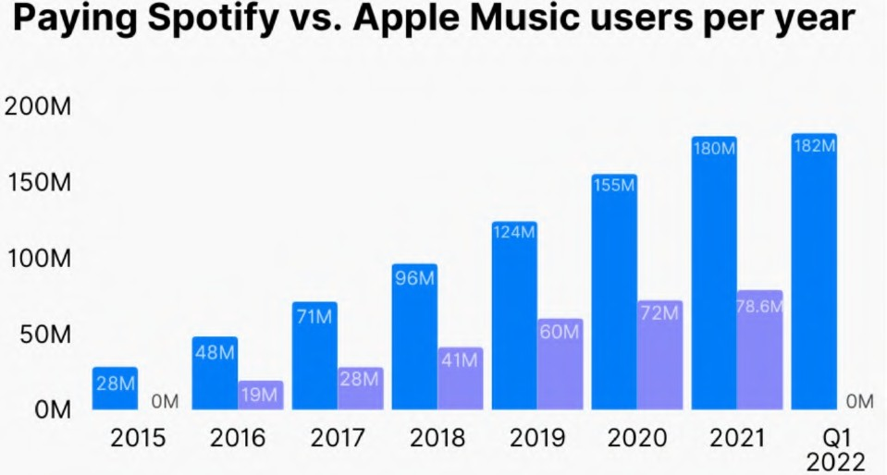

Spotify is the world’s biggest music streaming platform by number of subscribers. Users of the service simply need to register to have access to one of the largest collections of music in history, plus podcasts and other audio content.It operates on a freemium model.
To Increase the Time Spent listening on Spotify app with the new Initiatives to achieve the goal.
Vision :to become the world's leading audio platform, offering a vast and diverse library of music, podcasts, and other audio content ,with innovation and collaboration, and inspire a love of music and audio content around the world.
Mission : "unlock the potential of human creativity by giving a million creative artists the opportunity to live off their art and billions of fans the opportunity to enjoy and be inspired by these creators."
55+
19%
18-24
26%
45-5411%
16%
35-44
29%
25-34
Spotify User'sAge Demographics
Data: Spotify
Data: Spotify
1

Slide 3





Empathise
CurrentExperience
Pain Points
Pain Points:
User's want recommendations based on the activity of the user in day.
Finds difficult to navigate in the podcasts as there's no segmentation.
wants select genres with time to time according to the mood.
while listening to the music device via bluetooth
wants specific genres and recommendations.( with family members)
when doing certain activity wants listen certain kinda music, i.e don't want listen to the hip-hop music while working wants something smoothing.
Kshitij 25 Male Banglore
Software developer
Pranav 33 Male Bangalore
IT Engineer
User Says:
User Says:
I like music most of the time but love to listen
while driving and in my music system while in my home along with my family.
Needs:
Music is one my important part of day as it helps me to relax and helps in all emotion state , I like Spotify as it one of best and easy to use app," I would like if Spotify plays music according to daily activity of life such as driving , relaxing and jogging I listen different kinda music in each of the activity "
I work at fintech startup as Software developer engineer , I am Spotify user since 5 years, personally Spotify is one of the most used app ,
Needs :
my whole day is supported by music right from morning workout to my bed time , personally Spotify is one of the most used app , I am avid podcast listener I also enjoy long form of content ,
" I want Spotify to get my situation and play the genre & provide segments in podcasts too "
Jobs to Be Done
When - i want listen to music.
But - Spotify recommendations starts playing different kinda genres without knowing my intention . Please help me- to understand user emotion & the activity and play music.
So that - I can listen to the music according to my activity & intention.
Goals:
Need to understand the behaviour & emotion state , wants segments in podcasts to listen better and utilise time efficiently.
Goals:
Wants different genres of music and recommendations of it at different activity of days such as workout, driving , commuting , work or study, relaxing .
**Above pain points and statement are concluded after
conducting primary research via phone call for user and secondary research via social media platform and polls.
2

Slide 4
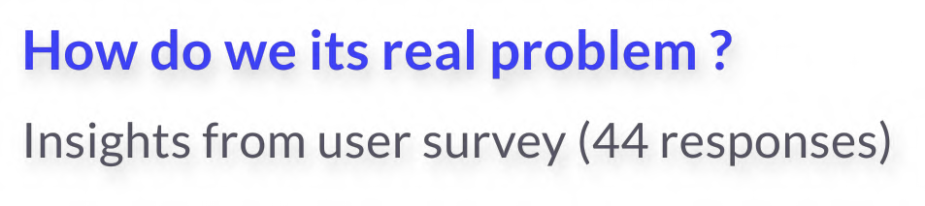





Problem
Defne
Validation of the problem
Music is important part of each individual life from helping any emotion state of the user to set emotions right at that point of time , each user has his her own taste of music, but also what kinda music you want to listen at what time you don't want be listening sad-core songs while your working out although you like them you want something electronic or hip-hop, understanding the user activity of the day helps them "listen music for longer time without disturbing their emotional state ".
36%
No of user who are using Spotify app & have active subscription .
66%
No users who want listen music according to their specific taste.
Felt discomfort while listening music and change in music is not apt for situation, but likes that genre in general.
Felt recommended Spotify songs should play according to the activity of day or let user do it themselves .
Per Month Per Year
75%
Pranav 33 Male Bangalore
IT Engineer
Pain Point
1 .Wants to listen specific type of music for each daily activity.
Let him set what kind of music he wants listen at different activity.
Recommend music based
on the activity user is doing.
55%
Goal
Music is my go to go therapy ,
i feel its integrated part of my life Spotify does the best job, i am also Spotifys top 2% of the listener in time spent with 39,420 minutes ,I also want Spotify to know what activity of the day i am doing so that it can recommend or let me set-up what kinda music i want for each part of the day.
18-24
25-34
445
478
34%
35-44
45-54
55+
445
2+activities
66%
No of people using
Spotify app for more
than two activities of the day.
3
378
278
0 200 400 600
Avg time spent on Spotify by age category
(Data: OnePoll)

Slide 5



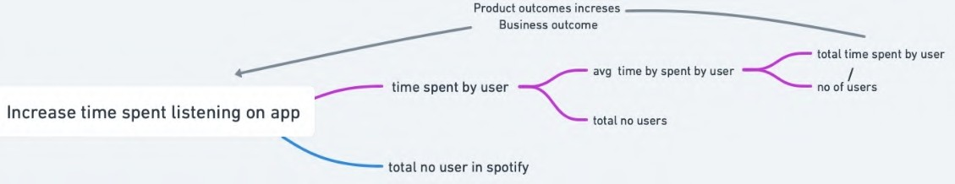

Defne
_{SAYING} " I don't want listen my deep house
On average, people spend 1.22 hours (or 1h 13min) per day listening to Spotify, which has increased over from 2022
With more number of creators increasing the music taste are varying for users ,Approximately 1040 artists on Spotify generated $1 million in 2021.
In 2020, 860 artists managed to generate over one million in earnings.
Monthly active user ( MAU) has increased over 17.7% in 2021 over 2020 , shows people turning up music app increased.
The Premium user base has increased 16.1% in 2021 over 2020 , shows need of music in user and experience the best music present. (Data: Spotify)
_{THINKING}" I wish I had recommendations
based upon activity I am doing"
music while working out"
"my personal playlist shouldn't play while I am listening in home music system "
"what if my high beats songs / adult songs
are played amidst my kids or family members"
DOING " Try creating different playlists for different use case / different activity"
FEELING
" I hope Spotify start recommending based on my activity"
"try creating a family friendly playlist so that I can play with family members"
"wish Spotify had family mode where we could enjoysongs without creating playlist time to time"
For User / Customer
User will able listen songs based on activity their indulged in
User don't have spend time creating playlist for different activity in their daily life .
For Business
Offer a more personalised music experience to the user.
Increase the time spent by the individual user .
Increase use case of Spotify in everyday life of user.
Increases time spent on app
Preferred music in the app will be played based upon their behaviour .
User can listen to preferred music by single click to set out modes in app of their choice.
The new feature has ability to increase the Spotify Premium subscriptions for larger non-subscribed user base.
4

Slide 6
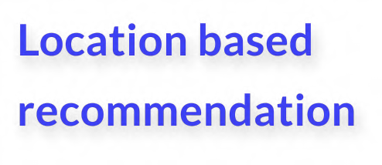
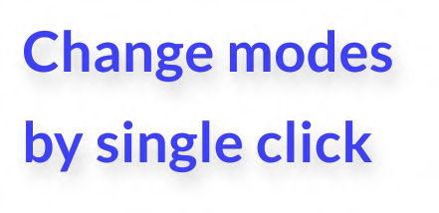





Possible Solutions
Ideate
Idea: by using the live location from user phone to identify current location and play out recommend music.
Idea: let users to define modes , set modes in particular activity of the day
Idea: Its feature which can be accessed by all the Spotify family sharing subscription where each account holder
and play music according to the modes
&recommend songs based on the modes can contribute to music and enjoy in the
family time.
Recommending songs based on user live location .
Optimise the recommendation of music based on the location of user on daily basis.
Understand the genres and play specific music only according to the activity based on location.
Recommends most played genres and music based on the demographic location.
Let the users to define mode by activity of their choice
By single click in the home page change
mode seamlessly and start playing music
let users set type of genre , music in each mode and also able edit them easily.
By setting it to Spotify mode works in the default manner.
The feature icon present in the home page & easy to access .
Take equal recommendations from all the family accounts and creates playlist so that all can enjoy.
Can use this feature on multiple occasions such family trip , family dinner or family events.
This can also used on daily basis while commuting and relaxing .
5. Each account holder can decide to contribute or not (can turn it off).
5

Slide 7



















































SOLUTIONS
VALUE TO USER
REACH
ALIGNMENT WITH COMPANY GOALS
EASE OF USE
FINAL SCORE
Location based recommendation
4.5
Selected solution : Location Based
Ease of use just by turning on location & gets best music .
location access can asked while downloading app itself.
provides more opportunity to increase user time spent on app.
Very ease to use as it just requires turn on location
Recommendations
Change modes by single click
3.5
Enables users to dekne the modes , use it & modify it
user should dekne modes and use it or use predekned modes
provides more opportunity to increase user time spent on app.
should be able dekne by the user manually or use templates
Family Time
user can have privacy with family members
existing family subscription user accounts can be availing this feature
provides more opportunity to increase user time spent on app.
doesn't require any efforts from users should only decide whether to contribute or not
4
(**Since we have been provided infinite tech bandwidth we are considering effort)
6

Slide 8
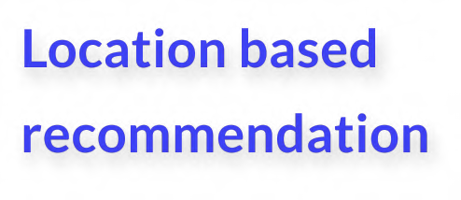
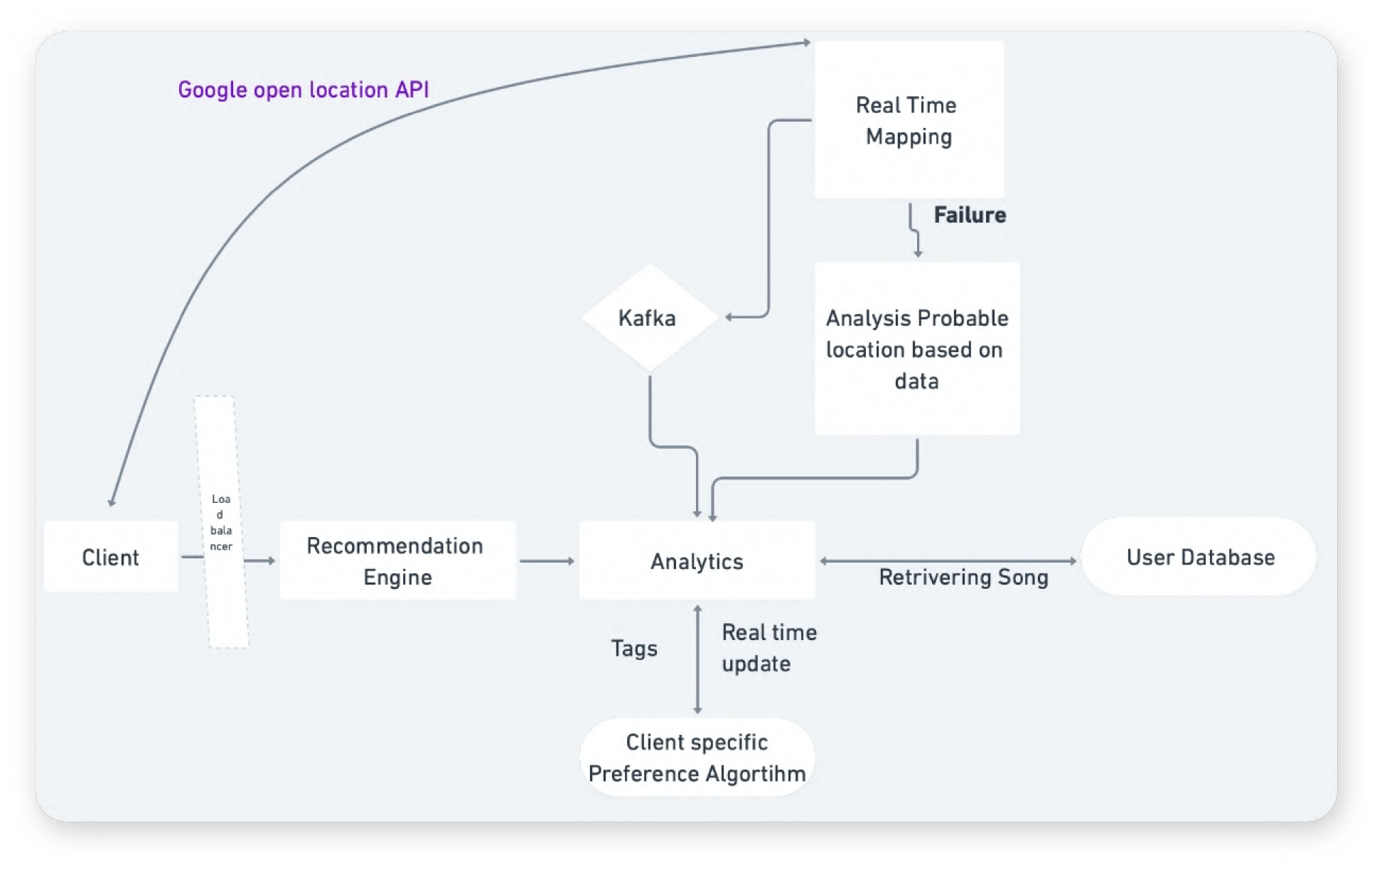
High-level system design
Functioning
The location based recommendation systems works user live location when the live location is turned on the, realtime data of location is query is sent to the real time mapping server query gets responded & sent to Kafka server and pushed into Analytics server when Analytics server gets real time mapping data its retrieves data from User database server on retrieving song the again query sent to Client specific Preference algorithm it responds with tags which personal recommendations and preferences and sent back to client server ,"If incase the Real time location is not updated the normal recommendation engines responds the query".
Example :
User turns on the location
Google open location Api — Finds user location as gym
User starts listening to the " workout genres " & " user personal recommendations" from personal choice and demographic choices"
Any update in user sides reflects in the
recommendation
7

Slide 9
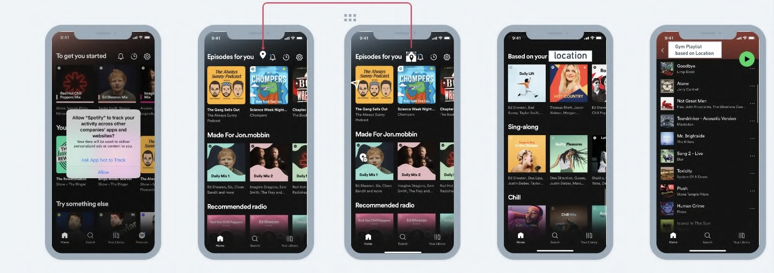
Wireframes for : Location based recommendation
1. Asks for location tracking permission.
2. the top right corner allows you to show live location.
3. Shows that live location is turned on.
4. based on live location recommendations starts showing up.
5. The playlist is updated based one the current user location. ( user preferences can modified)
8

Slide 10



North Star Metric:Time Spent Listening
Risk : User not comfortable sharing live location data.
Solutions: Spotify agreeing for privacy policy
between user & Spotify keeping data secured.
Risk: user want to listen random songs while the feature is on.
Solution: once the users plays first set songs which
is not in recommend playlist , normal recommendation will start recommending , this also happens even when there's sudden abrupt in live data.
Risk : User doesn't want track live continuously without permission .
Solutions: Providing options users to access location data only when the" app is in use".
9
Behaviour | Metric
Happiness | No. of People letting Spotify to access the location
Engagement | No of user who 's live location is on whenever Spotify is running. No of people who's have time spent while live location is on > 10 mins daily. Total time spent by user in live location based playlist weekly.
Adoption | No of people using location based playlist at least twice in a week. No of people using location based playlist > 10 times in month.
Retention | No. of people using location based playlist at least twice a week. No. of people who turn on location > 5 times in week.
Tasks Success | No. of people modifying the location based playlist at least once a week

