Slide 1
TRANSCRIPT INTELLIGENCE
Findings from 100 Customer & Internal Calls
What our support, sales, and internal calls are already telling us — and what to do about it.
Prashanth Kumar G V | Assignment submission – 10-July- 2026
Notes:
Open with the thesis, not the method: "We looked at 100 calls across support, account management, and internal engineering. Three of the most useful things in there weren't the two things we were asked to find — they were things that connect engineering reliability directly to revenue risk. That's where I want to spend most of today."

Slide 2
AGENDA
How today is structured
1
How we approached the data — 30 seconds — the how, not the point
2
What the calls are about — categorization
3
What people actually feel on these calls — sentiment, and the one trend that matters most
4
Three things beyond the ask — with a live example
5
Recommendations
2
Notes:
Set expectations that this is insight-first. "I'll go deep on process only where the how changes what you should trust about the what."

Slide 3
CONTEXT
The dataset, in one slide
30
Internal calls
30
Support calls
40
Account-management
(external) calls
• 100 calls, 3 call types we had to infer ourselves — the dataset didn't label this.
• Every call already carries an AI-extracted summary, topics, sentiment, and “key moments” — this isn't raw audio, it's a call-intelligence pipeline's output. We built on that signal rather than re-deriving it.
• One company (“Aegis”), three products (Detect, Comply, Identity), ~35 active customer accounts, Feb–Apr 2026.
3
Notes:
This slide exists to establish credibility for later claims — "when I say we validated X, here's what we validated it against."

Slide 4
METHODOLOGY
How we inferred call type (no label existed)
• Signal 1: email-domain count 1 domain on the call = internal; 2+ = a customer is present.
• Signal 2: the company's own consistent title convention “Support Case #1234 - ...” or “Aegis / <Customer> - ...”
• Result: 100% coverage, zero manual labeling, fully auditable.
Domain count
↓
Title pattern
↓
call_type label
4
Notes:
Quick, confident, move on. This is groundwork, not an insight — don't oversell it.

Slide 5
SECTION 1
What are these calls actually about?
Notes:
"These three came directly out of the same data — no new collection needed." (reuse framing note for section dividers as needed)

Slide 6
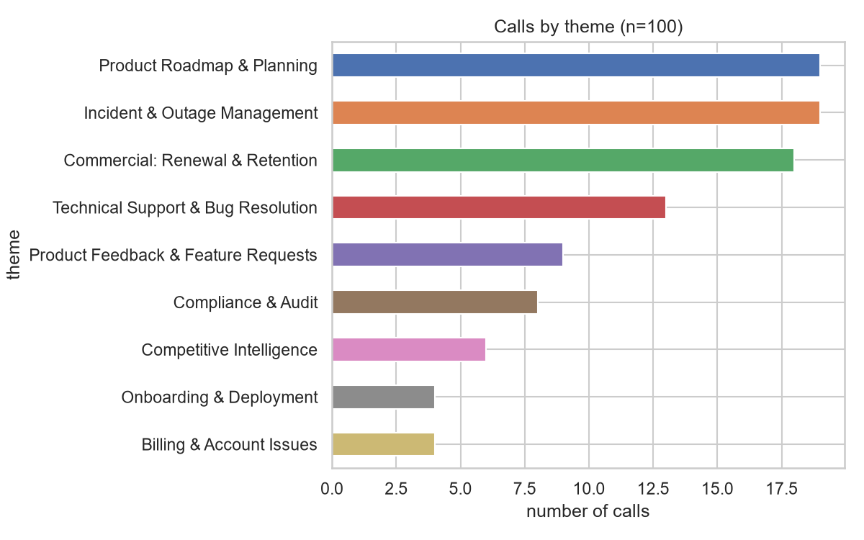
CATEGORIZATION
Nine categories, derived from how the business already talks
• No category is empty.
• None dominates unreasonably.
• Maps cleanly onto how a support lead, a PM, and an AM would each already think about their world.
6
Notes:
"No category is empty, none dominates unreasonably — this maps cleanly onto how a support lead, a PM, and an AM would each already think about their world."

Slide 7
CATEGORIZATION
Why hybrid — and a dead end we're glad we hit
Attempt 1: pure clustering
Embedding-based KMeans topped out at silhouette ≈ 0.07 — too weak to trust.
Attempt 2: naive topic-keyword rules
Put 55 of 100 calls into one “Incident” bucket — outage language bleeds into calls that merely reference it.
Attempt 3 (final): title-pattern-first, topics as tie-breaker
Company already names calls consistently. Fully explainable, zero API cost.
7
Notes:
This slide is doing real work — it shows you iterated and diagnosed a bad result instead of reporting the first number you got. If the panel only remembers one "how we think" slide, make it this one.

Slide 8
CATEGORIZATION
We validated the taxonomy instead of taking it on faith
4%
of calls flagged as
closer to a different
theme than assigned
0.39
Adjusted Mutual
Info vs. an independent
clustering run
• A healthy, low-ambiguity rate for real-world data — not zero, which would suggest overfitting to exact wording.
• Moderate positive agreement between two independent methods (rule-based labels vs. unsupervised clustering).
8
Notes:
"We're not claiming perfect separation — a perfect score here would actually worry me, it'd suggest overfitting to exact wording. This is what genuine, checked confidence looks like."

Slide 9
CATEGORIZATION
A category, made concrete
INCIDENT & OUTAGE MANAGEMENT
“INCIDENT: Detect Pipeline Failure - War Room”
A cascading failure in the event-ingestion layer left customers with zero threat-monitoring visibility for ~6 hours.
COMMERCIAL: RENEWAL & RETENTION
“Aegis / Blackridge Investments - Renewal Discussion”
TECHNICAL SUPPORT & BUG RESOLUTION
“Support Case #8749 - Coastal Living Co SAML Certificate Rotation Bug”
9
Notes:
Ground the taxonomy in real language before moving to sentiment — makes the next section land harder.

Slide 10
SECTION 2
What are people actually feeling on these calls?

Slide 11
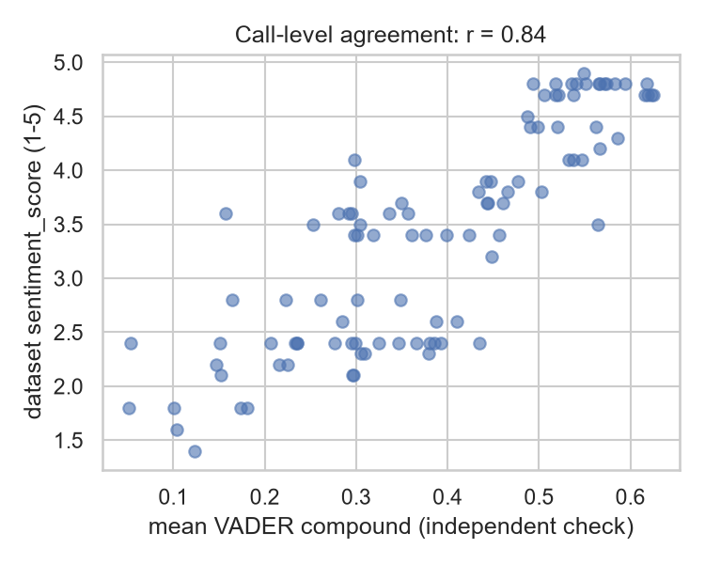
SENTIMENT
We checked the dataset's own sentiment before trusting it
• Every call ships pre-computed sentiment. We cross-checked it with VADER, a lexicon model unrelated to whatever produced this dataset.
• Raw per-sentence agreement: only 37%. Looked bad at first.
• Why: VADER tags 78% of sentences positive (ordinary politeness reads as positive); the dataset's model is more conservative (56% neutral) — correctly so.
• Aggregated to the call level: r ≈ 0.84. Strong agreement on overall direction and magnitude.
11
Notes:
"We didn't rebuild sentiment analysis from scratch — that would've just been a noisier copy of work already done well upstream. We checked it, trusted it, and spent our energy on what it means instead."

Slide 12
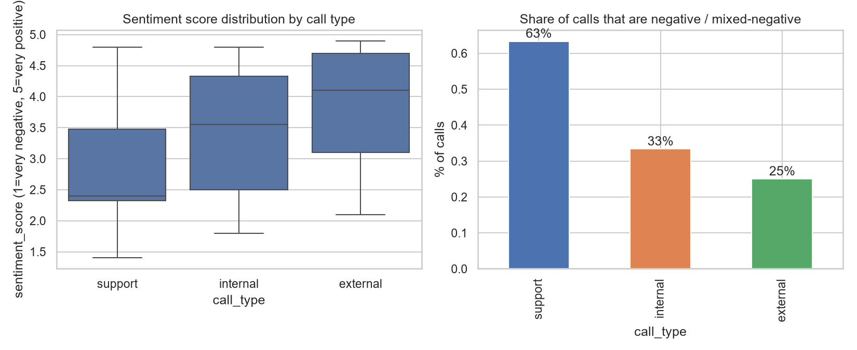
SENTIMENT
Sentiment by call type
Support
avg 2.83/5 · 63% negative
Internal
avg 3.42/5 · 33% negative
External (AM-led)
avg 3.85/5 · 25% negative
12
Notes:
"Unsurprising on its own — support calls run coldest because customers only file a ticket when something's already broken. The more interesting story is when each type dips, not just its baseline."

Slide 13
SENTIMENT
Sentiment by theme — the problem is narrow, not diffuse
Incident & Outage Management
avg 2.22 · 95% neg
Technical Support & Bug Resolution
avg 2.59 · 85% neg
Competitive Intelligence
avg 2.82 · 67% neg
Product Roadmap / Compliance / Onboarding / Feedback
avg 3.9 – 4.6 · 0–5% neg
13
Notes:
"This is actionable in a way 'improve customer sentiment' isn't. Customers aren't generally unhappy — reliability and bug-resolution conversations are specifically where the temperature drops. That's a narrow, fixable target."

Slide 14
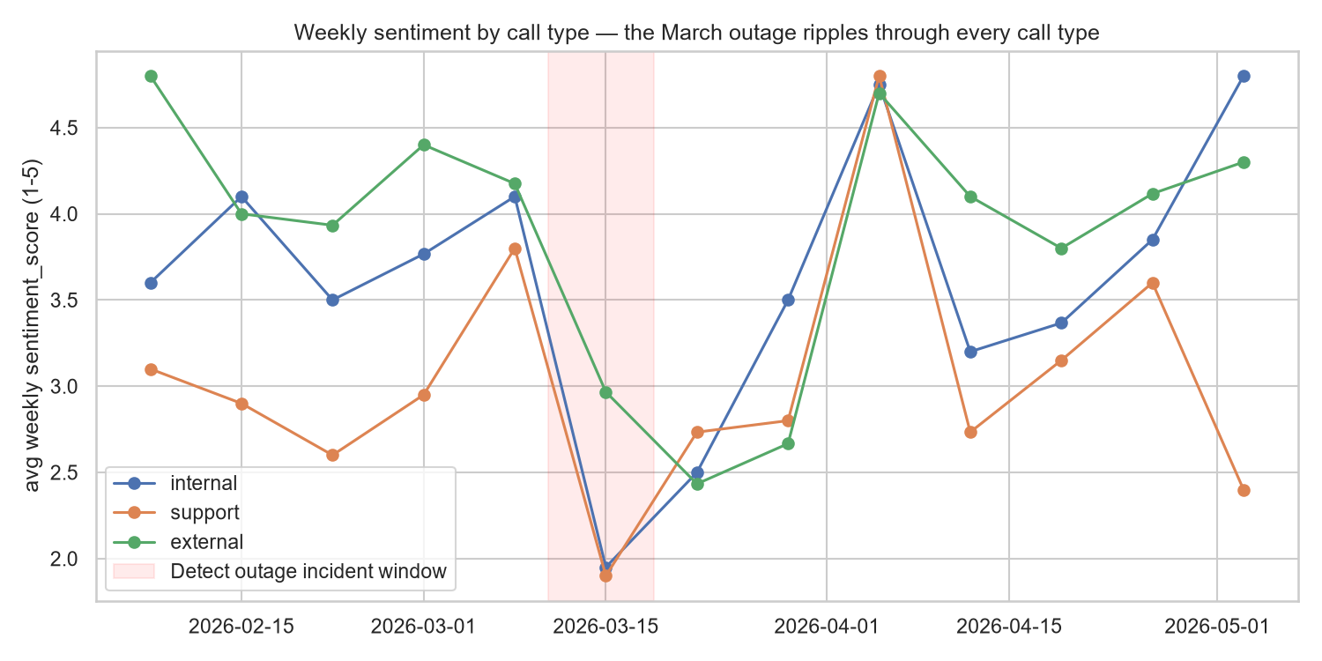
SENTIMENT
The trend that matters most
14
Notes:
Slow down here. Walk the line left to right. "Internal absorbs the shock first — that's the war room. External drops nearly as fast — AMs are having hard calls in real time. But look at support — it doesn't recover with the others. It stays cold for two more weeks. That's the long tail nobody's tracking today."

Slide 15
SENTIMENT
Why this should matter to this room
+2 wks
support sentiment lags
internal/external recovery
• A reliability incident's true cost outlasts the “resolved” milestone by roughly 2 weeks of depressed customer support sentiment — a staffing and process signal, not just an SRE metric.
• This is exactly the window where churn-risk language clusters (quantified next). Renewal conversations scheduled right after an incident carry extra risk.
15
Notes:
This is the bridge slide into the bonus section — reliability is a commercial risk, not just an engineering KPI, and we can now put a number on it.

Slide 16
SECTION 3
Beyond what we were asked
Three insights, straight out of the same data — no new collection needed.

Slide 17
BONUS INSIGHT 1
Incident blast radius
15 / 35
active customer accounts
touched within 3 weeks
of the incident (≈43%)
≈ 50%
drop in average sentiment
across every call type
during that window
• This turns “we should invest more in reliability” from an opinion into a quantified trade-off.
• One pipeline failure touched almost half our active book in three weeks.
17
Notes:
"This turns 'we should invest more in reliability' from an opinion into a quantified trade-off. One pipeline failure touched almost half our active book in three weeks."

Slide 18
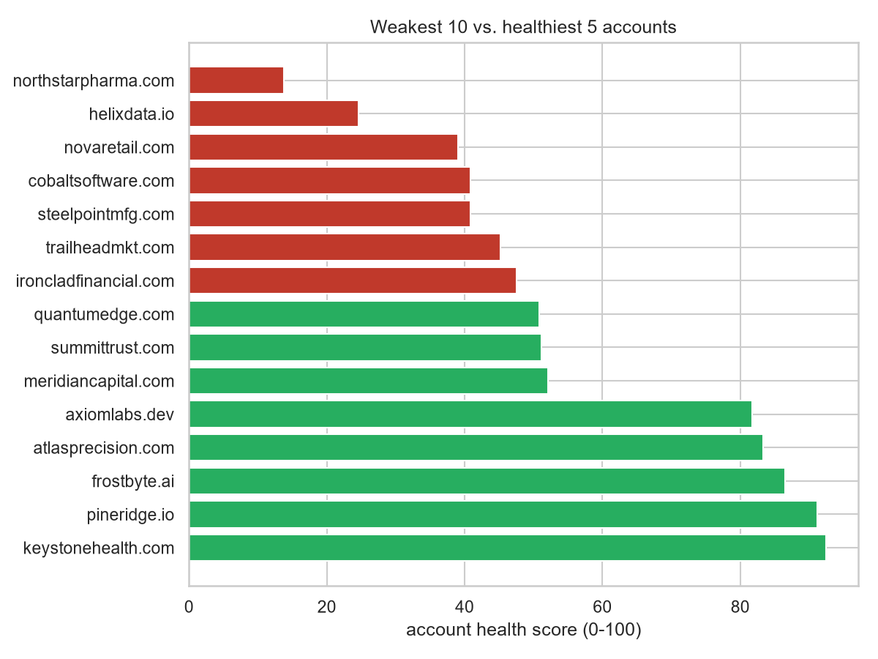
BONUS INSIGHT 2
Account health score — a worklist, not a report
• Blends avg sentiment, churn-topic frequency, and churn/concern key-moments into one 0–100 score — simple and auditable on purpose, not a black box.
• Weakest account: northstarpharma.com, 13.8 / 100 both of their calls were incident-driven and 100% churn-tagged.
• Healthiest: keystonehealth.com, 92.5 / 100
18
Notes:
"The point isn't the score — it's that a CS or sales leader gets a prioritized list to act on before the renewal conversation, instead of discovering risk during it."

Slide 19
BONUS INSIGHT 3
Talk-time balance — an honest null result
43–67%
Aegis speaking-time
share across 70
customer-facing calls
• Inferred who's Aegis vs. customer from speaker patterns — no direct label exists; cleanly separates all 76 speaker names in the sample.
• Nothing hits an extreme imbalance threshold on this sample. A legitimate finding, not a failed metric.
• The pattern that does show up: competitive-evaluation & renewal-concern calls are most customer-led (good — listening occasions); demos & deployment kickoffs are most rep-led (expected — presenting occasions).
19
Notes:
Don't oversell this one. "We're showing you a metric that didn't find a dramatic problem in this sample — but it's cheap to compute at scale, and it's exactly the kind of thing a support manager would want per-rep once call volume is real, to catch someone talking over customers on calls that should be discovery-oriented."

Slide 20
BEYOND THE ASK
A few more ideas we didn't build (and why that's fine)
Action-item accountability tracking
Every call has structured action items with an owner; matching commitments to later follow-through would surface a “promised but never closed” rate.
Competitive early-warning
Cross-reference competitive-mention tags with account health scores to flag low-health accounts actively evaluating a competitor.
Next-best-action per call
Turn today's after-the-fact action-item summary into a live suggestion (e.g. “escalate to engineering,” “schedule an exec check-in”).
20
Notes:
"We'd rather tell you clearly what these are and why they matter than ship a half version of each."

Slide 21
RECOMMENDATIONS
Recommendations
Give support leadership a 2-3 week “post-incident support surge” playbook
Support sentiment lags recovery by that long every time; proactive outreach in that window is cheap insurance against churn.
1
Feed the account health score into the CS/AM workflow
A ranked worklist beats reading transcripts. Northstar Pharma should have a save-play now, not at renewal time.
2
Treat reliability as a commercial metric, not just an SRE one
43% blast radius on a single incident is a number worth putting in front of the exec team alongside uptime %.
3
Extend the taxonomy's validation step into an ongoing QA loop
Cheap, and keeps the categorizer honest as call volume grows.
4
21
Notes:
Make these concrete and ownable — who would do #1, #2, etc. Shows product/eng thinking, not just data science.

Slide 22
Thank you
Questions & Q&A
Prashanth Kumar G V | Assignment submission – 10-July- 2026
Notes:
Have the notebook open and ready — panel was told they may ask to see code.

