Slide 1
DT Big Data Batch-3 S170026 H1b - PROJECT
K. Prashanth Narasimhan
NIIT Tnagar, Chennai
S171165200602

Slide 2
What is BIG DATA?
(The obvious slide in every BigData PPT)

Slide 3


Big Data
Capturing and managing lots of information
01
Working with many new types of data
02
Exploiting these masses of information and new datatypes with new styles of applications
03

Slide 4
The 4 V’s of Big Data
(Another obvious slide in every BigData PPT)

Slide 5
Volume
The main characteristic that makes data “big” is the sheer volume.
Variety:
Data that’s organized in multiple structures, ranging from raw text (which, from a computer’s perspective, has little or no discernible structure — many people call this unstructured data) to log files (commonly referred to as being semi-structured) to data ordered in strongly typed rows and columns (structured data).
Velocity
Velocity is the frequency of incoming data that needs to be processed.
Veracity
Veracity refers to the trustworthiness of the data.

Slide 6
What is driving the growth of Big Data?
Data is bound to grow..

Slide 7
New data sources: Every industry is changing, so is the type of data it generates
Larger information quantities
New data categories: Click trails through a website, Shopping cart manipulation, Tweets, Text messages
Commoditized hardware and software: Every single Person has Whatapp, Facebook and also a mobilephone which is constantly generating data

Slide 8
Differentiating between Big Data and traditional enterprise relational data
Thinking of Big Data as “just lots more enterprise data” is tempting, but it’s a serious mistake.

Slide 9
Big Data vs RDBMS
First, Big Data is notably larger — often by several orders of magnitude.
1
Secondly, Big Data is commonly generated outside of traditional enterprise applications.
2
And finally, Big Data is often composed of unstructured or semi-structured information types that continually arrive in enormous amounts.
3

Slide 10
The symbiotic relationship
Ofcourse to get maximum value from Big Data, it needs to be associated with traditional enterprise data, automatically or via purpose-builtapplications, reports, queries, and other approaches.
For example, a retailer might want to link its Web site visitorbehavior logs (a classic Big Data application) with purchaseinformation (commonly found in relational databases).
In another case, a mobile phone provider might want to offer awider range of smartphones to customers (inventory maintained in a relational database) based on text and image message volume trends (unstructured Big Data).

Slide 11
Knowing what you can do with Big Data

Slide 12
Big Data has the potential to revolutionize the way you do business. It can provide new insights into everything about your enterprise, including the following:
The way your customers locate and interact with you
The way you deliver products and services to the marketplace
The position of organization vs. your competitors
Strategies you can implement to increase profitability
And even “our project“ depending upon its ‘Veracity’ in the right hands can prove useful.

Slide 13
Checking out challenges of Big Data
Drawbacks of BigData

Slide 14
Big Data comes with its own unique set of obstacles that you must find a way to overcome, such as these barriers: Hint: Hadoop
Information growth:
Processing power:
Physical storage:
Data issues:
Costs:

Slide 15
Dividing and conquering
A Solution to our BigData problem
Hint: MapReduce

Slide 16
So what exactly is this thing with the funny name -- Hadoop?
Hadoop is a framework for storing data on large clusters of commodity hardware --everyday computer hardware that is affordable and easily available-- and running applications against that data.
A cluster is a group of interconnected computers (known as nodes) that can work together on the same problem.
Hadoop consists of two main components: a distributed processing framework named MapReduce/Yarn and a distributed file system known as the Hadoop distributed file system, or HDFS.
A MapReduce program is composed of a Map() (method) that performs filtering and sorting (such as sorting students by first name into queues, one queue for each name) and a Reduce() method that performs a summary operation (such as counting the number of students in each queue, yielding name frequencies).

Slide 17
Why MapReduce Alone Isn’t Enough
Unless your employer’s name happens to be Google, you probably don’t have enough internal software developers and system administrators to implement and maintain the entire infrastructure MapReduce needs.
So to face this challenge, Tools like Hive and Pig come into picture.
Hive, for example, provides a limited SQL-like capability that runs over MapReduce, thus making said MapReduce more approachable for SQL developers.
Hive also provides a declarative query language (the SQL-like HiveQL), which allows you to focus on which operation you need to carry out versus how it is carried out.

Slide 18
Though SQL is the common accepted language for querying structured data, some developers still prefer writing imperative scripts — scripts that define a set of operations that change the state of the data — and also want to have more data processing flexibility than what SQL or HiveQL provides.
And Pig is one such kind of imperative script.

Slide 19
H1B Project
The H1B is an employment-based, non-immigrant visa category for temporary foreign workers in the United States. For a foreign national to apply for H1B visa, an US employer must offer a job and petition for H1B visa with the US immigration department. This is the most common visa status applied for and held by international students once they complete college/ higher education (Masters, Ph.D.) and work in a full-time position.
We will be performing analysis on the H1B visa applicants between the years 2011-2016.

Slide 21
Graphical Output – H1b project

Slide 22
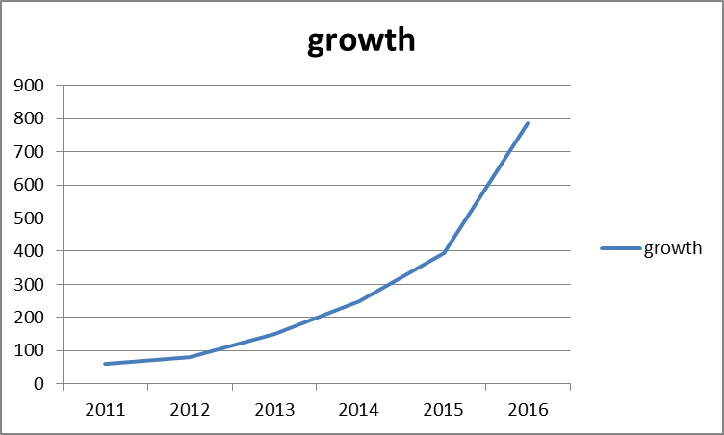
Q1) Is the number of petitions with data engineer jobs increasing over time?
Year | No of petitions | % growth
2011 | 60
2012 | 81 | 35
2013 | 151 | 86.41975
2014 | 249 | 64.90066
2015 | 394 | 58.23293
2016 | 786 | 99.49239

Slide 23
6) Find the percentage and the count of each case status on total applications for each year. Create a line graph depicting the pattern of All the cases over the period of time.

Slide 24
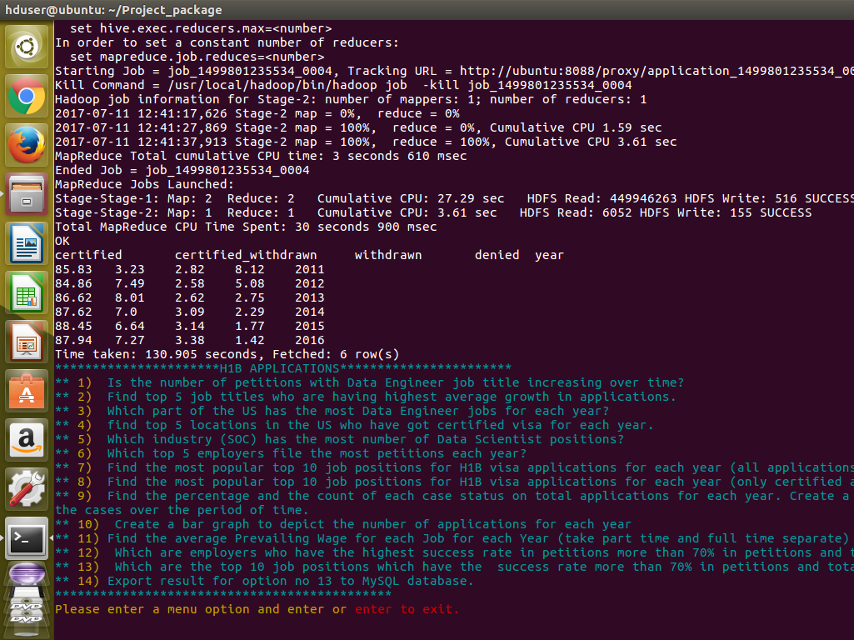

Slide 25
7) Create a bar graph to depict the number of applications for each year
Year | No of applications
2011 | 358767
2012 | 415607
2013 | 442114
2014 | 519427
2015 | 618727
2016 | 647803

Slide 26
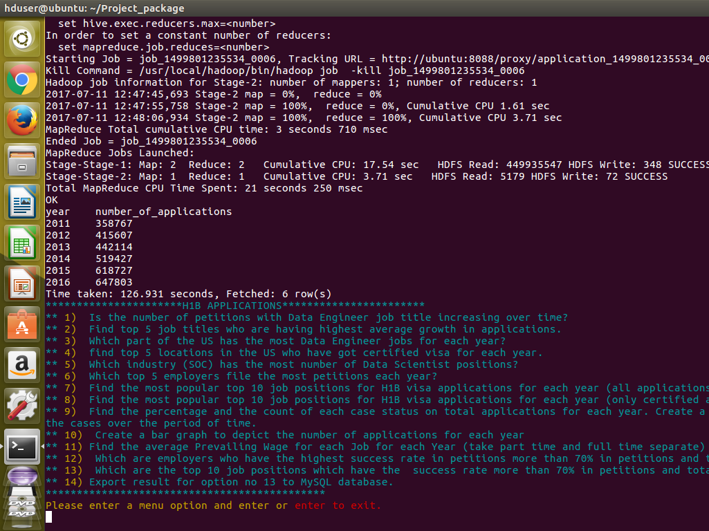

Slide 27
THANK YOU
Github Link: https://github.com/Prashanth-K-Narasimhan/Project_BigData

