Slide 1
NORDAGGLE presents…
Introduction to Python Workshop
Caroline Harbitz & Gina Schmalzle

Slide 2
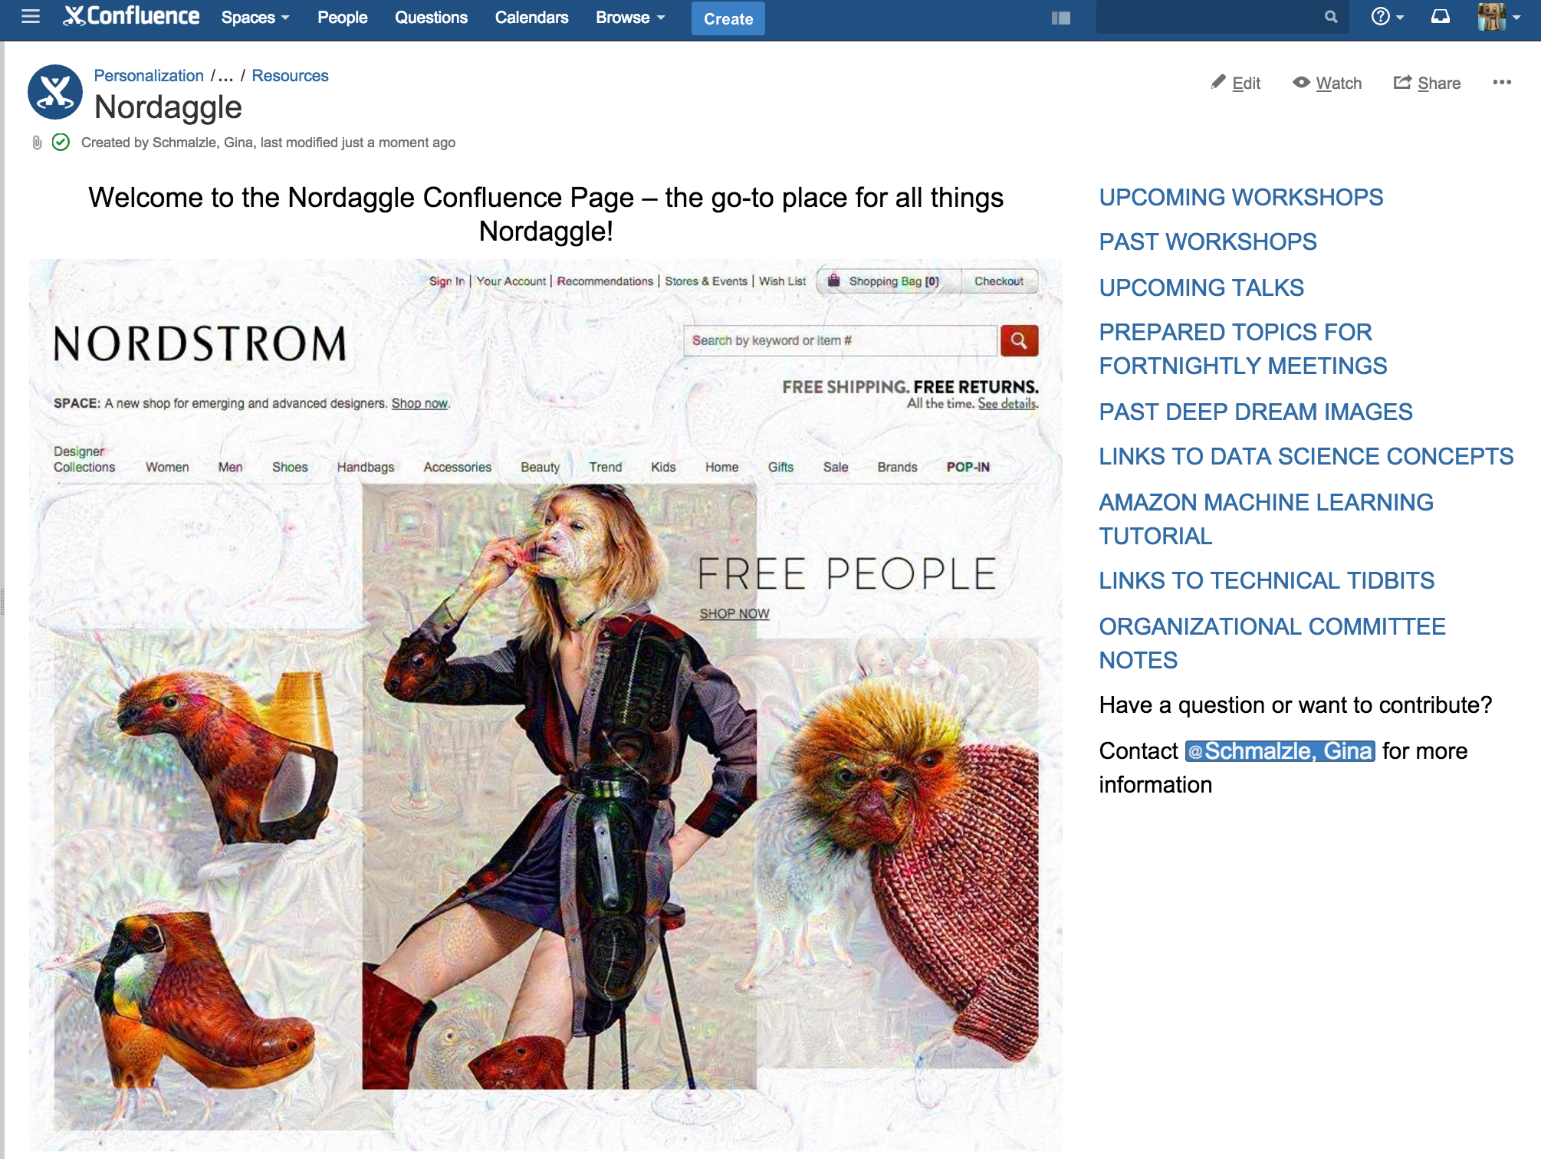
NORDAGGLE- What is it?
Primary purpose -- increase communication about data topics
Nordaggle – spin off from Kaggle
We host
Fortnightly meetings to talk about data topics and problems
Workshops
Competitions (not yet offered)
https://confluence.nordstrom.net/display/PER/Nordaggle

Slide 3
Special Thanks
Melissa Haklitch – logistics extraordinaire ☺
Jason Gowans and the Data Lab – Food and Drink
Heidi Whiting and James Pestrak – python/pip installation
Our TA’s!

Slide 4
Special Thanks
You!
212 Officially Signed Up
105 Beginner, 81 Intermediate and 22 Expert Programmers (4 no response)

Slide 6
What Next?
Build an executable python script.
For example:
Create a file named example.py (note the ‘.py)
In example.py write an example python script (e.g.: print(‘Hello world!’)), save and close.
At the command line type:
python example.py

Slide 7
What Next?
Use the ipython interactive shell
For example:
At the command line type: ipython
Start writing python code like you did with notebooks

Slide 8
What Next?
Try the final projects!
Two are in the repo:
python_bootcamp_final_project.ipynb
python_bootcamp_final_project_with_pandas.ipynb

Slide 9
What Next?
Think of your own project.
Tips:
Google and Stack Overflow are your friends
Try troubleshooting using print statements
Try using a debugger
https://wiki.python.org/moin/PythonDebuggingTools

