Slide 1
Address Book Management System
PROJECT
ON
A simple yet powerful project using C Programming
(Files, Structures, Arrays, and Functions)
By:- Prashanth reddy

Slide 2
Contents
Introduction
Purpose of the Project
Requirements
From Traditional to Digital
Block Diagram
Key Features & Concepts Used
Functions and Implementation
Why CSV Format?
Challenges Faced
Code & Outputs
Advantages and Disadvantages
Conclusion

Slide 3
Introduction
An Address Book is a digital system to store, manage, and organize contact information.
It works like a real-life phonebook but in a structured and efficient way.
Why use an Address Book?
Keeps contacts organized
Allows quick search
Prevents data loss
Ensures safe and fast storage
Saves time

Slide 4
Purpose of the Project
Build a functional Address Book using core concepts of C (arrays, structures, strings, file handling)
Reinforce structured programming and logical problem-solving
Ensure data is stored permanently using file operations (CSV format)
Handle edge cases and validation effectively
Demonstrate how basic C elements can create a real-world utility

Slide 5
Requirements
Programming Language: C (Advanced Level)
Compiler: GCC
Operating System: Linux / Windows
File Format: CSV (Comma-Separated Values)
Libraries Used: stdio.h, string.h, ctype.h

Slide 6
From Traditional to Digital
Traditional Address Book → Handwritten entries, no search or sort, prone to damage
Digital Address Book → Structured, searchable, permanent, editable, portable
Data is saved in CSV format, readable across all systems and editors.

Slide 7
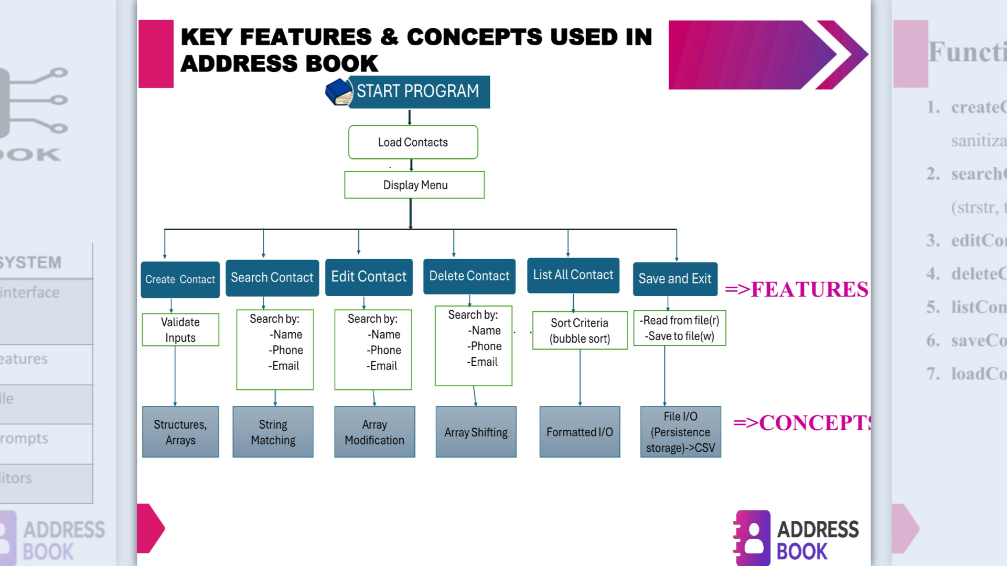
Block Diagram

Slide 8
Key Features & Concepts Used
FEATURES:
Add, search, edit, delete, and list contacts
Persistent data storage using files
Input validation and formatted output
CONCEPTS:
Arrays and Structures
File Handling (CSV)
String Manipulation
Modular Programming

Slide 9
Functions and Implementation
Create_ Contact() - Add new contacts with validation
Search_Contact() - Find contacts by name, phone, or email
Edit_Contact() - Modify existing contact details
Delete_Contact() - Remove a contact after confirmation
List_Contacts() - Display all stored contacts neatly
Save_Contacts_To_File() - Write data to CSV file
Load_Contacts_From_File() - Read data from CSV file

Slide 10
Why CSV Format?
Portable across any OS (Notepad, Excel, Linux)
Structured data in rows and columns (Name, Phone, Email)
Persistent storage even after program closure
Example: Like a versatile jacket usable in all seasons-CSV works across platforms efficiently.

Slide 11
Challenges Faced
Handling invalid inputs (characters instead of numbers)
Avoiding infinite loops during data entry
Managing string operations safely
Preventing segmentation faults from incorrect file modes

Slide 12
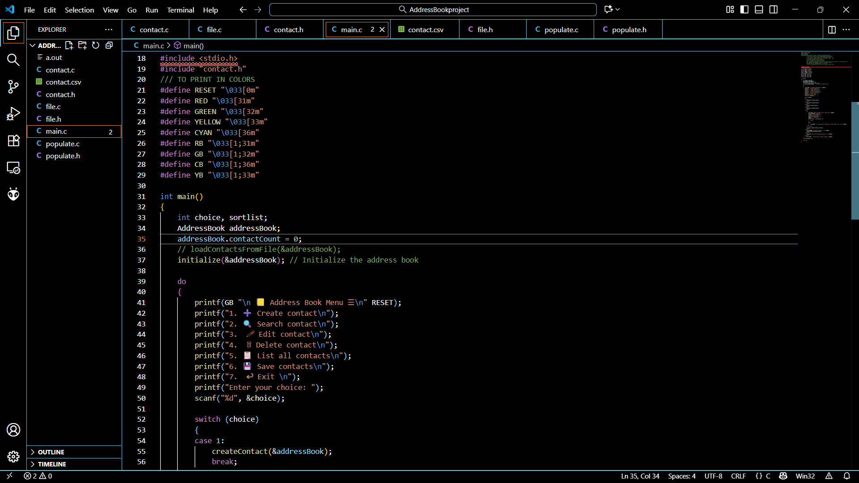
CODE

Slide 13
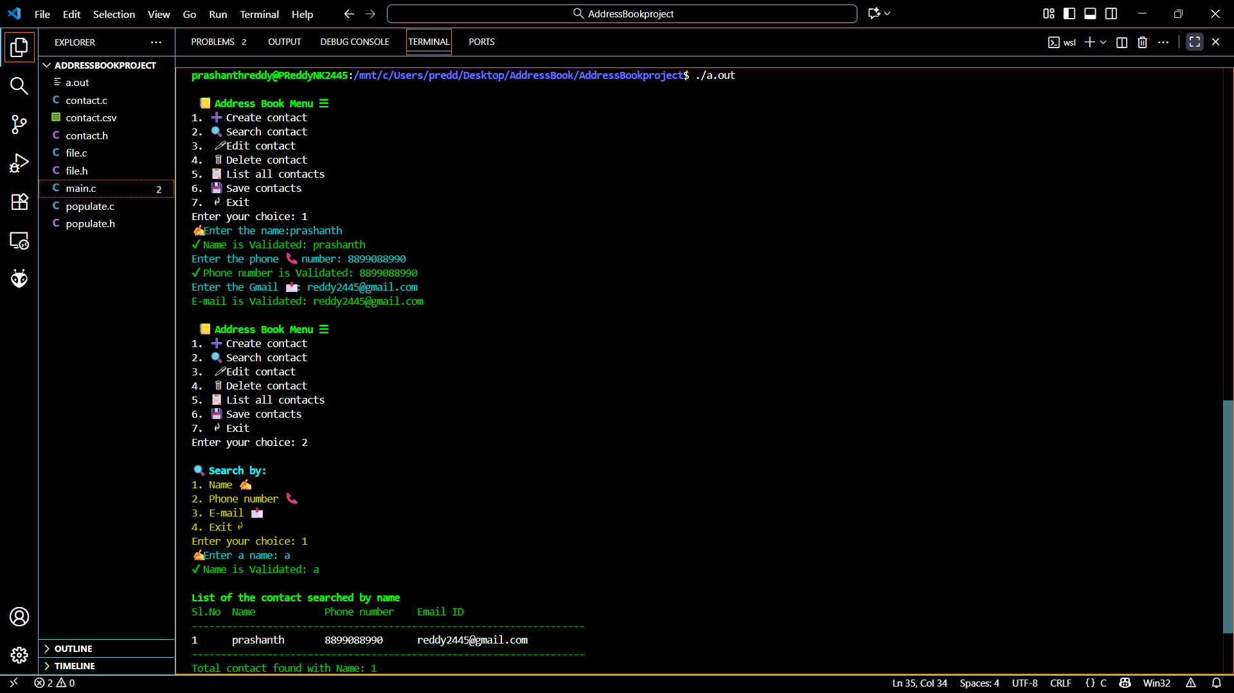
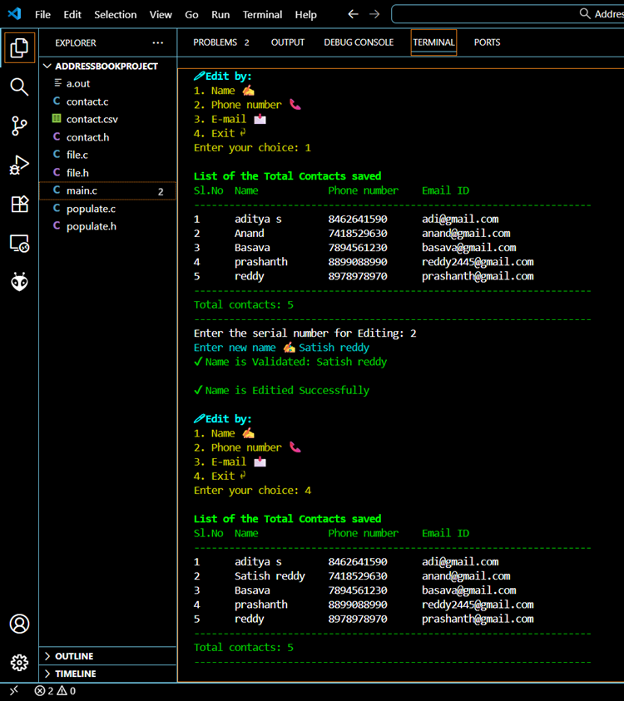
OUTPUTS Create contacts, search contacts, Edit contacts

Slide 14
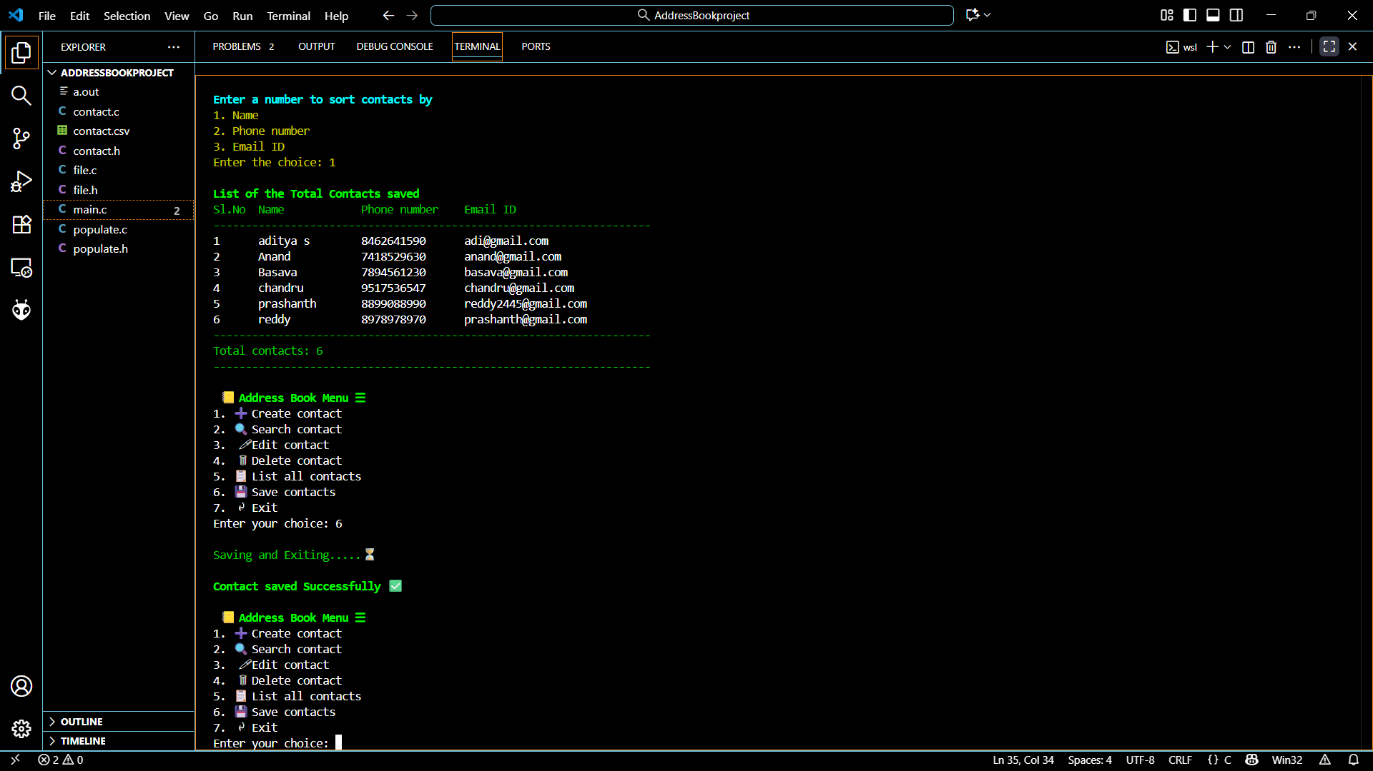
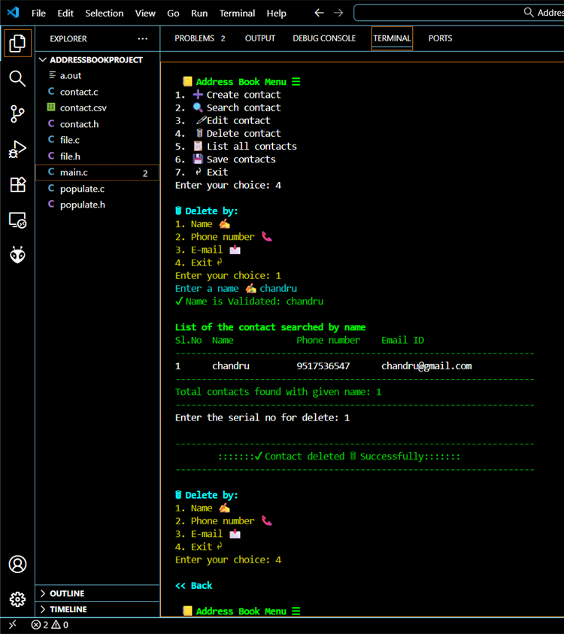
List contacts, Save contacts, Delete contacts

Slide 15
Advantages and Disadvantages
Advantages:
Organized contact management
Quick access and retrieval
Permanent data storage
Simple yet practical implementation
Disadvantages:
Dependent on external file
No encryption or data security

Slide 16
Conclusion
CSV format demonstrates smart, structured data storage
Proved that simple C code can become a practical mini-database
Highlights importance of modularity and structured design
Shows how file handling enables persistent and reliable storage
Foundation for larger data management systems

