Slide 1

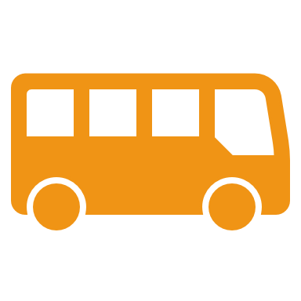
SmartTransit System
Presented By:
Vasudev Darse Shikari
Employee Id: 287632
Sahana B Srinivasa
Employee Id: 288058

Slide 2
Problem Statement
Urban residents face significant challenges with public transportation, such as:
1. Unpredictable bus schedules
2. Overcrowding during peak hours
3. Delays or detours affecting commute times
This discourages the use of public transport, worsening traffic congestion and environmental pollution.

Slide 3
Scope
1. Functional Requirements
- User Interface (UI), Bus Management, Passenger Management, Notification, etc.
2. Non-Functional Requirements
- Performance, Scalability, Security, Usability, etc.

Slide 4
Functional Requirements Overview
Key features include:
• Real-time bus tracking with location updates.
• Occupancy tracking and management.
• Notifications for bus status, delays, and crowding.
• Carpool management and integration.
• Admin control panel for managing buses, users, and schedules.

Slide 5
Non-Functional Requirements
1. Performance: Handle multiple buses and passengers concurrently.
2. Scalability: Accommodate growing number of buses and users.
3. Security: JWT authentication, secure data storage.
4. Reliability: Heartbeat mechanism to monitor bus health.
5. Usability: Mobile & desktop compatible interface.

Slide 6
Public API’s USED:
Razorypay Payment Gateway
OLA map

Slide 7
High-Level Design
• Web Interface
• API Gateway
• Microservices Architecture (Bus, User, Passenger Management, etc.)
• Database Systems
• Bus Thread Service
• Notification System

Slide 8
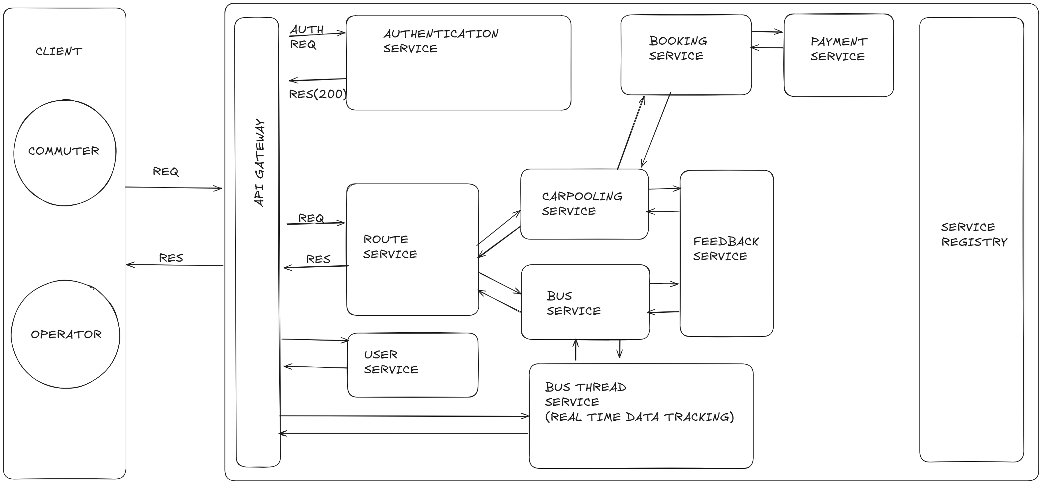
Architecture Diagram

Slide 9
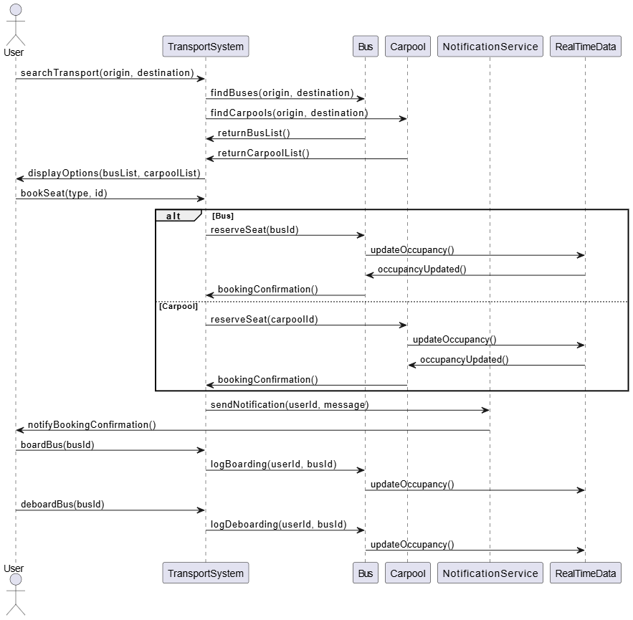
Sequence Diagram

Slide 10
Future Enhancement:
Advanced Predictive Analytics Implementing predictive analytics will enable the Bus Management System to forecast demand patterns,
Sustainable Transportation Initiatives Integrating sustainability metrics, such as emissions tracking and eco-friendly route planning.
User-Centric Customization Options Providing users with customizable features, such as personalized route suggestions and tailored notifications.

Slide 11
Conclusion
This SmartTransit System will streamline urban transportation by improving bus schedules, occupancy management, and real-time tracking, providing commuters with better service and reducing congestion.

