Slide 1
One sample test
Test if the mean height of students at this college is significantly different than 66.5 inches using a one-sample t test.
H0: µHeight = 66.5 ("the mean height is equal to 66.5")
H1: µHeight ≠ 66.5 ("the mean height is not equal to 66.5")

Slide 2
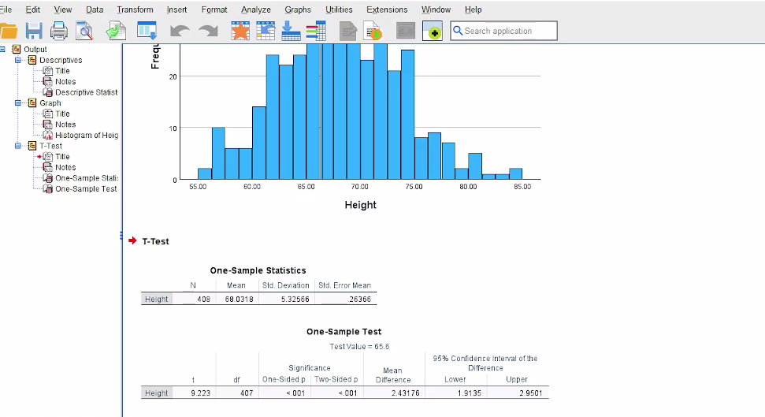

Slide 3
CONCLUSIONS
Our hypothesized population value was 66.5 inches, the [approximate] average height of the overall adult population. Since p < 0.001, we reject the null hypothesis that the mean height of students at this college is equal to the hypothesized population mean of 66.5 inches and conclude that the mean height is significantly different than 66.5 inches.

Slide 4
2 sample t test or independent t test
In our sample dataset, students reported their typical time to run a mile, and whether or not they were an athlete. Suppose we want to know if the average time to run a mile is different for athletes versus non-athletes. This involves testing whether the sample means for mile time among athletes and non-athletes in your sample are statistically different (and by extension, inferring whether the means for mile times in the population are significantly different between these two groups). You can use an Independent Samples t Test to compare the mean mile time for athletes and non-athletes.
The hypotheses is:
H0: µnon-athlete − µathlete = 0 ("the difference of the means is equal to zero")
H1: µnon-athlete − µathlete ≠ 0 ("the difference of the means is not equal to zero")

Slide 5
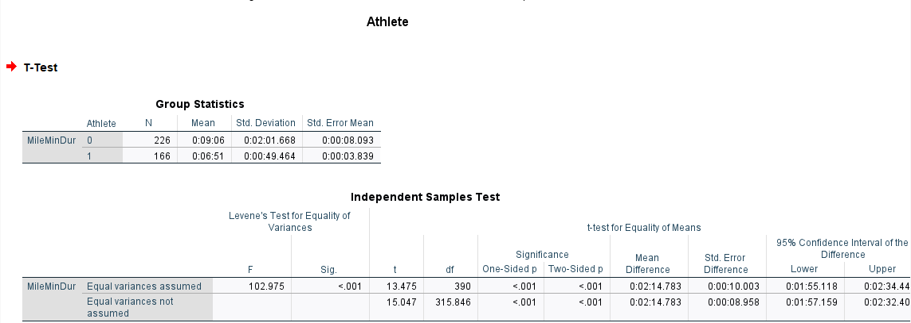

Slide 6
CONCLUSION
Since p < .001 is less than our chosen significance level α = 0.05, we can reject the null hypothesis, and conclude that the mean mile time for athletes and non-athletes is significantly different.

Slide 7
One-Way ANOVA ("analysis of variance")
In the sample dataset, the variable Sprint is the respondent's time (in seconds) to sprint a given distance, and Smoking is an indicator about whether or not the respondent smokes (0 = Nonsmoker, 1 = Past smoker, 2 = Current smoker). Let's use ANOVA to test if there is a statistically significant difference in sprint time with respect to smoking status. Sprint time will serve as the dependent variable, and smoking status will act as the independent variable.

Slide 8
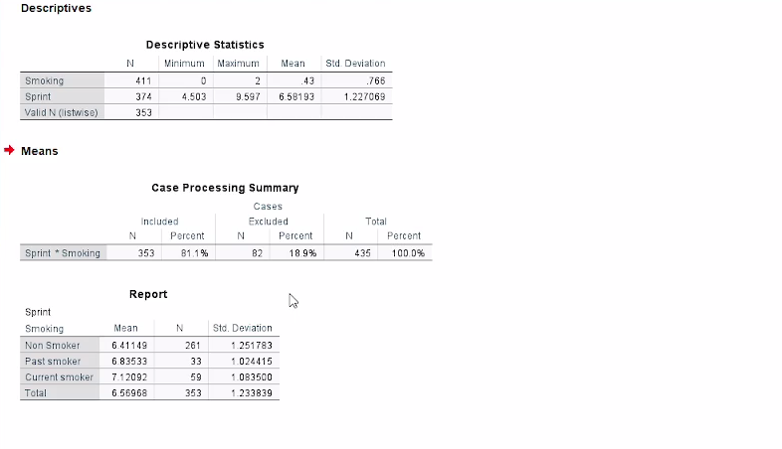

Slide 9
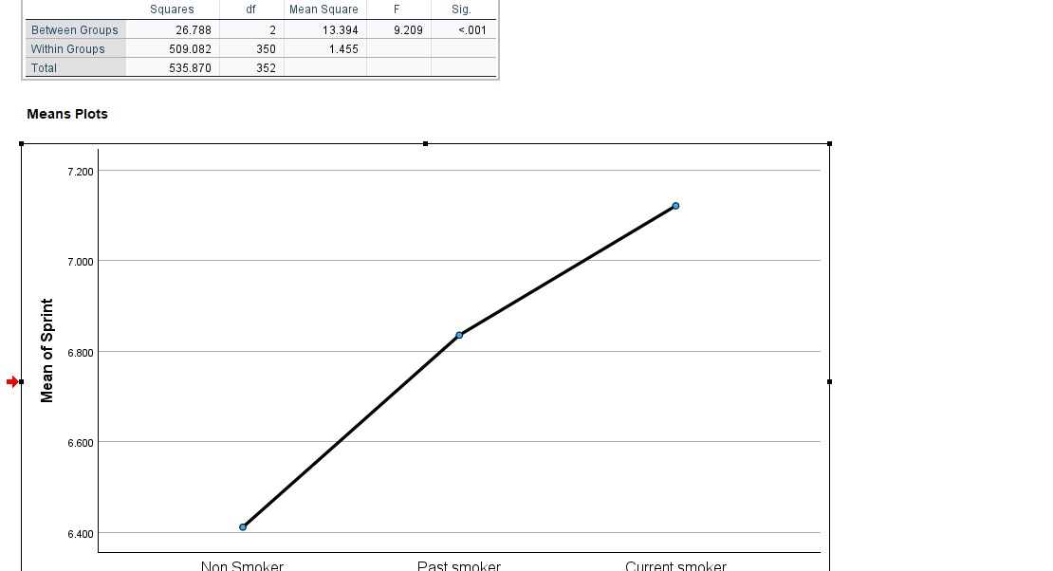

Slide 10
CONCLUSIONS
We conclude that the mean sprint time is significantly different for at least one of the smoking groups (F2, 350 = 9.209, p < 0.001). Note that the ANOVA alone does not tell us specifically which means were different from one another.

Slide 11
Chi-Square Test of Independence
PROBLEM STATEMENT
In the sample dataset, respondents were asked their gender and whether or not they were a cigarette smoker. There were three answer choices: Nonsmoker, Past smoker, and Current smoker. Suppose we want to test for an association between smoking behavior (nonsmoker, current smoker, or past smoker) and gender (male or female) using a Chi-Square Test of Independence (we'll use α = 0.05).

Slide 12
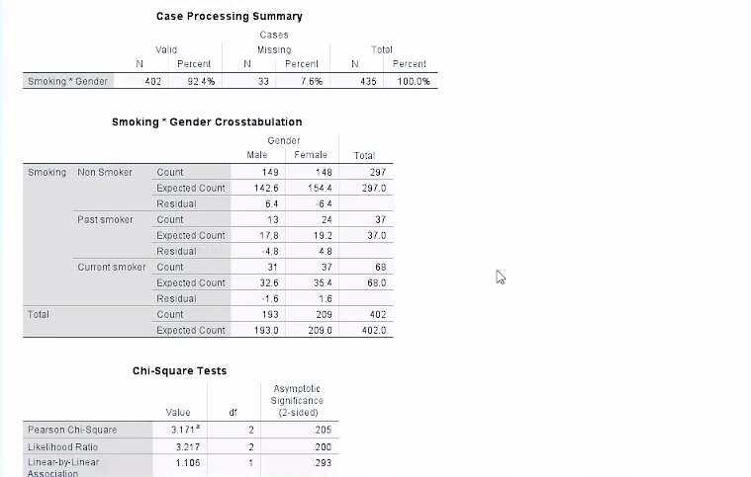

Slide 13
CONCLUSIONS
Since the p-value is greater than our chosen significance level (α = 0.05), we do not reject the null hypothesis. Rather, we conclude that there is not enough evidence to suggest an association between gender and smoking.
No association was found between gender and smoking behavior (Χ2(2)> = 3.171, p = 0.205).

