Slide 1
Coursera Capstone IBM Applied Data Science Capstone Opening a New Shopping Mall in Kuala Lumpur, Malaysia By: Prashanth KV

Slide 2
INSTRUCTIONS FOR USE
For many shoppers, visiting shopping malls is a great way to relax and enjoy themselves during weekends and holidays. They can do grocery shopping, dine at restaurants, shop at the various fashion outlets, watch movies and perform many more activities. Shopping malls are like a one-stop destination for all types of shoppers. For retailers, the central location and the large crowd at the shopping malls provides a great distribution channel to market their products and services. Property developers are also taking advantage of this trend to build more shopping malls to cater to the demand. As a result, there are many shopping malls in the city of Kuala Lumpur and many more are being built. Opening shopping malls allows property developers to earn consistent rental income. Of course, as with any business decision, opening a new shopping mall requires serious consideration and is a lot more complicated than it seems. Particularly, the location of the shopping mall is one of the most important decisions that will determine whether the mall will be a success or a failure.

Slide 3

Business Problem
The objective of this capstone project is to analyse and select the best locations in the city of Kuala Lumpur, Malaysia to open a new shopping mall. Using data science methodology and machine learning techniques like clustering, this project aims to provide solutions to answer the business question: In the city of Kuala Lumpur, Malaysia, if a property developer is looking to open a new shopping mall, where would you recommend that they open it?

Slide 4
Data:
To solve the problem, we will need the following data:
• List of neighbourhoods in Kuala Lumpur. This defines the scope of this project which is confined to the city of Kuala Lumpur, the capital city of the country of Malaysia in South East Asia.
• Latitude and longitude coordinates of those neighbourhoods. This is required in order to plot the map and also to get the venue data.
• Venue data, particularly data related to shopping malls. We will use this data to perform clustering on the neighbourhoods.

Slide 5
Sources of data and methods to extract them
This Wikipedia page (https://en.wikipedia.org/wiki/Category:Suburbs_in_Kuala_Lumpur) contains a list of neighbourhoods in Kuala Lumpur, with a total of 70 neighbourhoods. We will use web scraping techniques to extract the data from the Wikipedia page, with the help of Python requests and beautifulsoup packages. Then we will get the geographical coordinates of the neighbourhoods using Python Geocoder package which will give us the latitude and longitude coordinates of the neighbourhoods.
After that, we will use Foursquare API to get the venue data for those neighbourhoods. Foursquare has one of the largest database of 105+ million places and is used by over 125,000 developers. Foursquare API will provide many categories of the venue data, we are particularly interested in the Shopping Mall category in order to help us to solve the business problem put forward. This is a project that will make use of many data science skills, from web scraping (Wikipedia), working with API (Foursquare), data cleaning, data wrangling, to machine learning (K-means clustering) and map visualization (Folium). In the next section, we will present the Methodology section where we will discuss the steps taken in this project, the data analysis that we did and the machine learning technique that was used

Slide 6
Methodology
We need to get the list of neighbourhoods in the city of Kuala Lumpur. Fortunately, the list is available in the Wikipedia page (https://en.wikipedia.org/wiki/Category:Suburbs_in_Kuala_Lumpur). We will do web scraping using Python requests and beautifulsoup packages to extract the list of neighbourhoods data. However, this is just a list of names. We need to get the geographical coordinates in the form of latitude and longitude in order to be able to use Foursquare API. To do so, we will use the wonderful Geocoder package that will allow us to convert address into geographical coordinates in the form of latitude and longitude. After gathering the data, we will populate the data into a pandas DataFrame and then visualize the neighbourhoods in a map using Folium package. This allows us to perform a sanity check to make sure that the geographical coordinates data returned by Geocoder are correctly plotted in the city of Kuala Lumpur.

Slide 7
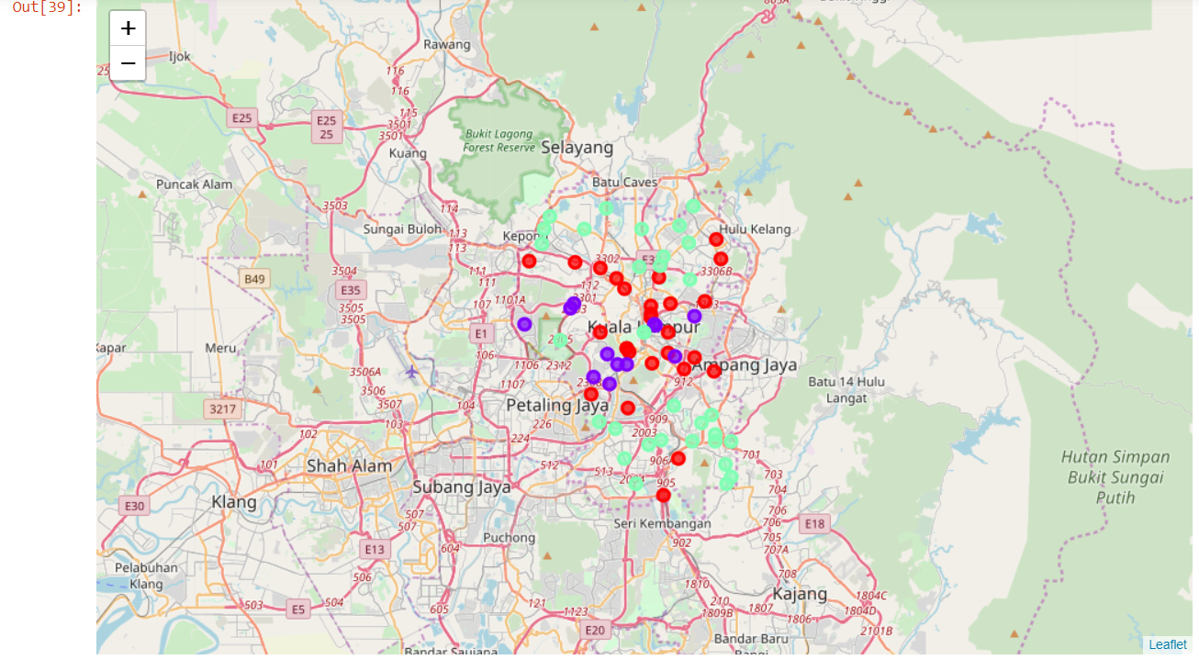
Results
The results from the k-means clustering show that we can categorize the neighbourhoods into 3 clusters based on the frequency of occurrence for “Shopping Mall”:
• Cluster 0: Neighbourhoods with moderate number of shopping malls
• Cluster 1: Neighbourhoods with low number to no existence of shopping malls
• Cluster 2: Neighbourhoods with high concentration of shopping malls
The results of the clustering are visualized in the map below with cluster 0 in red colour, cluster 1 in purple colour, and cluster 2 in mint green colour.

Slide 8
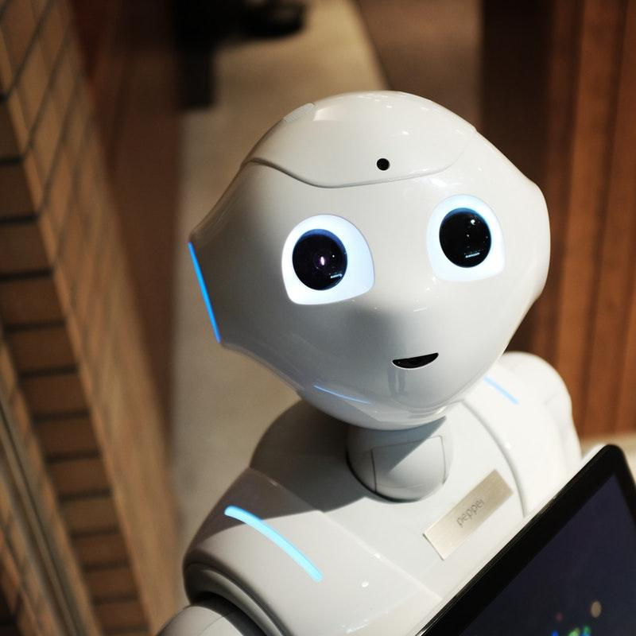
Limitations and Suggestions for Future Research
In this project, we only consider one factor i.e. frequency of occurrence of shopping malls, there are other factors such as population and income of residents that could influence the location decision of a new shopping mall. However, to the best knowledge of this researcher such data are not available to the neighbourhood level required by this project. Future research could devise a methodology to estimate such data to be used in the clustering algorithm to determine the preferred locations to open a new shopping mall. In addition, this project made use of the free Sandbox Tier Account of Foursquare API that came with limitations as to the number of API calls and results returned. Future research could make use of paid account to bypass these limitations and obtain more results

