Slide 1
Presentation on
Life Expectancy Prediction using Decision Tree Regression From Scratch
Presented by,
Prashanth M

Slide 2
MACHINE LEARNING MODEL FROM SCRATCH
Problem Understanding
Data Collection.
Data Preparation.
Choose a Model.
Construct the Model Class from Python OOPs
Train the Model
Evaluate the Model
Parameter Tuning
Make Predictions

Slide 3
PROBLEM STATEMENT
To predict the life expectancy of whole population of different countries based on bmi ratio, people condition for different diseases and various other features.

Slide 4
BUILDING ALGORITHM FROM SCRATCH
Pandas and Numpy Libraries are used for defining the model with varies functions and also for splitting the data.
Python Class and Functions.
While building algorithm from scratch one should have pre knowledge of model working and its parameters.
Matplotlib and seabourn are used for visualization.

Slide 5
DATASET
ROWS : Dataset Consists of 2938 number of instances including all missing values.
Columns : Dataset Consists of 22 attributes including target variable.
Target variable : ” Life Exepentacy ”
Problem type : Regression

Slide 6
Data Cleaning and Pre-processing

Slide 7
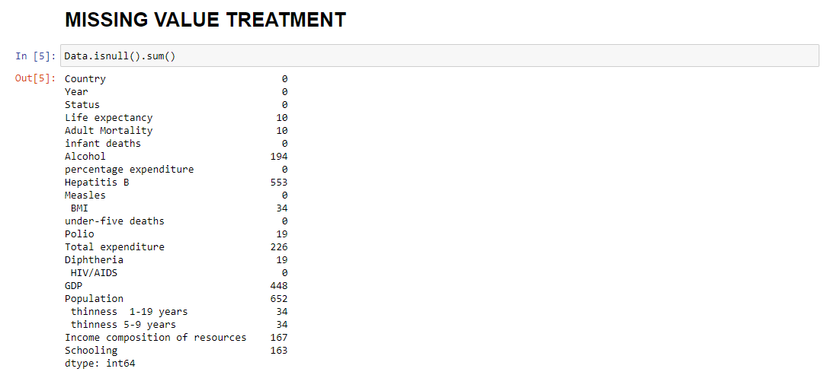
MISSING VALUE TREATMENT
Missing values are imputed using mean values of each features.
Data[null_columns]=Data[null_columns].fillna(Data[null_columns].mean())

Slide 8
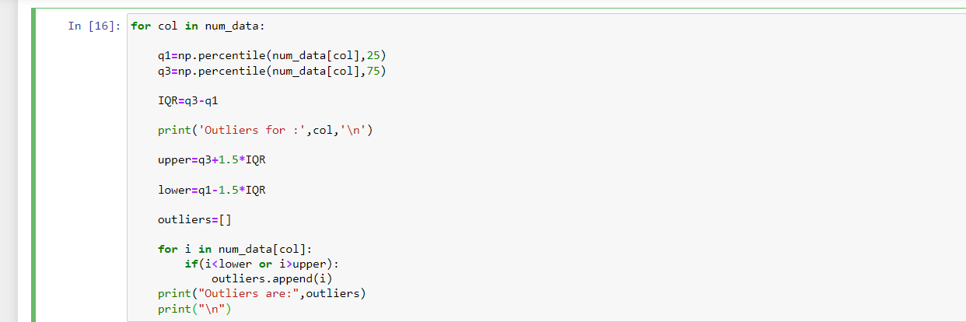
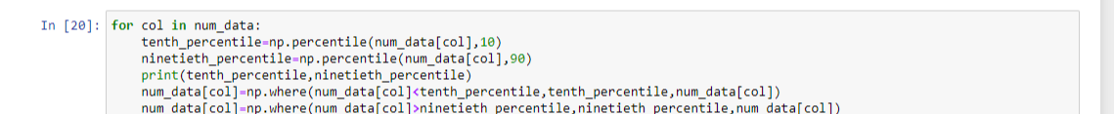
OUTLIER TREATMENT
I have used IQR for detecting Outliers and tenth &ninty percentile values to replace the outliers.

Slide 9
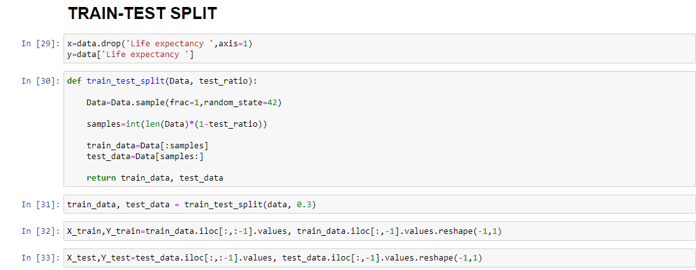
TRAIN TEST SPLIT
Sample fuction is used to randomize the data.
Test ratio is used to divide the data appropriately to fed into the model for training and testing.

Slide 10
Models Building

Slide 11
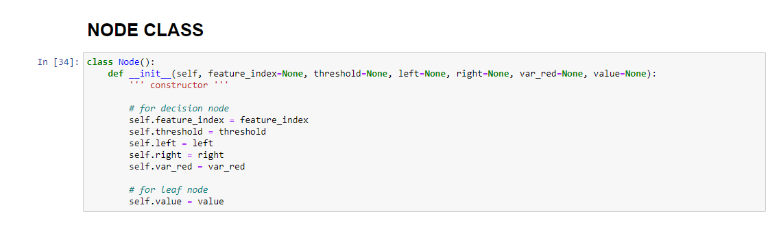
NODE CLASS
Node class is a constuctor that defines all the attributes present at the decision node.

Slide 12
TREE CLASS
It consist of constructer the defines tree parameters which are used as stopping criterion for a decision tree.
Various functions those defines each and every step of building perfect CART decision tree regressor.
Those are:
build_tree function : Defines procedure to build tree and returns leaf value.
get_best_split : Splitting procedure is explained here and returns best split.
split : Explains splitting the features.
variance_reduction : Define varience reduction formula to determine best split.
calculate_leaf_value : Calculates leaf node Value.
fit : fitting data into model.
make_prediction and predict : for output prediction.
mse and r_squared : Evaluation of model

Slide 13
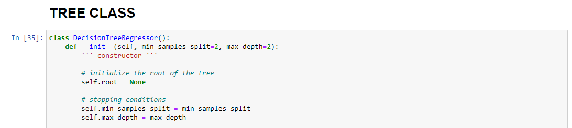
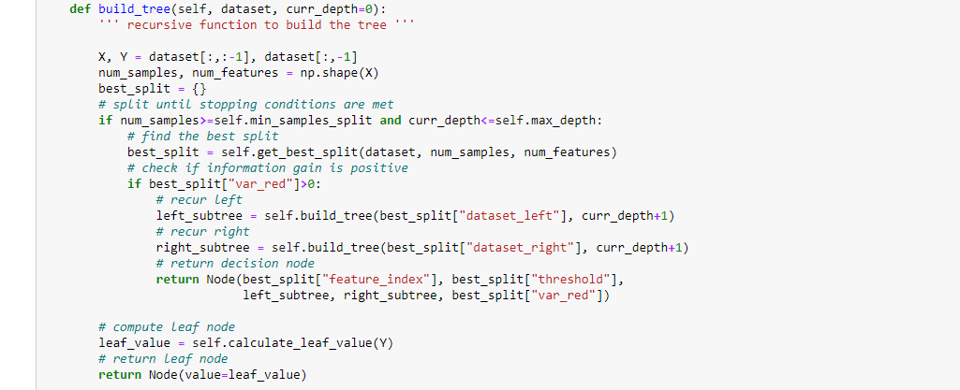

Slide 14
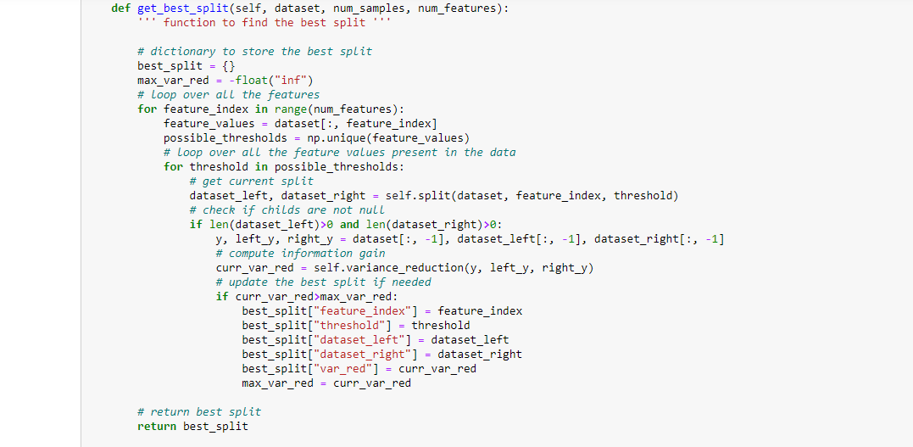
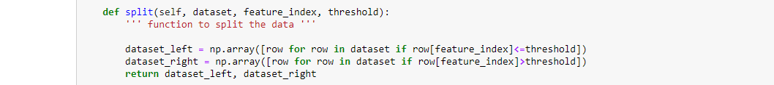

Slide 15
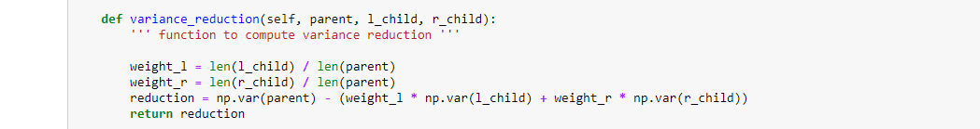
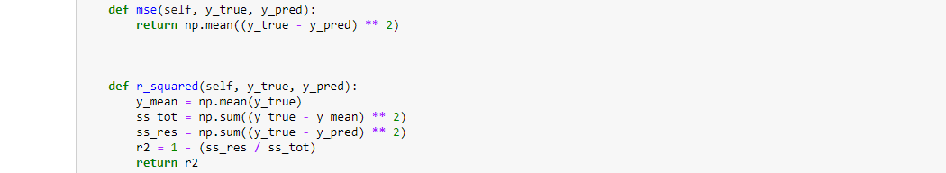

Slide 16
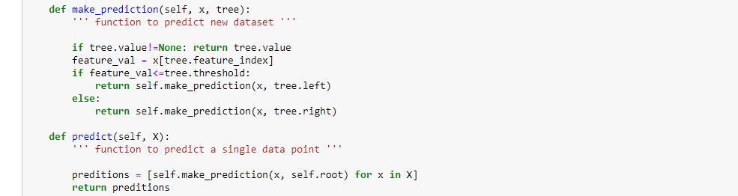

Slide 17
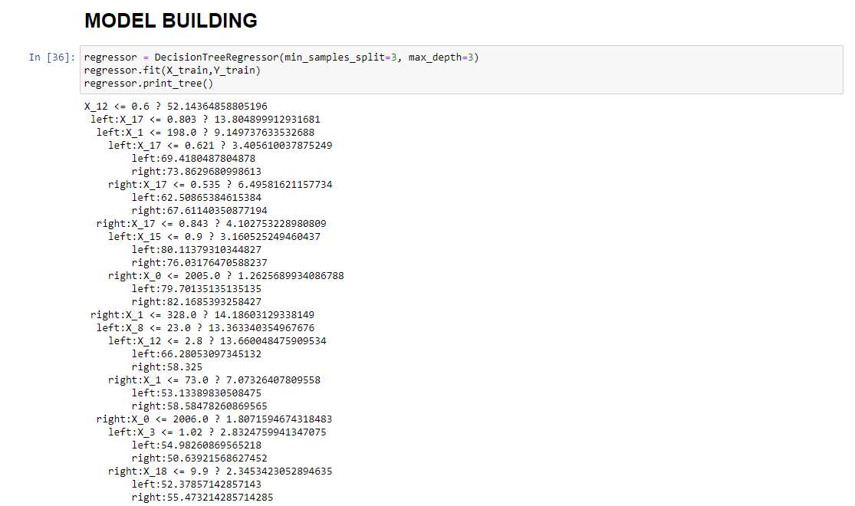

Slide 18
Model Predictions
MSE of the model I got is 170.67 which is quite high.
R2 value is for testing -1618.93 which is very bad for decision tree indicates data is not fitted properly to the model and it requires tuning.
But from sklearn library maodel is perfoming very good than model from scratch.

Slide 19
Thank You

