Slide 1
Presentation on
Car Price Prediction using Decision Tree Regression
Presented by,
Prashanth M

Slide 2
Machine Learning Life Cycle:
Problem Understanding
Data Collection.
Data Preparation.
Choose a Model.
Train the Model
Evaluate the Model
Parameter Tuning
Make Predictions

Slide 3
Problem Statement
Determine the Price of the car by looking at its features and design before manufacturing and looking at its resources.

Slide 4
IMPORT LIBRARIES
Scikit-learn library for splitting the data into train-test samples, building models, model evaluation and Encoding
Model: Decision Tree Regressor
Metric for evaluation: MSE
Encoding:Onehot Encoder and Label Encoder
GridSearchCV:Hyper Parameter Tuning
Seabourn, matplotlib for data visualizations.
Pandas and Numpy for data manipulation.

Slide 5
Features of the Dataset
Rows:
* We have 11914 rows in our dataset
Features:
* We have 16 columns in that
- 9 numerical features
- 7 categorical features
Target Variable: MSRP
Problem Type- Regression type

Slide 6
Data Cleaning and Pre-processing

Slide 7
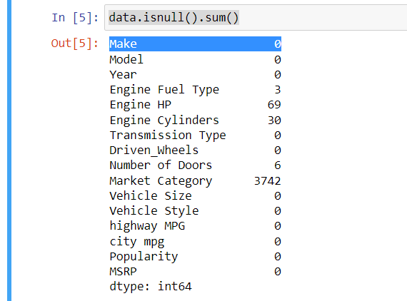
Missing value Treatment
Since there are many null values in Market Category column so I removed entire column from the dataset.
Missing Values of other columns are treated using mode or median or else rows are deleted.

Slide 8
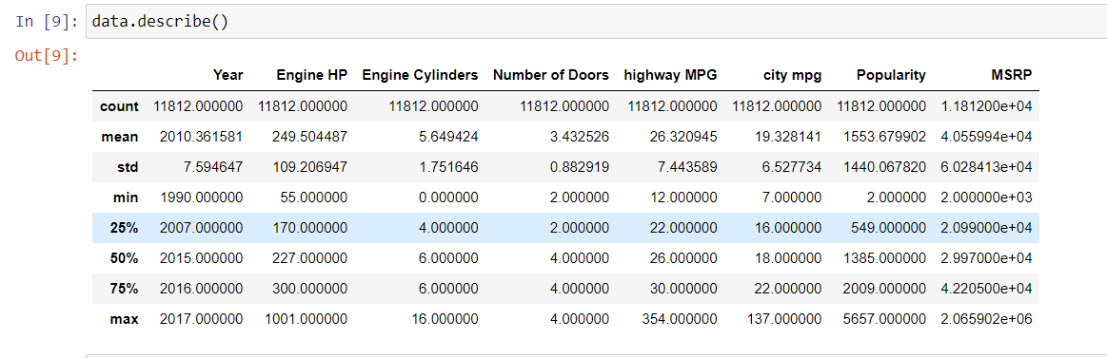
Outliers Treatment
Describe function shows that there is high std in some columns indicating that many outliers are present in the dataset.
So, I have used IQR for detecting Outliers and tenth &ninty percentile values to replace the outliers.

Slide 9
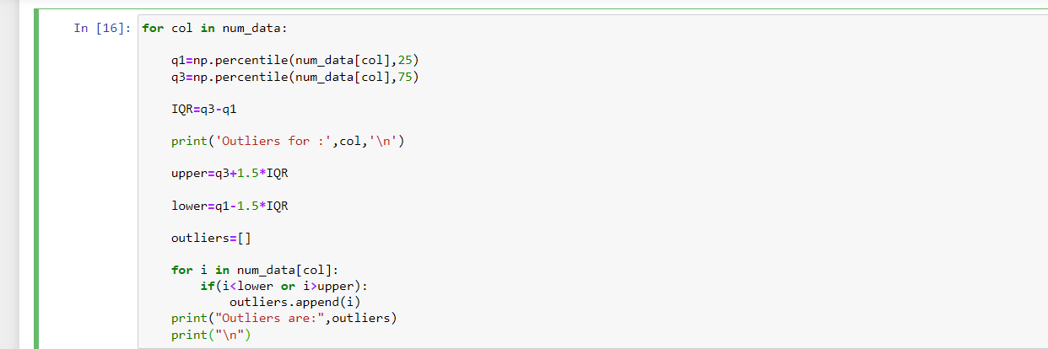
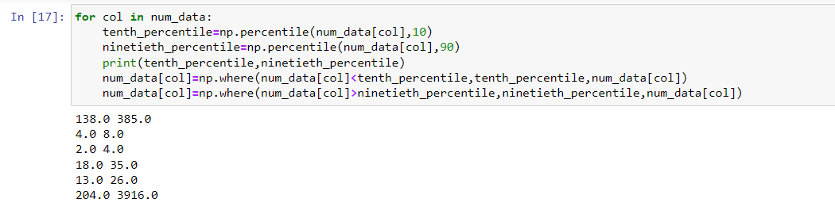

Slide 10
Encoding the Categorical Data
There were 5 categorical features in dataset
By using pd.get_dummies() and sklearn LabelEncoder for Encoding.
If column is having large number of unique values then delete that column.

Slide 11
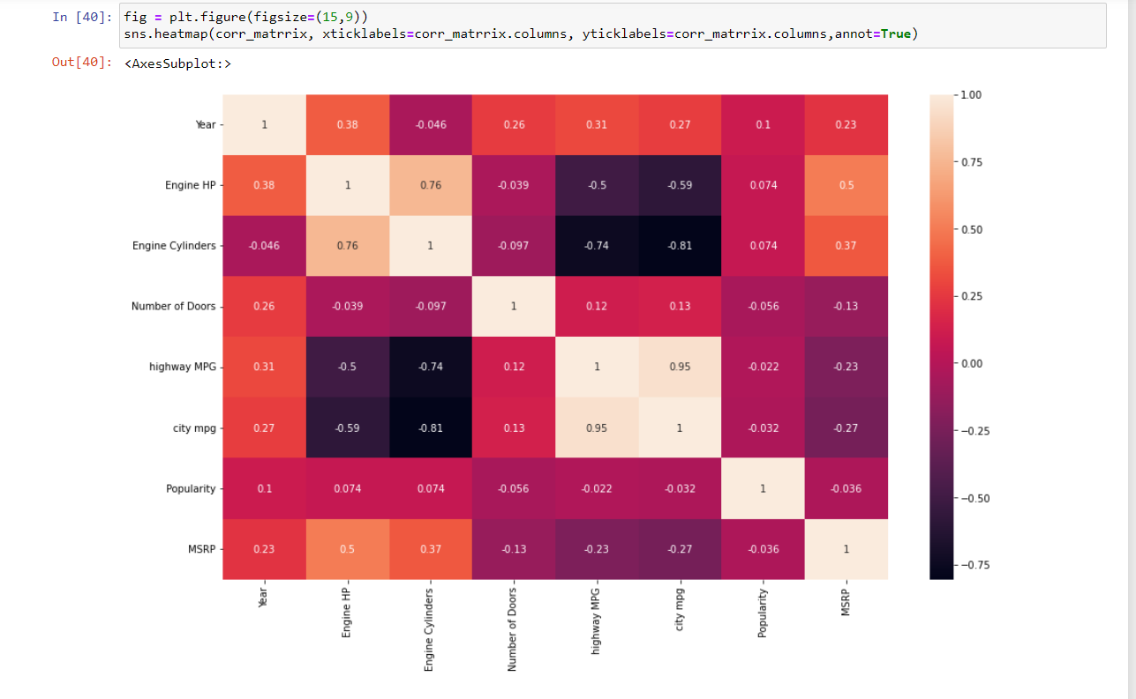
Correlation Matrix

Slide 12
Models Building

Slide 13
Models Used
Predictive Model used is Decision Tress Regression.
MSE I got is 621862771.077 is pretty higher since the price of car is very high.
R2 value is for testing is 0.7786 and for training is 0.9576.So,this is the condition of overfitting.

Slide 14
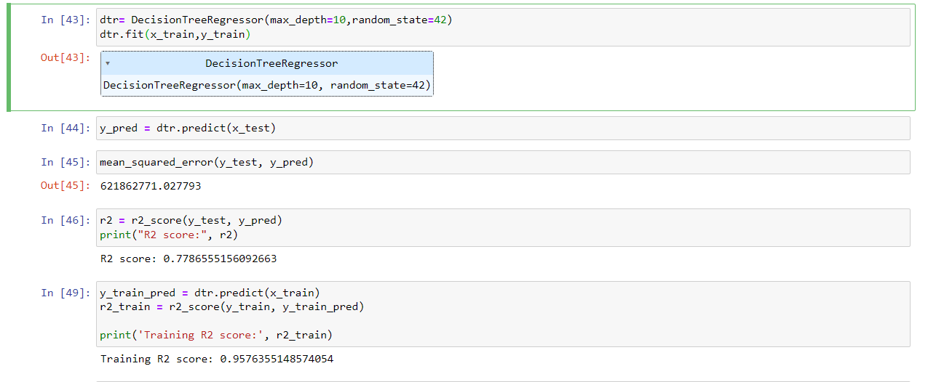

Slide 15
Tree Pruning
Pruning is a technique used to reduce the complexity of a decision tree and prevent overfitting.
There are two types of Pruning techniques,
a)Pre-pruning:also known as early stopping, involves setting a stopping criterion before the decision tree is fully grown.
example
b)Post-pruning: also known as backward pruning or cost-complexity pruning, involves growing a decision tree to its full size and then removing branches that do not improve the model's performance.
This is done by using a tuning parameter called the cost complexity parameter (ccp_alpha).
ccp_alpha value is evaluated for every subtrees that are formed by removing nodes iteratively.which ever the gives highest performance on both train and test data that value of cost-complexity parameter is retained with the tree.
clf= DecisionTreeClassifier(criterion= ‘mse',max_depth=10) clf.fit(X_train,y_train)

Slide 16
Hyper parameter tuning.
Here I used GridSearchCV to find best parameters for our Decision tree regression model.
After tuning the model I got
MSE: 125674495.1388 and 0.801 score

Slide 17
Conclusion
I got better performance of the model after hyper Parameter Tuning.
R2 value increased from 77% to 80% is pretty good improvement of the model.

Slide 18
Thank You

