Slide 1
DATA ANALYTICS — INDIVIDUAL PROJECT
Video Game Sales Analysis
Regional preferences, generational trends, critic-score impact, and publisher consistency in the global video game market
Prashanth Pinniboyina
Student ID: 49834918
Dataset: Video Game Sales Dataset — Updated / Extra Feat (Kaggle)

Slide 2
OVERVIEW
Why This Analysis Matters
Problem Statement
Dataset
The video game industry spans many regions, platforms, and publishers, each with different consumer preferences and commercial dynamics. Publishers and developers often lack a clear, data-driven view of how regional tastes differ, how the market has evolved across console generations, whether critical acclaim actually translates into sales, and which publishers reliably produce hits versus those with occasional breakout success.
Video Game Sales Dataset — Updated / Extra Feat (Kaggle)
Platform, genre, publisher & regional sales figures
Regions: North America, Europe, Japan, Other
Critic and user review scores included
Format: CSV, analyzed in Python (pandas, seaborn)
This project uses historical sales and review data to answer these questions with quantitative evidence — insights that can inform regional marketing strategy, platform investment, and publisher performance evaluation.
Repository: github.com/PrashanthPinniboyina/49834918_DS-120B
2

Slide 3
APPROACH
Methodology
01
02
03
Data Collection
Data Cleaning
Transformation
Obtain the dataset from Kaggle in CSV format.
Handle missing Critic/User scores, remove duplicates, standardize labels.
Map platforms to console generations; compute normalized regional shares.
04
05
06
Exploratory Analysis
Visualization
Interpretation
Aggregate, group, and correlate to answer each business question.
Grouped bars, heatmaps, scatter plots, and time-series charts.
Draw conclusions and document assumptions/limitations.
3

Slide 4
SCOPE
Four Business Questions
1
Which genres/platforms dominate by region (NA vs. EU vs. Japan)?
2
How have sales trends shifted over console generations?
3
Do critic scores correlate with sales?
4
Which publishers have the most consistent hit rate?
4

Slide 5
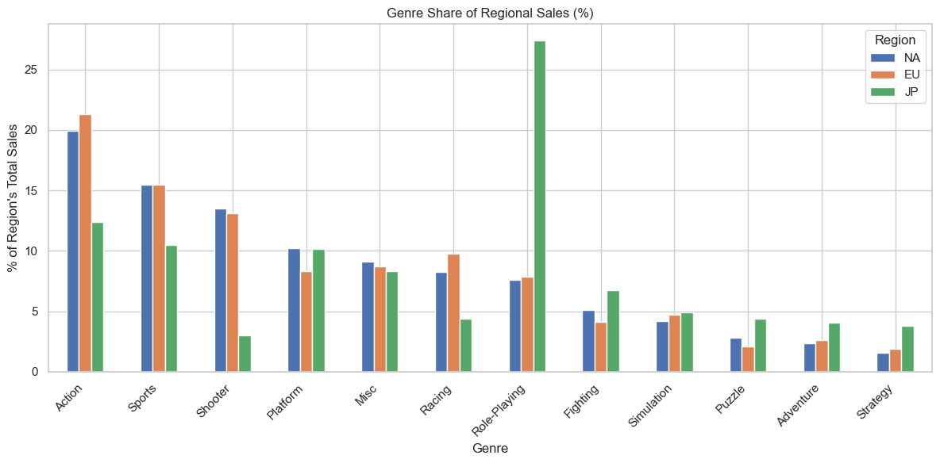
QUESTION 1 — REGIONAL DOMINANCE
Genre Preference Varies Sharply by Region
Key Findings
Role-Playing games take a massive 27% share of Japan's sales — far above NA (7.6%) or EU (7.8%).
Action leads in NA (19.9%) and EU (21.3%), but trails in Japan (12.4%).
Shooter titles are far more popular in NA/EU (~13-14%) than Japan (3.0%).
Sports sales share is remarkably consistent across all three regions (~15.4%).
5

Slide 6
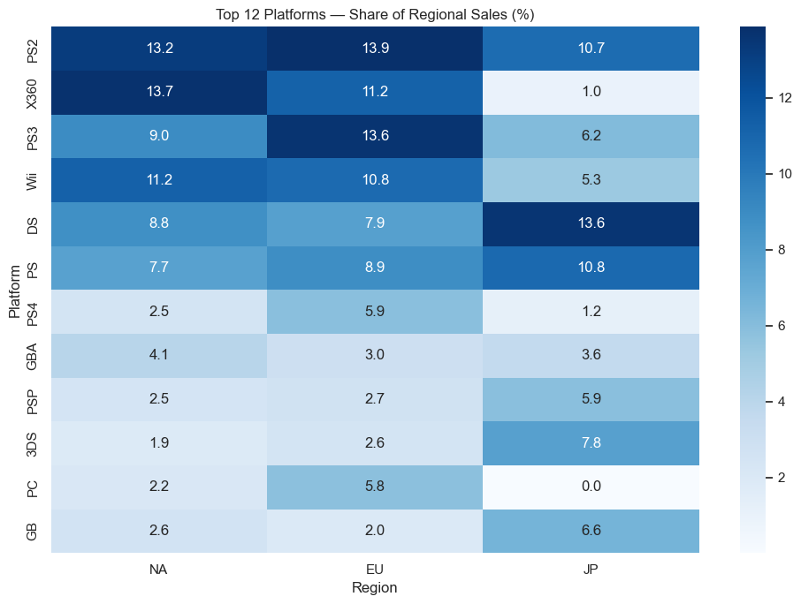
QUESTION 1 — REGIONAL DOMINANCE
Platform Success Is Regionally Concentrated
Key Findings
Xbox 360 sales are heavily NA/EU-driven (13.7% / 11.2%) with almost no Japan presence (1.0%).
PS2 and Wii show balanced, consistently strong shares across all three regions.
Handhelds (DS, GB, 3DS) and PC punch well above their global weight in Japan and EU.
PS4 sales share is comparatively small everywhere in this dataset, reflecting its later release window.
6

Slide 7
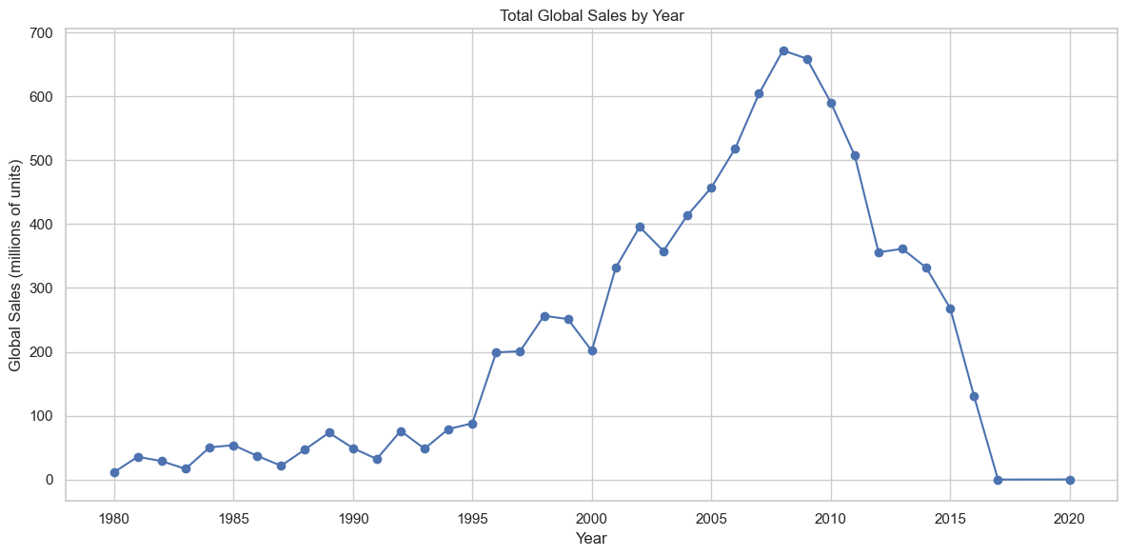
QUESTION 2 — GENERATIONAL TRENDS
Global Sales Peaked in the Late 2000s
Key Findings
Sales grew steadily from the 1980s through the mid-1990s, then accelerated sharply post-2000.
The 2006-2010 window (7th generation) marks the all-time commercial peak of the industry in this dataset.
The post-2011 decline reflects a shift toward digital distribution and mobile gaming, underrepresented in retail-sales datasets like this one.
Peak year: 2008 (~672M units) — sales fall sharply after 2011 as tracked physical-sales volume declines industry-wide.
7

Slide 8
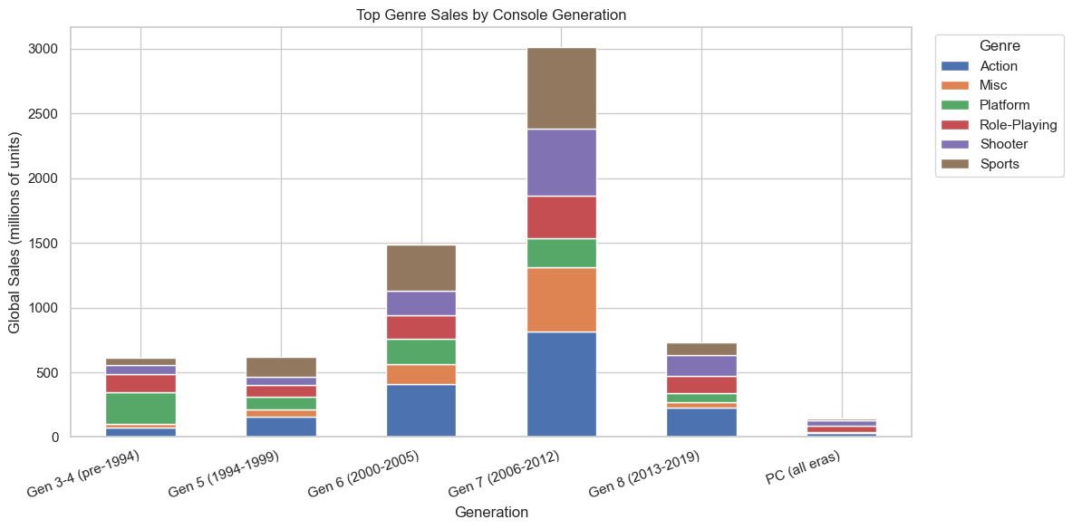
QUESTION 2 — GENERATIONAL TRENDS
Action & Misc Genres Drove the 7th-Gen Boom
Key Findings
Gen 7 (2006-2012) dwarfs every other era — over 3,000M units across the top six genres alone.
Action's share grows steadily each generation, becoming the dominant genre by Gen 7.
Misc games surge specifically in Gen 7, likely reflecting the Wii-era casual gaming boom.
PC sales stay a small, steady slice across all eras in this physical-sales-oriented dataset.
Note: Bar height ≈ total unit sales for that generation across the six leading genres shown.
8

Slide 9
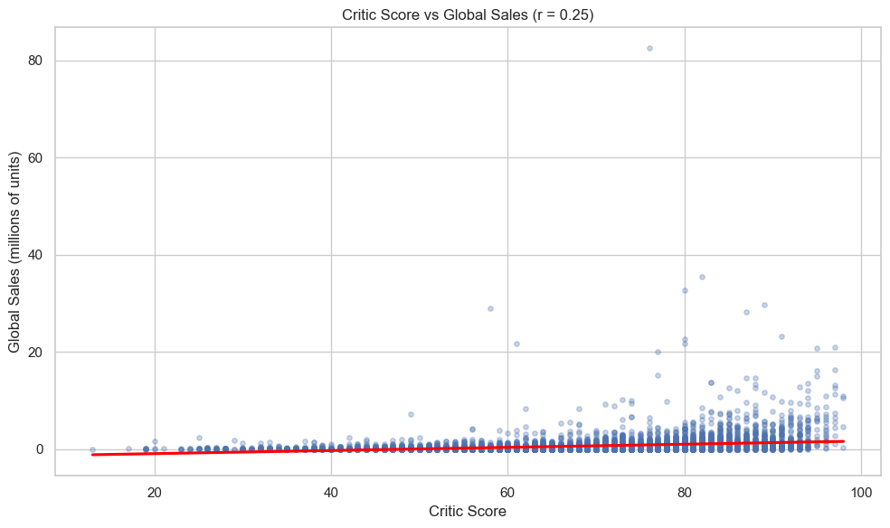
QUESTION 3 — CRITICAL RECEPTION
Critic Scores Are Only a Weak Predictor of Sales
Key Findings
Correlation is weak: r = 0.25 between Critic_Score and Global_Sales.
Most games cluster near zero sales regardless of score — a high score does not guarantee commercial success.
The single biggest outlier (~82M units at a ~76 score) likely reflects a pack-in or franchise blockbuster, not review-driven demand.
Confirms that non-review factors — franchise strength, marketing, platform reach — matter more than critical reception alone.
9

Slide 10
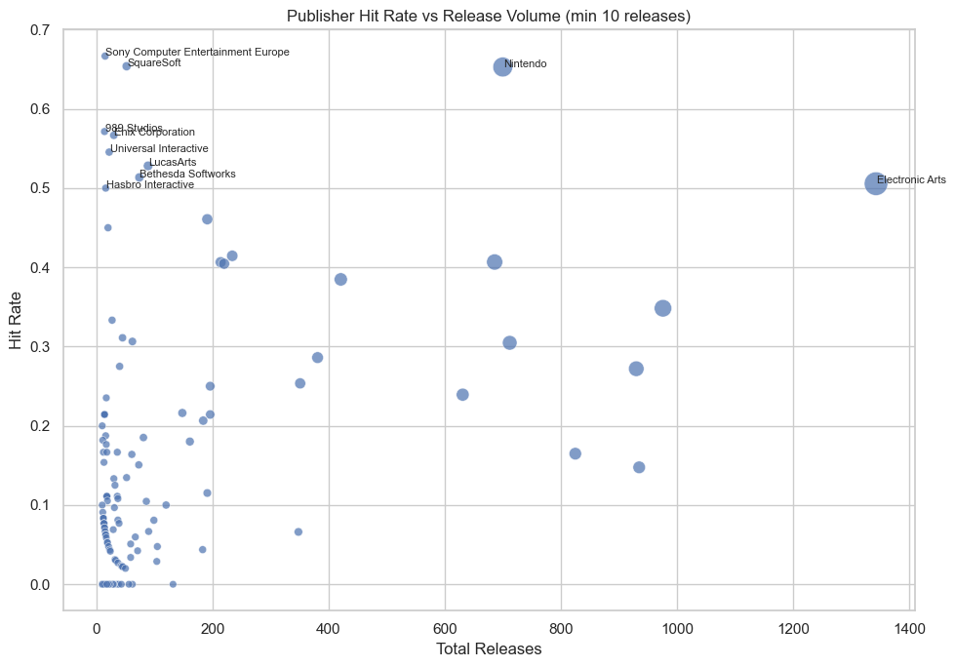
QUESTION 4 — PUBLISHER CONSISTENCY
Nintendo Leads on Volume-Adjusted Consistency
Key Findings
Nintendo stands out: ~700 releases with a 0.65 hit rate — high volume AND high consistency.
Electronic Arts has the largest catalog (~1,340 releases) with a solid 0.51 hit rate, showing scale without sacrificing much consistency.
Sony Computer Entertainment Europe and SquareSoft show even higher hit rates (~0.65-0.67), but on very few releases (~10-20) — likely small-sample effects.
Most publishers cluster below a 0.2 hit rate regardless of volume, showing genuine hits are rare industry-wide.
10

Slide 11
WRAP-UP
Conclusions & Next Steps
Regional taste is a real, measurable divide — Japan skews toward RPGs and native handhelds; NA/EU favor Action and Shooters.
The industry's commercial center of gravity (7th generation, 2006-2012) has already passed in physical-sales terms; digital-era trends need a different data source to confirm.
Critic scores are a weak predictor of sales (r = 0.25) — franchise strength and marketing matter more than review quality.
Nintendo combines high release volume with a 0.65 hit rate — the strongest evidence of genuine, repeatable publisher success in the dataset.
Repository
github.com/PrashanthPinniboyina/
49834918_DS-120B
Prepared by
Prashanth Pinniboyina
ID: 49834918
11

