Slide 1


Clients go further, faster with
DBA reports
Automation
People. Partnership. Performance.

Slide 2
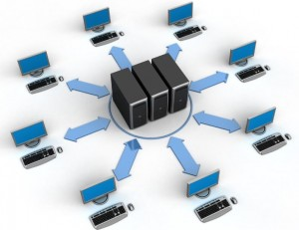
SQL Inventory
New framework for capacity report.
CMS is the source of truth.
Data integration is done through linked servers, connected to each management box on respective data centers.
Captures data from various data centres along with cloud environments.
Joined with SAM table to pull Application owners and Server type.
Stored in a master table Dbasupport.CMS_Tracker_master on centralised management box P054SQLMGMT03.
Data refreshes every week through job Dbasupport .CMS_tracker_report.
Archived to a table monthly to validate missing servers (Decoms and new server builds).
India Team Size
2
People. Partnership. Performance. epiqglobal.com

Slide 3
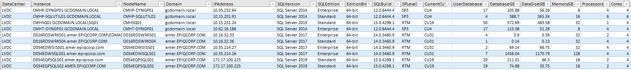
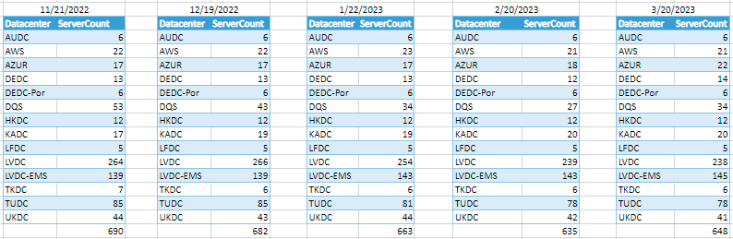
Inventory Report:

Slide 4
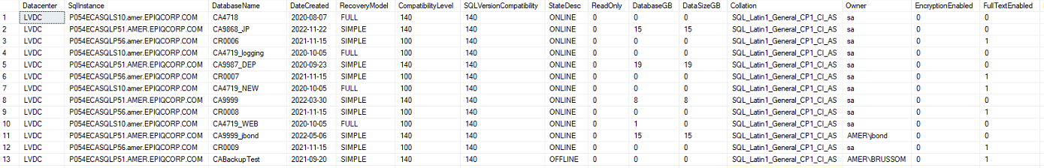
DatabaseSettings:
Collection of databases setting details across an enterprise and stores in a table Dbasupport.DatabaseSettings_master.
Helps to run reports based on the requirement, like list all the databases with simple recovery model. Etc..
This is run through a job named DBA - DatabaseSettings & commandLog - master

Slide 5
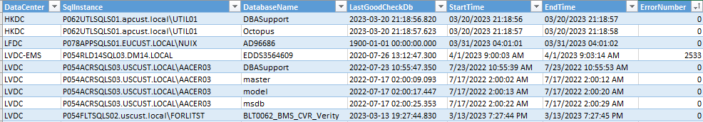
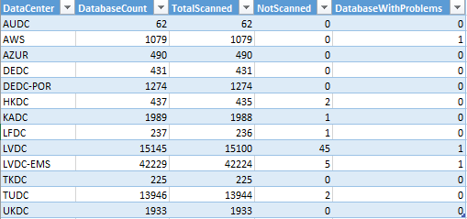
DBCC report:
Contains details of the databases that have not been processed integrity checks over the days (capped to 2 weeks)
Also has the details to find those databases that have errors encountered
Stores in a table Dbasupport.CommandLog_CheckDB_master
This is run through a job DBA - DatabaseSettings & commandLog – master.
The summary is grouped by DC.

Slide 6
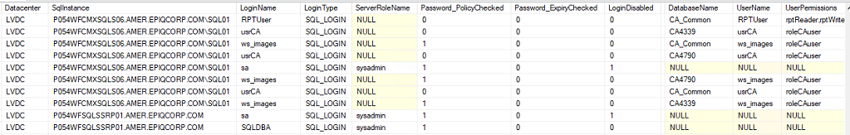
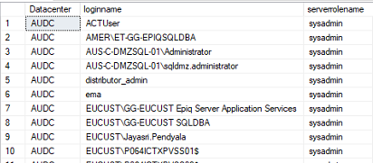
Logins Details:
This table DBASupport.Logins_info_master stores the Login details including security details , password policy details , etc.
Helps to validate elevated permissions in SQL for Non DBA groups in production systems.
Ensure password_policy check and password expiry check.
This is run through a job DBA - LoginsInfo_master

