Slide 1

MERN HACKATHON PROBLEM 92
Cyber Incident Response Planner
A tabletop planner that ranks fictional alerts and compares routes across linked systems.
PROBLEM DOMAIN
Cybersecurity incident-response planning
BRANCH
SECTION
CSM - AIML
AIML - F
TEAM
YALAMADDI PRASHANTH
M.B.WILSONRAJ
Roll number 25MVCSMR0538
Roll number 25MVCSMR0507
SAI DIKSHIT REDDY
BODINI LOKESH GOUD
Roll number 25MVCSMR0478
Roll number 25MVCSMR0473
PROBLEM 92 CYBER INCIDENT RESPONSE PLANNER
01 / 07
Notes:
Project introduction. Problem 92 for the MERN hackathon. The domain is cybersecurity incident-response planning. Introduce the supplied team roster. All four members are in Section AIML - F, Branch CSM - AIML. One-line idea: the planner makes a fictional response order and route trade-offs visible.

Slide 2
THE CHALLENGE
Incidents touch connected systems.
During an incident, responders must decide which alert to examine first and how affected systems relate to one another before they consider containment.
WHY IT MATTERS
KEY CHALLENGES
A clear rationale supports human review when service availability, evidence preservation, and response effort all matter.
01
Rank competing alerts with visible criteria.
02
Represent possible reachability between systems.
03
Compare routes with different hop counts and costs.
The sample contains 4 open alerts, 7 modeled systems, and 10 links.
Fictional tabletop inputs. Counts are not incident statistics.
PROBLEM 92 CYBER INCIDENT RESPONSE PLANNER
02 / 07
Notes:
The challenge requires a response order plus a model of system dependencies. This deck presents the operational tensions as design context, not as measured incident statistics. NIST SP 800-61 Rev. 3, published in April 2025, frames incident response as part of broader cybersecurity risk management: https://csrc.nist.gov/pubs/sp/800/61/r3/final . CISA's federal playbook discusses evidence, service availability, and resource trade-offs in its federal context: https://www.cisa.gov/sites/default/files/2024-08/Federal_Government_Cybersecurity_Incident_and_Vulnerability_Response_Playbooks_508C.pdf

Slide 3
OUR INNOVATION
The model explains each choice.
The planner combines an explicit priority score with a system graph, then shows route options against the selected goal.
VISIBLE PRIORITY
MODELED REACHABILITY
Severity, spread potential, system criticality, and evidence confidence contribute to the score.
Breadth-first search shows which linked systems are reachable by hop count. Reachability does not confirm compromise.
TWO ROUTE GOALS
EDITABLE TABLETOP
Compare fewest links with lowest positive entered effort, using BFS and Dijkstra.
Change fictional incidents or links, recalculate, and inspect how the plan changes.
Unique approach: algorithms are part of the user workflow, and their assumptions stay visible.
PROBLEM 92 CYBER INCIDENT RESPONSE PLANNER
03 / 07
Notes:
Our innovation is an inspectable tabletop workflow. The weighted score, graph semantics, route objective, and fictional cost inputs remain visible. The app avoids suggesting that possible reachability is confirmed compromise or that a proposed route automatically isolates a host.

Slide 4
HOW IT WORKS
Inputs become a plan responders can inspect.
INPUT → PROCESSING → ALGORITHM → OUTPUT
Input
Processing
Algorithm
Output
Incident signals
System links
Positive effort estimates
›
Score each alert
Build an adjacency list
Read route costs
›
Max-heap ranking
BFS reachability
BFS and Dijkstra routes
›
Priority order
Reachable systems
Route and cost
USER JOURNEY
Run the plan, select an alert, inspect the score and reachability, compare routes, then edit the fictional scenario if needed.
PROBLEM 92 CYBER INCIDENT RESPONSE PLANNER
04 / 07
Notes:
Walk through the flow: incident severity, spread, confidence, asset criticality, links, and positive sample costs enter the browser. The app scores incidents and creates an undirected adjacency list. The heap ranks incidents, BFS traces reachability and fewest hops, and Dijkstra calculates lowest entered effort. The output is a planning view, not an action.

Slide 5
TECHNOLOGY & ALGORITHM
The data structure matches the decision.
TECH STACK
React 19, Vite, JavaScript. Scenario state stays in the current browser page.
METHOD
WHY IT FITS
TIME AND SPACE
Binary max-heap
Repeatedly returns the highest-scoring open incident.
O(I log I) time
O(I) space
Breadth-first search
Explores reachability one link layer at a time.
O(V + E) time
O(V + E) space
Dijkstra with binary heap
Finds the minimum sum of positive link estimates.
O((V + E) log V) time
O(V + E) space
I = open incidents. V = modeled systems including the isolation gateway. E = network links.
No Express API or MongoDB yet.
PROBLEM 92 CYBER INCIDENT RESPONSE PLANNER
05 / 07
Notes:
The current app uses React 19 and Vite with in-memory browser state. It is not a full MERN stack yet. Ranking all I incidents with a binary heap is O(I log I) time and O(I) space. BFS is O(V+E) time and space. Dijkstra with a binary heap is O((V+E) log V) time and O(V+E) space for this simple graph. These are algorithmic bounds, not benchmark measurements.

Slide 6
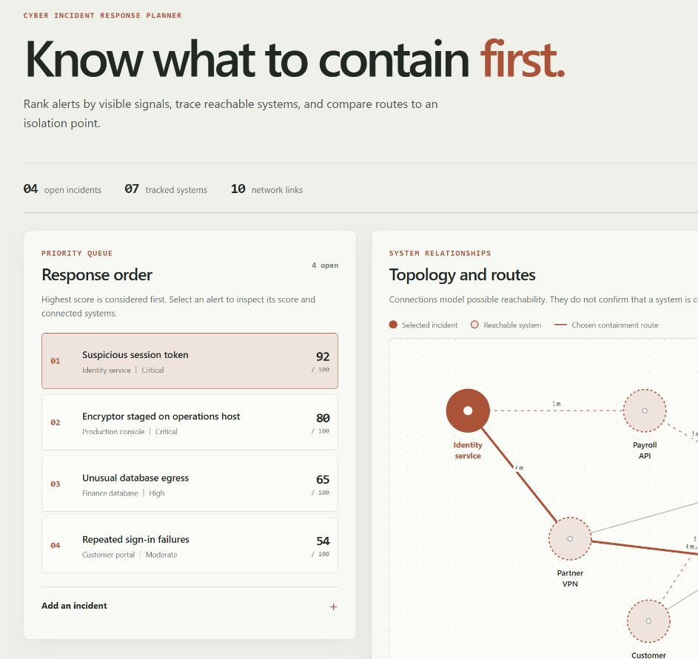
DEMO & IMPACT
A sample output from the working planner.
The local demo starts with fictional data.
TOP ALERT
92 / 100
Suspicious session token
Affected system: Identity service
ROUTE COMPARISON
Fewest links
2 links, 18 estimated minutes
Lowest effort
3 links, 15 estimated minutes
PRACTICAL BENEFIT
Makes priority reasons and route trade-offs visible for a human tabletop review.
Illustrative sample results, not measured incident response performance.
PROBLEM 92 CYBER INCIDENT RESPONSE PLANNER
06 / 07
Notes:
Demo & impact. This is a screenshot from the running local planner. It ranks four fictional incidents; the selected identity alert scores 92. The route results are sample edge estimates: two hops totaling 18 minutes, or three hops totaling 15. The app has no benchmarked throughput, monitoring feed, persistence, or containment integration. The practical value is a visible structure for a tabletop discussion.

Slide 7
FUTURE VISION
Validate the model before scaling it.
CURRENT ACHIEVEMENT
A working local tabletop demo with editable fictional incidents, a dependency graph, a priority queue, and two route objectives.
NEXT IMPROVEMENTS
Validate score weights and effort estimates with incident responders. Add persistence and a backend only if the event requires a full MERN build.
SCALABILITY
Test larger graphs, define access controls, and review privacy before any real incident data or operational integration.
An explainable planning aid. Response authority stays with people.
Thank you | Questions
PROBLEM 92 CYBER INCIDENT RESPONSE PLANNER
07 / 07
Notes:
Future vision. Current: an offline-friendly local browser prototype with fictional data. Next: validate the model with practitioners, then decide whether an API and database are needed by the event rubric. Before handling real incidents, define access, retention, audit, and privacy controls. Do not imply current operational readiness. Close with: an explainable planning aid, with response authority remaining with people.

