Slide 1
Digital Marketing – Internship at Skill Craft Technology
Case Study Brand – Nike
Track code: DM
Presented by: Madda Prashanthi
(Intern – Digital Marketing)
Intern ID :- SCT/FEB26/0943

Slide 2
TASK -1
Influencer Collaboration Strategy

Slide 3
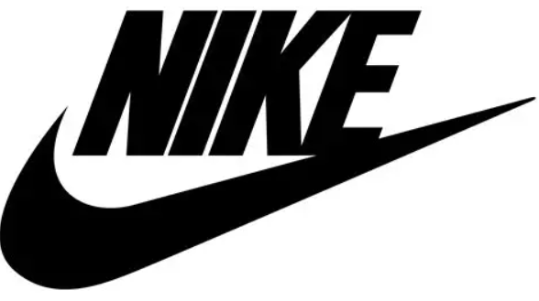
Brand Introduction
Brand Name: Nike
Industry: Sportswear & Athletic Apparel
Founded: 1964
Headquarters: United States
Nike is one of the world’s leading sportswear brands known for innovation, performance, and motivational branding. The company designs athletic footwear, apparel, and accessories for professional athletes and fitness enthusiasts.
Nike’s marketing strategy focuses heavily on emotional storytelling, athlete endorsements, and digital engagement. The brand promotes confidence, determination, and the mindset of “Just Do It.”

Slide 4
Target Audience
Nike primarily targets:
Age Group: 16–35 years
Gender: Male & Female
Interests: Sports, gym, running, fitness, athleisure fashion
Income Level: Middle & Upper middle class
Geography: Global market (Strong presence in India, USA, Europe)
Nike connects with individuals who are performance-driven, ambitious, and passionate about fitness and sports.

Slide 5
Proposed Influencers
To maximize digital reach, engagement, and brand credibility, Nike should adopt a multi-tier influencer strategy by collaborating with athletes and lifestyle personalities who align with performance, fitness, and youth motivation.
Selected Influencers:
Cristiano Ronaldo
Virat Kohli
Neeraj Chopra
Disha Patani

Slide 6
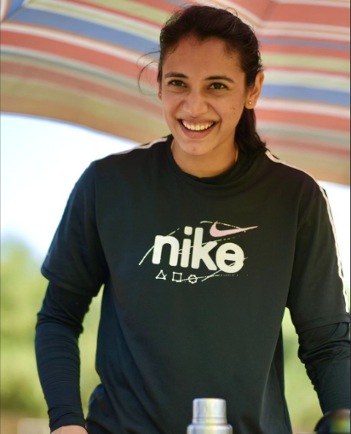
Smriti Mandhana
Platform: Instagram
Audience: Indian youth, women’s cricket fans, fitness enthusiasts
Followers: 9M+
Estimated Engagement Rate: 3–6%
Estimated Engagement per Post: 300K–600K interactions
Strong representation of women in sports
Inspires young female athletes
Positive and authentic brand image
Reason for Selection: Smriti Mandhana is an official Nike-associated athlete in India. She represents confidence, performance, and women empowerment, aligning strongly with Nike’s positioning in women’s sportswear and athletic excellence.

Slide 7
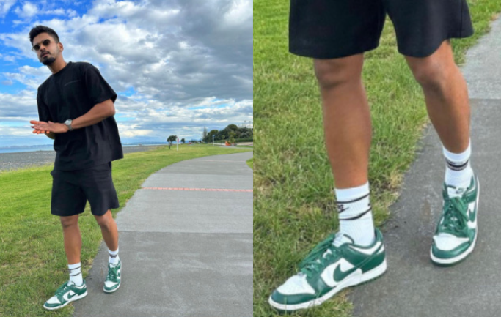
Shreyas Iyer
Platform: Instagram
Audience: Indian cricket fans & urban youth
Followers: 12M+
Estimated Engagement Rate: 2–4%
Estimated Engagement per Post: 250K–500K interactions
Stylish and modern athlete image
Strong urban youth appeal
Featured in Nike’s global campaign
Reason for Selection: Shreyas Iyer represents the new-generation Indian athlete. His energetic personality and fashion-forward style help Nike connect with modern Indian youth and athleisure audiences.

Slide 8
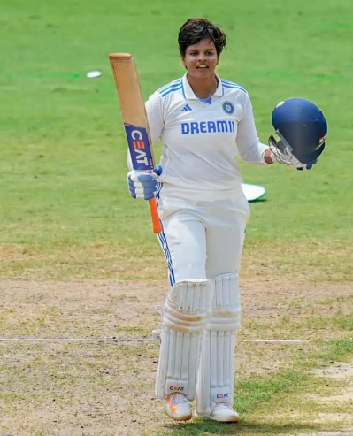
Shafali Verma
Platform: Instagram
Audience: Young sports enthusiasts & cricket fans
Followers: 2M+
Estimated Engagement Rate: 4–7%
Estimated Engagement per Post: 80K–150K interactions
Youth icon in women’s cricket
High engagement from loyal followers
Featured in Nike India campaigns
Reason for Selection: Shafali Verma’s fearless playing style and youthful energy align with Nike’s bold and performance-driven identity. She strengthens Nike’s connection with Gen Z audiences.

Slide 9
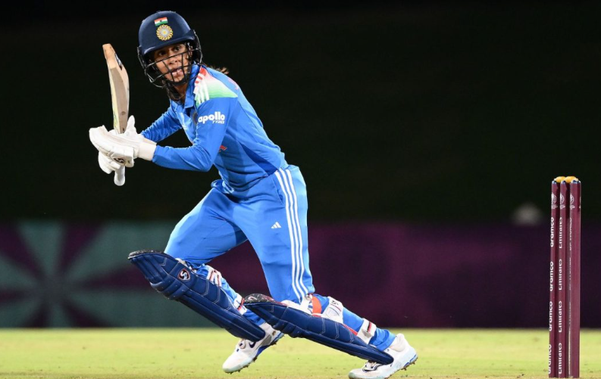
Jemimah Rodrigues
Platform: Instagram
Audience: Women’s sports followers & youth
Followers: 2.5M+
Estimated Engagement Rate: 4–6%
Estimated Engagement per Post: 100K–180K interactions
Vibrant and relatable personality
Strong women empowerment representation
Campaign presence with Nike India
Reason for Selection: Jemimah Rodrigues enhances Nike’s emotional storytelling in India. Her cheerful and determined persona supports Nike’s community-driven and empowering brand image.

Slide 10
THANK YOU

