Slide 1


Feel the Indian Food
Prashanthi Koudi Akshar Patel Keerthi Reddy Ellanki

Slide 2
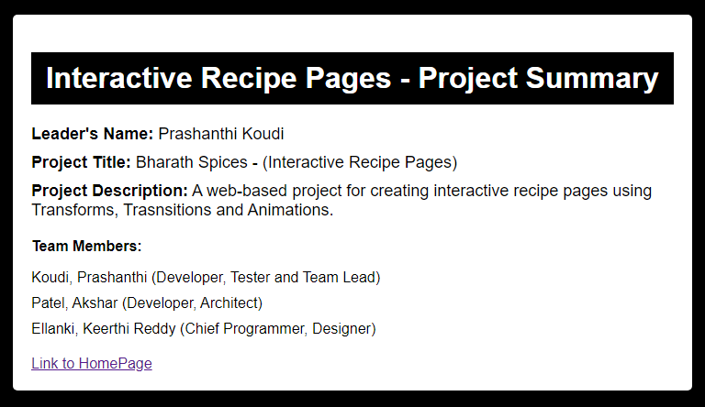

Slide 3
Problem Statement
Indian cuisine is renowned for its rich and diverse flavours. With a multitude of recipes originating from different regions, there's a treasure trove of culinary delights waiting to be explored.
To make this wealth of knowledge accessible to food enthusiasts and home cooks, there is a need for a user-friendly Recipe Webpage.
This Recipe Webpage is to offer a user-friendly platform where individuals can discover, learn, and savour the vast array of Indian dishes while fostering a community of food lovers.

Slide 4
Solution Overview
Bharath spices is a webpage that introduces you to Indian cuisine and helps you to cook authentic Indian recipes by yourself.
The webpage will aim to be the go-to resource for Indian recipes, helping users cook delicious meals and experience the richness of Indian culture through its culinary traditions.
This webpage will cater to the needs of both seasoned cooks and beginners, making it easy to find, learn, and prepare Indian dishes.

Slide 5
Key features
The webpage consists of various Indian food recipes along with their ingredients.
When user hovers on a particular recipe it displays the ingredients and below it there will be instructions to your recipe.
It also gives you the estimated time to cook your favourite Indian food.
Hover on the reasons in the main page to know interesting facts.

Slide 6
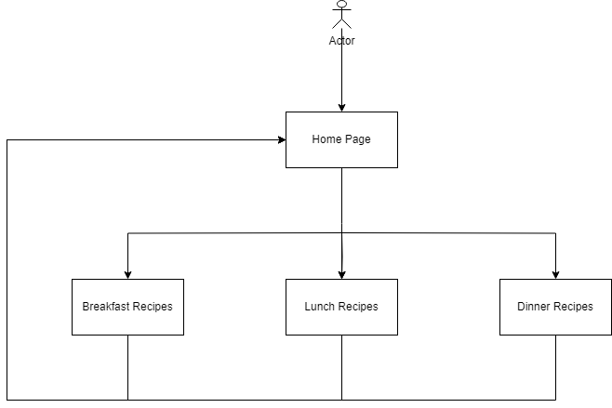
ER Diagram

Slide 7
UI Design

Slide 8
UI Design

Slide 9
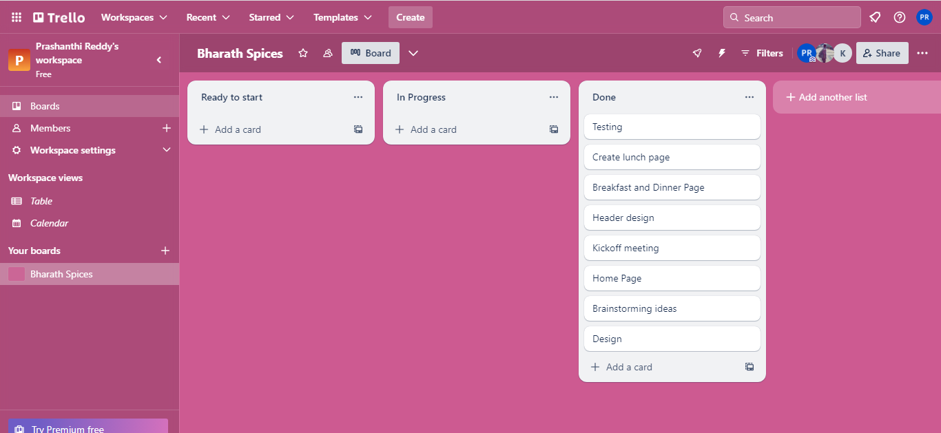
Kanban Methodology(Trello)
Workflow stages – Ideating Planning Design Developing Testing

Slide 10
Testing
Functional Testing
Cross-Browser and Cross-Device Testing
Content Review
Validation

Slide 11


Slide 12
Demo

