Slide 1

MID TERM PRESENTATION
HomeGoods Inventory Management
TEAM: INTERNATIONAL TECHIES

Slide 2

TEAM MEMBERS
TEAM MEMBERS:
SAI SURENDRA KOMMINENI
VENUKESWARI OOTLA
PRASHANTHI VELPULA
PROJECT GUIDE
DR.ERIC FREDERICKS

Slide 3

AGENDA
PROJECT DESCRIPTION
TECHNOLOGY
PROJECT TIMELINE
GANTT CHART
DIAGRAMS
SOFTWARE REQUIREMENTS
TEAM CONTRIBUTION
PROJECT PROGRESS
CURRENT IMPLEMENTATION
CONCLUSION

Slide 4
PROJECT DESCRIPTION
Our project, HomeGoods Inventory Management, is a proposed web application aimed at streamlining inventory management for store managers. The application will provide a secure login system for authorized users, allowing them to efficiently manage categories such as furniture, electronics, and home decor. Store managers will be able to add, edit, and delete inventory items, with detailed pages displaying information like price, description, and ratings. The backend will be built using either Firebase or MongoDB, ensuring efficient data storage and real-time updates. The frontend will be developed using HTML, CSS, and ReactJS, with a focus on simplicity, flexibility, and enhanced inventory control to reduce manual effort and improve operational efficiency.

Slide 5

TECHNOLOGY
FRONTEND: ReactJS
BACKEND: Firebase or MongoDB
UI: HTML, CSS, JavaScript

Slide 6
PROJECT TIMELINE
ID | Task | Start Date | End Date | Duration (Days)
1 | Planning and Design | 9/25/24 | 9/30/24 | 6
2 | Front End Development Phase 1 | 10/1/24 | 10/29/24 | 29
3 | Back End Development | 10/15/24 | 11/12/24 | 29
4 | Front End Development Phase 2 | 11/12/24 | 11/19/24 | 8
5 | Testing and Deployment | 11/20/24 | 11/27/24 | 8
6 | Documentation | 11/29/24 | 12/3/24 | 5

Slide 7
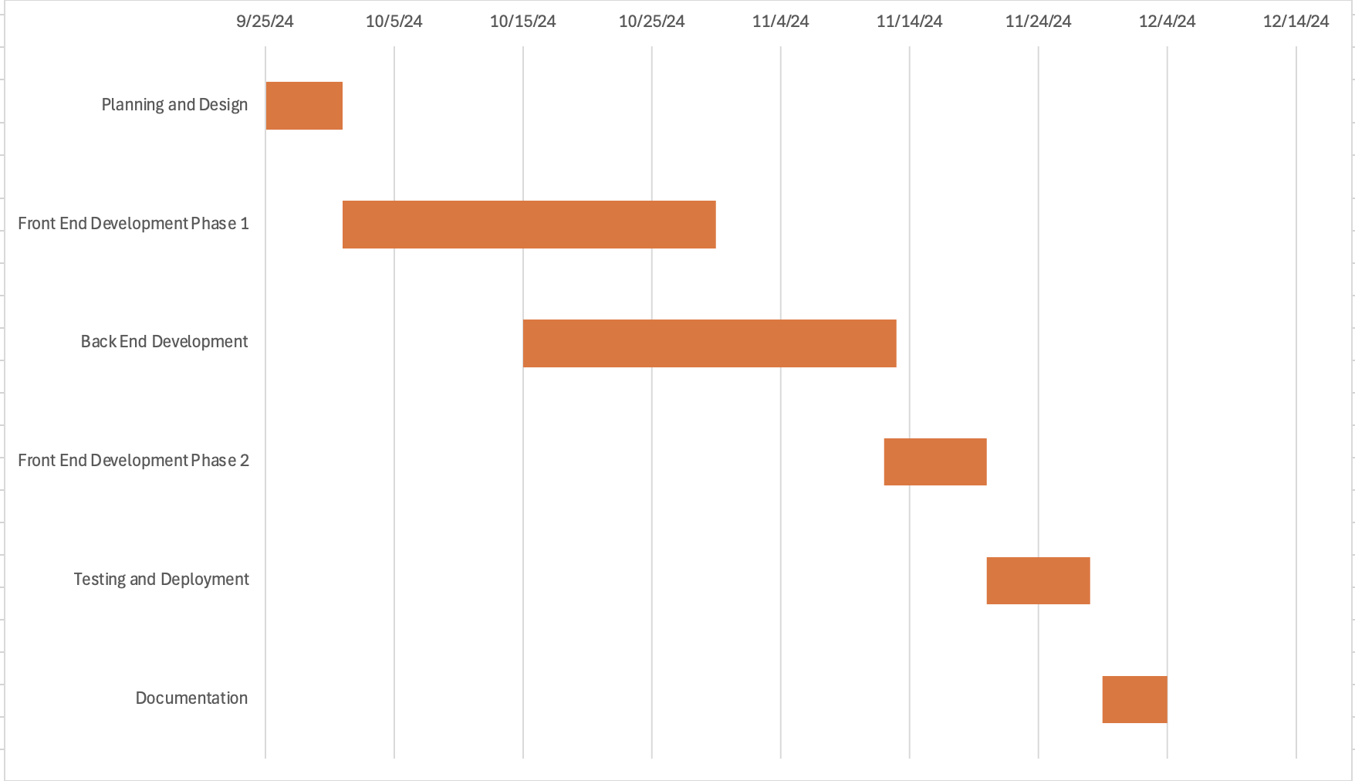
GANTT CHART

Slide 8
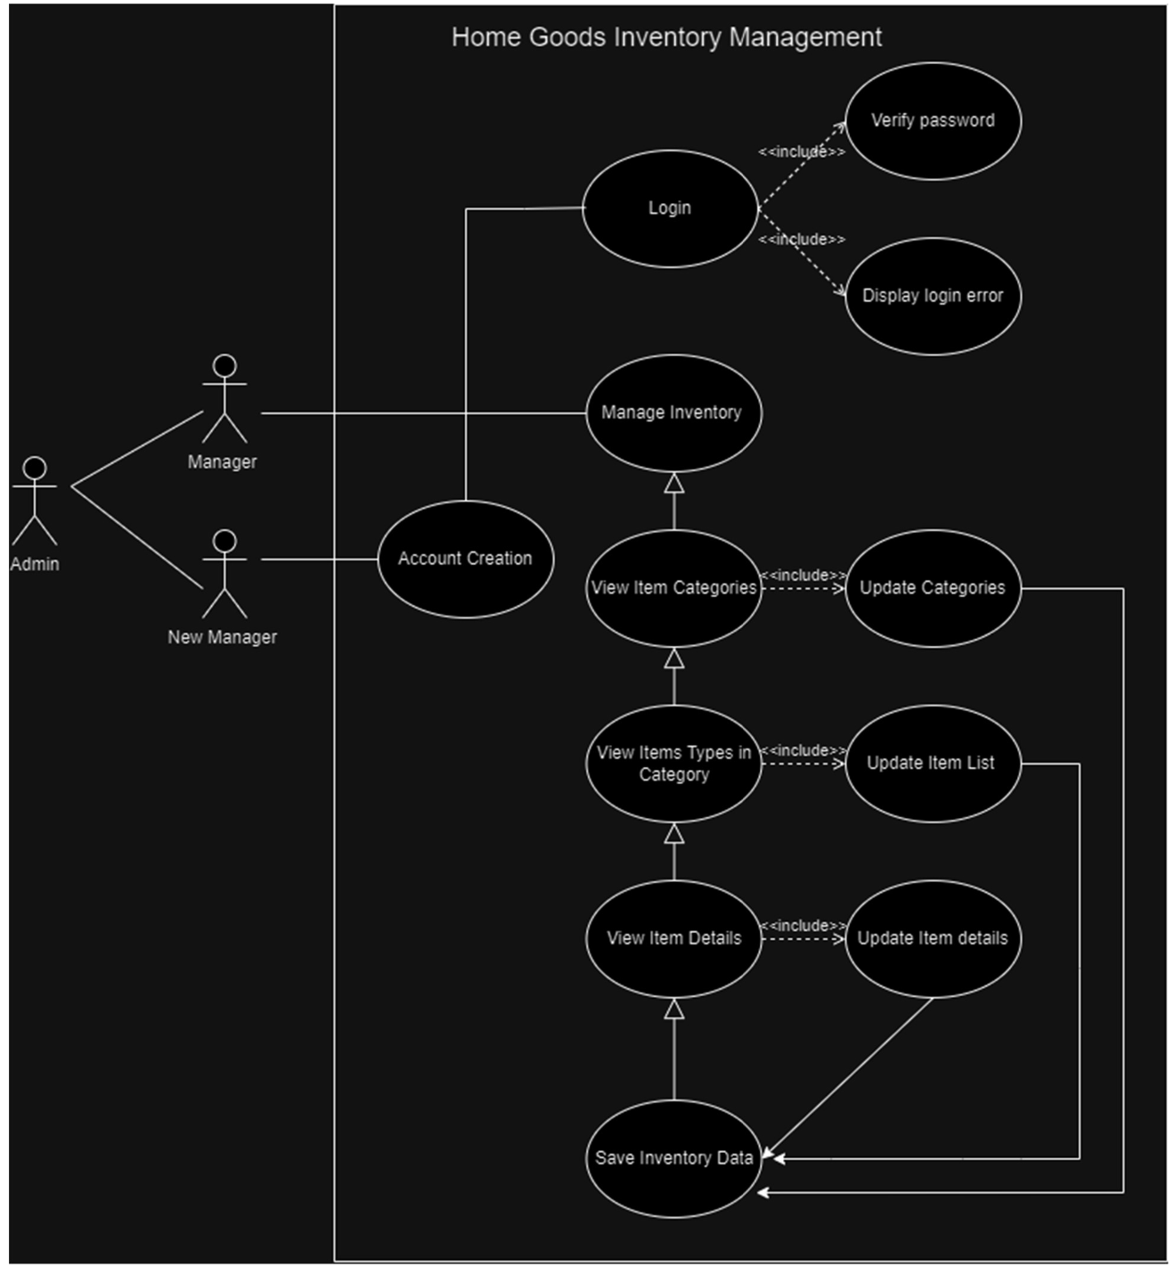
USECASE DIAGRAM

Slide 9
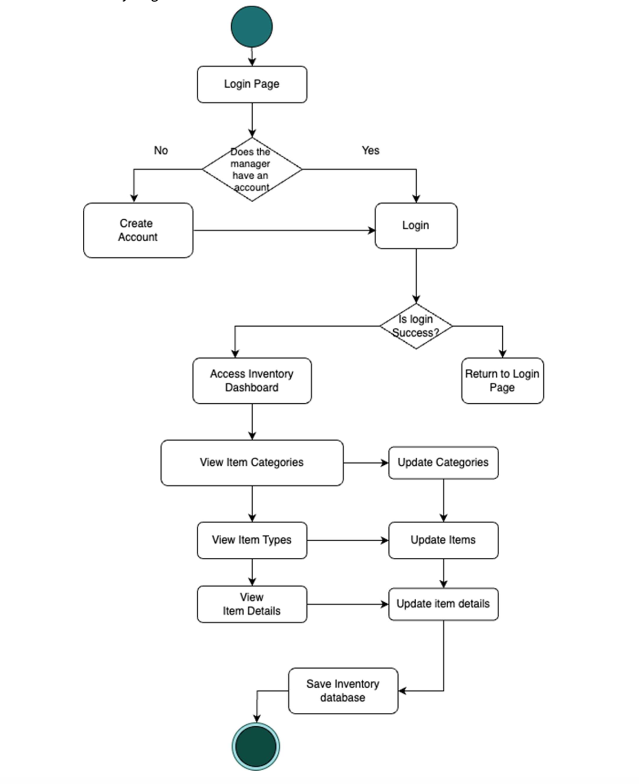
ACTIVITY DIAGRAM

Slide 10
REQUIREMENT(S)
Functional Requirements:
User Authentication and Session Management
The system shall allow authorized store managers to log in using their credentials and create accounts in case of new users.
Store managers shall be able to safely stop their session by logging out of the system.
Search Functionality
The system shall allow managers to browse the inventory dashboard through categories and add new categories if necessary.
The system shall provide a search bar that allows store managers to search for categories or items based on their category or name.
The system shall permit store managers to use the search feature on the item type page to look for particular item types within a category (for example, sofas in the Furniture category).
Navigation
The Items list page shall be displayed when the user presses any category from the main page.
The Item description page, including details like name, price, image, and rating, shall be displayed when the user presses any item from the Items list page.
Item Details Editing
The system shall allow store managers to change or modify any item's details, including its name, price, description, reviews, ratings, and image, via the item's detailed page.
Category and Item Addition
The system shall allow store managers to add new categories to the inventory by entering new category names.
The system shall allow store managers to add new items to the inventory by entering details such as category name, item name, price, description, and image through a dedicated form.
Category and Item Deletion
The system shall allow store managers to delete categories by clicking the delete button.
If an item is no longer available, the system shall allow the store manager to remove it from the inventory.

Slide 11
REQUIREMENT(S)
Non-Functional Requirements
Performance
The system shall provide high performance with a response time of 2-3 seconds for any search functionality.
The system shall respond to user actions in less than 5 seconds during peak hours.
Scalability
The system shall be scalable, supporting adding new categories and items as the inventory grows without affecting system performance.
Security
The system shall provide data security by restricting access only to authorized users through a secure login process by validating the email and password from the backend.
Data shall be secured by giving access only to authorized users.
Availability
The system shall be available 99.9% of the time, ensuring store managers can access the HomeGoods Inventory Management platform with minimal downtime.
Compatibility
The system shall be compatible with all browsers and responsive across different devices.
The system shall be platform-independent, ensuring that store managers can access and manage inventory across various operating systems such as Windows and Mac.
Data Consistency
The system shall maintain data consistency between the front-end and back-end when multiple users update the inventory simultaneously.
The system shall update the inventory data promptly and ensure the uniformity.
Usability
The system's interface shall be simple, enabling store managers to perform inventory functions without much training.

Slide 12
TEAM CONTRIBUTION
Venu: Developed the login page.
Prashanthi: Created the "Create Account" functionality.
Sai Surendra: Designed the item categories page.

Slide 13
PROJECT PROGRESS
Overall Progress: 30% complete
Frontend:
30% completed
Login page, "Create Account" page, and item categories page done
Backend:
Not yet started

Slide 14
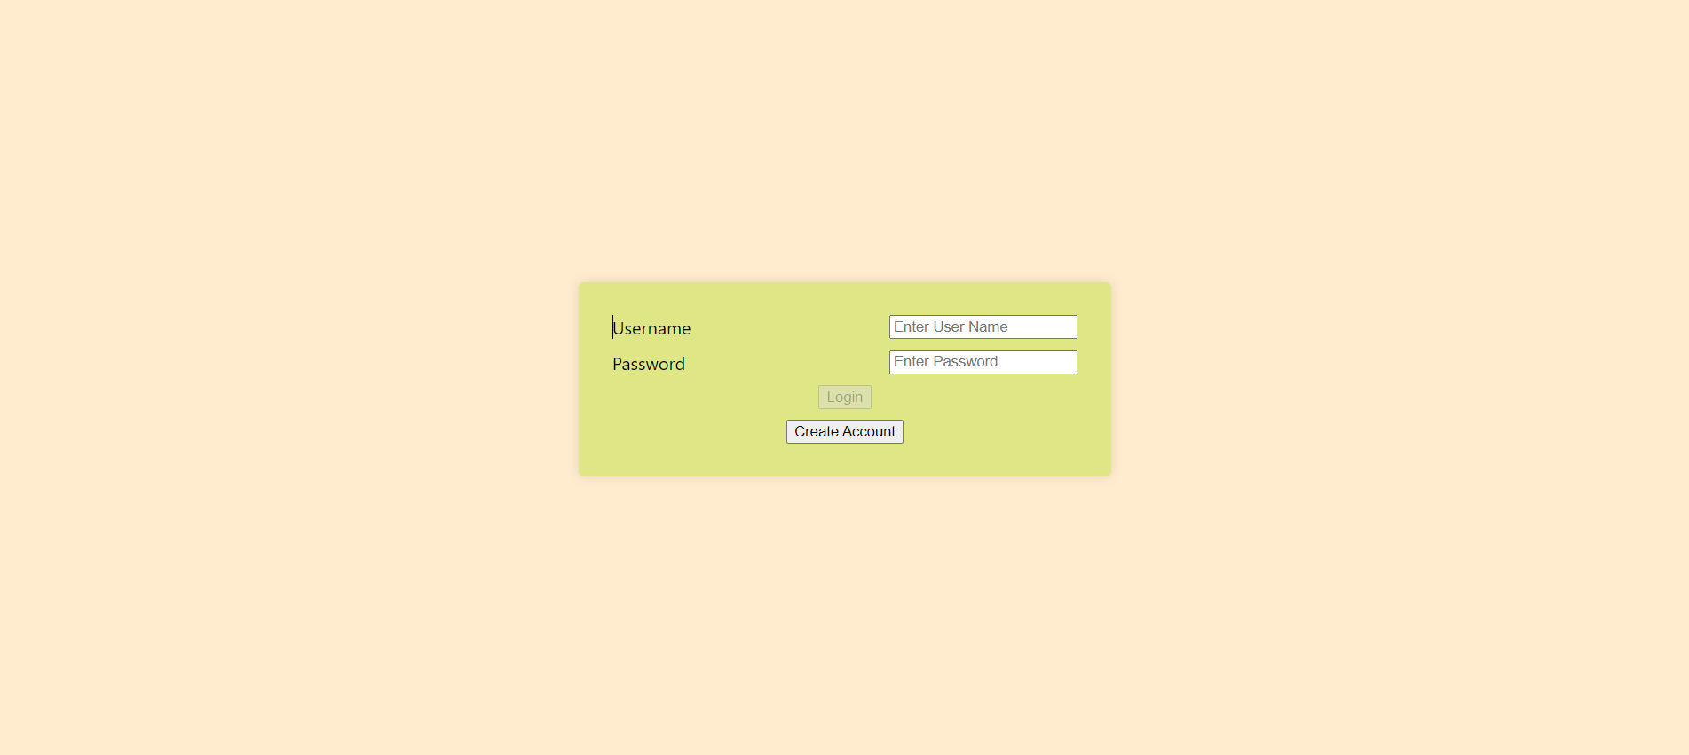
CURRENT IMPLEMENTATION

Slide 15
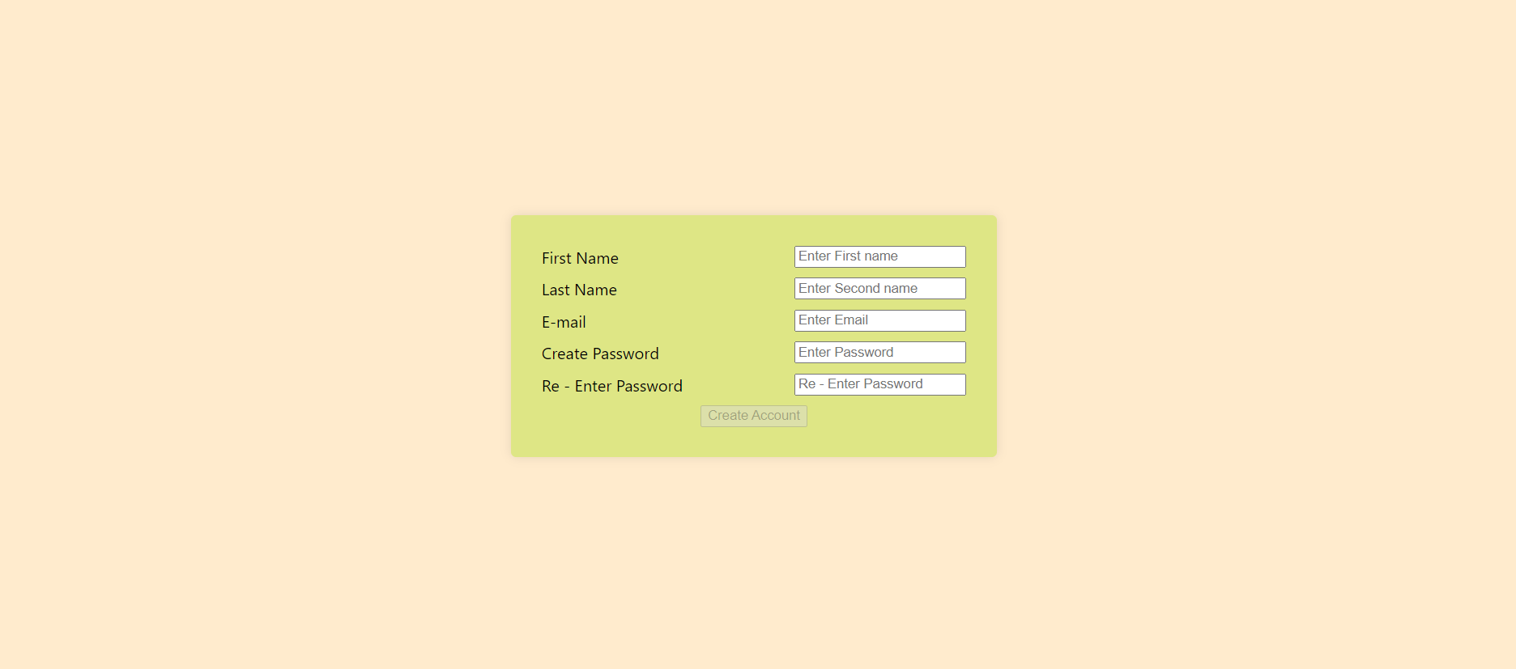
CURRENT IMPLEMENTATION

Slide 16
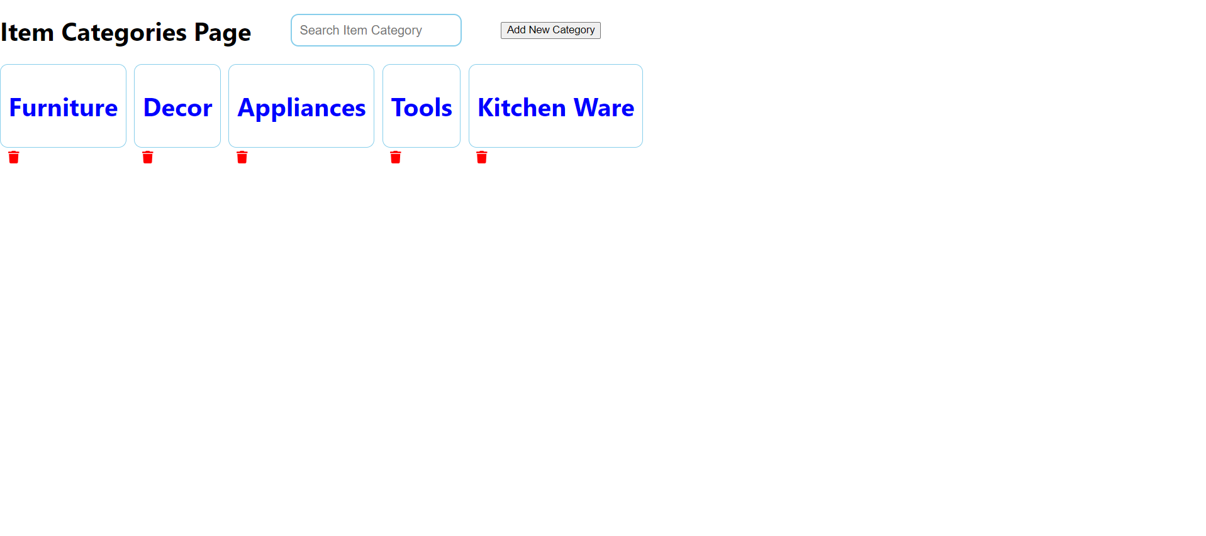
CURRENT IMPLEMENTATION

Slide 17

THANK YOU

