Slide 1
INFO 5082: SEMINAR IN RESEARCH AND RESEARCH METHODOLOGY
Prof: Dr. Junhua Ding

Slide 2
FAKE NEWS DETECTION

Slide 3
Introduction:
Fake news encapsulates pieces of news that may be fabricated and is shared without thinking, generally spread through social media and other online media.
This is often done to further or impose certain ideas and is often achieved with political agendas. Such news items may contain false and/or exaggerated claims and may end up being viralized by algorithms, and users may end up in a filter bubble

Slide 4

When researchers working on finding an automated learning tool to detect fake news, realized that there was not enough data and better technique to train their algorithms.
They did the only rational task and compiled thousands of fake news and articles and provided the machine which may be able to identify and separate fake news from correct news and articles.
The main objective is to detect the fake news, which is a classic text classification problem with a straightforward proposition. It is needed to build a model that can differentiate between “Real” news and “Fake” news

Slide 5
Dataset
The dataset contains two types of articles fake and real News. This dataset was collected from real-world sources.
The truthful articles were obtained by crawling articles from Reuters.com (News website) and for the fake news articles, it was collected from different sources, and it contains more than 12,600 articles.
The fake news articles were collected from unreliable websites that were flagged by PolitiFact(a fact-checking organization in the USA) and it contains more than 12,00 articles .
The dataset contains different types of articles on different topics, however, the majority of articles focus on political and World news topics

Slide 6
Methodologies:
Here, I have used count vectorizer or a tf-idf matrix ( i.e word tallies relatives to how often they are used in the articles of the dataset )can help . Since this problem is a kind of text classification, Implementing a Naive Bayes classifier, Ensemble modeling, SVM algorithm, logistic Regression, Random Forest to chose the best Accuracy.
The actual goal is in developing a model which was the text transformation (count vectorizer vs tf-idf vectorizer) and choosing which type of text to use (headlines vs full text). Now the next step is to extract the most optimal features for count vectorizer or tf-idf-vectorizer, this is done by using a n-number of the most used words, and/or phrases, lower casing or not, mainly removing the stop words which are common words such as “the”, “when”, and “there” and only using those words that appear at least a given number of times in a given text dataset.

Slide 7
Algorithms used:
Natural Language Tool Kit (NLTK)
Logistic Regression
Support Vector Machine Algorithm
Naïve Bayes Algorithm
TF-IDF
Random Forest Algorithm
Ensemble learners

Slide 8
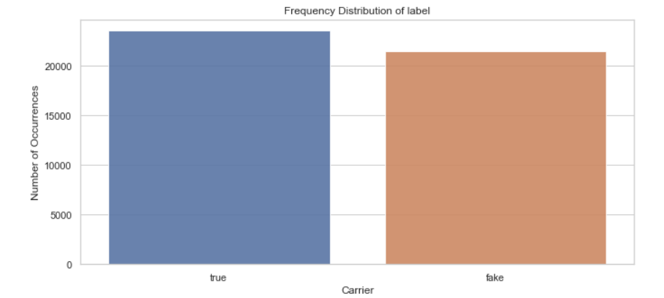
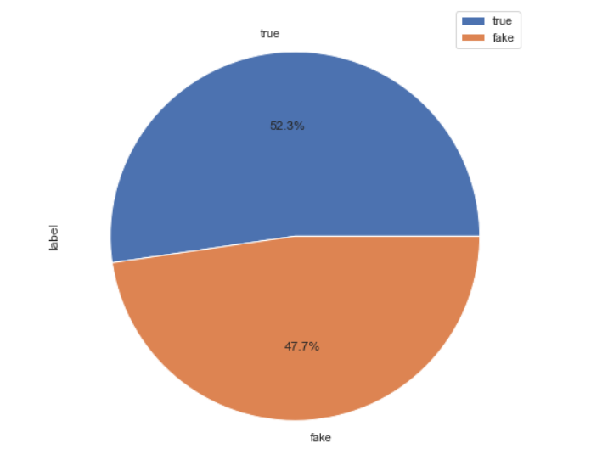
DATA ANALYSIS:
Frequency distribution of the true and fake news:

Slide 9
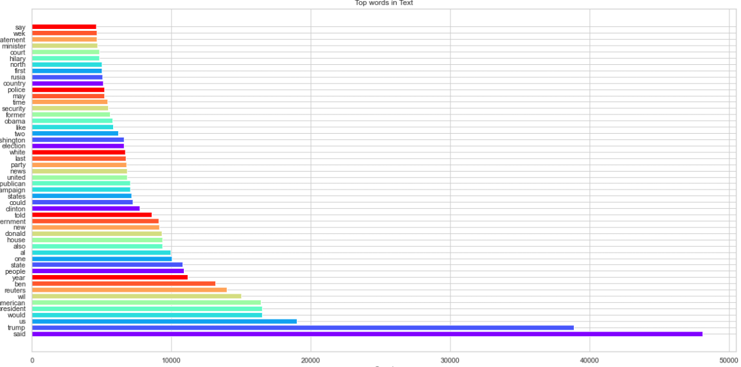
DATA ANLAYSIS:
Words that repeated mostly in the news:

Slide 10
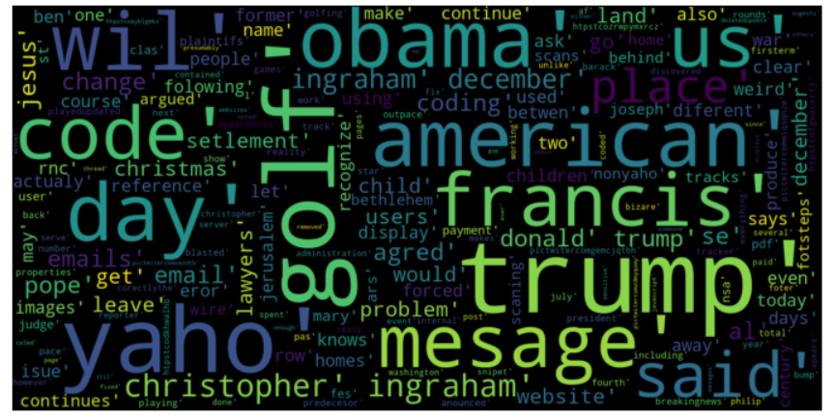
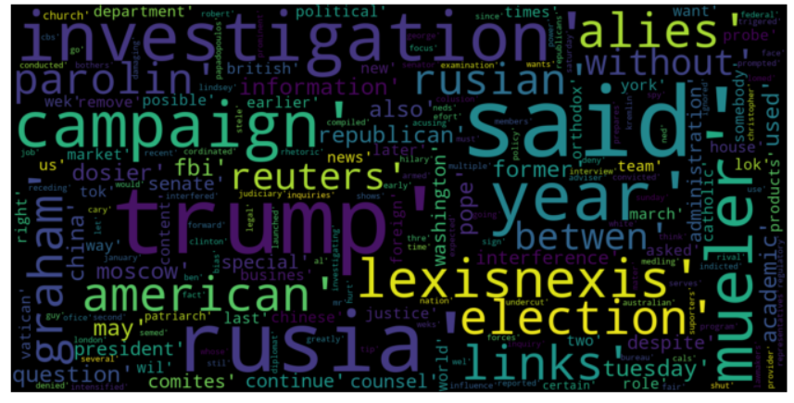
DATA ANLAYSIS:
Words cloud in the true and fake news:
True News Fake news
There are many similar words in both, so this shows that there is some distinguishing feature between most real and fake news titles, and including titles in our analysis

Slide 11
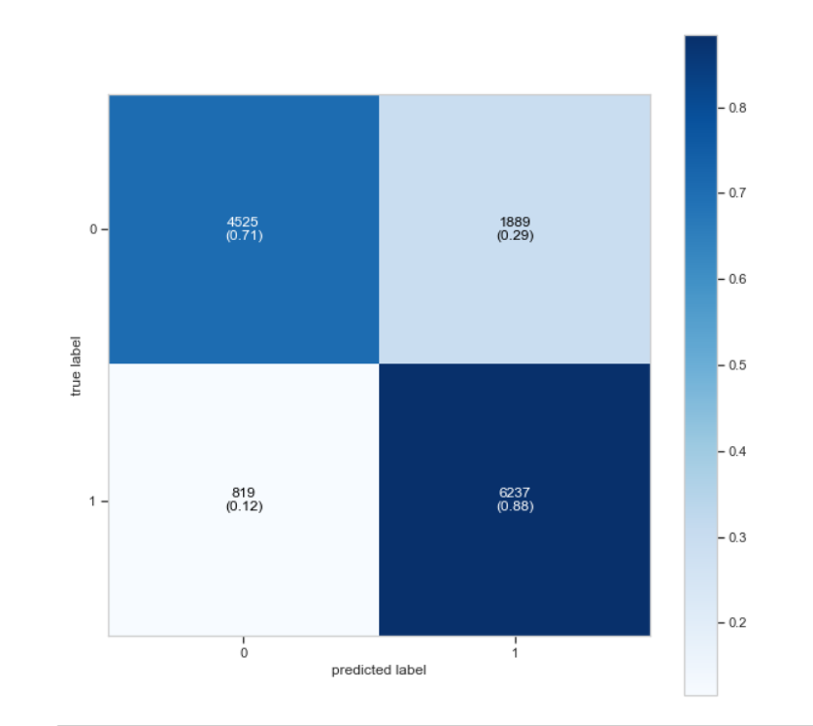
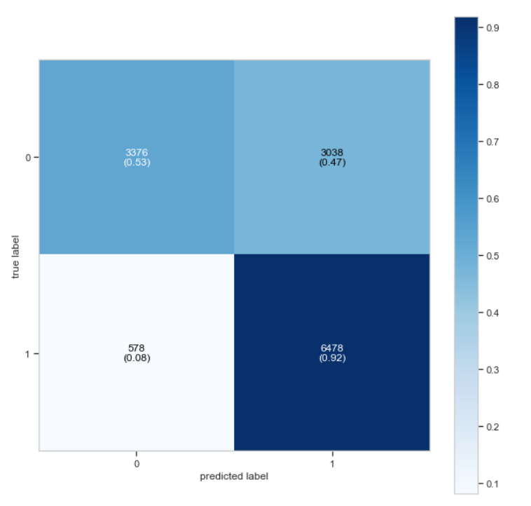
DATA ANLAYSIS:
Support vector Machine Algorithm confusion Matrix:
Naïve Bayes Algorithm confusion Matrix:

Slide 12
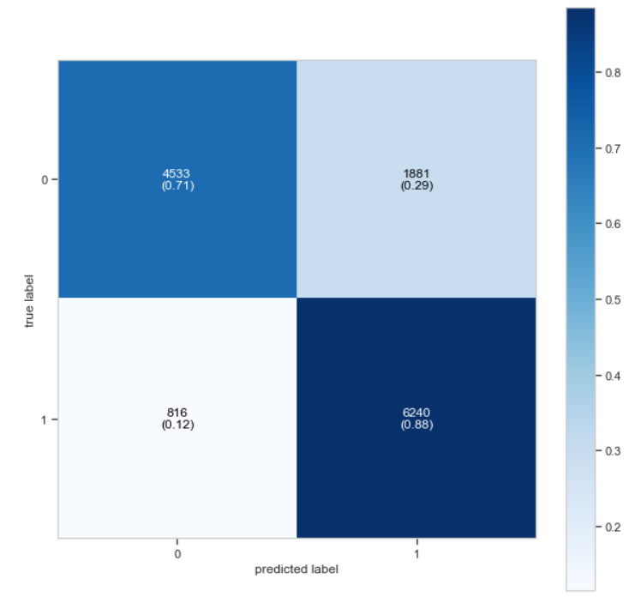
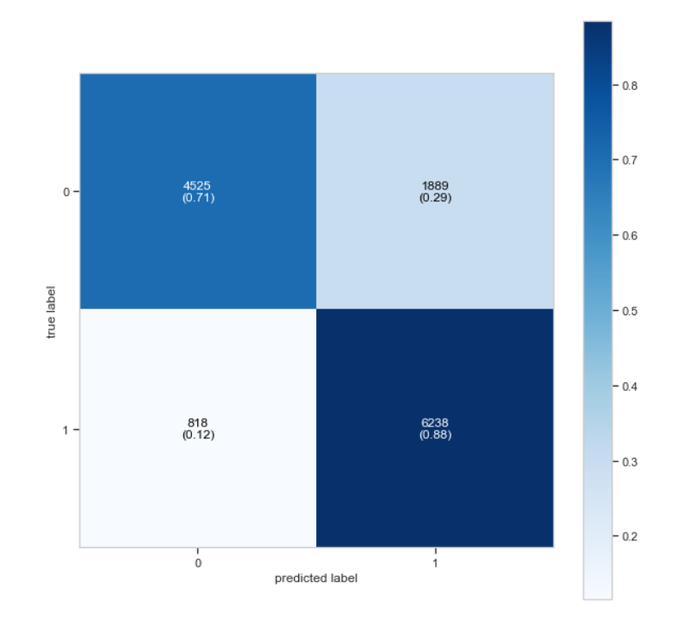
DATA ANLAYSIS:
Logistic Regression confusion Matrix:
Ensemble Technique confusion Matrix:

Slide 13
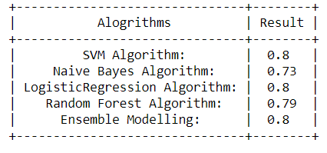
DATA ANLAYSIS:
Comparing all the algorithm results:

Slide 14
References:
Ahmed H, Traore I, Saad S. “Detecting opinion spams and fake news using text classification”, Journal of Security and Privacy, Volume 1, Issue 1, Wiley, January/February 2018.
Ahmed H, Traore I, Saad S. (2017) “Detection of Online Fake News Using N-Gram Analysis and Machine Learning Techniques. In: Traore I., Woungang I., Awad A. (eds) Intelligent, Secure, and Dependable Systems in Distributed and Cloud Environments. ISDDC 2017. Lecture Notes in Computer Science, vol 10618. Springer, Cham (pp. 127-138).

Slide 15
Thank You

