Slide 1

Teams Work Document Search

Slide 2
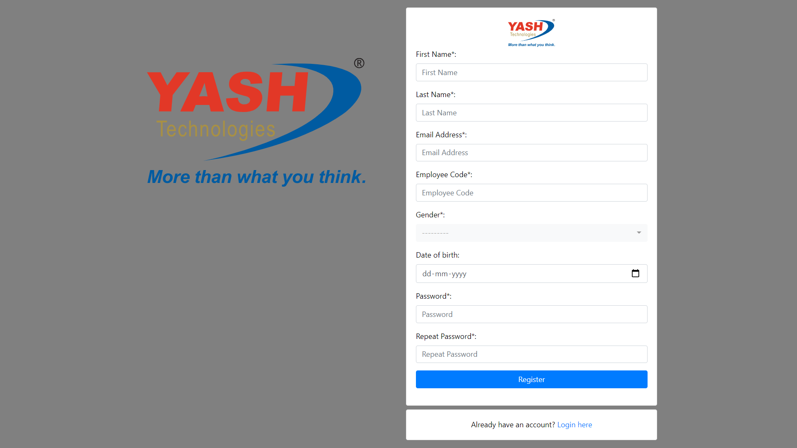
1. User Registration

Slide 3
User Registration Fields
1. First Name - mandatory
2. Last Name – mandatory
3. Email Address – mandatory – unique
4. Employee code – mandatory – unique
5. Gender – select field (Male, Female, Other)
6. Date of Birth – optional field
7. Password and Repeat Password – mandatory – values should be same

Slide 4
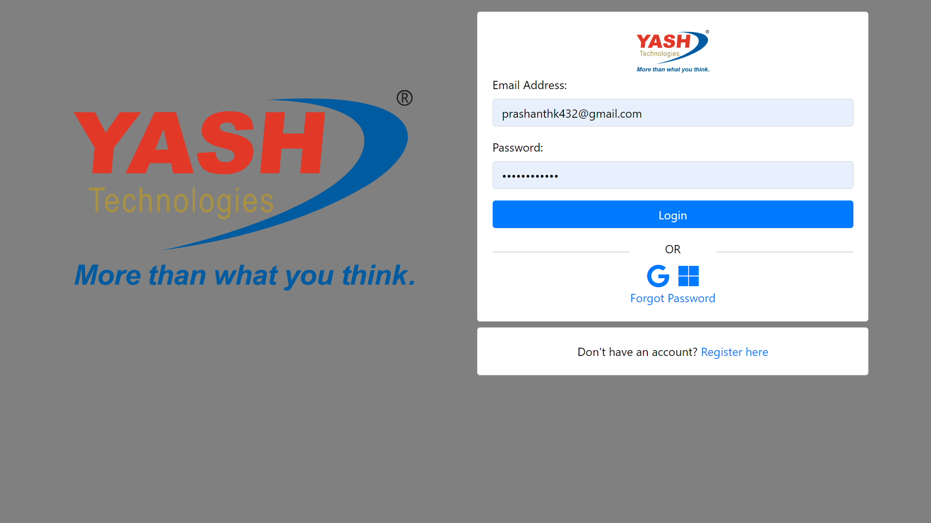
2. User Login

Slide 5
User Login Fields
1. Email Address – mandatory
2. Password – mandatory
After clicking the login button, it will check the email and password with already registered users. It users find then it will create the user session and take in to home page.

Slide 6
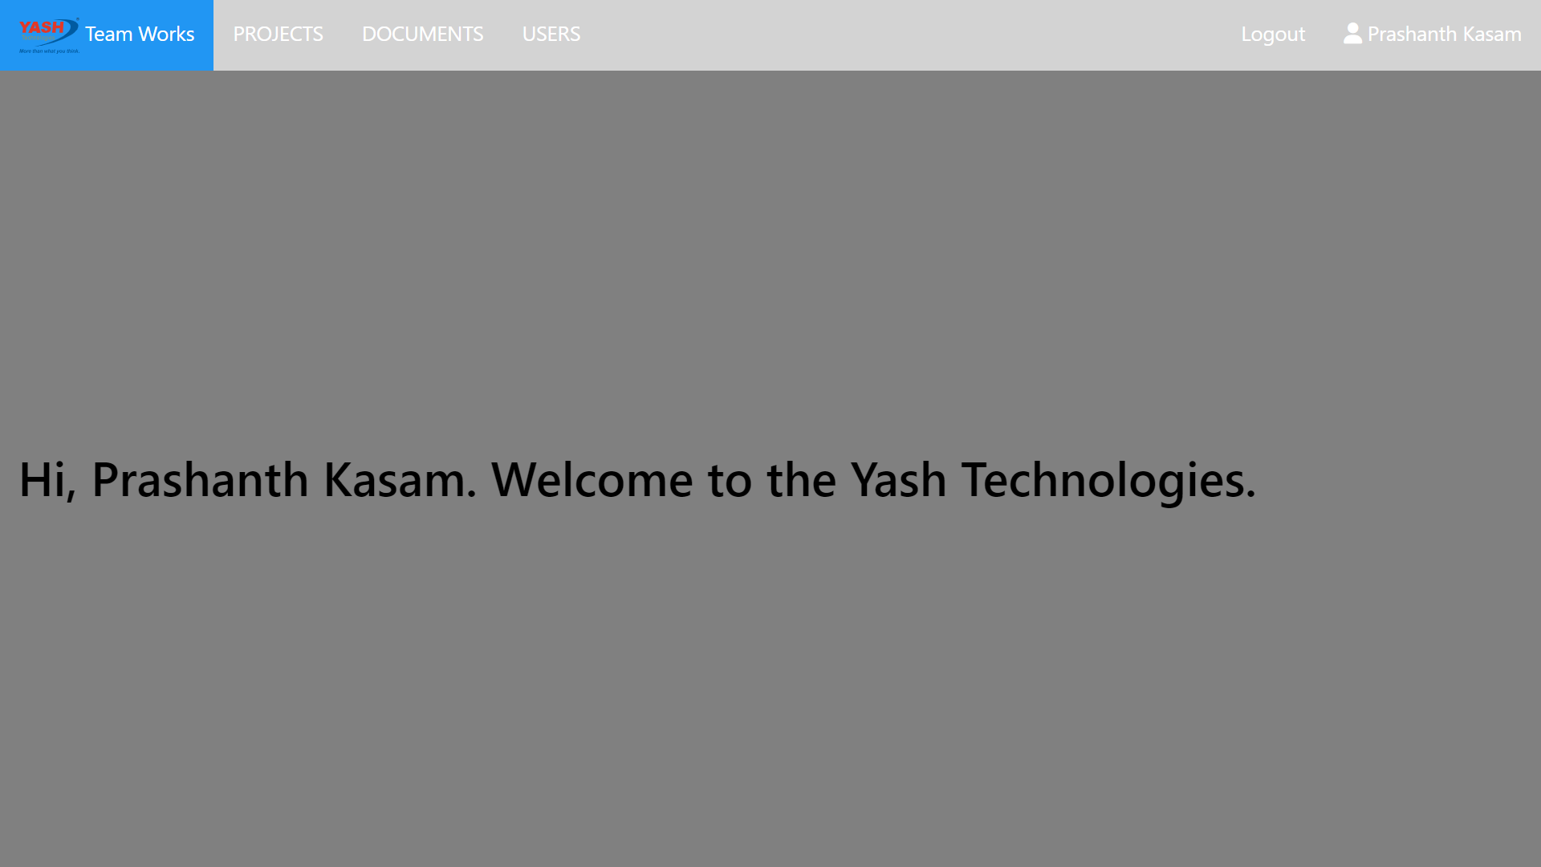
3. Home page after Login

Slide 7
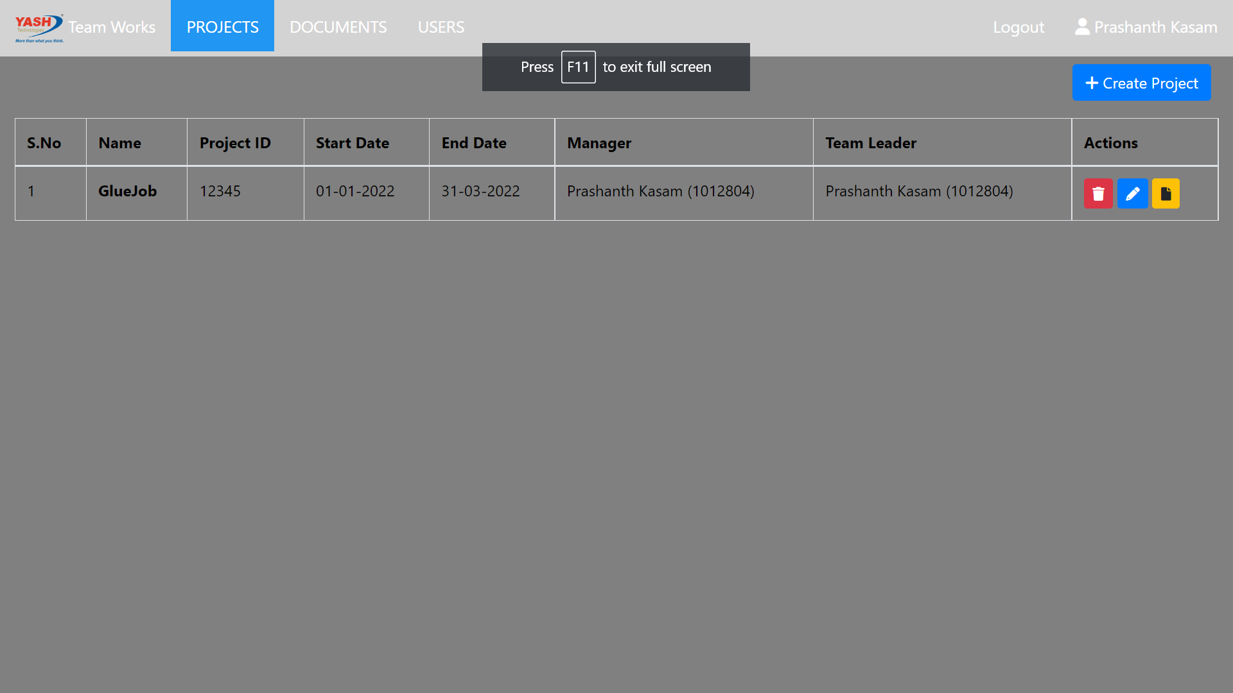
4. Projects List Page

Slide 8
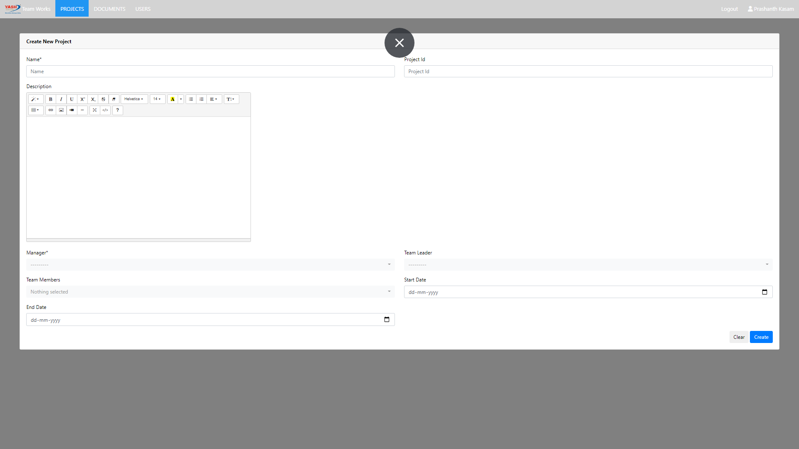
5. Project Create Page

Slide 9
Project create fields
1. Name – mandatory – Name of the Project.
2. Project ID – optional – Id of the Project.
3. Description – optional – Description of the Project.
4. Manager – mandatory – select field – Select the manager of the Project.
5. Team Leader – optional – select field – select the team leader of the Project.
6. Team members – optional – multi select field – select all the team members of the project.
7. Start Date – optional – Project start date
8. End Date – optional – Project end date

Slide 10
6. Users Hierarchy
Super User
Manager
Team Leader
Team Member 2
Team Member 3
Team Member 1

Slide 11
7. Users and Roles
1. Super User
- Create, Delete, Edit - Project
- Assign Manager to Project
- Create and Access to all Projects and Documents.
2. Manager
- Edit, Delete – Project
- Assign Team Leader and Team Members to Project
- Create and Access to his Projects documents
3. Team Leader
- Assign Team Members to Project.
- Create and Access to his Projects documents.
4. Team Member
- Create and Access to his Projects documents.

Slide 12
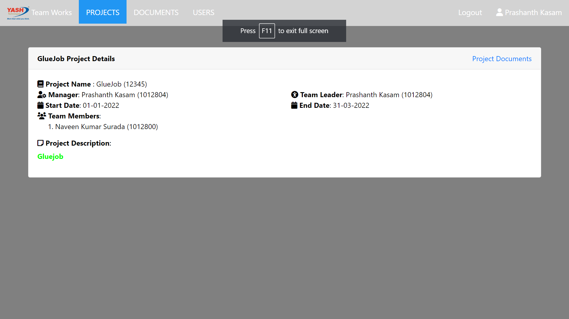
8. Project Details Page

Slide 13
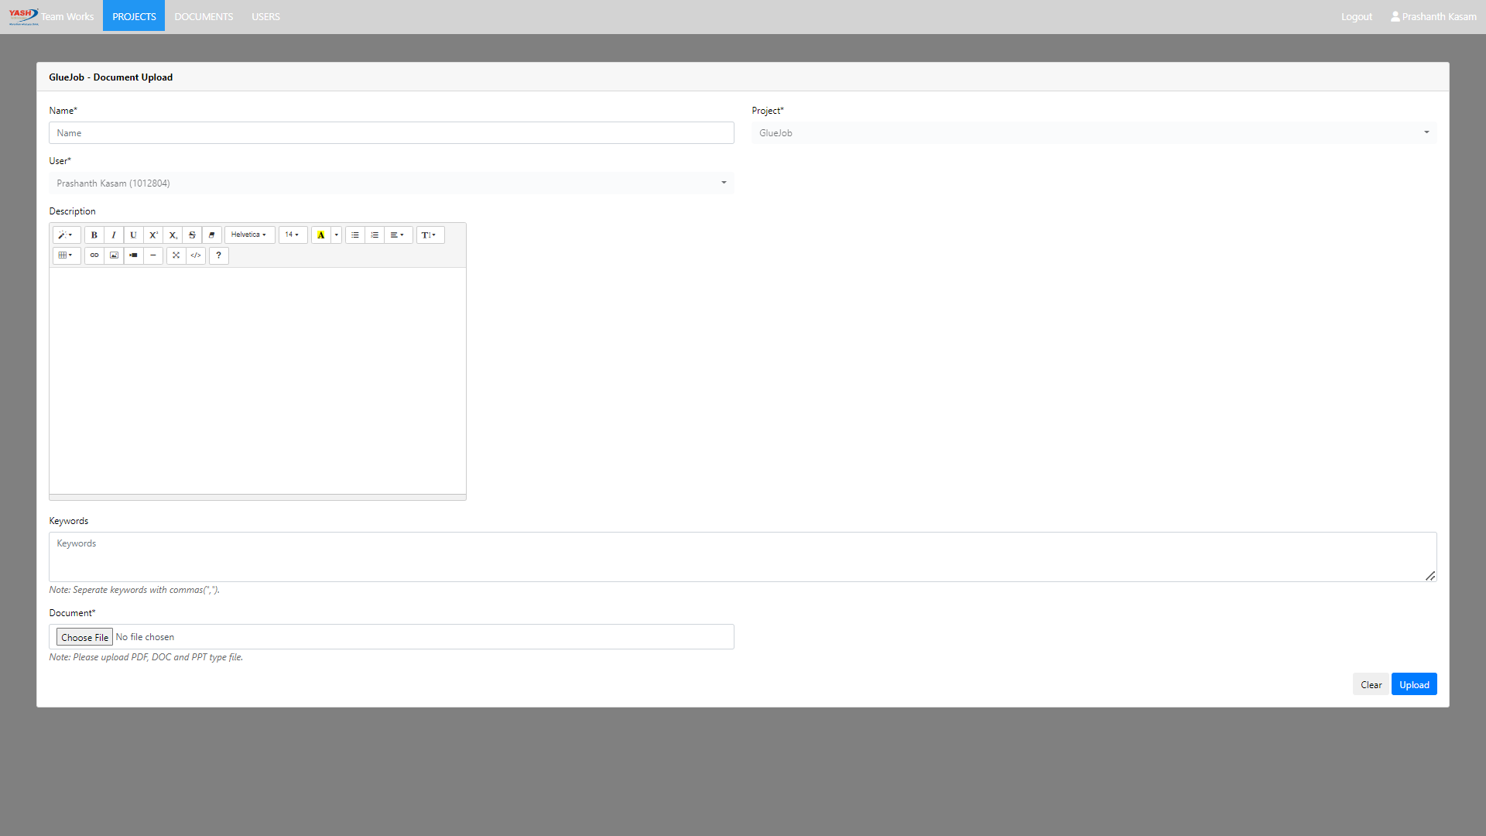
9. Project Document Upload Page

Slide 14
9. Document Upload Fields
1. Name – mandatory – Document Name
2. Project – automatically select and not editable
3. User – automatically select the current login user and not editable
4. Description – optional - description of the document
5. Keywords – optional - keywords of the document, used for document search
6. Document – File Field – Use can select pdf, doc and ppt.

Slide 15
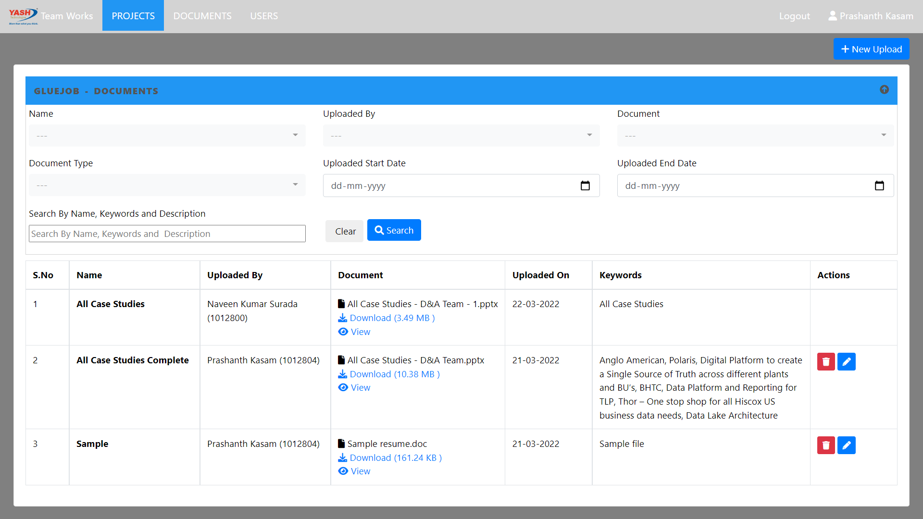
10. Documents List and Search

Slide 16
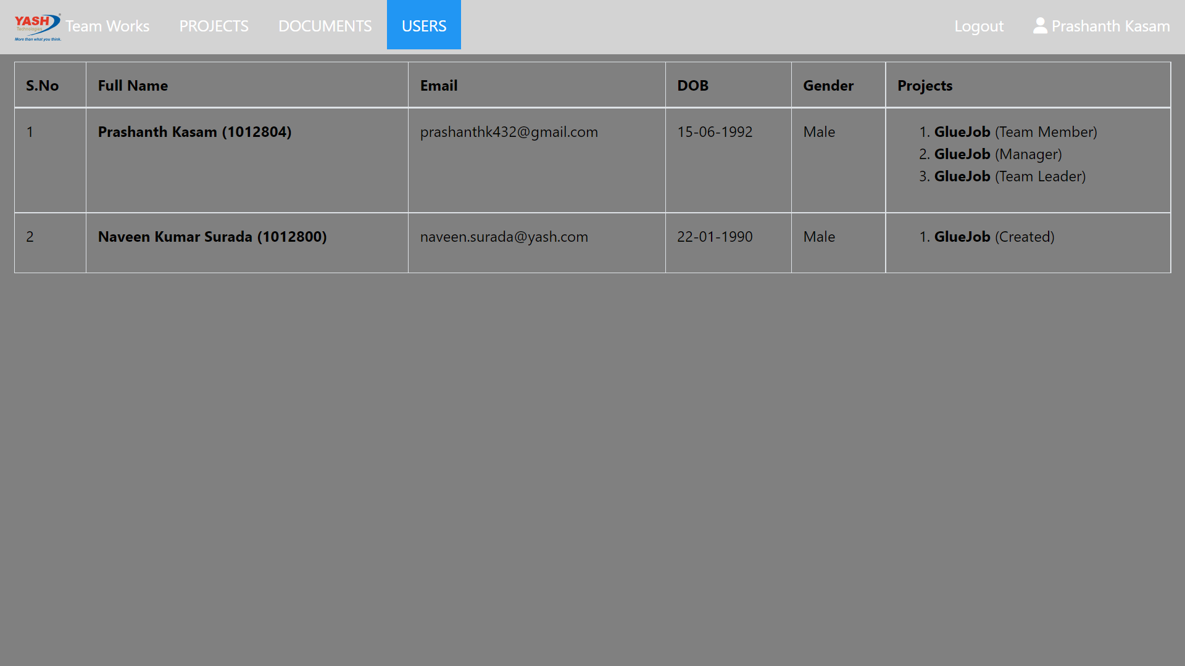
11. Users List Page

Slide 17
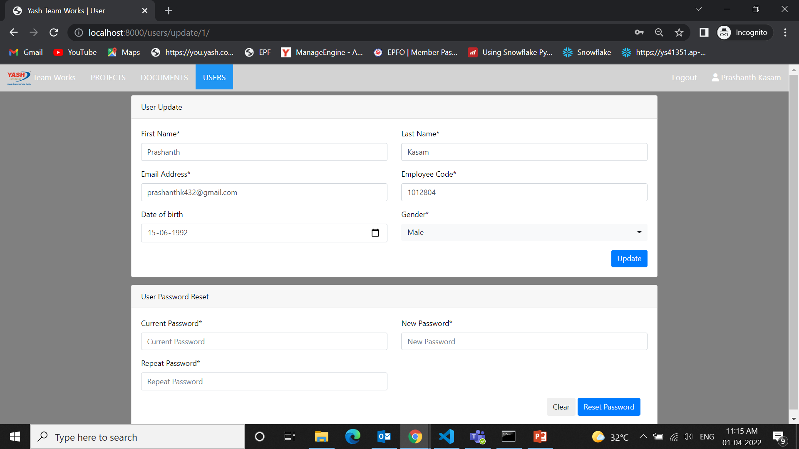
12. User Profile Update and Password Reset Page

