Slide 1
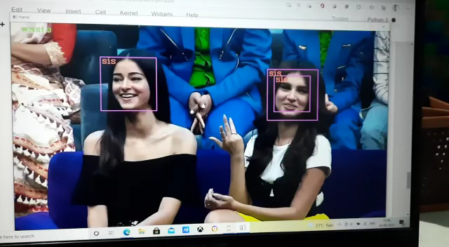
Sample execution on youtube video

Slide 2
CODE​ :
​
Steps Involved ​
Importing required Dependencies​
Training CNN models in separate files​
Loading CNN models which are trained in other folders​
Declaration of an audio function to convert string output to audio format​
Using opencv to capture input images from webcam​
Converting the input image to grayscale (black and white) image ​
Using Haarcascades to detect faces from the input video​
Cropping only faces from input video ​
Resizing the image with width and height as (40,40) px

Slide 3
Passing the extracted images to the model ​​
Printing predictions​​
Providing an audio output if and only if the user desires​​
Keys and their controls :
press q to exit
press f to know about the person
press e to know their Emotion
press t to know the current Time

