Slide 1
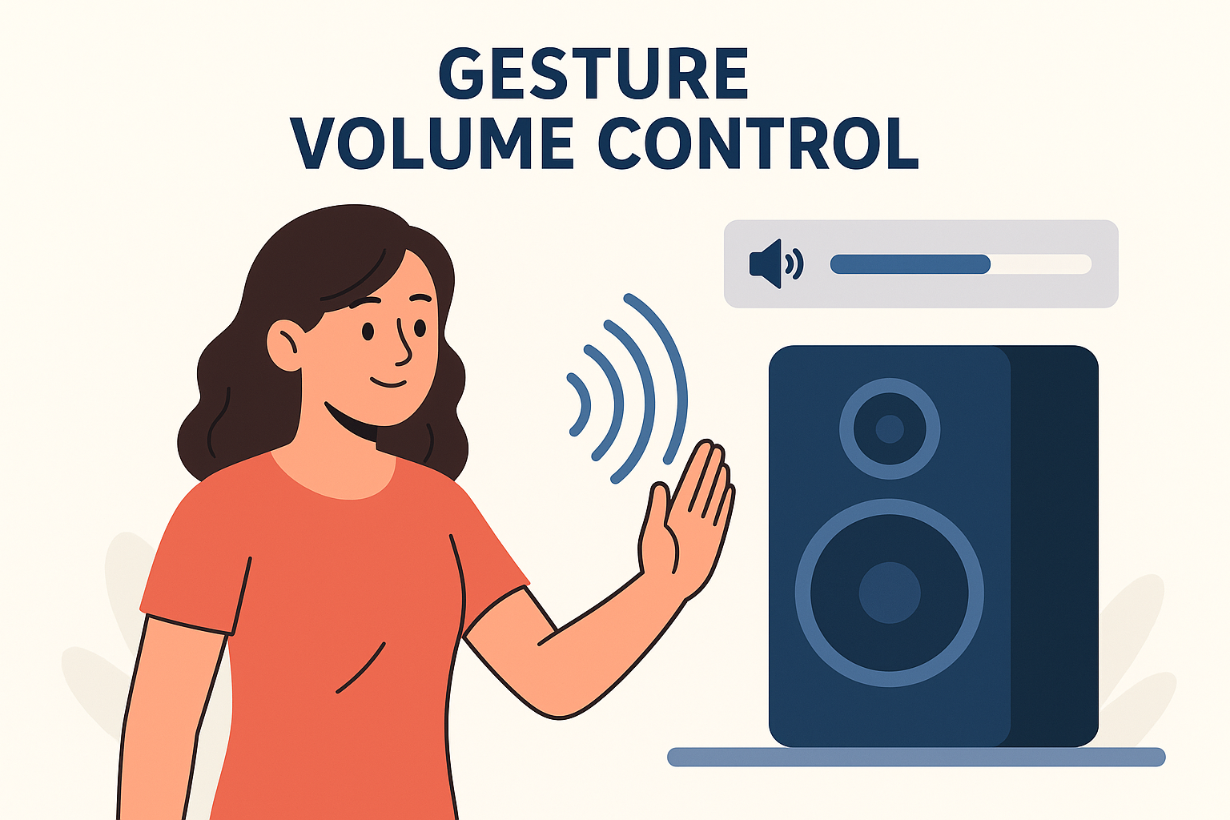

GestureVolume: Volume Control with Hand Gestures
Milestone 3
Mentor: Dr. D. Bhanu Prakash (MENTOR – INFOSYS)
Presenting by: Prashanti Hebbar

Slide 2
Objectives
The gesture distance will be mapped to system volume levels from 0% to 100%.
Volume control will be executed using PyAutoGUI or equivalent libraries with smooth transitions.
This will translate the calculated gesture distance into a volume level between 0% and 100%.
PyAutoGUI or platform-specific audio control libraries will be used to set the system volume dynamically. A smoothing function will be applied to reduce sudden volume jumps.

Slide 3
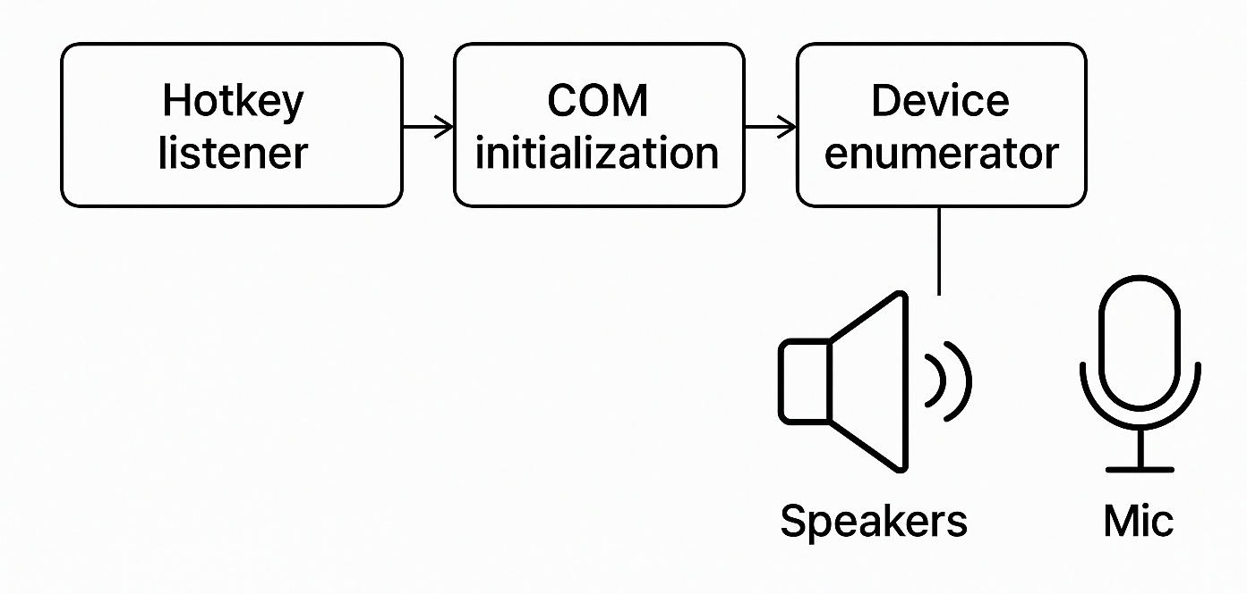
Solution overview
Technology stack & dependencies
A Python script using keyboard for hotkeys and pycaw/COM to control audio endpoints.
Components: Hotkey listener → COM initialization → Device enumerator → Volume control API
Python 3.x
Libraries: keyboard, pycaw, comtypes
ctypes.POINTER, cast: used to cast the COM interface pointer returned by Activate() into a Python-accessible interface.
comtypes.*: COM interop helpers. CoInitialize / CoUninitialize are required to initialize COM in the calling thread before using COM objects. CreateObject creates COM objects (MMDeviceEnumerator).
CLSCTX_ALL is a constant to specify activation context.

Slide 4
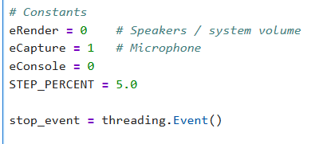
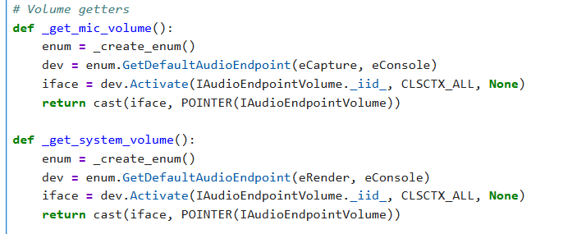
Implementation
eRender / eCapture / eConsole are integer constants used by MMDevice API calls to select render (playback) vs capture (microphone) devices and role.
These functions return a usable IAudioEndpointVolume pointer for the default microphone (_get_mic_volume) and speakers (_get_system_volume)

Slide 5
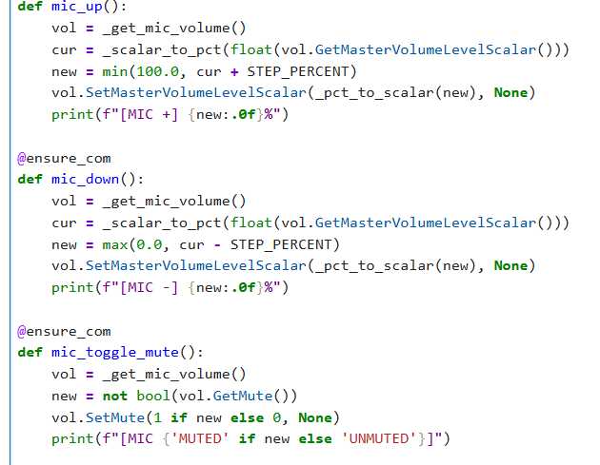
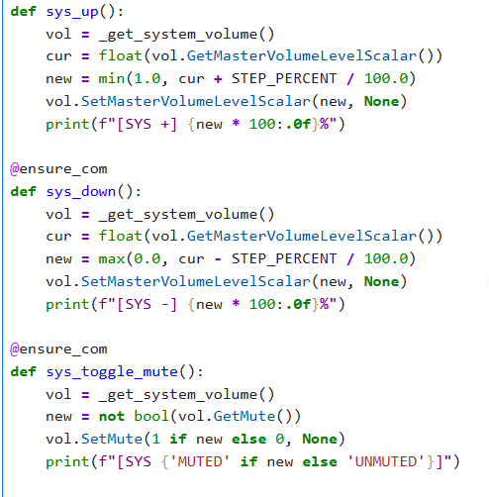

Slide 6
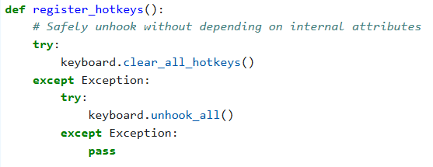
clear_all_hotkeys() attempts to remove previously registered hotkeys safely.
keyboard.add_hotkey(hotkey, callback) registers global hotkeys

Slide 7
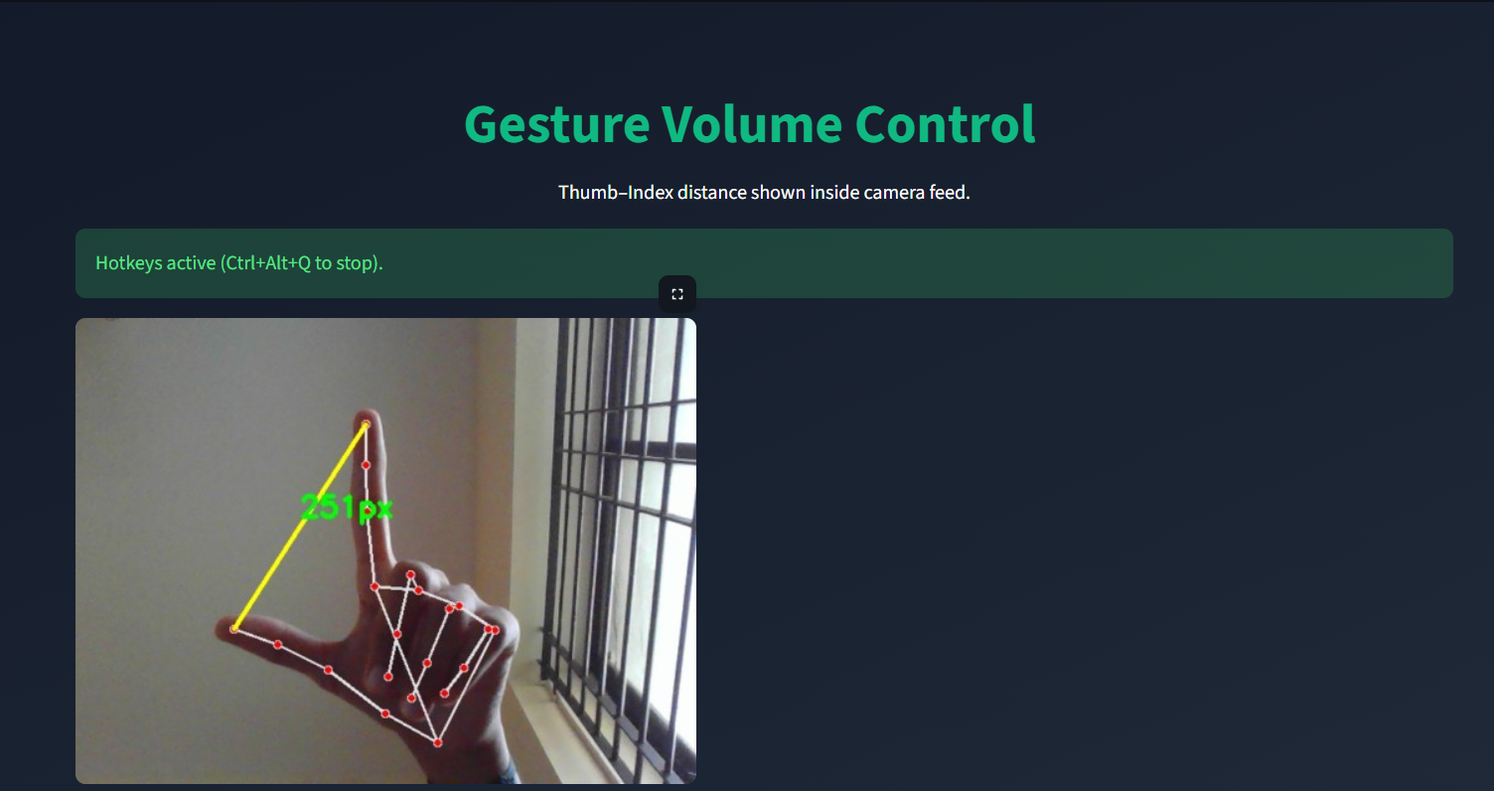
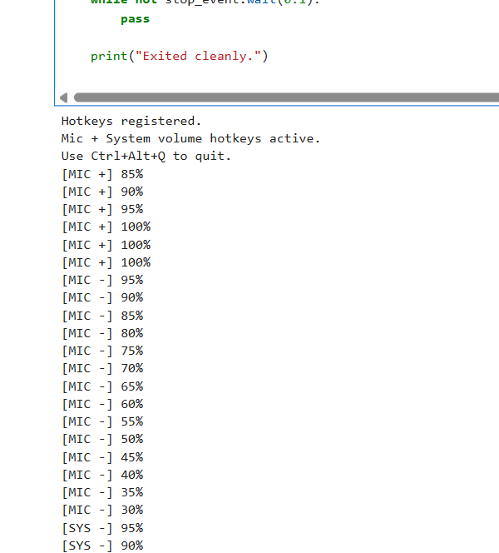
Output

Slide 8
Thank You

