Slide 1

Product Category Classification Using Image and Text Data
Classify Amazon products into categories using CLIP (frozen) and a trained MLP probe on image + text embeddings.
Multimodal Deep Learning | CLIP-based Classification

Slide 2
Problem Statement: • Noisy/incomplete listings (varying text quality, missing fields). • Text-only misses visual cues; image-only misses specs/brand. • Similar products are hard to separate with one modality.
Challenges: • Text-only misses visual cues (appearance, colour, design). • Image-only misses specs, brand, and wording.
Goal: • Robust category prediction using both image and text. • Combined signals improve accuracy & robustness.

Slide 3
Project Objectives: • Build a multimodal classifier using product name + description + image. • Use pretrained CLIP (openai/clip-vit-base-patch32) — no encoder training from scratch.
Approach: • Extract frozen CLIP image + text embeddings (512 + 512). • Concatenate to 1024-dim and train an MLP probe.
Generalisation: • Train only the MLP head (N=1,035) to reduce overfitting. • Lower compute cost and faster iteration.

Slide 4
Dataset Overview: • Source: Amazon Product Dataset 2020 (Kaggle). • Domain: Toys & Games (4 categories). • Size: 1,035 valid samples (image + text).
Classes: • Board Games • Jigsaw Puzzles • Stuffed Animals & Teddy Bears • Action Figures
Splits: • Train/Val: 80/20 stratified (split column in processed_labels.csv). • Evaluation performed on the validation set.

Slide 5
Data Preprocessing: • Images: parse first valid URL → download locally. • CLIP processor resizes/normalises (224×224) for embedding extraction. • Text: NFKC normalisation + whitespace cleanup.
Text field: • Merge: product name + description joined with “ || ”. • Tokenise with CLIP (max 77 tokens).
Labels: • Fixed label_map (category→0–3). • Split consistency via uniq_id + split alignment (processed_labels.csv).

Slide 6
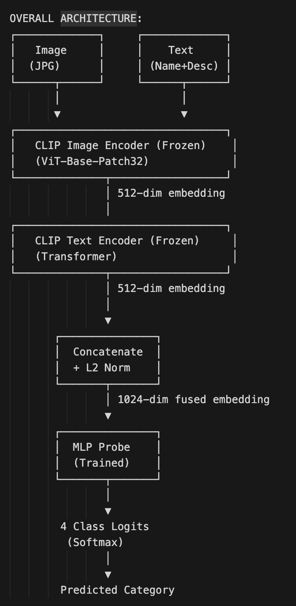
Model Architecture: • Frozen CLIP image encoder (ViT-B/32) → 512-dim embedding (L2-normalised). • Frozen CLIP text encoder (Transformer) → 512-dim embedding (L2-normalised).
Fusion: • Concatenate image + text embeddings → 1024-dim vector. • No additional re-normalisation after concat (per project).
Classifier head: • MLP: 1024 → 256 (ReLU) → dropout 0.2 → 4 logits. • Only MLP head is trained; CLIP remains frozen.

Slide 7
Training Strategy: • Trainable params: MLP head only; CLIP encoders frozen. • Loss: CrossEntropyLoss (multiclass). • Optimiser: Adam (lr=1e-3, weight_decay=1e-4).
Regularisation: • Dropout = 0.2 in the MLP head. • Weight decay = 1e-4.
Early stopping: • Monitor validation loss; patience = 3. • Save best checkpoint (lowest val loss). • Up to 10 epochs; batch size 64.

Slide 8
Evaluation Metrics: • Accuracy on validation set. • Per-class Precision / Recall / F1 (average=None). • Macro F1 for balanced summary.
Diagnostics: • Confusion matrix to inspect error patterns. • Classification report + metrics.json exported by evaluate.py.
Why these metrics: • Macro F1 avoids bias toward majority classes. • Confusion matrix reveals which categories confuse each other.

Slide 9
Results Summary: • Validation accuracy ≈ 98.07%; Macro F1 ≈ 0.9808. • Strong performance across all 4 categories.
Per-class (approx): • Board Games: F1≈0.98 • Jigsaw Puzzles: F1≈0.97 • Stuffed Animals: F1≈0.99 • Action Figures: F1≈0.98
Confusion matrix: • Most predictions fall on the diagonal (correct). • Small confusions mainly between Board ↔ Jigsaw and Action ↔ others.

Slide 10
Conclusion & Future Work: • Frozen CLIP + lightweight MLP achieves high accuracy with low training cost. • Pretrained multimodal features transfer well to product categorisation.
Future work: • Fine-tune CLIP (partial/full) when more data is available. • Attention-based fusion instead of simple concat. • Scale to more categories; handle missing modalities.
Deployment: • Use in cataloguing, search, recommendations, and moderation pipelines. • Add confidence thresholds + active learning for new categories.

