Slide 1
Hotel Review
Data Science Project​

Slide 2


Agenda
A
Introduction
Primary Goals
EDA
Model Building
Deployment

Slide 3
Introduction
Even though Tourism industry is slowly catching up the hotel industry, there are some travelers that prefer the hotels over vacation rentals. As those travelers are usually busy people who travel for work, we created this list of Hotel Review Data set

Slide 4
Primary Goals
This is a dataset which consists of 20,491 reviews and ratings for different hotels and our goal is to examine how travelers are communicating their positive and negative experiences in online platforms for staying in a specific hotel
Major objective is what are the attributes that travelers are considering while selecting a hotel. With this manager can understand which elements of their hotel influence more in forming a positive review or improves hotel brand image.

Slide 5
Plan for Project Execution
Deploy strategic Model networks with compelling Client needs
Row Data
Getting row data from client get information about the data
Checking primary requirement of client
Visualization
Perform EDA to get the details from the data and understand data set
Build the various classification model to get whose model fit and getting best accuracy
Deployment
Basic Steps
Model Budling

Slide 6
Timeline
Presentation of Our work on Hotel review
Sep 3rd week
Sep 4th Week
Oct 1st Week
Various Model Building
Oct 2nd week
Deployment with finalized Model
Oct 3rd week
Getting data from clients as well as getting information about requirement and need of Business
Data Cleaning , Data Preprocessing , EDA

Slide 7
EDA

Slide 8
Basic EDA
Head
Tail
Shape
Isnull
Info
Value Count

Slide 9
Bar Chart

Slide 10
Pie Chart

Slide 11
Text Preprocessing
In natural language processing, text preprocessing is the practice of cleaning and preparing text data. NLTK and re are common Python libraries used to handle many text preprocessing tasks.
Length of reviews
Lowercase the review
Removing Digits and Punctuation marks
Removing the extra spaces
Steaming and Lemmatization
Word cloud

Slide 12
Text Preprocessing Length of Review

Slide 13
Word Cloud

Slide 14
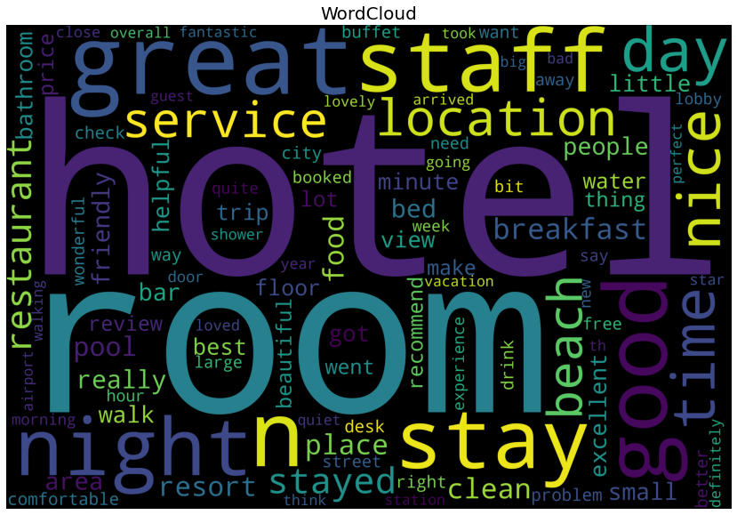
Review Word cloud

Slide 15
Sentiment Analysis

Slide 16
Count plot for no. of Sentimental Reviews

Slide 17
Pie Chart

Slide 18
Normalize Stacked Bar Plot

Slide 19
Model Building

Slide 20
Models
This project aims at developing a machine-learning algorithm that will determine if a certain Hotel review such attribute that traveler are consider while selecting hotels by the using different classifiers,
To understand which elements of their hotel influence more in forming a positive review or improves hotel brand image.
To do so, we have used the following classification methods:
Logistic Regression
KNN
Naïve Bayes
Decision Tree
Random Forest
LGBM

Slide 21
Models Accuracy
Sr.No. | Models | Training Accuracy | F1 Score | Testing Accuracy | F1 Score
1 | Logistic Regression | 0.900 | 0.898 | 0.852 | 0.849
2 | KNN | 0.747 | 0.675 | 0.719 | 0.638
3 | Naive Bayes | 0.837 | 0.790 | 0.828 | 0.777
4 | Decision tree | 0.800 | 0.757 | 0.764 | 0.713
5 | Random Forest | 0.988 | 0.988 | 0.831 | 0.796
6 | LGBM | 0.966 | 0.964 | 0.849 | 0.29

Slide 22
CONFUSION MATRIX
All Models Confusion Matrix

Slide 23
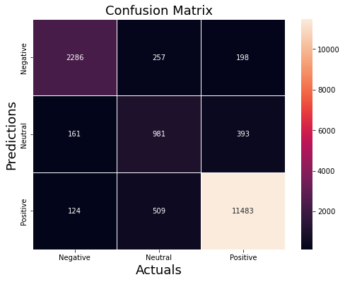
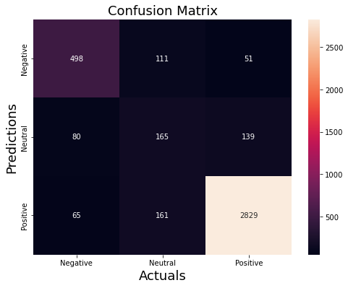
Logistic Regression
Training Confusion Matrix
Testing Confusion Matrix

Slide 24
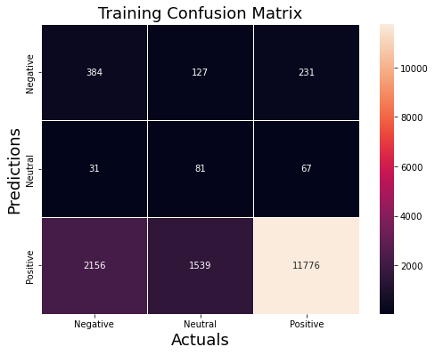
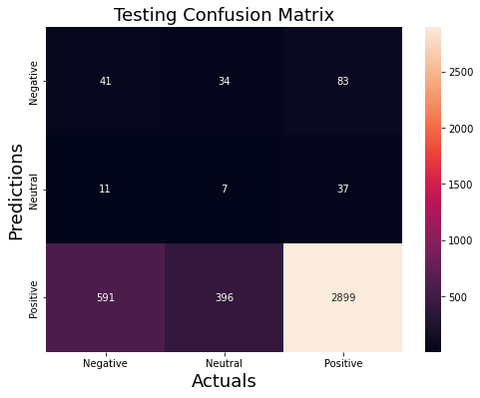
K-NEAREST NEIGHBORS
Training Confusion Matrix
Testing Confusion Matrix

Slide 25
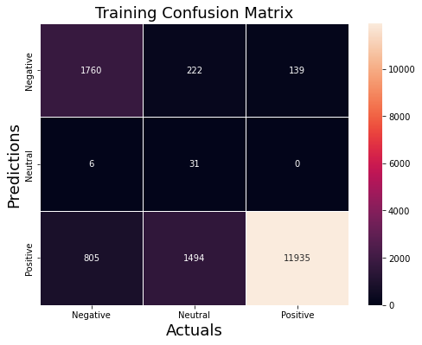

Naive Bayes Model
Training Confusion Matrix
Testing confusion matrix

Slide 26
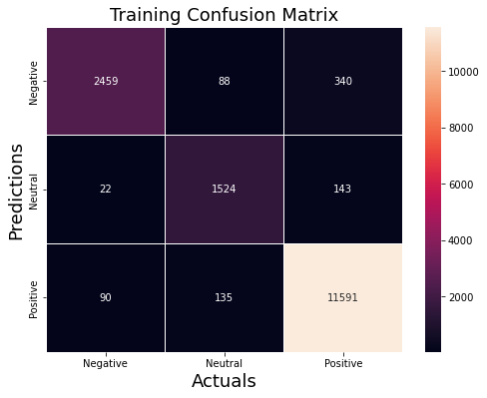

Decision Tree Model
Training Confusion Matrix
Testing Confusion Matrix

Slide 27
Random Forest Model
Training Confusion Matrix
Testing Confusion Matrix

Slide 28
DEPLOYMENT
Deployment On Naive Bayes

Slide 29
Why Naive Bayes
Naive Bayes classification is a popular choice for classification model building, and it performs well in a number of real-world applications.
Its key benefits are its simplicity, efficiency, ability to handle noisy data and for allowing multiple classes of classification. It also doesn’t require a large amount of data to work well.
Another important benefit of naive Bayes is that it is robust to missing data. This is because it is a generative probabilistic model.
In our problem Naive bayes Training accuracy 83.30% and F1 score 79.00% and Testing accuracy 82.8% and F1 score 77.70% training and testing accuracy all most similar that’s why we select naive bayes for deployment .

Slide 30
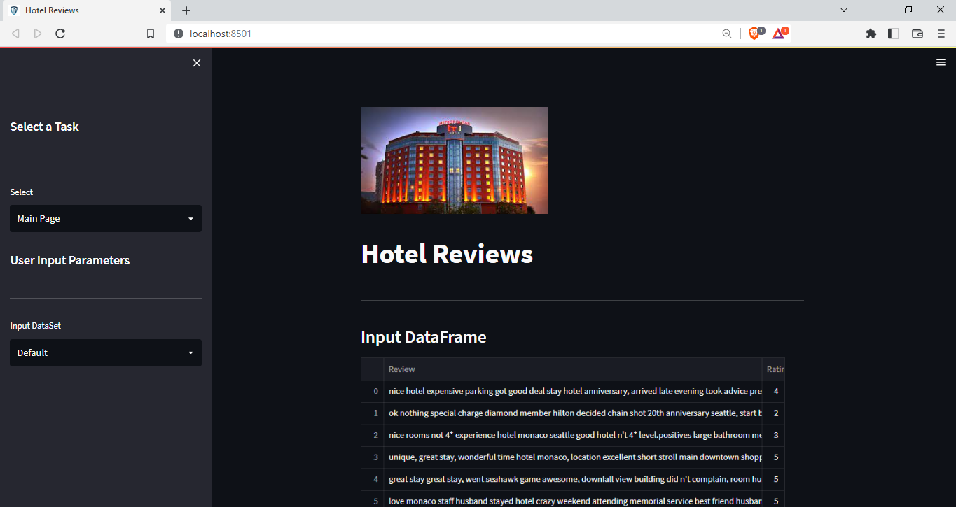
Interface of Deployment

Slide 31
Contact Information
Group Members Contact Details

Slide 32
Contact’s
Sr. No | Name | Contact No. | Email ID | GitHub Id
1 | Ayush Patidar | 9131985346 | ayushpatidar1712@gmail.com | Ayushpaatii1712
2 | Anup Vetal | 8668314822 | anupsv1997@gmail.com | JustAnupSv
3 | Farzan Nawaz | 7898480467 | farzannawaz4787@gmail.com | Farzan04
4 | Nilesh Patil | 7875581402 | itsnilesh45@gmail.com | nilesh-4545
5 | Prashant Khandekar | 7030870449 | pkhandekar108@gmail.com | Prashantkhandekar
6 | Prasad Waje | 8999714455 | prasadwaje2029@gmail.com | Prasadwaje
7 | Vikram Krishna | 9553300586 | vikramkrishan06@gmail.com

Slide 33
Teamwork is the ability to work together toward a common vision. The ability to direct individual accomplishments toward organizational objectives. It is the fuel that allows common people to attain uncommon results
“
”
-Andrew Carnegie

Slide 34

Thank you

