Slide 1



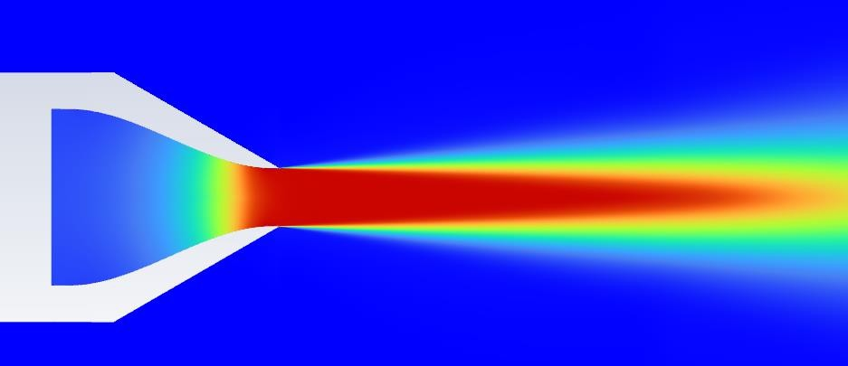
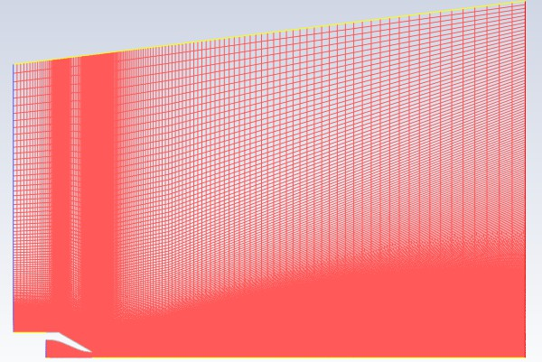
Compressible Flow in Converging Nozzle
Prepared by: Prashant Kamble

Slide 2
Introduction
Objectives: I perform a comprehensive numerical simulation of compressible subsonic flow in a converging nozzle, validated against experimental measurements and NASA CFD results.
Thrust Evaluation: The thrust generated by the nozzle is computationally evaluated and validated against theoretical limits.
Numerical Framework: The computational workflow utilizes ANSYS DesignModeler for geometry construction, ANSYS Meshing for structured grid generation, and ANSYS Fluent as the finite volume solver.
Validation Parameters: Key aerodynamic parameters, specifically the centerline axial velocity and radial velocity distributions, are compared to assess model fidelity.
CFD Study of Compressible Flow in ARN2 Nozzle | Prashant Kamble
2

Slide 3
Introduction
Reference Case: This validation study focuses on the ARN2 (Axisymmetric Radio Nozzle 2) geometry, a benchmark case obtained from the NASA Turbulence Modeling Resource (TMR).
Geometric Specifications: The detailed geometry profile and coordinate specifications are derived from NASA Technical Reports (NASA/TM-2005-213799).
CFD Study of Compressible Flow in ARN2 Nozzle | Prashant Kamble
3

Slide 4
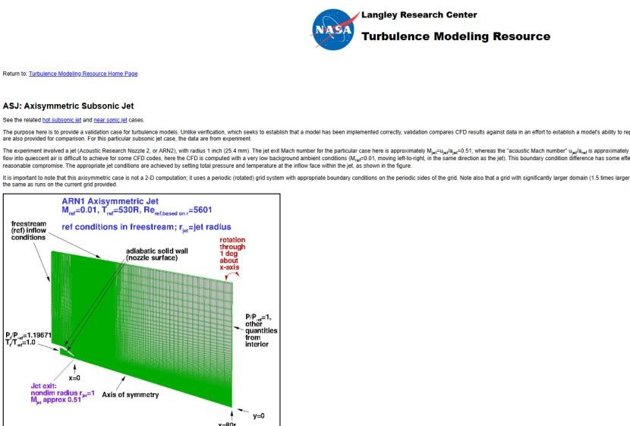
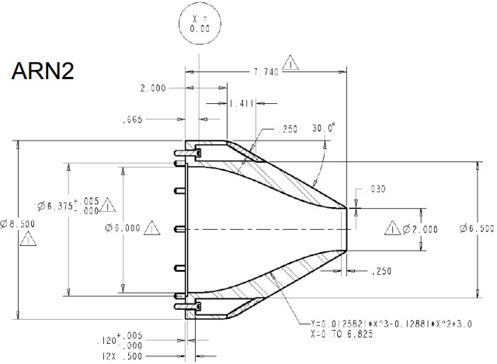
CFD Study of Compressible Flow in ARN2 Nozzle | Prashant Kamble
4

Slide 5

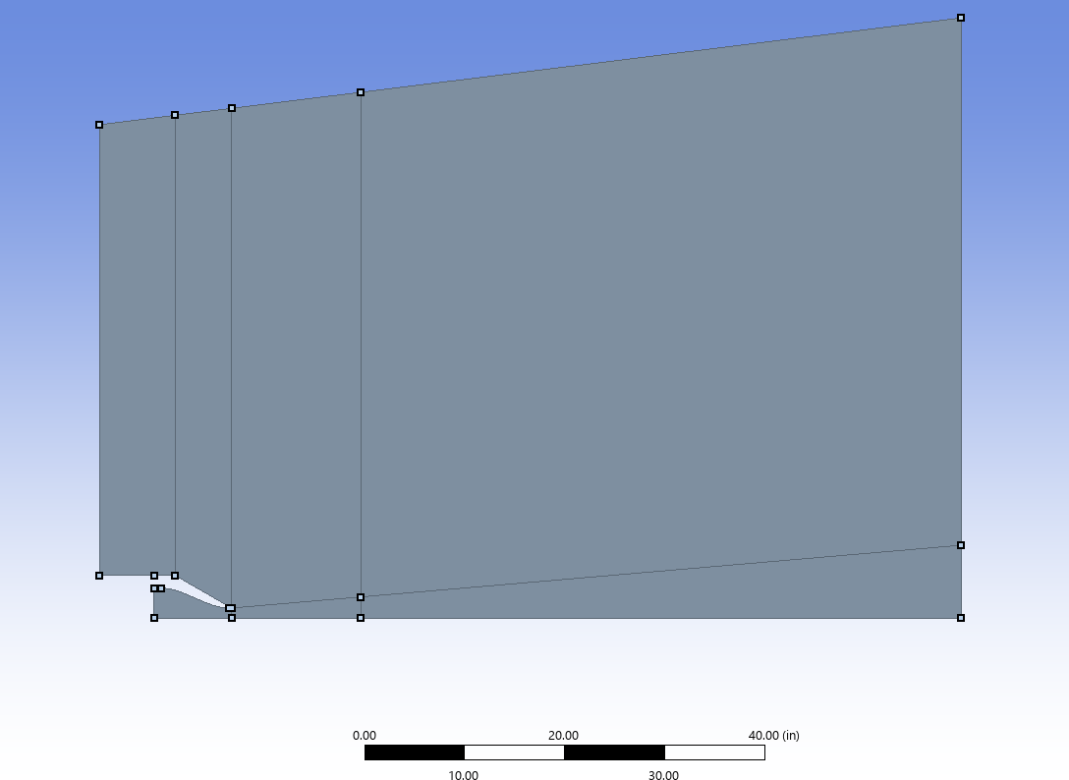
Geometry
Geometry Derivation: The nozzle inner contour is modeled from x = 0 to x = 6.825 inches using reference coordinate polynomials.
Domain Boundaries: The computational domain spans from -12.5 inches upstream of the exit to 80.0 inches downstream, extending 50.0 inches radially at the inlet and 60.0 inches at the outlet, representing a free-jet configuration.
Grid Alignment: The domain is structured to match the NASA-standard validation grids.
CFD Study of Compressible Flow in ARN2 Nozzle | Prashant Kamble
4

Slide 6
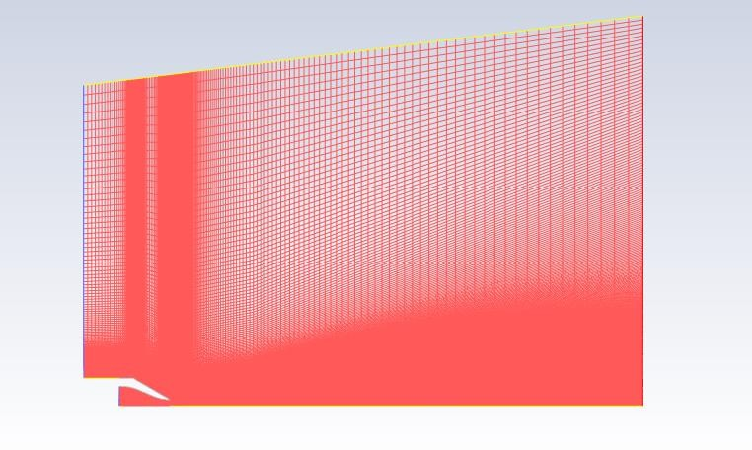
Mesh for ARN2 Nozzle
Grid Generation: Structured grids are generated using ANSYS Meshing, resolving the boundary layer with a wall-normal grid spacing yielding y+ < 5.
Mesh Quality: The baseline grid comprises approximately 100,000 hexahedral elements with a minimum orthogonal quality of 0.17, meeting numerical stability criteria.
CFD Study of Compressible Flow in ARN2 Nozzle | Prashant Kamble
5

Slide 7
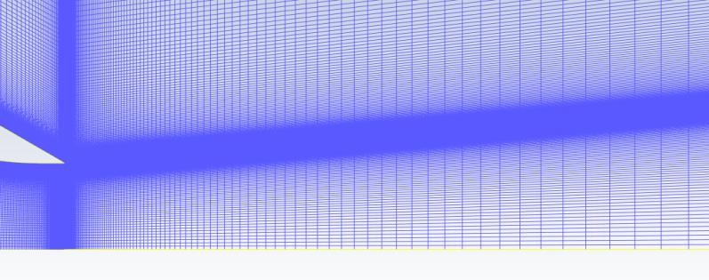

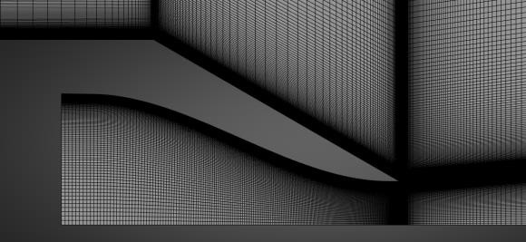
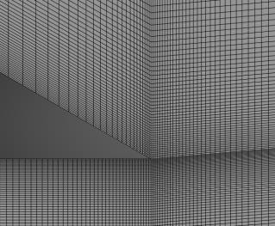
Mesh for ARN2 Nozzle
CFD Study of Compressible Flow in ARN2 Nozzle | Prashant Kamble
7

Slide 8
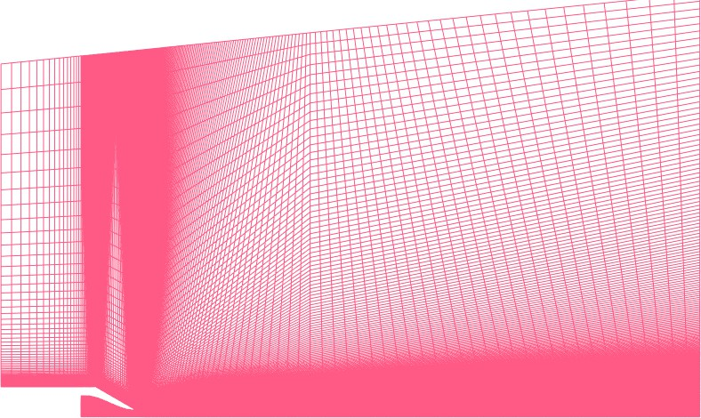







Three Meshes for Mesh independence study
70,600 cells (Coarse Grid)
128,740 cells (Medium Grid)
214,900 cells (Fine Grid)
CFD Study of Compressible Flow in ARN2 Nozzle | Prashant Kamble
6

Slide 9
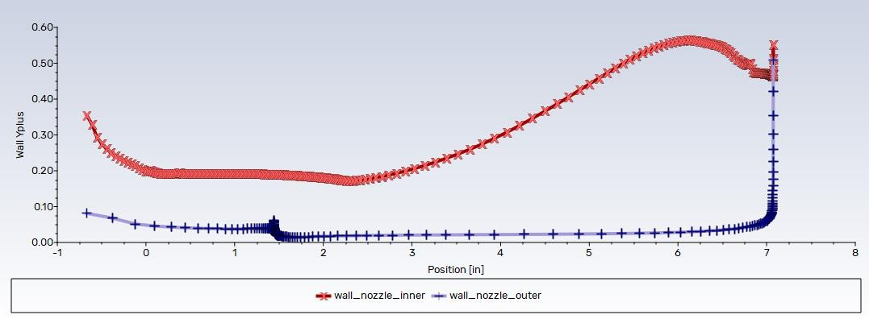
Y+ distribution for the Fine mesh SST model
Boundary Layer Resolution: Wall y+ values are maintained below 1.0 across the entire nozzle wall boundary for all three grid levels under the SST k-ω model, ensuring direct resolution of the viscous sublayer without wall functions.
CFD Study of Compressible Flow in ARN2 Nozzle | Prashant Kamble
7

Slide 10
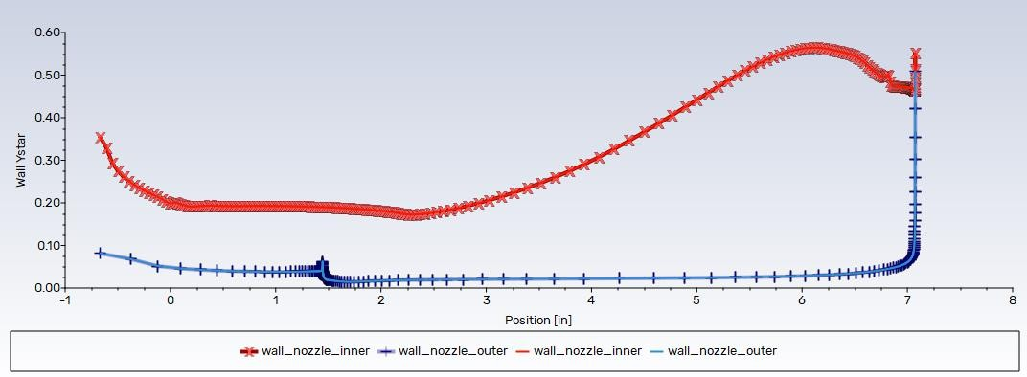
Y+ vs Y* distribution for the Fine mesh SST model
Grid Resolution Equivalence: Comparison of y+ and y* distributions shows negligible differences, verifying the suitability of the boundary layer spacing for low-Reynolds-number modeling.
CFD Study of Compressible Flow in ARN2 Nozzle | Prashant Kamble
8

Slide 11
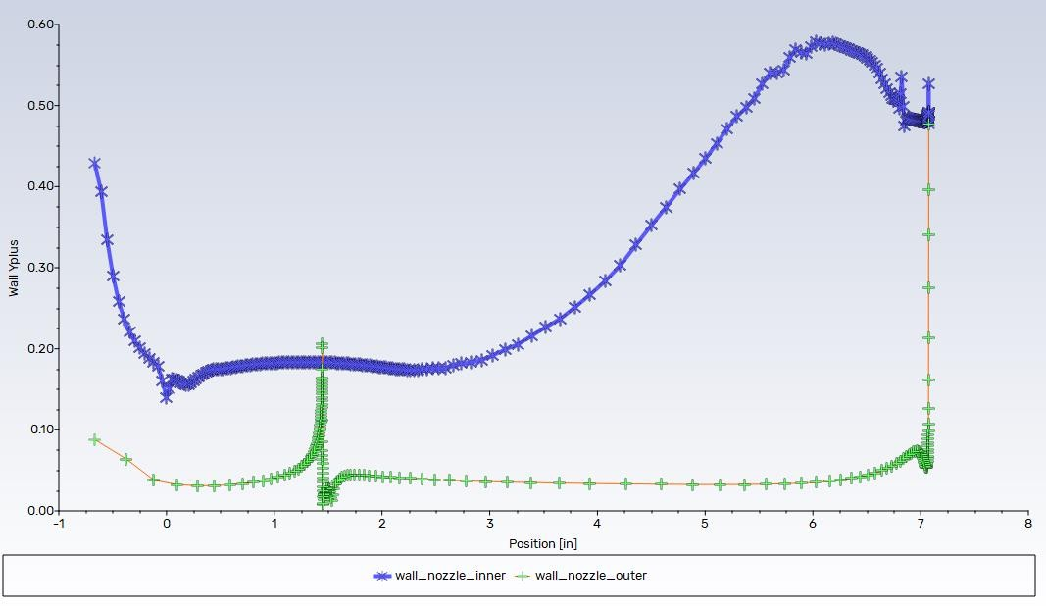
Y+ distribution for the Fine mesh SA model
CFD Study of Compressible Flow in ARN2 Nozzle | Prashant Kamble
9

Slide 12
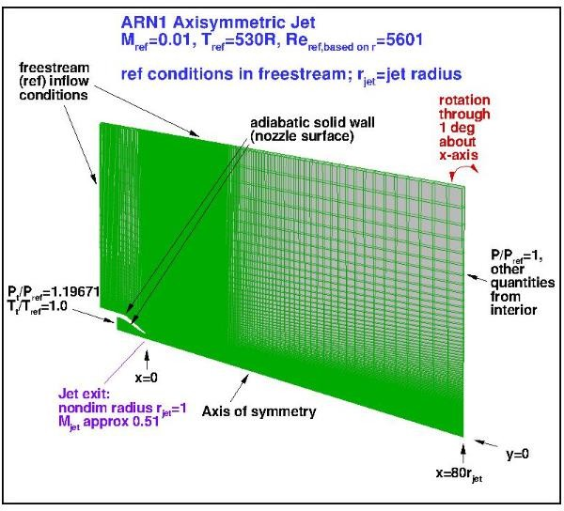
Important parameters
Reference Length: Nozzle throat radius (R_ref) = 1.0 inch (25.4 mm).
Flow Parameters: Reynolds number (Re_D) = 5,601 based on reference throat diameter.
Thermodynamic States: Reference temperature T_ref = 294.4 K (530 R), Reference pressure P_ref = 101,325 Pa.
Total Conditions: Nozzle inlet total-to-reference pressure ratio P_t/P_ref = 1.19671 (P_t = 121,256.6 Pa); total temperature T_t = 294.4 K.
Jet Exit State: Jet Mach number (M_jet) = 0.51.
CFD Study of Compressible Flow in ARN2 Nozzle | Prashant Kamble
10

Slide 13
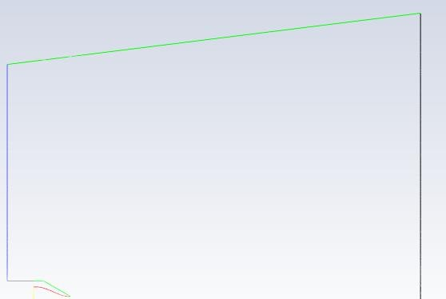
Boundary Conditions
Symmetry
Operating pressure = 0 Pa
Pressure inlet P_{total} = 101325 Pa P_{static} = 101325 Pa T_{total} = 294.4 K
Pressure Outlet 101325 Pa
294.4 K
Pressure inlet
P_{total} = 121,256.64 Pa P_{static} = 101325 Pa T_{total} = 294.4 K
Axis
CFD Study of Compressible Flow in ARN2 Nozzle | Prashant Kamble
11

Slide 14
Boundary Conditions Configuration
Freestream Inlet: Pressure inlet boundary condition configured with total pressure Pt = 101,325 Pa, static pressure Ps = 101,325 Pa, and total temperature Tt = 294.4 K.
Nozzle Inlet: Pressure inlet boundary condition with total pressure Pt = 121,256.64 Pa, static pressure Ps = 101,325 Pa, and total temperature Tt = 294.4 K.
Outlet Boundary: Pressure outlet boundary condition set to a static pressure of 101,325 Pa and backflow temperature of 294.4 K.
Symmetry & Centerline: Axisymmetric boundary conditions enforced along the centerline axis (y = 0); symmetry boundaries defined at domain outer bounds.
Operating Pressure: Set to 0 Pa to ensure absolute pressure calculations across the density-based coupled solver.
CFD Study of Compressible Flow in ARN2 Nozzle | Prashant Kamble
12

Slide 15
Computational Settings
Solver Configuration: A density-based coupled solver is employed to resolve the compressible flow equations.
Turbulence Modeling: Turbulence closure is achieved using the Spalart-Allmaras (SA) and SST k-ω models to compare their performance in shear-layer development.
Spatial Discretization: A second-order upwind scheme is utilized for the momentum equations to ensure spatial accuracy.
Fluid Modeling: Air is modeled as an ideal gas, with dynamic viscosity computed via Sutherland's law to account for temperature dependencies.
Initialization & Convergence: I implemented Full Multi-Grid (FMG) initialization and solution steering, with the Courant-Friedrichs-Lewy (CFL) number scaled from 0.1 to 100 over 5,000 iterations to achieve steady-state convergence.
CFD Study of Compressible Flow in ARN2 Nozzle | Prashant Kamble
13

Slide 16
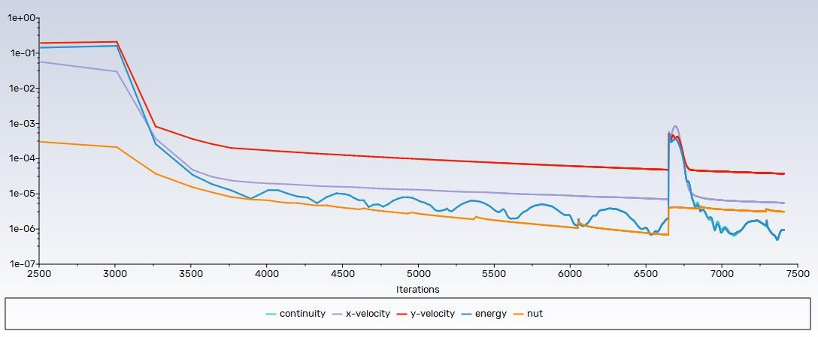
Solution Convergence
Residual Convergence History
CFD Study of Compressible Flow in ARN2 Nozzle | Prashant Kamble
14

Slide 17
Solution Convergence Analysis
Residual Monitoring: Solution convergence is evaluated based on normalized residual behavior, monitored to a strict threshold of < 10^-6 for all equations.
Conservation Balances: Mass and energy flow rates across the nozzle inlets and outlet are verified to ensure conservation properties.
Asymptotic Stability: Centerline axial velocity and wall shear stress profiles are monitored to guarantee asymptotic convergence over 5,000 iterations.
CFD Study of Compressible Flow in ARN2 Nozzle | Prashant Kamble
15

Slide 18
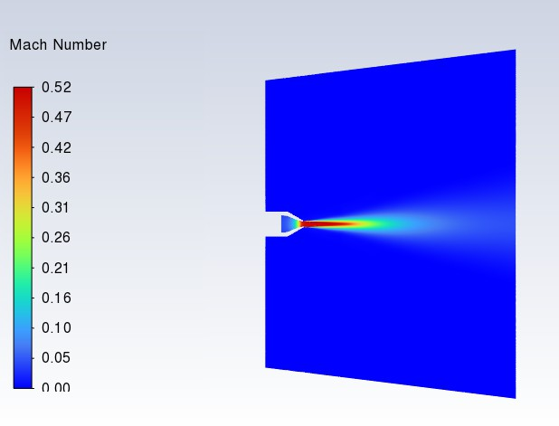
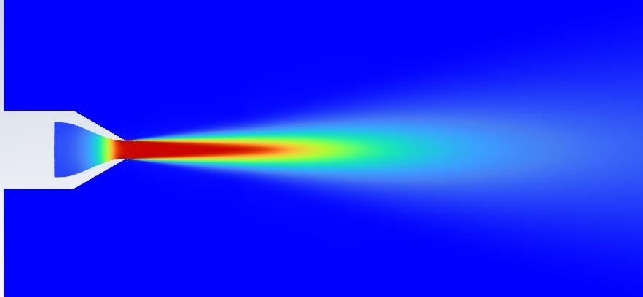
Results – Mach No. Contours
SST Coarse Mesh Y + ~ 1
CFD Study of Compressible Flow in ARN2 Nozzle | Prashant Kamble
16

Slide 19
Validation – Velocity along centerline
AXIAL VELOCITY VS AXIAL DISTANCE PRESENT CFD VS NASA'S DATA
NASA experimental
SA Fine Mesh
NASA SA
SST Coarse Mesh
SA Coarse Mesh
SST Meduim Mesh
SA Meduim Mesh
SST Fine Mesh
1.2
1
0.8
U/U
0.6
0.4
0.2
0
0
5
10
15
20
25
X/D
CFD Study of Compressible Flow in ARN2 Nozzle | Prashant Kamble
17

Slide 20
Centerline Velocity Validation Overview
Validation Parameter: The centerline axial velocity ratio (U/Uj) is plotted against normalized axial distance (X/Dj) from the nozzle exit to evaluate solver accuracy.
Validation Datasets: CFD centerline profile predictions for Spalart-Allmaras (SA) and SST k-ω models are validated against NASA subsonic jet experimental data.
Near-Exit Agreement: All configurations of mesh resolution and turbulence models show highly consistent, correct behavior within the jet potential core region (X/Dj < 5.0).
CFD Study of Compressible Flow in ARN2 Nozzle | Prashant Kamble
18

Slide 21
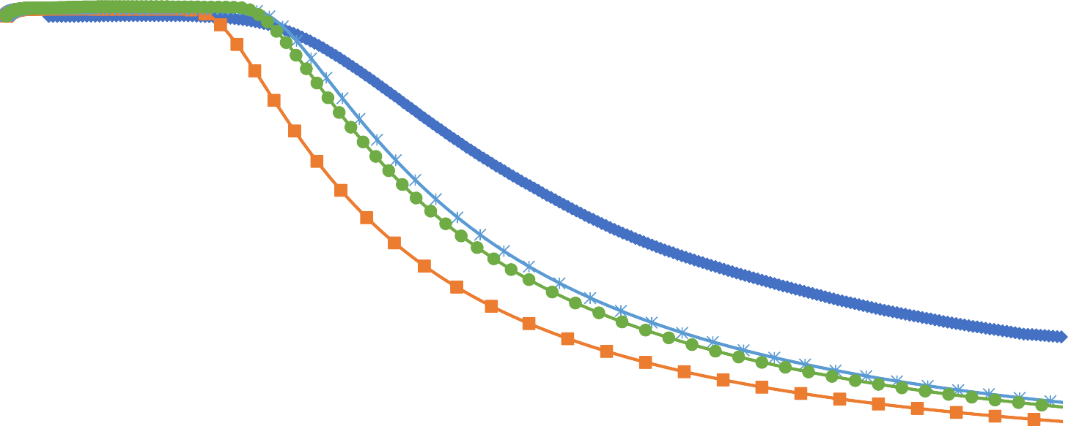
Validation – Velocity along centerline
AXIAL VELOCITY ALOG AXIS
MESH INDEPENDENCE STUDY SA
NASA experimental Present CFD SA Coarse Mesh Present CFD SA Meduim Mesh Present CFD SA Fine Mesh
1.2
1
0.8
U/U
0.6
0.4
0.2
0
0
5
10
15
20
25
X/D
CFD Study of Compressible Flow in ARN2 Nozzle | Prashant Kamble
19

Slide 22
Spalart-Allmaras (SA) Grid Convergence
Grid Density Sensitivity: The Spalart-Allmaras (SA) model demonstrates noticeable grid sensitivity, especially in predicting jet dissipation downstream (X/Dj > 10.0).
Coarse Mesh Performance: The Coarse mesh (70.6k cells) underpredicts jet dissipation downstream, showing an average deviation of 5.13% relative to the Fine mesh.
Mesh Convergence: The Medium mesh (128.7k cells) achieves solid grid convergence, tracking the Fine mesh (214.9k cells) profile within a 1.53% average difference.
CFD Study of Compressible Flow in ARN2 Nozzle | Prashant Kamble
20

Slide 23
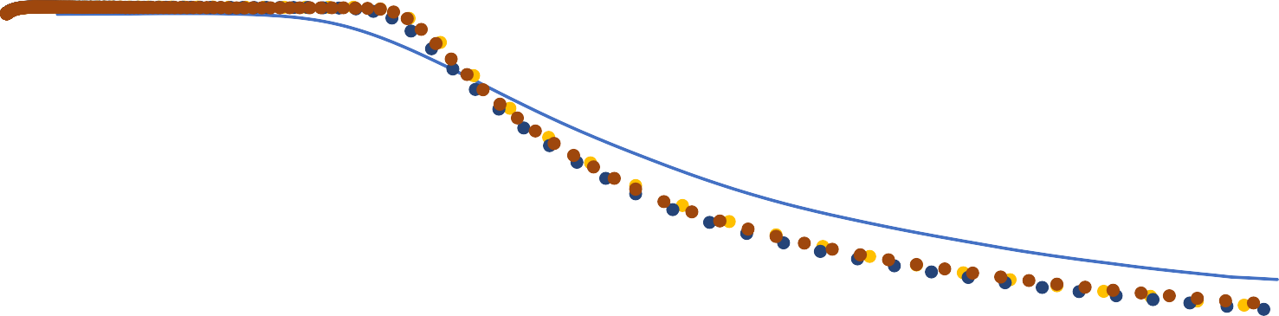
Validation – Velocity along centerline
Axial velocity vs Axial Distance Mesh Independece study SST
1.2
1
0.8
0.6
0.4
0.2
0
U/U
0
5
10
15
20
25
X/D
NASA experimental
SST Coarse Mesh
SST Meduim Mesh
SST Fine Mesh
CFD Study of Compressible Flow in ARN2 Nozzle | Prashant Kamble
21

Slide 24
SST k-ω Grid Convergence
Grid Density Robustness: The SST k-ω model shows remarkable numerical stability, showing minimal sensitivity to grid refinement along the centerline axis.
Coarse Grid Validation: The Coarse grid (70.6k cells) provides excellent predictions, deviating by only 0.73% on average from the Fine grid (214.9k cells).
Grid Independence: The Medium grid (128.7k cells) matches the Fine grid profile within 1.01% average difference, verifying grid independence.
CFD Study of Compressible Flow in ARN2 Nozzle | Prashant Kamble
22

Slide 25



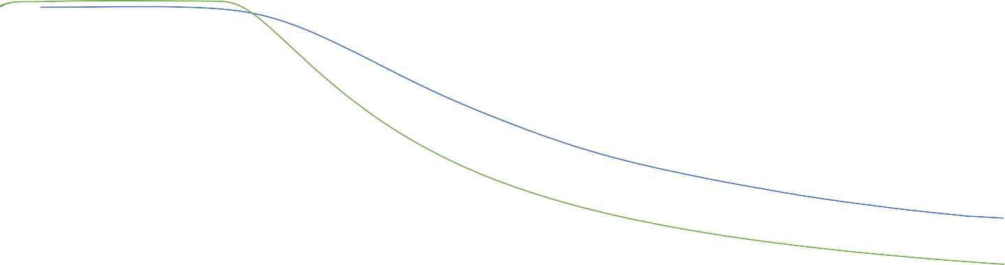

Validation – Velocity along centerline
Axial velocity vs Axial Distance With two Turbulence Models
1.2
1
0.8
0.6
0.4
0.2
0
U/U
0
5
10
15
20
25
X/D
NASA experimental
SA Fine Mesh
SST Fine Mesh
CFD Study of Compressible Flow in ARN2 Nozzle | Prashant Kamble
23

Slide 26
Turbulence Model Predictive Comparison
Jet Core Agreement: Both SA and SST models capture the potential core length and initial jet development accurately up to X/Dj ≈ 5.0 (errors under 2.2%).
SST Mixing Performance: The SST k-ω model captures shear layer mixing and jet dissipation downstream with a Mean Absolute Percentage Error (MAPE) of 12.06% and a max error of 21.22%.
SA Mixing Limitations: The SA model overpredicts jet decay downstream, underpredicting centerline velocity with an overall MAPE of 27.00% and a max error of 48.57% at X/Dj = 25.0.
CFD Study of Compressible Flow in ARN2 Nozzle | Prashant Kamble
24

Slide 27

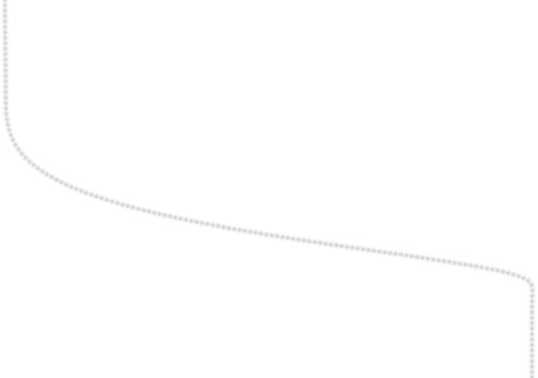

Validation – Velocity along Y direction at X/Dj = 2
Velcoity along Y axis at X/Dj = 2.0
1.4
1.2
1.0
0.8
Y/Dj
0.6
0.4
Experimental NASA
CFD Present SA
0.2
u/Uj
0.0
0.0
0.2
0.4
0.6
0.8
1.0
1.2
CFD Study of Compressible Flow in ARN2 Nozzle | Prashant Kamble
25

Slide 28
Radial Velocity Validation at X/Dj = 2.0
Potential Core Profile: The normalized radial velocity profile (u/Uj vs Y/Dj) at X/Dj = 2.0 validates the transverse potential core width of the jet.
Shear Layer Validation: The Spalart-Allmaras (SA) model successfully captures the steep velocity gradients within the mixing shear layer boundary (Y/Dj ≈ 0.5).
Momentum Diffusion: Excellent alignment with NASA experimental data confirms that transverse momentum diffusion and mixing layer expansion are correctly modeled.
CFD Study of Compressible Flow in ARN2 Nozzle | Prashant Kamble
26

Slide 29
Conclusion I: Model Validation & Physics
Turbulence Model Validation: Spalart-Allmaras (SA) and SST k-ω models demonstrate excellent accuracy near the nozzle exit (X/Dj < 5.0), matching experimental centerline velocity within 2.2% deviation.
Downstream Jet Dissipation: The SST k-ω model shows superior predictive capabilities in the jet decay region (X/Dj > 10.0), with an overall profile Mean Absolute Percentage Error (MAPE) of 12.06%.
Velocity Decay Underprediction: The SA model significantly overpredicts jet dissipation further downstream, resulting in a maximum velocity underprediction error of 48.57% at X/Dj = 25.0, compared to 21.22% for the SST model.
CFD Study of Compressible Flow in ARN2 Nozzle | Prashant Kamble
27

Slide 30
Conclusion II: Grid Convergence & Setup
SST Grid Convergence: The SST model demonstrates extreme robustness to mesh density, showing a mean velocity difference of only 0.73% between Coarse (70.6k cells) and Fine (214.9k cells) grids.
SA Grid Sensitivity: The SA model exhibits higher grid dependence, showing a 5.13% mean difference between Coarse and Fine grids, which reduces to 1.53% for the Medium grid.
Grid Selection Recommendation: A Medium mesh (128.7k cells) offers an optimal balance of speed and accuracy, achieving convergence within 1.6% relative to the Fine mesh for both turbulence models.
Solver Configuration: The Fluent density-based solver coupled with a second-order momentum discretization scheme successfully resolved the nozzle's compressible flow physics (Mjet = 0.51) and shear layer interactions.
CFD Study of Compressible Flow in ARN2 Nozzle | Prashant Kamble
28

Slide 31
References & Resources
NASA TMR Verification Resource: tmbwg.github.io/turbmodels/index.html
Subsonic Jet Validation Case Page: tmbwg.github.io/turbmodels/jetsubsonic_val.html
TMR Grid Definition & Coordinates: tmbwg.github.io/turbmodels/jetsubsonic_grids.html
Experimental PIV Reference Study: NASA/TM—2011-216807 (NTRS Page)
Direct Reference PDF Document: NASA Glenn PIV Dataset (Direct Link)
CFD Study of Compressible Flow in ARN2 Nozzle | Prashant Kamble
31

